Slide 1
WEL COME

Slide 2
ROLE OF MRITYUJAYA RASA IN IMMUNOMODULATION
PRESENTER
Dr. PRIYANKA B PATIL
Assistant Professor, Dept of RS & BK
RKM AMC & Hospital
Vijayapura.

Slide 3
CONTENTS
Introduction
Scope
Concept of immunomodulation
Yoga/Formulation
List of references
Method of preparation
Properties
Mode of action
Discussion
conclusion

Slide 4
Introduction
Due to over industrialization, changed lifestyle, exposure to pollutants, junk foods & Viruddhahara
difficulties in following Dinacharya & Ritucharya
ultimately resulting into Dhatudourbalya leading to many autoimmuene disorders like Amavata.
Ayurveda has many potent tools to rearrange disorder of immuene system, also brings modulation

Slide 5
SCOPE
Most potent tool
Immunomodulators are considered now as one of the most potent tools in the management of health and disease by modern medicine.
A subject of scientific investigation.
. The modulation of immune response by using Ayurvedic medications as a possible therapeutic measure has now become a subject of scientific investigation.
Bringing the Modern concept closer to the Ayurveda
The recent understanding of Circadian rhythms, seasonal variatons, different psychological states on immune system, neuro - endocrine – immune axis or the influence of exercise are unfolding many such concepts which are bringing the modern concept closer to the Ayurvedic principles of Vyadhikshamatwa.

Slide 6
Concept of Immunomodulation
Definition
: An Immunomodulator can be defined as a substance which can influence any constituent or function of the immune system in specific or non specific manner including both innate or adaptive arms of immune response
Concept
The concept in modern scientific understanding would mean enhancement of immune responsiveness of an organism against a pathogen by nonspecifically activating the immune system
Classification
1. Immuno adjuvants
2. Immunostimulants
3. Immunosuppresants

Slide 7
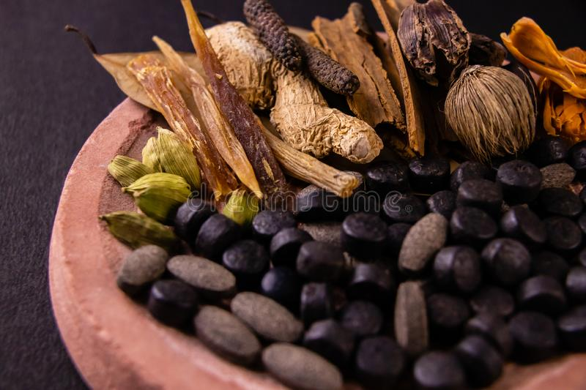
YOGA – MRITHYUJAYA RASA
INTRODUCTION
Mrithyunjaya Rasa is most popular herbo-mineral Formulation mentioned under Jwaradhikara in all references. Most of the Jwarahara yogas having Hingula and Vatsanabha as main ingredients.
It’s one of the best Rasayoga to reduce the Jwara with Different Anupanas. It rectifies agni by acting on rasavaha srotas.
Most of the ingredients of formulation are having properties of Tikta madhura rasa, laghu ruksha teekshna guna, katu vipaka and ushna veerya and having kaphavata shamaka properties.

Slide 8
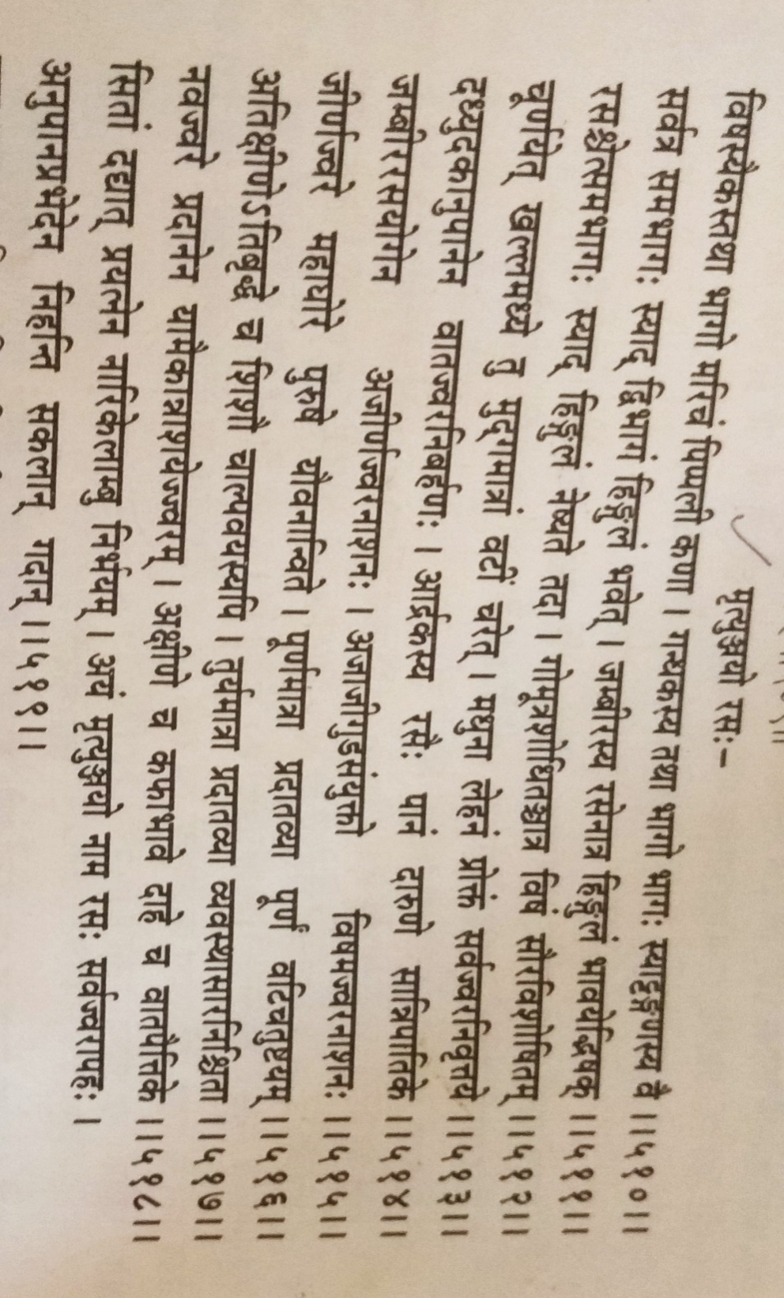
List of references
AFI 1st Volume ( BR )
Bhaishajya Ratnavali Jwaradhikara (510-519).
Rasendra Sara Sangraha, Jwara Chikitsa 624pp.

Slide 9
INGREDIENTS
Sh Vatsanabha -1part
Marica - 1 part
Pippali – 1 part
Sh Gandhaka - 1 part
Sh Tankana - 1 part
Sh Hingula – 2 part
OR
7. Sh Rasa (Parada) – 1 part.

Slide 10
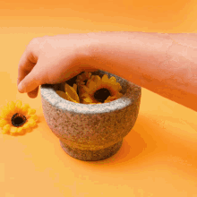
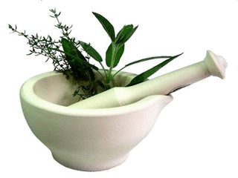
Method of preparation & Dose
Shuddha Vatsanabha Which Is Purified By Immersing It In Gomutra And Exposing To Sunlight For 3 Days Is Taken In Clean Kalwa Yantra And Powdered.
To This Maricha, Pippali Churna Is Added. Godugdha Shodhita Gandhaka And Shodhitatankana Of Equal Quantity Is Added.
Finally Jambeera Swarasa Bhavita Shuddha Hingula 2 Parts Is Added. If Shuddha Hingula Is Not Available Then 1 Part Of Shuddha Parada Can Be Added.
Whole Mixture Is Homogenously Mixed And Vati Of Mudga Pramana Is Prepared And Stored.
Dose
125mg acc to A.F.I
Indication:
Sarva jwarapaha
Anupana vibhedena nihanti Sakalan Gadan

Slide 11
Properties of drugs
Name | Rasa | Guna | Veerya | Vipaka | Karma
Vatsanabha | Madhura | Laghu Ruksha Tikshna Vyavayi | Ushna | Katu | Jwarahara, vishahara, rasayana, vatakaphahara
Maricha | Katu | Laghu tikshna | Ushna | Katu | Vatakaphahara, Deepana, pramathi
Pippali | Katu | Laghu, snigdha | Ushna | Madhura | Vatakaphahara, udara Deepana, amavata,
Gandhaka | Katu | Sara | Ushna | Madhura | Vishaghna, rasayana, jvara, amadosha
Tankana | Kshariya | Ruksha guru | Ushna | - | Lekhana, hridya, jvara
Hingula | Katu | Laghu | Ushna |  | Garavisha, hridroga, amavata, rasayana
Parada | Shadrasa | Guru snigdha | Ushna | Madhura | Rasayana, balya, yogavahi.

Slide 12
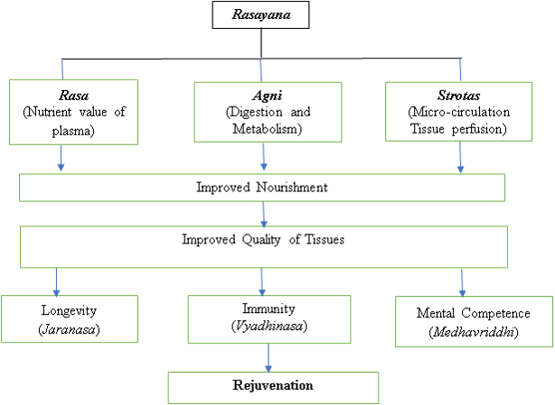
MODE OF ACTION

Slide 13
Discussion
Mrityunjaya rasa contains drugs which are visha hara property & viruddhahara generates amavisha in body, so drug act in a way to eliminate ama & increasing quality of agni.
Most of drugs are tikta in nature, tikta rasa is best amapachaka, helps in rasadusthi which is main reason of autoimmuene disorders like amavata, udarda, tvakroga etc.
Mrityunjaya rasa has shoolahara, shothahara property which helps in symptoms of amavata
Kledaghna & agideepaka properties decreases ama.
Rasayana/Immunomodulator helps to improve digestion and metabolism as well as microcirculations, thus allowing to obtain the best qualities of all Dhatus.

Slide 14
Conclusion
Rasayana acts on seven Dhatus which further improves the Oja which is responsible for producing good immune power in the body. This Oja gives immunity to the body by nonspecific way mediated through neutrophils and monocytes and by specific way mediated by B lymphocytes which acts against the virus and bacterial pathogens.
Humoral mediated by B lymphocytes become plasma cells and produces immunoglobin which destroys antigens.
Same as mrityunjaya rasa Majority of Rasayana drugs works on numerous organs by improving their functions by acquiring Vyadhikshamatva through its appetizer, digestive, cognition enhancement, antioxidant, adaptogenic and immunomodulators.

