Slide 1
Astanga Hridaya Sutrasthana 11th Chapter Doshadi Vijnaneeya Adhyaya
By,
Dr. Pushpa A. Biradar
Assistant Professor
Department of Samhita Siddhanta
RKM Ayurvedic Medical College
Vijayapur - 586101

Slide 5
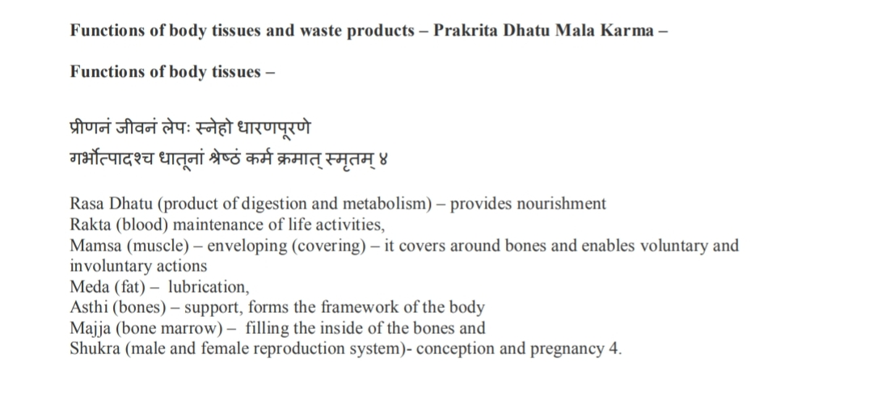

Slide 7
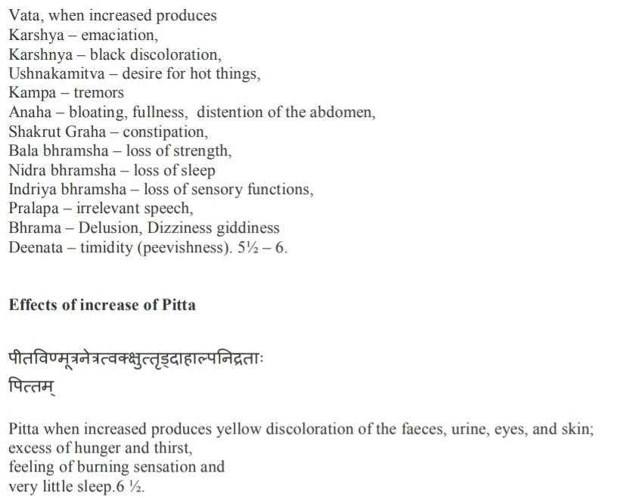

Slide 10
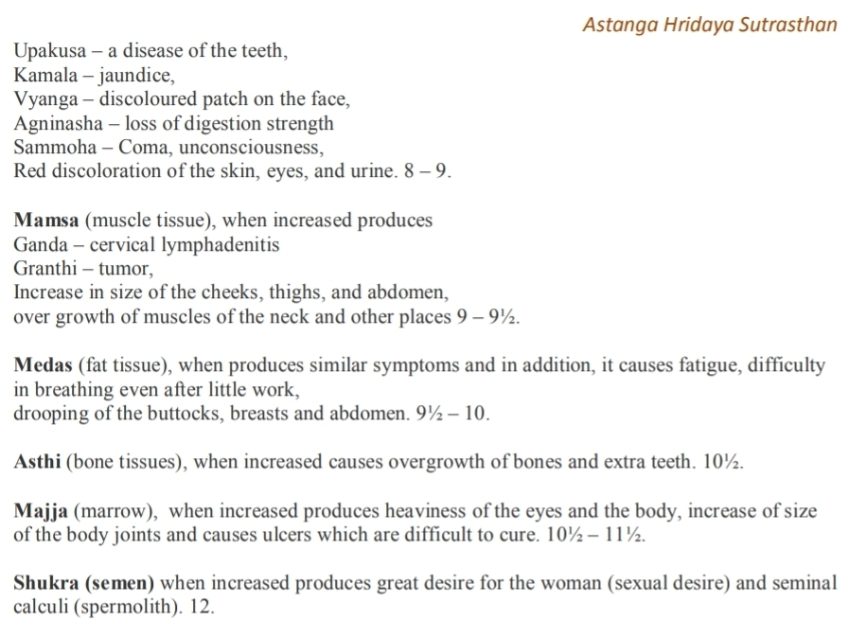

Slide 19
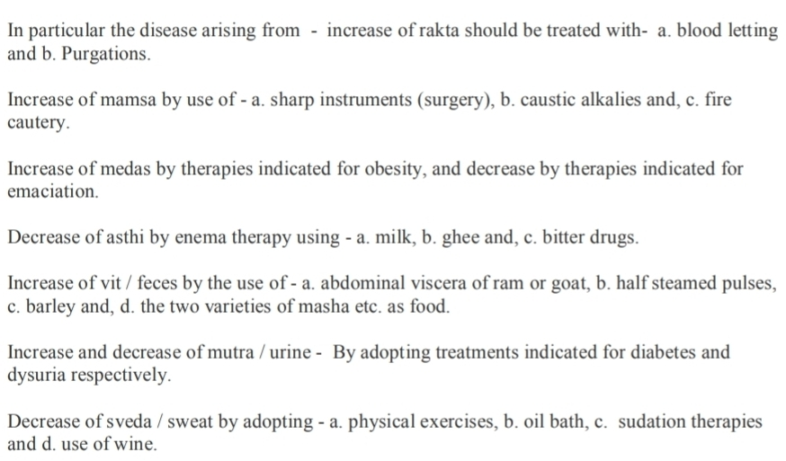

Slide 25
Thank You

