Slide 1
Astanga Hridaya Sutrasthana 12th Chapter Doshabhediya Vijnaneeya Adhyaya – Part I
By,
Dr. Pushpa A. Biradar
Assistant Professor
Department of Samhita Siddhanta
RKM Ayurvedic Medical College
Vijayapur - 586101

Slide 4
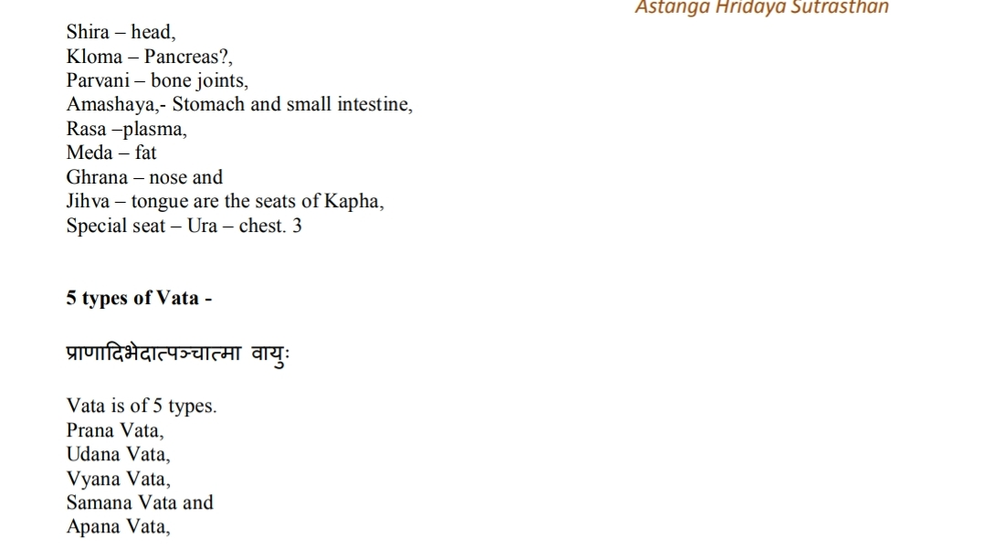

Slide 20
Thank You

