Slide 1
ARTERIAL SUPPLY OF BRAIN
BY:
DR. manjula vastrad
asst.prof
Dept of rachana shareera
Smvvs rkm amc vijayapur

Slide 2
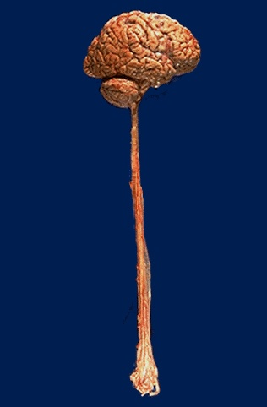
INTRODUCTION
The brain is one of the most metabolically active organs in the body, receiving 17% of the total cardiac output.
Brain accounts 2.5% of body weight, but it receives 1/6th of cardiac output .

Slide 3
INTRODUCTION
Amount of blood cerebral circulation carries – Cerebral Blood Flow
In an adult, Cerebral blood flow is typically 750 millilitres per minute.
The brain receives it’s blood from two pairs of arteries, the carotid and vertebral arteries which are interconnected in the cranial cavity – Arterial circle – Circle of Willis.
About 80% of the brain’s blood supply comes from the carotid, and the remaining 20% from the vertebral artery.

Slide 4
The Vertebro-basilar System
The vertebral artery is a branch of the first part of subclavian artery.
It enters the subarachnoid space in the upper part of vertebral canal after piercing the Dura & Arachnoid mater.
It unite with its fellow at lower border of Pons and forms Basilar artery.

Slide 5
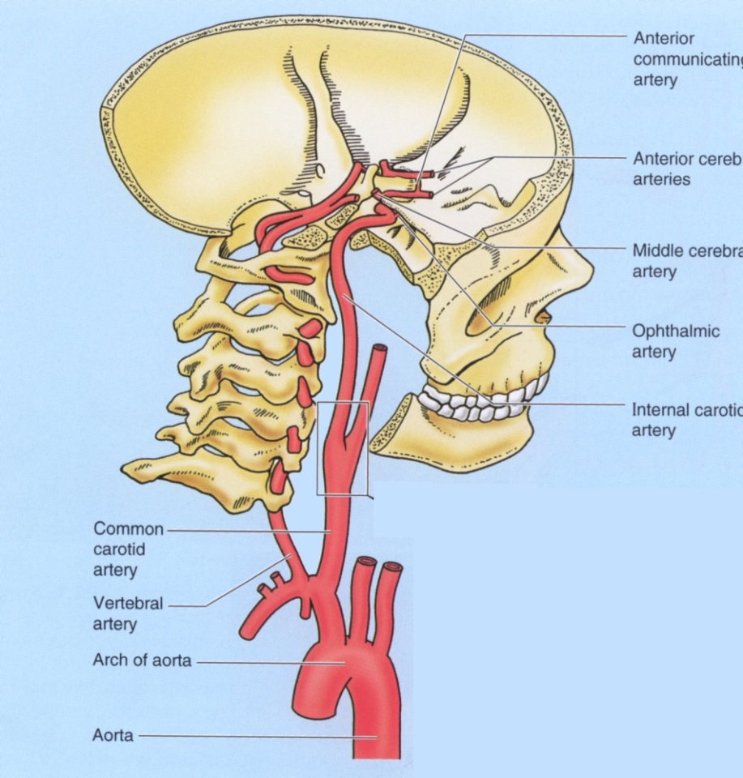
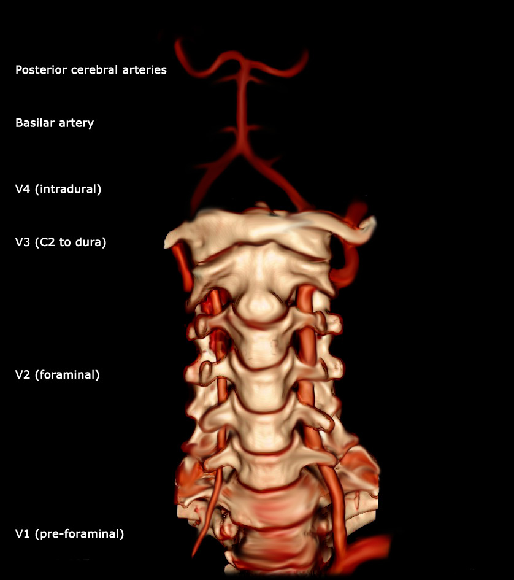

Slide 6
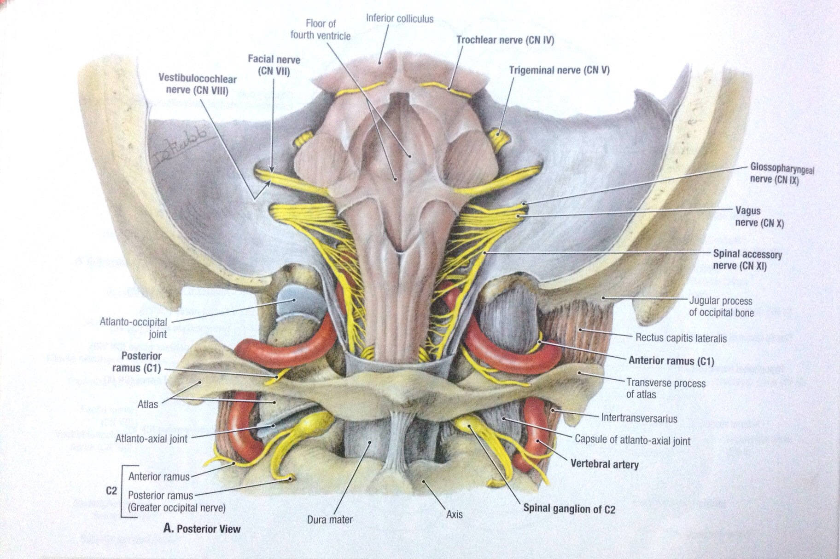

Slide 7
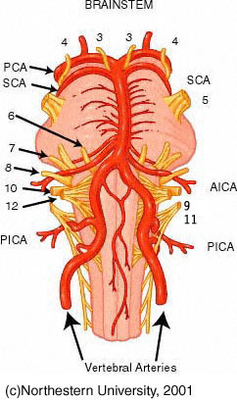
BRANCHES OF VERTEBRAL ARTERY
Posterior spinal artery
Posterior inferior cerebellar artery
Anterior spinal artery
Medullary branches
Meningeal branches

Slide 8
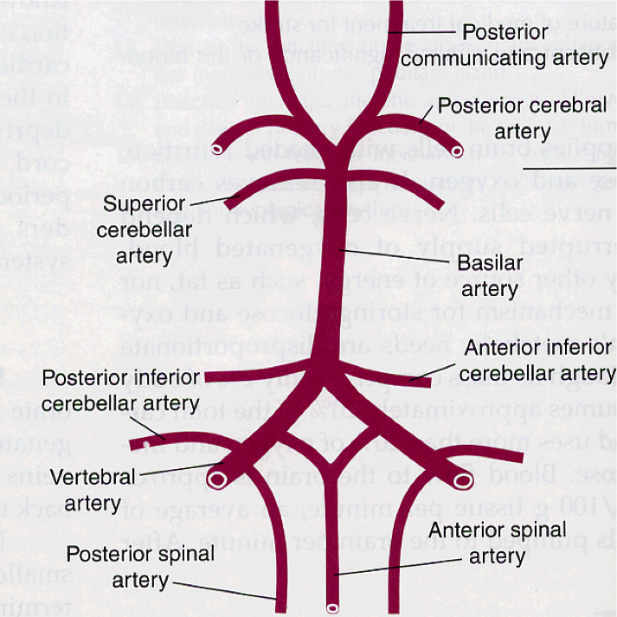
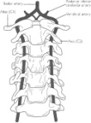
BRANCHES OF VERTEBRAL ARTERY

Slide 9
BASILAR ARTERY
Formed by the union of two vertebral arteries at the lower border of Pons.
Lies in the median groove of Pons in Cisterna pontis.
It ends by dividing into two Posterior Cerebral Arteries at the upper border of pons.

Slide 10
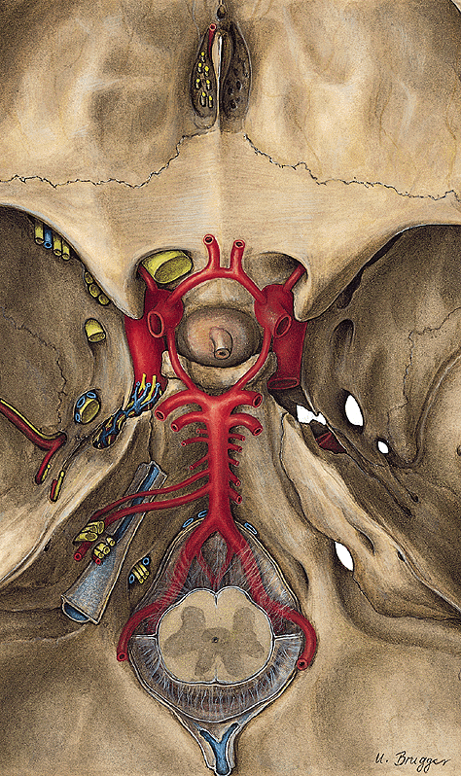
COURSE

Slide 11
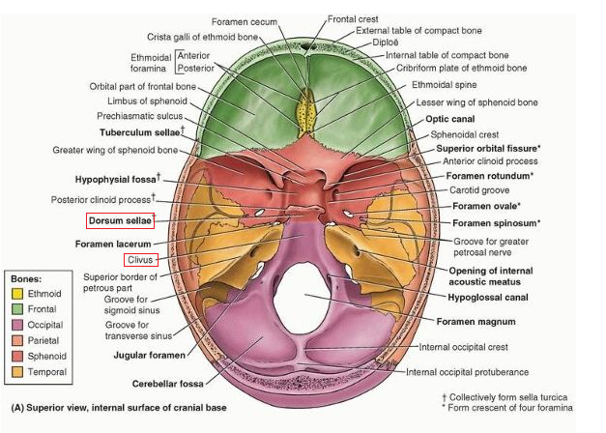

Slide 12
Branches of basilar artery
Anterior inferior cerebellar artery
Labrynthine artery
Pontine branches
Superior cerebellar artery
Posterior cerebral artery

Slide 13
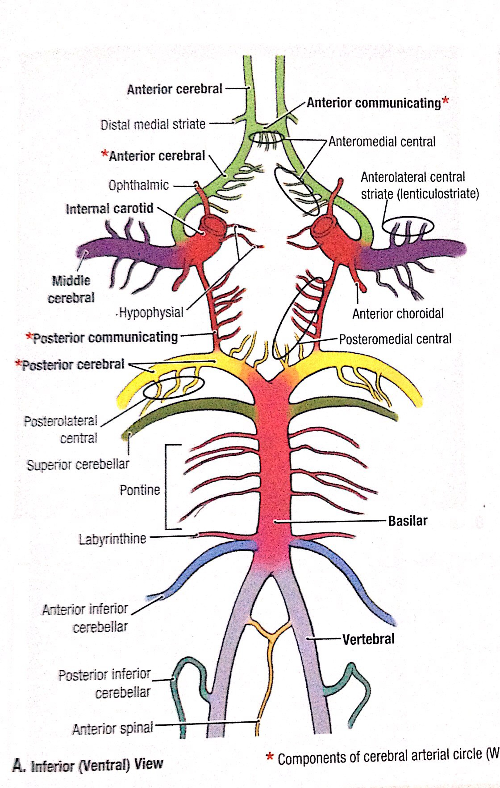

Slide 14
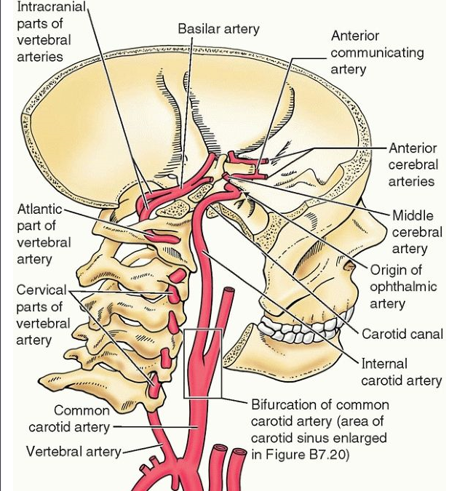
Internal carotid artery
The internal carotid arteries arise in the neck from common carotid arteries.
Internal carotid arteries enters middle cranial fossa through the carotid canal at the base of skull.

Slide 15
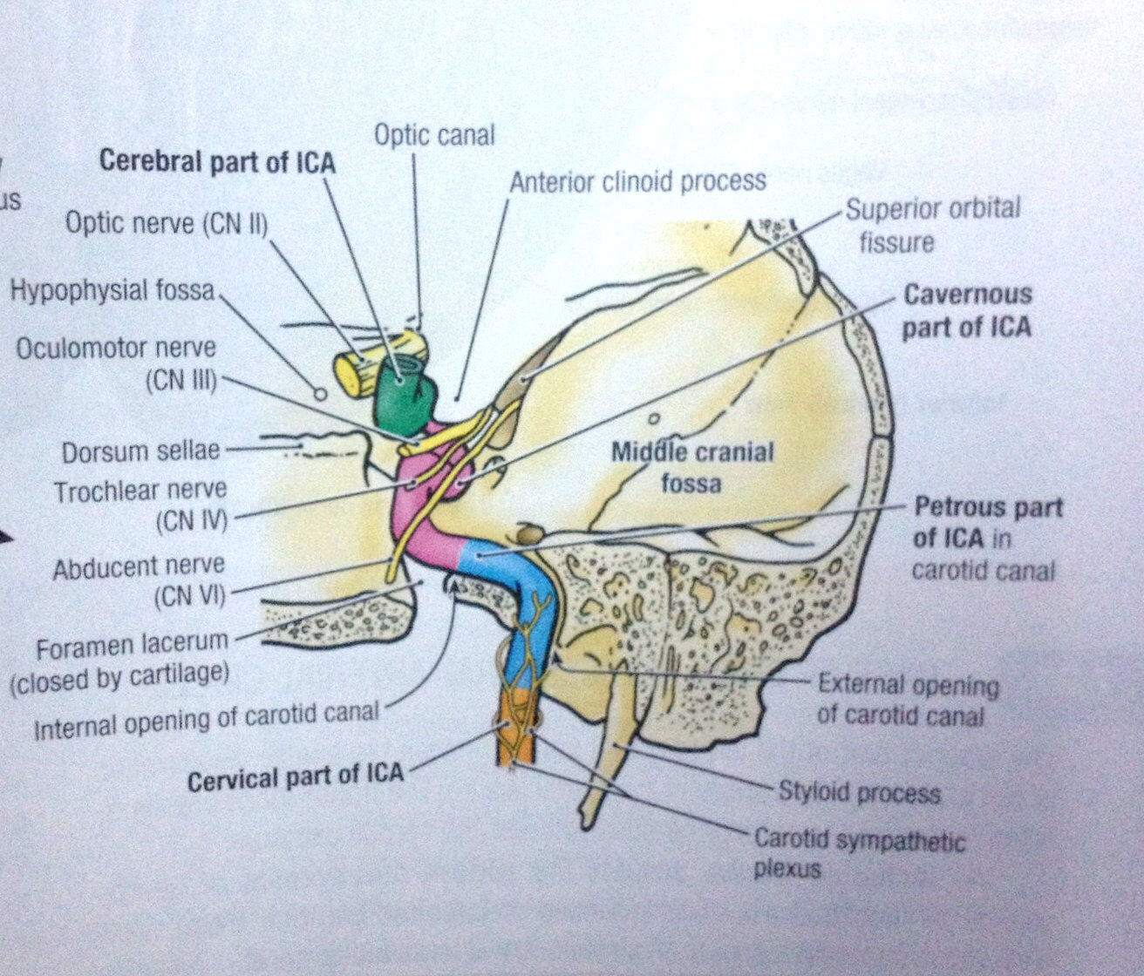
Course of ICA

Slide 16
Branches of ica
Posterior communicating artery
Ophthalmic artery
Hypophysial artery
Anterior choroidal artery
Anterior cerebral artery
Middle cerebral artery

Slide 18
CEREBRAL ARTERIES
Anterior cerebral artery supply most of the medial and superior surfaces of the brain and the frontal pole.
2. Middle cerebral artery supply the lateral surface of the brain and the temporal pole.
3. Posterior cerebral artery supply the inferior surface of the brain and the occipital pole

Slide 19
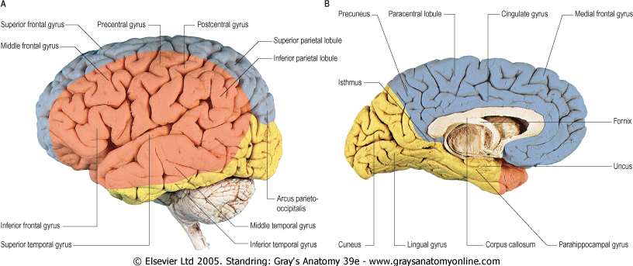
CEREBRAL ARTERIES

Slide 20
Posterior cerebral artery
These are the two terminal branches of Basilar Artery.
Diverge at superior border of Pons.
On the anterior surface of midbrain, each posterior cerebral artery receives posterior communicating branch from corresponding ICA.

Slide 21
BRANCHES OF PCA
Posteromedial central branches
Posterolateral central branches
Posterior choroidal branches
Cortical branches

Slide 22
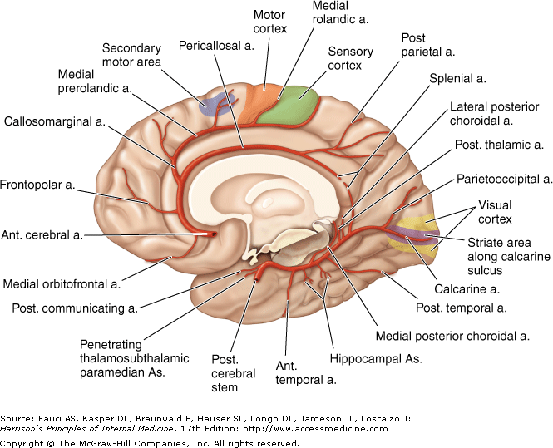
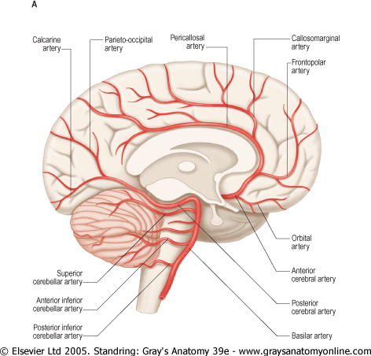
CORTICAL BRANCHES OF PCA

Slide 23
Posterior Cerebral Artery & Important Areas Of Cortical Distribution
LOBE | AREA
OCCIPITAL | VISUAL
TEMPORAL | OLFACTORY

Slide 24
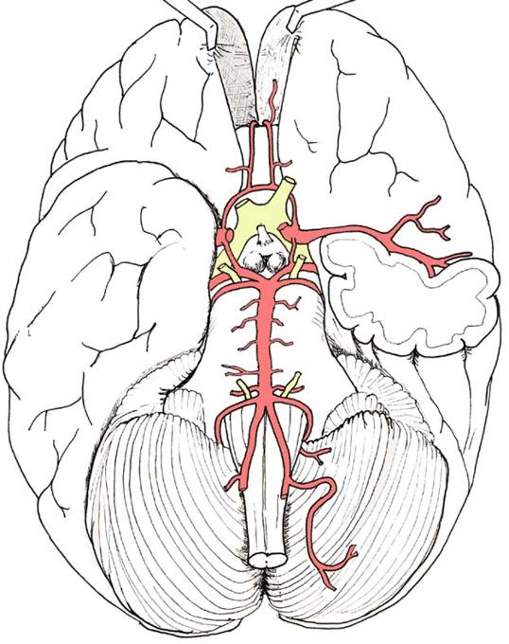
Anterior cerebral artery
It arises from the internal carotid artery below the anterior perforated substance, lateral to the optic chiasma.
Here it runs forwards and medially crossing above the optic nerve to reach the longitudinal fissure separating the two cerebral hemispheres.

Slide 25
Anterior cerebral artery
The arteries of the two sides lie close together and are united to each other by the anterior communicating artery.
Now turns sharply to reach the genu of the corpus callosum then body and ends in posterior part .

Slide 26
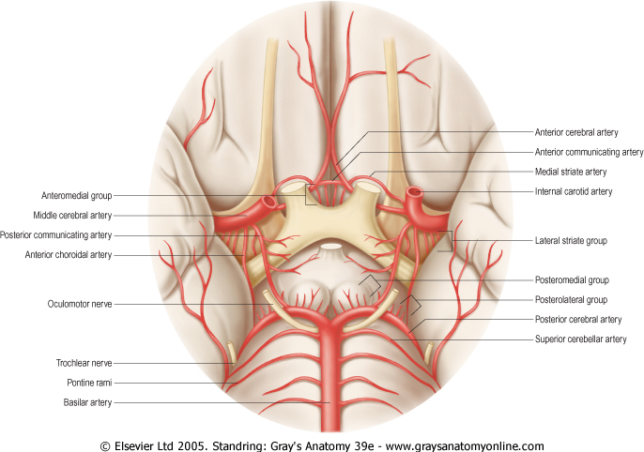
BRANCHES OF ACA

Slide 27
CORTICAL BRANCHES OF ACA

Slide 28
MIDDLE CEREBRAL ARTERY
Large terminal branch of internal carotid artery which lies in line with it.
It runs laterally in the stem of lateral sulcus where it branches and projects to many parts of lateral cerebral cortex.
It supply blood to the anterior temporal lobes and insular cortices.

Slide 29
MIDDLE CEREBRAL ARTERY

Slide 30
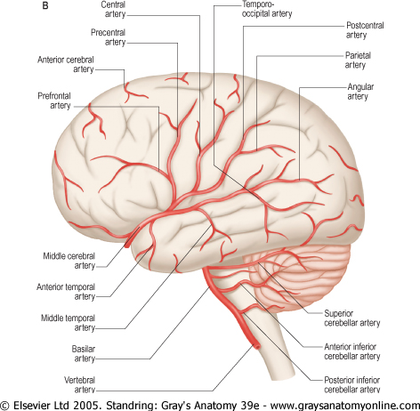
MIDDLE CEREBRAL ARTERY

Slide 31
Choroid plexuses
The Anterior Choroidal A: from the Internal Carotid A supply the choroid plexus of the lateral ventricle .
The Posterior Choroidal A.: from the Posterior cerebral artery to supply the choroid plexus of the lateral ventricle and 3rd ventricle .
The Choroidal Branch of Posterior inferior Cerebellar A – to supply choroidal plexuses of 4th venticle

Slide 32
Circle Of Willis
Site: at the base of the brain around interpeduncular fossa.
Function: Important anastomosis between the 2 internal carotid arteries in front & Vertebro-basilar system behind.
It attempts to equalize the flow of blood to different parts of brain and provides a collateral circulation in the event of obstruction of one of its components.
Arteries forming it:
Rt. & Lt. internal carotid artery.
Rt. & Lt. anterior cerebral arteries.
Rt. & Lt. posterior cerebral arteries.
Rt. & Lt. posterior communicating arteries.
Anterior communicating artery.

Slide 33
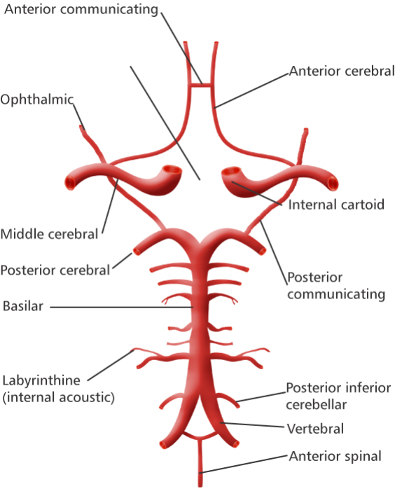
CIRCLE OF WILLIS

Slide 34
APPLIED
ANATOMY

Slide 35
STROKE
Stroke or cerebrovascular accident:- Blockage in the artery – cerebral infarction
Carotid artery
Basilar artery
Bleeding within the brain – Intracerebral haemorrhage
Aneurysm
Subarachnoid haemorrhage
Hypertension

Slide 36
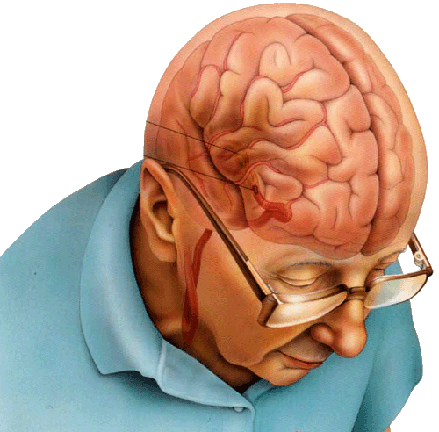
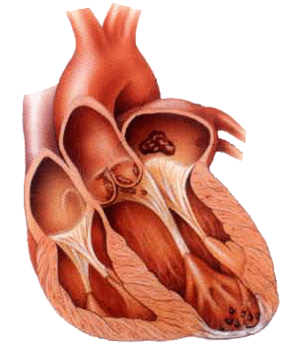
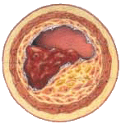
Area of oxygendeprives brain
Blockage
Thrombus
Plaque

Slide 37

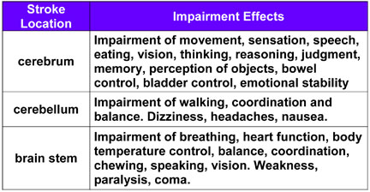

Slide 38
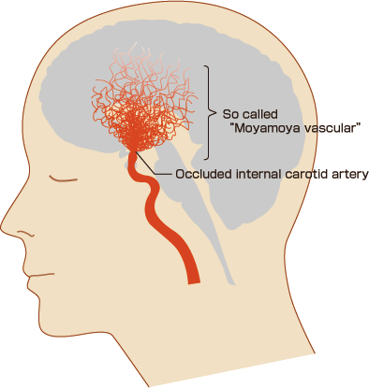
MOYAMOYA DISEASE
This disease occurs when the large arteries carrying nutrients to the brain become blocked, causing fine blood vessels to develop in the surrounding area to compensate for the lack of blood flow.
The name "moyamoya disease" comes from the fact that these collateral vessels have the appearance of a puff of smoke ("moyamoya" in Japanese).

Slide 39
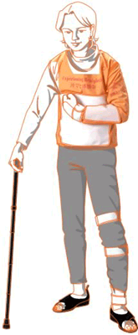
HEMIPLEGIA
Hemiplegia is a common condition. It is an upper motor neuron type of paralysis of one half of the body, including the face. It is usually due to an internal capsule lesion caused by thrombosis of one of the lenticulostriate branches of middle cerebral artery .
One of the lenticulostriate branches is most frequently ruptured , it is known as charcot’s artery of cerebral hemorrhage. This lesion also produces hemiplegia with deep coma, and is ultimately fatal.

Slide 40
THANK
YOU

Slide 41
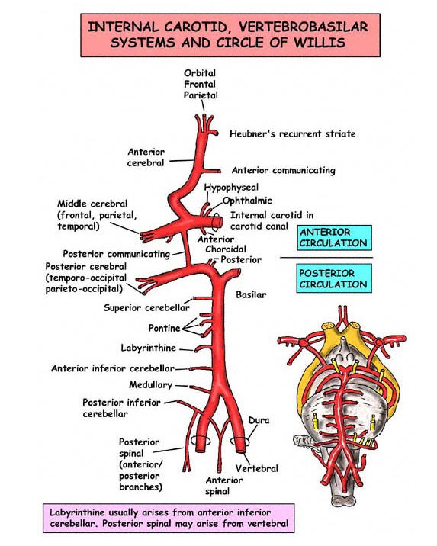

Slide 42
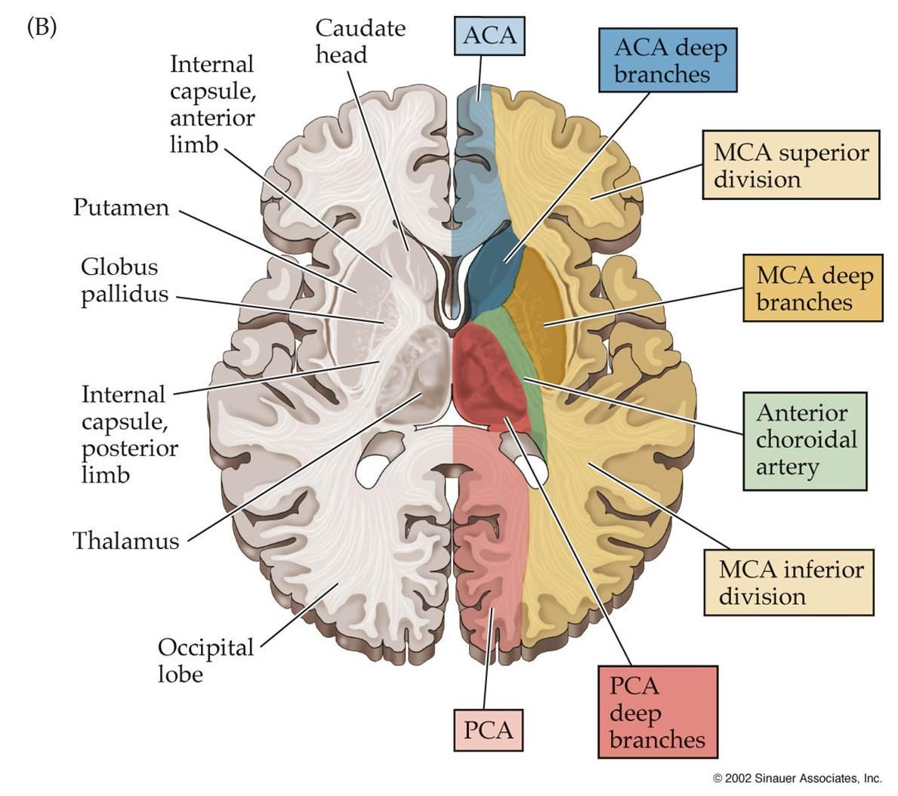

Slide 43
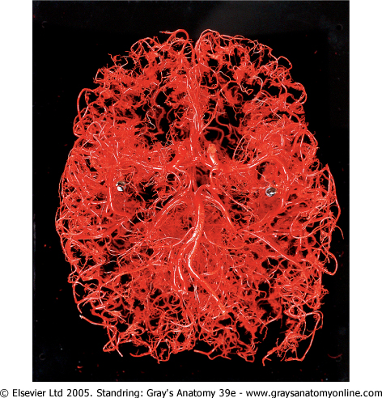
Resin cast of the arterial supply of the brain

Slide 44
Arteries to specific brain areas
Corpus striatum | Medial and lateral striate branches Anterior and middle cerebral arteries
Thalamus | P communicating A , Basilar A. Posterior cerebral artery
Midbrain | Posterior cerebral Artery, Sup cerebellar Artery, Basilar Artery
Pons | Pontine branches of Basilar, Anterior inferior cerebellar, superior cerebellar Artery
Medulla oblangata | Vertebral, posterior inferior cerebellar artery, Anterior inferior cerebellar Artery
Cerebellum | Superior cerebellar, Anterior inferior cerebellar Artery, Posterior inferior cerebellar Artery
Internal capsule

Slide 45
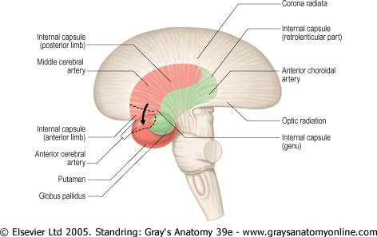
ACA – central branches
Territory supplied by branches of the anterior and middle cerebral arteries is shown in red. Territory supplied by the anterior choroidal artery is shown in green

Slide 47
