Slide 1
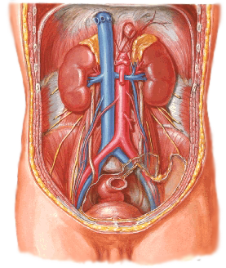
KIDNEYS
BY-
DR.MANJULA.VASTRAD
ASST.PROF
DEPT. OF RACHANA SHAREERA
SMVVS RKM AMC VIJAYAPUR
EMAIL: manjula.prasad2010@gmail.com

Slide 2
CONTENTS
INTRODUCTION
SURFACE ANATOMY
EXTERNAL & INTERNAL FEATURES
RELATIONS OF THE KIDNEYS
BLOOD SUPPLY
NERVE SUPPLY
LYMPHATIC DRAINAGE
CLINICAL ANATOMY

Slide 3
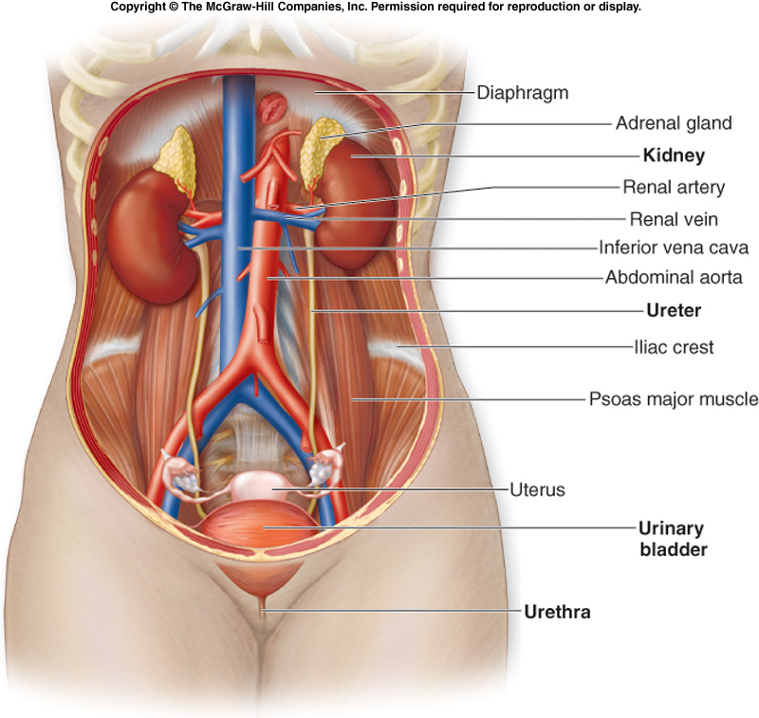
INTRODUCTION
SYNONYMS
The kidneys are also known as RENES or NEPHROS.
DEFINITION
The kidneys are a pair of excretory organs situated on the posterior abdominal wall, one on each side of the vertebral column, behind the peritoneum.
Because their position is posterior to the peritoneum of the abdominal cavity, they are said to be retroperitoneal.

Slide 4
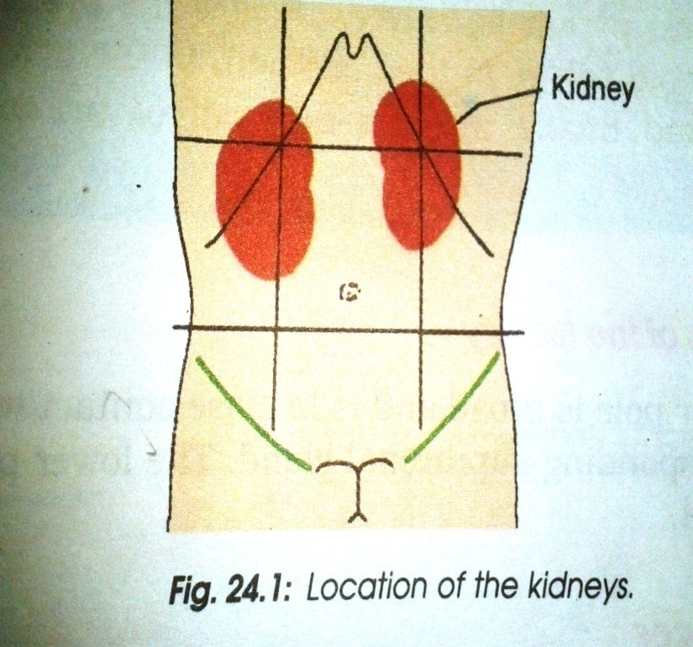
LOCATION
The kidneys occupy the epigastric, hypochondriac, lumbar and umbilical regions.
Retroperitoneal
Upper poles - T12 vertebra
Lower poles - L3 vertebra
Right kidney ~ 2cm lower than left

Slide 5
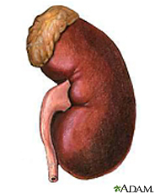
SIZE - WEIGHT
A typical adult kidney is
-10–12 cm (4–5 in.) long,
-5–7 cm (2–3 in.) wide,
-3 cm (1 in.) thick
About the size of a bar of bath soap.
On an average,the kidney weighs about 135–150gm

Slide 6
SURFACE ANATOMY
Draw the median and transpyloric planes
Mark the hilum 5 cm away from the median plane on transpyloric plane, that of the right kidney a little below and of the left kidney a little above the transpyloric plane.
This will be just internal to the anterior extremity of the 9th costal cartilage.
Draw the shape of the kidney 8.5 cm in length and 5 cm in breadth with the upper pole 4.2 cm and lower pole 8.5 cm away from the median plane.
The left kidney should be drawn little higher than right.

Slide 8
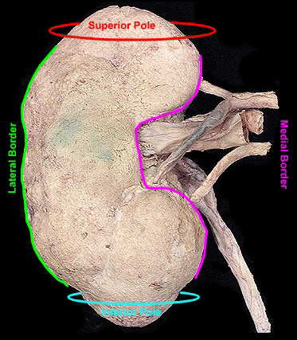
EXTERNAL FEATURES
The kidneys are reddish brown, bean shaped organ.
TWO POLES – Superior and Inferior
TWO BORDERS – Medial and Lateral border
TWO SURFACE – Anterior and Posterior surface
HILUM - Indentation at the concave medial border.
Stuctures seen at Hilum from anterior to posterior:
Renal vein
Renal artery
Renal pelvis

Slide 9
Coverings of kidneys
FROM DEEP TO SUPERFICIAL:
Fibrous Capsule (Renal Capsule)
Thin membrane which closely invests the kidney
Covers outer surface of kidneys.
Perinephric Fat (Perirenal Fat)
Thin layer of adipose tissue lying outside the fibrous capsule.
Thickest at the borders, fills up the extra space in renal sinus.
Forms cushion for the kidneys.
Renal Fascia
This is a fibroareolar sheath which surrounds the kidney and perirenal fat k/as Fascia of Gerota.
Anchors kidney to posterior wall.
Paranephric Fat
Lies outside the renal fascia.
Fills up the paravertebral gutter and forms cushion for the kidneys.

Slide 10
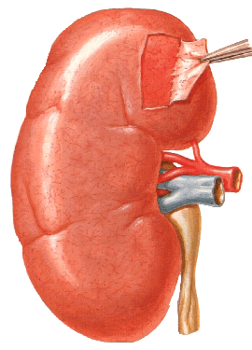

Slide 11
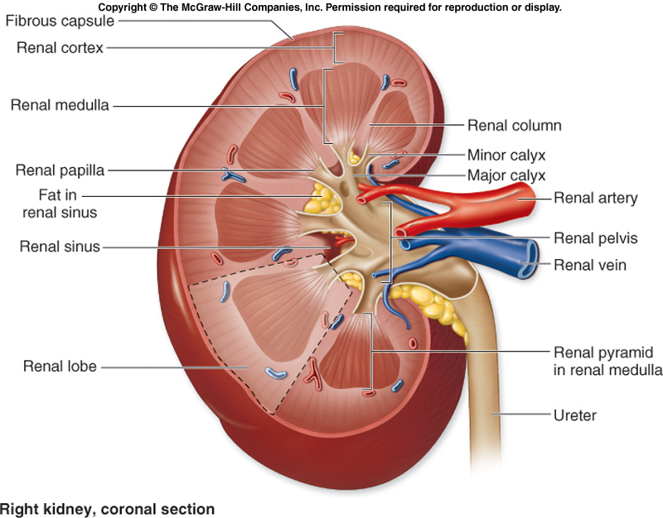
INTERNAL FEATURES
A coronal section through the kidney reveals two distinct regions:
1) Renal Cortex (cortex - bark)
2) Renal Medulla (medulla-inner portion)
RENAL CORTEX
Superﬁcial, light red area.
The renal cortex is extending from the renal capsule to the bases of the renal pyramids and into the spaces between them.
Those portions of the renal cortex that extend between renal pyramids are called Renal columns.

Slide 12
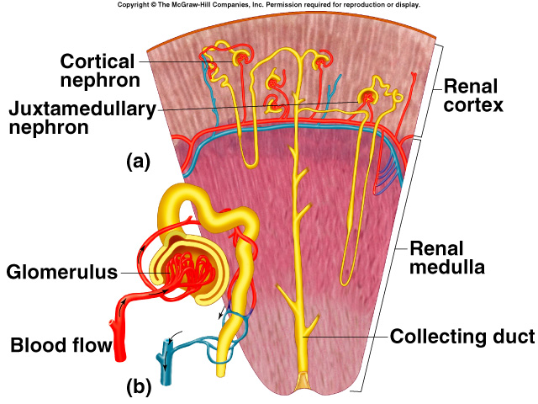
INTERNAL FEATURES
RENAL MEDULLA
Divided into renal pyramids.
8 to 15 per kidney.
Base against cortex.
Apex called renal papilla.
Together, the renal cortex and renal pyramids of the renal medulla constitute the parenchyma or functional portion of the kidney. Within the parenchyma are the functional units of the kidney-called Nephrons .
Filtrate (ﬁltered ﬂuid) formed by the nephrons drains into large collecting ducts, which extend through the renal papillae of the pyramids. The papillary ducts drain into cuplike structures called minor and major calyces

Slide 14
INTERNAL FEATURES
Minor calyx:
Funnel shaped
Receives renal papilla
8 to 15 per kidney, one per pyramid
Major calyx
Fusion of minor calyces
2 to 3 per kidney
Major calyces merge to form renal pelvis
Renal Lobe
A renal lobe consists of a renal pyramid, its overlying area of renal cortex, and one-half of each adjacent renal column

Slide 15
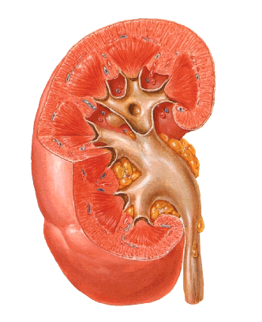
Renal pyramid
cortex
Renal column
Renal sinus
Minor calyx
Major calyx
papilla
Renal pelvis

Slide 16
RELATIONS OF RIGHT KIDNEY
ANTERIORLY : -The Suprarenal Gland
-The Liver
-The Second Part Of The Duodenum
-The Right Colic Flexure
- Coils of Jejunam
POSTERIORLY: -The diaphragm
- The Costodiaphragmatic Recess Of The Pleura
- The 12th Rib
- The Psoas, Quadratus Lumborum, And
Transversus Abdominis Muscles
- The Subcostal , Iliohypogastric, And Ilioinguinal
nerves run downward and laterally

Slide 17
RELATIONS OF RIGHT KIDNEY
ANTERIOR RELATIONS
POSTERIOR RELATIONS

Slide 18
RELATIONS OF LEFT KIDNEY
ANTERIORLY: The Suprarenal Gland
- The Spleen
- The Stomach
- The Pancreas
- The Left Colic Flexure
- Coils Of Jejunum
POSTERIORLY: The Diaphragm
-The Costodiaphragmatic Recess Of The Pleura
-The 11th (the left kidney is higher) And 12th Ribs
-The Psoas, Quadratus Lumborum, And
T Transversus Abdominis Muscles.
-The Subcostal, Iliohypogastric, And Ilioinguinal
Nerves run downward and laterally.

Slide 19
RELATIONS OF LEFT KIDNEY
ANTERIOR RELATIONS
POSTERIOR RELATIONS

Slide 20
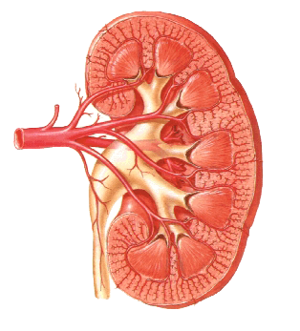
BLOOD SUPPLY OF KIDNEYS
The kidneys receive blood from the renal arteries, left and right, which branch directly from the abdominal aorta. Despite their relatively small size, the kidneys receive approximately 20% of the cardiac output
PATH:
At or near hilus, renal artery divides into anterior and posterior divisions. Further branching give rise to segemental arteries, each of which supplies one vascular segement.

Slide 21
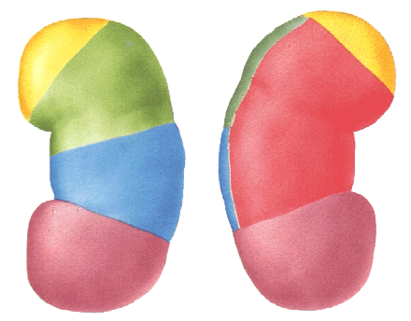
Vascular renal segment
Superior (apical)
Upper
Posterior
Middle
Inferior (lower)

Slide 22
BLOOD SUPPLY OF KIDNEYS
DIVISION OF RENAL ARTERY
Each renal artery branches into segmental arteries, dividing further into interlobar arteries which extend through the renal columns between the renal pyramids.
The interlobar arteries then supply blood to the arcuate arteries that run through the boundary of the cortex and the medulla.
Each arcuate artery supplies several interlobular arteries that feed into the afferent arterioles that supply the glomeruli.
Blood plasma is filtered across the glomerulus into the glomerular space.
Once the blood plasma is filtered
blood leaves the glomerulus
enters an efferent arteriole.
Efferent arteriole is still carrying oxygenated blood
a gas and nutrient exchange with the kidney tissues has not yet occurred.

Slide 24
BLOOD SUPPLY OF KIDNEYS
The efferent arterioles branch into one of two types of capillary networks:
Peritubular capillaries
Vasa recta
These capillary networks are responsible for the actual exchange of gases and nutrients
Peritubular capillaries: primarily in cortex
Vasa recta: surround the thin tubes that project into the medulla
Path for veins:
Interlobular veins to arcuate veins to interlobar veins to the renal vein

Slide 25
LYMPHATIC DRAINAGE
The lymphatics of the kidney drain into the lateral aortic nodes located at the level of origin of renal artery.
NERVE SUPPLY
The kidney is supplied by the renal plexus, an offshoot of the coeliac plexus.

Slide 26
APPLIED ANATOMY

Slide 27
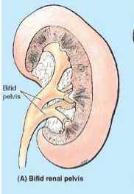
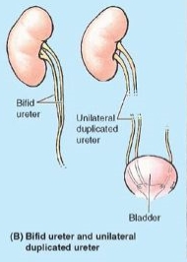
Congenital Anomalies of Kidneys
Bifid renal pelvis and ureter are fairly common.
These anomalies result from division of the metanephric diverticulum (ureteric bud), the primordium of the renal pelvis and ureter.
The bifid renal pelvis and/or ureter may be unilateral or bilateral; however, separate openings into the bladder are uncommon.

Slide 28
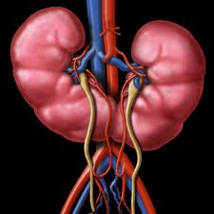
HORSESHOE KIDNEY
Horseshoe kidney, also known as renal fusion or super kidney, is a congenital disorder affecting about 1 in 500 people.
In this disorder, the patient's kidneys fuse together to form a horseshoe-shape during development in the womb. The fused part is the isthmus of the horseshoe kidney.

Slide 29
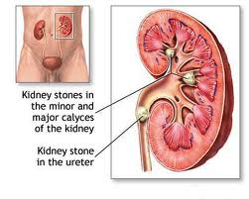
Renal calculi
A kidney stone, also known as a renal calculus is a solid concretion or crystal aggregation formed in the kidneys from dietary minerals in the urine.
About 80% of those with kidney stones are men.
Kidney stones typically leave the body by passage in the urine stream, and many stones are formed and passed without causing symptoms.
If stones grow to sufficient size (usually at least 4 millimeters) they can cause obstruction of the ureter.
Dietary factors that increase the risk of stone formation include low fluid intake and high dietary intake of animal protein, sodium, refined sugars, fructose , grapefruit juice, apple juice, and cola drinks.

Slide 30
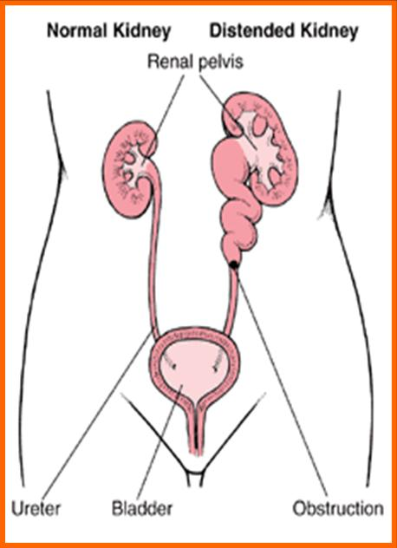
Hydronephrosis
Hydronephrosis — literally means "water inside the kidney“
It refers to distension and dilation of the renal pelvis and calyces, usually caused by obstruction of the free flow of urine from the kidney.
If untreated, it leads to progressive atrophy of the kidney

Slide 31
Renal Mobility
The kidneys are maintained in their normal position by intra-abdominal pressure and by their connections with the perirenal fat and renal fascia.
Each kidney moves slightly with respiration.
If the amount of perirenal fat be reduced, the mobility of the kidney may become excessive and produce symptoms of renal colic caused by kinking of the ureter.

Slide 32
Kidney Trauma
The kidneys are well protected by the lower ribs, the lumbar muscles, and the vertebral column. However, a severe blunt injury applied to the abdomen may crush the kidney against the last rib and the vertebral column.
Depending on the severity of the blow, the injury varies from a mild bruising to a complete laceration of the organ.
Penetrating injuries are usually caused by stab wounds or gunshot wounds and often involve other viscera.
Because 25% of the cardiac outflow passes through the kidneys, renal injury can result in rapid blood loss

