Slide 1
A Critical analysis.
COVID-19
Facts And Figures.
Dr. Shiddappa Gundikeri
Department of medicine
KIMS HUBLI
16/3/2020

Slide 2
MAIN HEADINGS OF THIS TALK
WHY THE WORLD IS SO SCARY ABOUT THESE VIRAL PANDEMICS !!!
COMMON VIRUSES CAUSING RTI
ABOUT ONGOING PANDEMIC- CHINA’S EXPERIENCES
INFLUENZA VS COVID-19
COVID-19; WORLD SCENARIO.
CONCLUSIONS

Slide 3
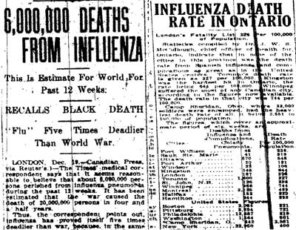
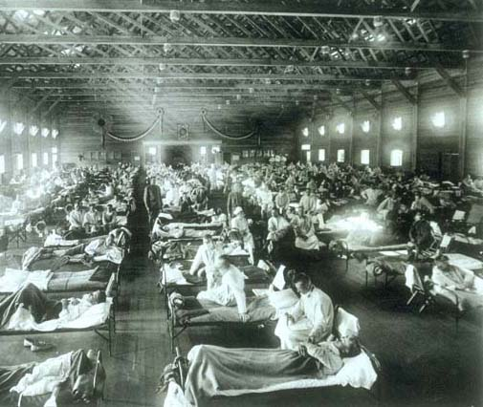
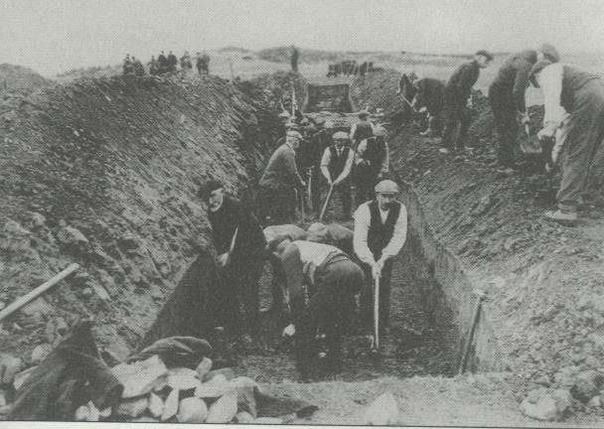

Slide 4
WHY THE WORLD IS SO SCARY ABOUT THESE VIRAL PANDEMICS !!!

Slide 5
1918 Spanish Flu
H1N1 virus
The world’s most lethal pandemic ever.
First appeared in Kansas in March 1918
  Within one wk, spread to every state in US
  Those who fell ill in the morning were dead by night
  Those who survived of flu often died of complications (such as bacterial pneumonia).
By April 1918, virus spread to Europe, China, Japan, Africa, and South America

Slide 6
1918 Spanish Flu………
In August 1918, a second wave.
  Called as the “Main Wave”
  Virus killed >1 lakh/wk.
By October 1919, flu strain vanished(18 mon)
Mortality was greater than the 4-yrs “Black Death” ie Plague

Slide 7
1918 Spanish Flu……
>50 crores were affected. ie 1/3rd of world population.
Mortality rate was >2.5%, while seasonal flu had been 0.01-0.1%
Most deaths occurred in young, healthy adults

Slide 8
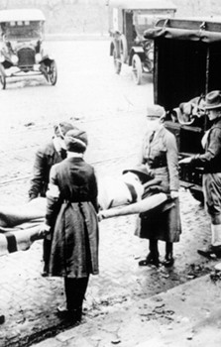
MOST FATAL EVENT
IN HUMAN HISTORY
WORLDWIDE FATALITIES:
5-10 CRORE IN 18 MONTHS
US FATALITIES:
20lakhs
U.S. LIFE EXPECTANCY AT BIRTH

Slide 9

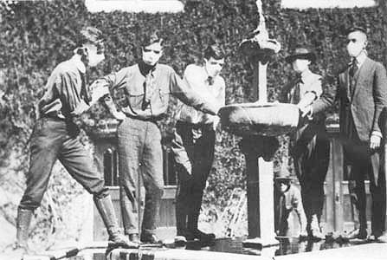
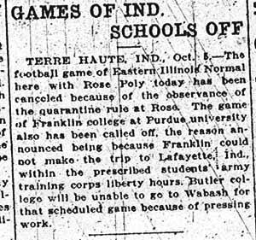
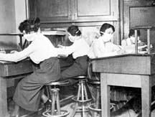
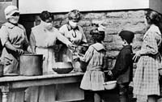
SCHOOLS FACE TOUGH PANDEMIC QUESTIONS

Slide 10
Are we due for the next influenza pandemic?
Other serious flu pandemics during 20th century- 1957, 1968
    1957 –H2N2-The Asian Flu- killed 20 lakhs people, including 70,000 in the US.
    1968- H3N2- The Hong Kong Flu- killed 10 lakhs people, including 34,000 in the US.
They tend to occur in cycles, every 10-40 yrs,
There was no major pandemic since many years.
Yes, we are due for such pandemics.
Notes:
During the 20th century there were three serious influenza pandemics, killing millions of people:
1918 The Spanish Flu killed tens of millions of people around the world, including at least 500,000 people in the United States.

Slide 11

Recent coronavirus pandemics
2002–2003- SARS-CoV ; Severe acute respiratory syndrome.
  Began in China, spread to 28 countries in Asia, Europe, America.
  Total cases(~90% in China); 8000 with Martality rate-10%
  The disease was milder in the US and less severe among children.
  The natural reservoir- Bat
    The outbreak originated from human contact with infected semi-domesticated animals.
Notes:
Some ill individuals (“super-spreaders”) appeared to be hyperinfectious and were capable of transmitting infection to 10–40 contacts, although most infections resulted in spread either to no one or to three or fewer individuals. SARS originated in Guangdong, China in November 2002
Affected 8096 persons, 774 deaths in 26 countries

Slide 12
2012-MERS-CoV- Middle East respiratory syndrome(MERS).
  In 30 October 2013, 124 cases and 52 deaths in Saudi Arabia
  By Dec 2019, 2,500 cases, killed 851, mortality rate- 35%.
  No sustained spread in communities.
  The source of MERS-CoV; Bats may be the animal reservoir and camels serve as an intermediate host.
Notes:
All cases outside middle east have been associated with contact or travel to six countries in or near the Arabian Peninsula: Jordan, Kuwait, Oman, Qatar, Saudi Arabia, and United Arab Emirates.
Cases have also been reported in France, Italy, Tunisia, Germany, Spain, and the UK.
The median IP; 5 days (max 9–12 days).
Begin with cough and fever, progress to ARDS and respiratory failure within a week. Some cases manifest as mild URI only.
Renal failure has been noted
Diarrhea and vomiting are also common and pericarditis has been reported.

Slide 13
Acute respiratory infections and we

Slide 14
Burden of Respiratory Viruses
Two-thirds to three-fourths of cases are caused by viruses.
  The vast majority are URTI
  LRTI can also develop, particularly in younger age groups, in elderly, pt with co-morbities and in certain epidemiologic settings.
>200 antigenically distinct viruses from 10 genera causes Acute RTIs.
Likely additional agents will be described in the future.
Notes:
The use of antibiotics to treat viral respiratory infections represents a major cause of abuse of these drugs.

Slide 15
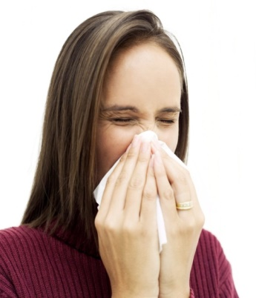
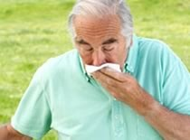
Acute Viral RIs (commonly URIs);
  Annual epidemics occur regularly
  Children <6yr- average 12 colds/ year.
  Childrens>6yr- average 6 colds/year.
  Adults- 3-4 cases/person/ year.
  Usually recover in seven to ten days, but in some up to three weeks.
Notes:
during colder months in temperate climates and rainy season in the tropics.
Adults who are in contact with young children have more colds than those who are not.
Remain high until age 6, then progressivly decreases.

Slide 16
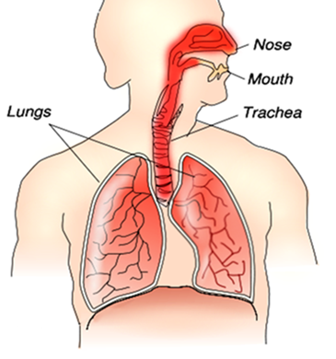
Common viruses causing RTI
Most commonly- Rhinovirus (30–80%)
Other commonly implicated are;
  Coronaviruses (15-30%),
  Influenza viruses (10–15%),
  Adenoviruses (5%),
  Respiratory syncytial virus, Enteroviruses other than rhinoviruses, Human parainfluenza viruses, and Metapneumovirus.
  Herpes simplex virus.

Slide 17
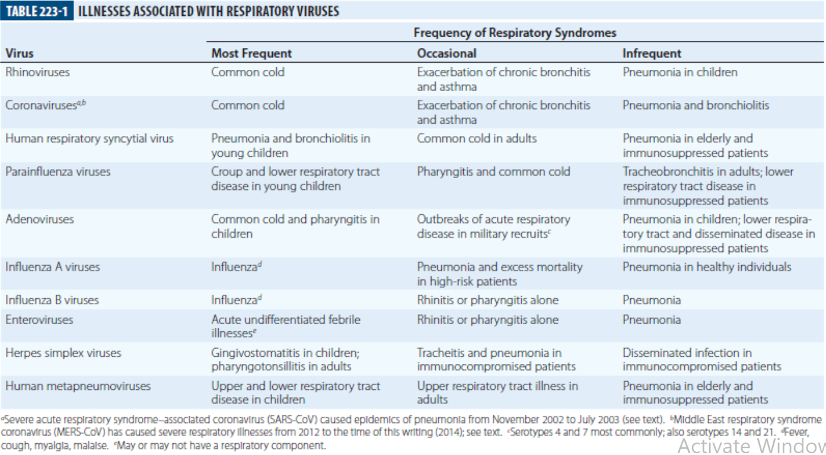

Slide 18
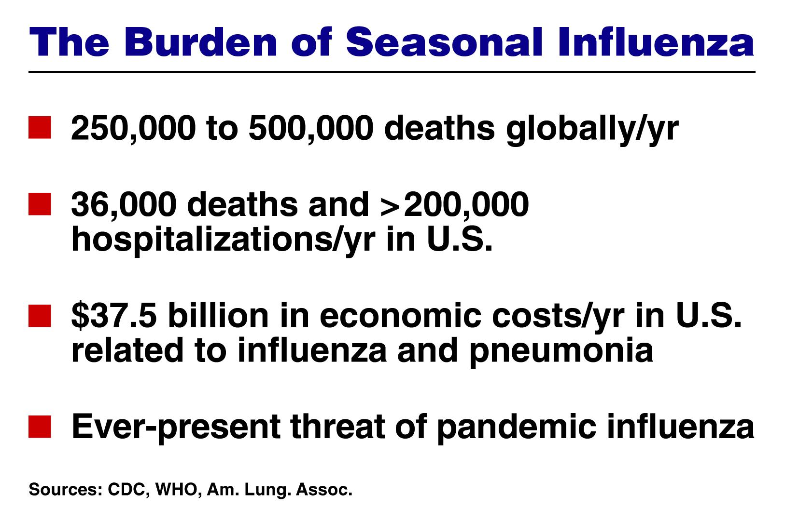

Slide 19
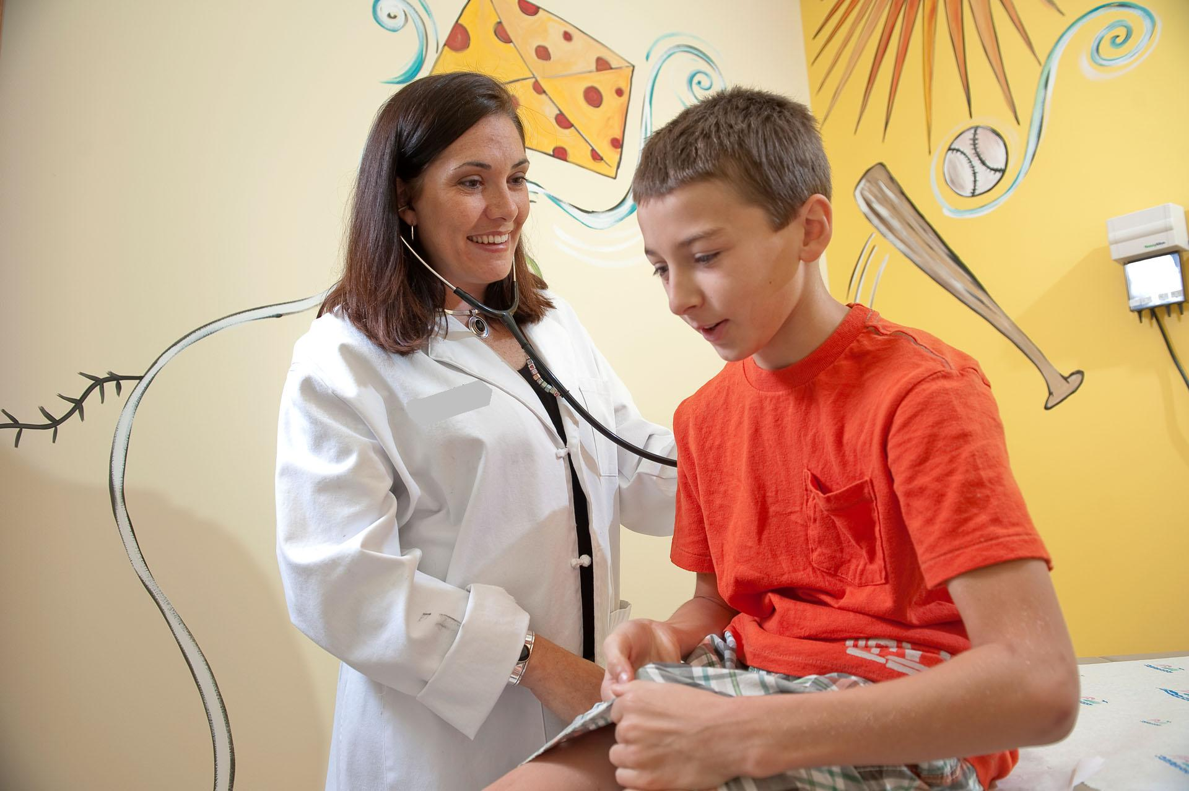
Coronaviruses (CoV)

Slide 20
Corona Viruses
A large family of viruses that cause illness ranging from the common cold to more severe diseases.
Present ongoing outbreak – COVID-19 VIRUS- is a new strain not been previously identified in humans.

Slide 21
There are seven important strains of human coronaviruses:
Human coronavirus 229E (HCoV-229E)
Human coronavirus OC43 (HCoV-OC43)
Human coronavirus NL63 (HCoV-NL63)
Human coronavirus HKU1
SARS-CoV-Novel coronavirus-2002
MERS-CoV- Novel coronavirus 2012 .
Novel coronavirus (2019-nCoV), also known as Wuhan coronavirus.('Novel' means newly originated)
The coronaviruses HCoV-229E, -NL63, -OC43, and -HKU1 continually circulate in the human population and cause respiratory infections in adults and children world-wide.

Slide 22
Coronaviruses are not new to this world, they are present even before B.C.
All of them are derived from animals say BAT.
Accounts for significant percentage of all common colds, primarily in winter and early spring seasons.
  Can also cause;Bronchitis, either direct viral bronchitis or a secondary bacterial bronchitis. Pneumonia, either direct viral pneumonia or a secondary bacterial pneumonia
Seroprevalence for strains HCoV-229E and HCoV-OC43; >80% in adult populations.
Notes:
have demonstrated that are acquired early in life and increase in prevalence with advancing age.

Slide 23
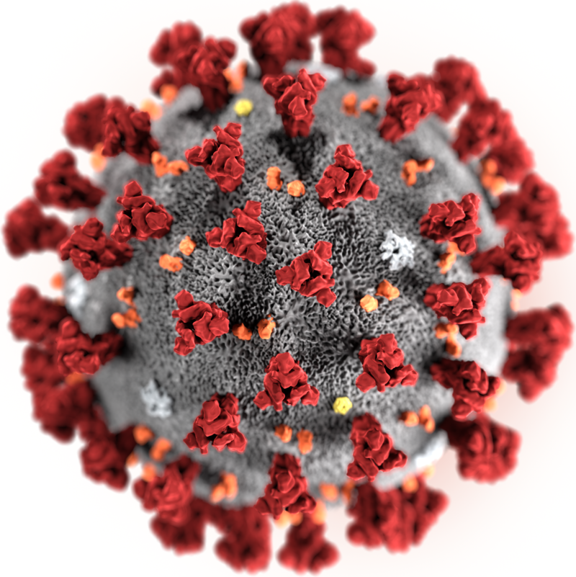
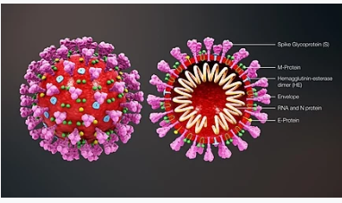
Coronaviruses-Morphology
Crownlike appearance produced by the club-shaped projections that stud the viral envelope.
Enveloped viruses with ss-RNA genome.
Genomic size; 26 to 32 kilobases, the largest for an RNA virus.
Measures; 100–160 nm in diameter.
Infect a wide variety of animals

Slide 24
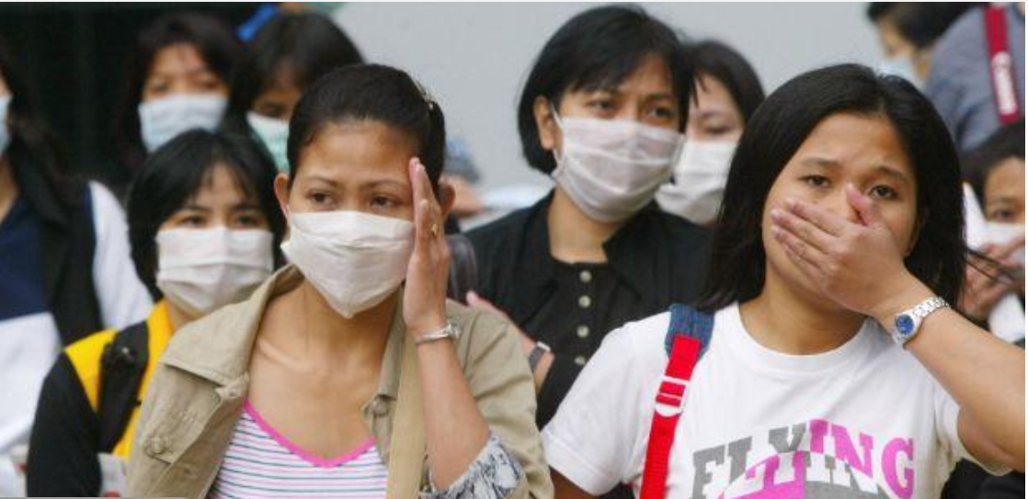
As per the report of the WHO-China Joint Mission on COVID-19 as of 20th feb 2020.
Released on 3rd march 2020.
Now about present ongoing outbreak 2019-nCoV

Slide 25
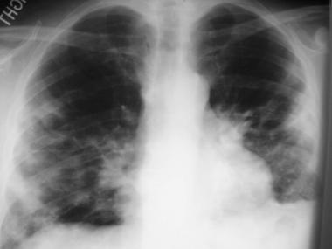
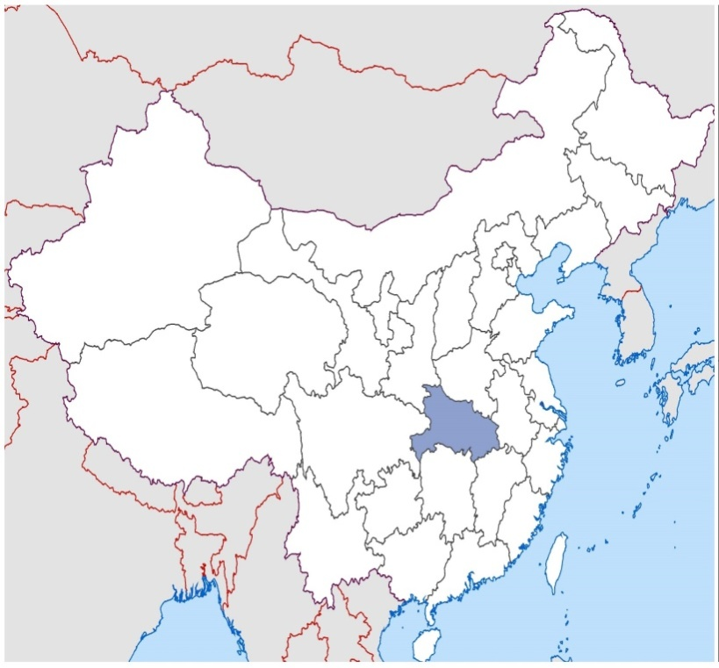
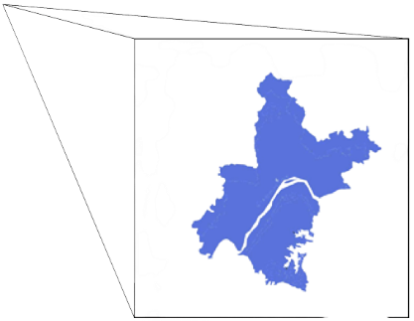

Cluster of Pneumonia Cases of Unknown Origin in December 2019
Hubei
Wuhan

Slide 26
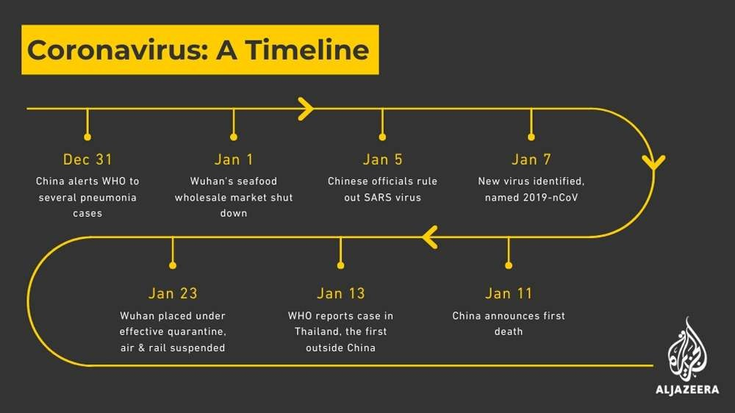

Slide 27
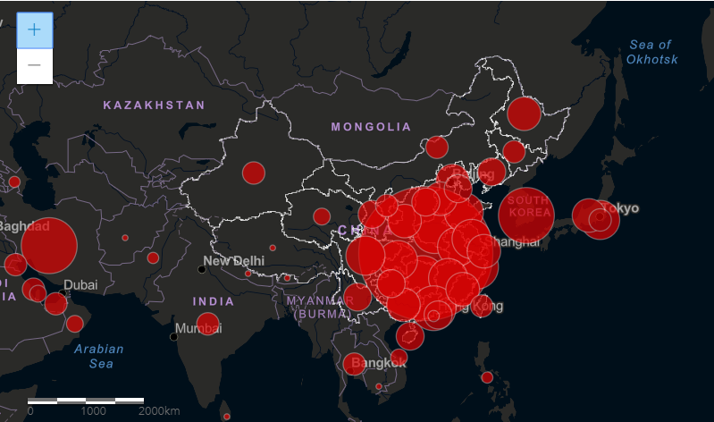
Analysis of 56,000 lab confirmed COVID-19 virus infected cases in china, reported as of 20 February 2020

Slide 28
Demographic characteristics;
COVID-19
Among 56,000 lab confirmed cases.
  75% are from Hubei
  Median age; 50 yrs (range 2 days-100 yrs old)
    Majority(80%) b/n 30–70 yrs.
  51 % are male
  20% are Farmers or laborers.
  Only 2.5% are Children aged <19 yrs.
  Health care workers: 4%
    88% reported from Hubei

Slide 29
Zoonotic origin
COVID-19 is a New zoonotic virus.
From phylogenetics analyses, bats appear to be the reservoir.
But the intermediate host(s) not yet identified.
First started from ‘Wuhan live animal and seafood markets’
Has similarities to SARS CoV (80%) and bat coronaviruses (96%)
Notes:
Comparisons of the genetic sequences of this virus and other virus samples have shown similarities to SARS-CoV (80%) and bat coronaviruses (96%), which makes an ultimate origin in bats likely.

Slide 30
How long does virus survive outside body?
It behaves like other coronaviruses.
  This vary under different conditions (e.g. type of surface, temperature or humidity of the environment).
  1-2 days on nonporous surfaces
  8-12 hours on porous surfaces
  Common disinfectants such as 70% Ethanol and bleach can kill the virus
If you think a surface is infected, clean it with simple disinfectant.
Clean your hands with an alcohol-based hand rub or wash them with soap and water.
Notes:
Avoid touching your eyes, mouth, or nose

Slide 31
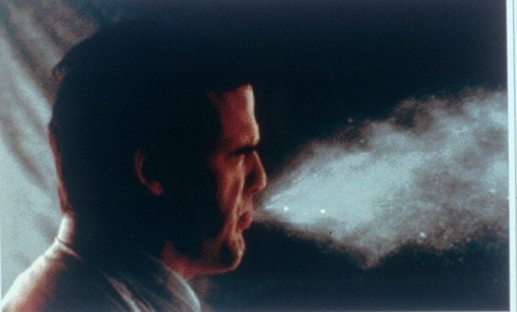
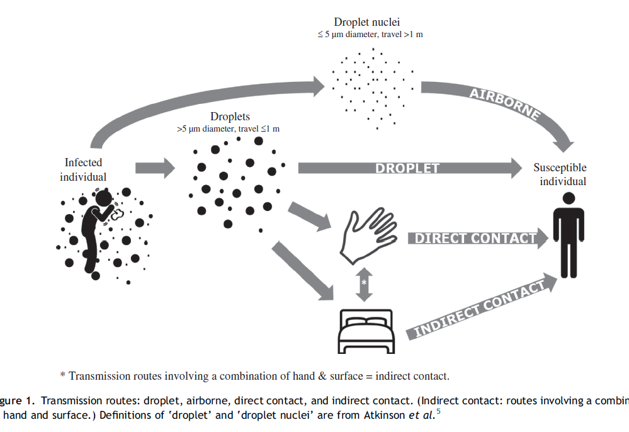
Routes of transmission
Transmitted via droplets and fomites.
  Airborne spread not reported and not a major driver of transmission
  Fecal shedding in some pts but not a major driver of transmission.

Slide 32
Transmission dynamics
Household transmission- The Main cause
  Human-to-human transmission largely occurring in families.
  Among 344 clusters involving 1308 cases, most clusters (80-85%) have occurred in families.
  Secondary attack rate in households ranges from 3-10%
    10% early in the outbreak and fell to 3% with faster isolation
School outbreaks not a feature of this outbreak – this may simply be because of the closure of schools during most of this outbreak

Slide 33
Transmission in health care settings and among health care workers (HCW).
  2,055/55,924 (4%) lab-confirmed cases.
  Most identified in early stage when experience with the new disease was lower.
  Additionally, many have been infected within the household rather than in a health care setting.
  Transmission within health care settings and amongst HCW does not appear to be a major transmission drive.
Transmission in other closed settings is happening but not the major driver in China (e.g. prisons, restaurants)

Slide 34
Contact Tracing
China has a policy of meticulous case and contact identification for COVID-19.
  In Wuhan >1800 teams of epidemiologists, a minimum of 5 people/team, are tracing tens of thousands of contacts a day.
Contact follow up was painstaking, Bcoz of medical observation of them upto 14 days.
1- 5% of contacts were subsequently developed COVID-19.

Slide 35
In Shenzhen City, among 3000 identified close contacts.
  Only 3% were found to be infected with COVID-19.
In Sichuan Province, among 25,000 identified close contacts
  Only 1% were found to be infected with COVID-19.
In Guangdong Province, among 10,000 identified close contacts.
  Only 5% were found to be infected with COVID-19.

Slide 36
Testing at fever clinics and at routine ILI/SARI surveillance systems
PCR testing for COVID-19 virus done for all pts of fever, or influenza-like-illness (ILI), or severe acute respiratory infection (SARI), visiting these systems.
  In Wuhan, COVID-19 testing of ILI samples (20/wk) in Dec 2019 to first two wks of Jan 2020.
    No positive results in the dec 2019 samples,
    1 adult positive in the first wk of Jan 2020(5%),
    3 adults positive in the second wk of Jan 2020(15%)
    All children tested were negative, but a large number were positive for influenza.

Slide 37
  In Guangdong, from 1-14 January, only 1/15,000 samples tested positive for COVID-19 virus.
  In one hospital in Beijing, No COVID-19 positive samples among 1900 collected from 28 Jan 2020 to 13 Feb 2020.
  In a hospital in Shenzhen, 0/40 samples were positive for COVID-19.
  From fever clinics in Guangdong.
    Just 0.14% of 3,20,000 fever clinic screenings were positive for COVID-19.
Notes:
Positive for COVID-19 virus decreased over time from a peak of 0.5% positive on 30 January to 0.02% on 16 February.

Slide 38
Susceptibility
COVID-19 is a newly identified virus, there is no known pre-existing immunity in humans.
Everyone is assumed to be susceptible, although there may be risk factors of increasing susceptibility to infection in some.
This requires further study, to know whether there is neutralising immunity after infection.

Slide 39
Children aged under 19 years.
Relatively low attack rate( 2.5% of cases).
Infected children largely had contact tracing to households adults.
A very small proportion of those developed severe (2.5%) or critical disease (0.2%).
Notes:
Within Wuhan, among testing of ILI samples, no children were positive in November and December of 2019 and in the first two weeks of January 2020.

Slide 40
Pregnant women and COVID-19
Pregnant women do not appear to be at higher risk of severe disease.
In an investigation of 147 pregnant women (64 confirmed, 82 suspected and 1 asymptomatic).
  8% had severe disease
  1% were critical.

Slide 41
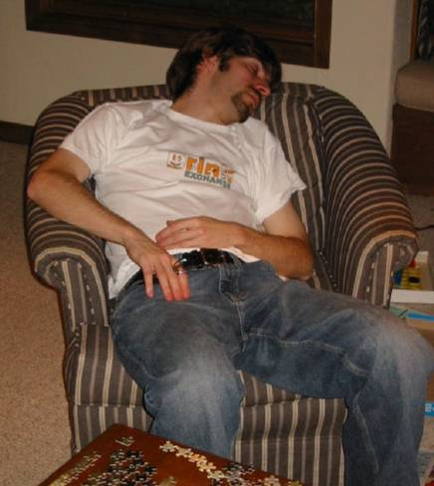
The signs, symptoms, disease progression and severity
Report of WHO China Joint Mission, Feb 2020

Slide 42
Disease presentation ranges from asymptomatic to severe pneumonia and death.
Based on 55,924 laboratory confirmed cases, typical signs and symptoms include:
  Fever (90%),
  Dry cough (70%),
  Fatigue (40%),
  Sputum production (33%),
  Shortness of breath (20%),
  Sore throat (15%),
  Headache (13%), myalgia or arthralgia (15%), chills (12%), nausea or vomiting (5%),
  Nasal congestion (5%), diarrhea (4%), and hemoptysis (1%), and conjunctival congestion (1%).

Slide 43
Pts developed signs and symptoms, on an average of 5-6 days after infection(mean IP; 5-6 days, range 1-14 days).
  80% had mild to moderate disease, which includes non-pneumonia and pneumonia cases. Most had recovered.
  15% had severe disease (dyspnea, respiratory frequency ≥30/minute, SpO2 ≤93%, PaO2/FiO2 ratio <300, and/or lung infiltrates >50% of the lung field within 24-48 hours)
  5% are critical (respiratory failure, septic shock, and/or multiple organ dysfunction/failure).

Slide 44
Asymptomatic infections rare(1-3%).
  Majority of asymptomatic cases on the date of identification went on to develop disease later.
  These does not appear to be a major driver of transmission
Individuals at highest risk for severe disease and death include;
  People aged >60 years
  Those with underlying conditions such as HTN, DM, cardiovascular disease, chronic respiratory disease and cancer.

Slide 45
Age and Severity of Illness (n=72,314)
China CDC Weekly Vol2 (8)
Notes:
Case fatality rate increases with increase in age above 60 years .

Slide 46
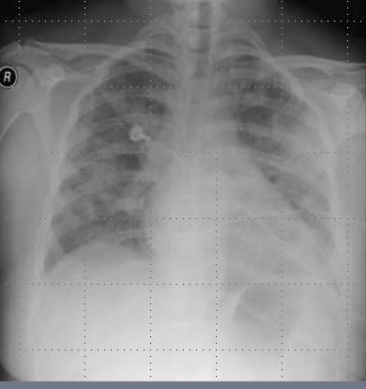
Severity of Illness (n=72,314)
China CDC Weekly Vol2 (8)

Slide 47
Virus shedding and Risk of Transmission in COVID-19 pts following Onset of Illness (n=18)
High viral load detected soon after symptom onset up to day 21 of illness onset
More in nose than throat
Viral shedding
  Highest in the early course.
  Can be detected in the 24-48 hrs prior to disease onset
  Usually continues for 7-12 days in mild/moderate cases, and for >2 wks in severe cases
(NEJM, DOI 10,1056)

Slide 48
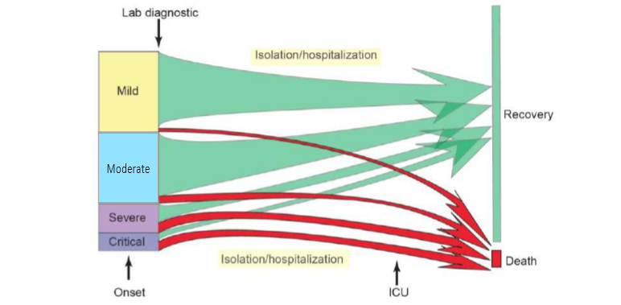
Data on the progression of disease
Progression: approx. 10-15% of mild/moderate cases become severe, and approximately 15-20% of severe become critical

Slide 49
Mortality
2100/56,000 have died (crude fatality ratio 2-4%).
  Mortality was higher in the early stages (17% for cases from 1st to 10th January)
  Reduced over time to 0.7% after 1 February.
  Mortality varies by location and intensity of transmission (i.e. ~6% in Wuhan vs. 0.7% in other areas of China).
  The Joint Mission noted that the standard of care has evolved over the course of the outbreak.

Slide 50
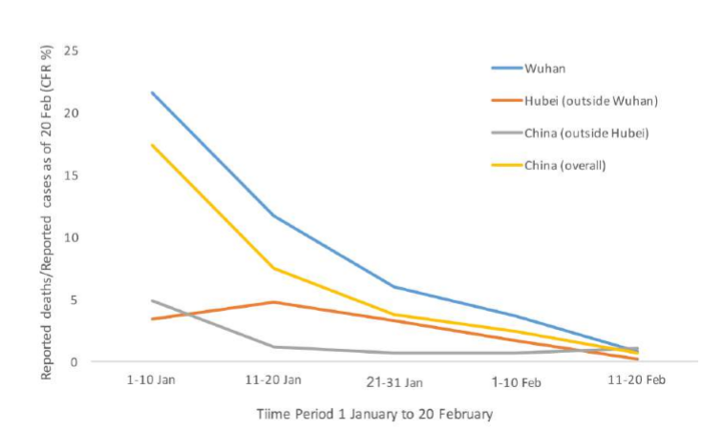
Figure; Case fatality ratio (reported deaths among total cases) for COVID-19 in China over time and by location, as of 20 February 2020

Slide 51
  Mortality increases with age, highest over 80 yrs of age (22%).
  Mortality is higher among males compared to females (5% vs. 3%).
  By occupation, Retirees had the highest mortality rate- 9%.
  Pts with no comorbid conditions had a mortality rate-1.5%,
  Pts with comorbid conditions had higher rates- 13% for cardiovascular disease, 9% for diabetes, 8% for hypertension, 8% for chronic respiratory disease, and 7% for cancer.

Slide 52
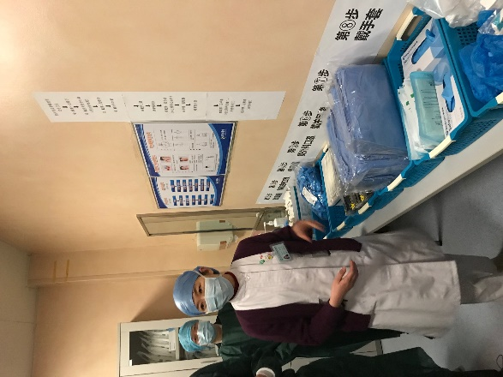
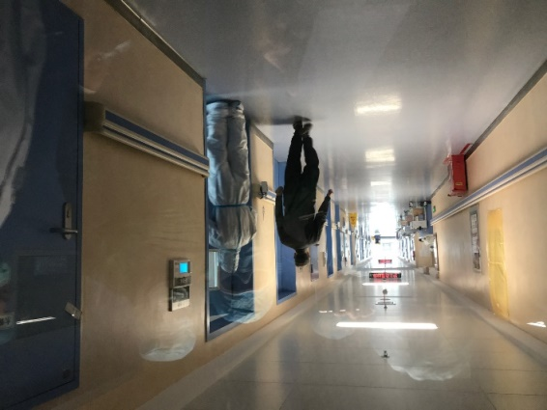
Clinical recovery
Average times:
  From onset to the development of severe/critical disease, is 1 wk;
  From symptoms to recovery
    For mild cases is 2 wks;
    For severe cases is 3-6 wks;
  From symptoms onset to death; 1 wk (critical) to 2-8 wks.
Notes:
The median time from onset to complete clinical recovery for mild cases is ~2 wks and 3-6 weeks for severe or critical cases.
Time Period
Among pts who have died, the time from symptom onset to outcome ranges from 2-8 wks.
From exposure to symptom onset is 5-6 days;

Slide 53
Encouragingly, Guangdong CDC study of 125 severe cases.
  26.4% have recovered and been released from hospital,
  46.4% had improved and were reclassified as having mild/moderate disease (i.e. + milder pneumonia).
  13.5% died.
  Early identification of cases allows for earlier treatment.

Slide 54
Severity of Illness and Outbreak Containment
Ability to contain is less in mild or asymptomatic emerging diseases
80% of COVID-19 illness is mild and asymptomatic

Slide 55
Similarities b/n COVID-19 and Influenza
Firstly, both have a similar disease presentation.
  Both cause respiratory disease, ranging from asymptomatic to severe disease and death.
Secondly, both are transmitted by contact, droplets and fomites.
  As a result, the same public health measures, such as hand hygiene and good respiratory etiquette (coughing into your elbow or into a tissue and immediately disposing of the tissue), are important to prevent infection.

Slide 56
Differences b/n COVID-19 and Influenza
First, COVID-19 does not transmit as efficiently as influenza.
  In COVID-19, virus are shed after symptom onset- A major driver of transmission.
  In influenza, viruses are shed before appearance of symptoms – A major driver of transmission
  Influenza has a shorter IP and a shorter serial interval than COVID-19 virus.
    The serial interval for COVID-19 virus is 5-6 days, while for influenza virus, the serial interval is 3 days.
  influenza spread faster than COVID19.
Notes:
With influenza, people who are infected but not yet sick are major drivers of transmission, which does not appear to be the case for COVID-19.
Only 1% of COVID-19 cases do not have symptoms, and most develop symptoms within 2 days.
That means-
For influenza, Transmission of virus before appearance of symptoms – is a major driver of transmission
In contrast, people can shed COVID-19 virus just 24-48 hrs prior to symptom onset, this does not appear to be a major driver of transmission.

Slide 57
  Children are important drivers of influenza virus transmission in the community.
    For COVID-19 virus, Children are infected from adults, rather than vice versa.
  Using surveillance systems, while looking for cases of COVID-19, influenza and other respiratory diseases.
    They found very few cases of COVID-19 among such samples or no cases at all.
Notes:
The reproductive number – the number of secondary infections generated from one infected individual – is understood to be b/n 2 and 2.5 for COVID-19 virus, higher than for influenza.

Slide 58
Comparison of mortality and transmissibility of Human Infection with Coronavirus and Influenza virus
Source: Communicable Disease Manual
Notes:
The R0 ( R naught or Replication number signifies how many persons can be affected by a virus in optimal conditions in general.

Slide 59
The second, COVID-19 causes more severe disease than seasonal influenza.
  While many people have built up immunity to seasonal flu, COVID-19 is a new virus to which no one has the immunity.
      Therefore, severe infection for COVID-19 will be higher than influenza.
      80% of infections are mild or asymptomatic,
      15% are severe infection, requiring oxygen
      5% are critical infections, requiring ventilation.

Slide 60
  Mortality rate for COVID-19 > Seasonal influenza.
    For COVID-19 is b/n 2-3%.
    For seasonal influenza, mortality is < 0.1%.
  At most risky are
    For influenza, children, pregnant women, elderly, those with underlying chronic medical conditions and those who are immunosuppressed.
    For COVID-19, older age and underlying conditions.
Notes:
Globally, about 3.4% of reported COVID-19 cases have died. By comparison, seasonal flu generally kills far fewer than 1% of those infected.

Slide 61
Third, we have vaccines and therapeutics for seasonal flu, but no vaccine and no specific treatment for COVID-19.
Fourth, we don’t talk about containment for seasonal flu – it’s just not possible. But it is possible for COVID-19.
  We don’t do Contact tracing and Containment for seasonal flu – but countries should do it for COVID-19, because it will prevent infections and save lives.
Notes:
However, clinical trials of therapeutics are now being done, and more than 20 vaccines are in development.

Slide 62
COVID-19 vs INFLUENZA
COVID-19 spreads less efficiently than flu,
COVID-19 transmission does not appear to be driven by the people who are not sick.
It causes more severe illness than flu.
There are not yet any vaccines or therapeutics, but it can be contained – which is why we must do everything we can to contain it.

Slide 63
COVID-19 and Influenza: a brief comparison
COVID-19 is less infectious than influenza but leads to more serious illness and death
SIMILARITIES
Both cause mild to severe respiratory disease and death.
Spread by contact, droplets and fomites.
Preventative measures the same: hand hygiene, respiratory etiquette, social distancing
DIFFERENCES
Influenza spreads faster than COVID-19: influenza has a shorter IP and shorter serial interval
Transmission of virus before symptoms is a major driver of spread for influenza, not for COVID-19 virus
The reproductive number is 2-2.5 for COVID-19 virus, 1-1.8 for pandemic influenza
Children are commonly infected with influenza. Children are less infected and less affected by COVID-19.
Severe illness and death seem to be more common in COVID-19

Slide 64
How china managed COVID-19 cases in hospital
Preparedness
Follow the principle of early identification, early isolation, early diagnosis and early treatment.

Slide 65
Suspect cases are isolated in a single rooms, wear a surgical mask (for source control).
  Staff wear a cap, eye protection, n95 masks, gown and gloves (single use only).
In Wuhan
  Most suspects were cohorted in a normal pressure isolation ward.
  Staff wear PPE continuously, changing it only when they leave the ward.

Slide 66
Discharge policies
Pts are discharged after clinical recovery (afebrile >3 days, resolution of symptoms and radiologic improvement) and 2 negative PCR tests taken 24 hrs apart.
Upon discharge, they are asked to minimise family and social contact and to wear a mask.

Slide 67
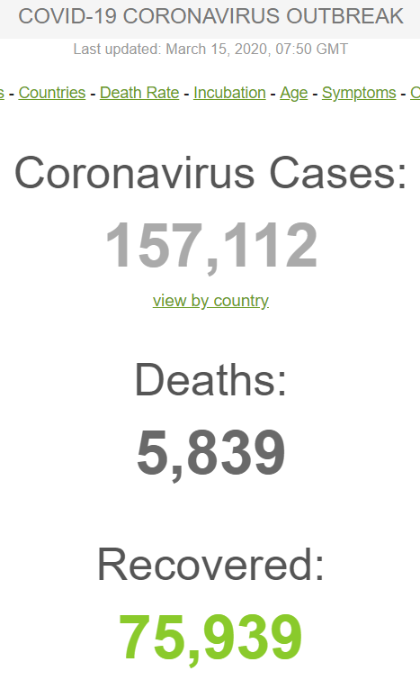
New Cases of COVID-19 since 1 Feb 2020
Notes:
What we can see is while cases in China seems to be going down , cases outside China are growing every day.

Slide 68
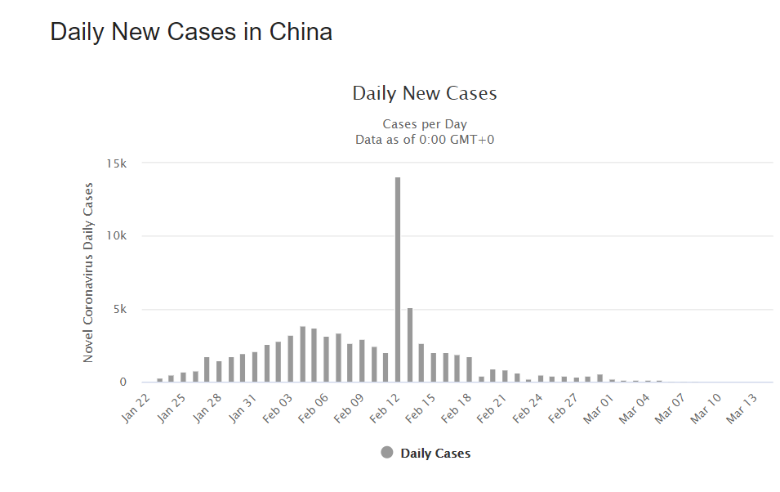
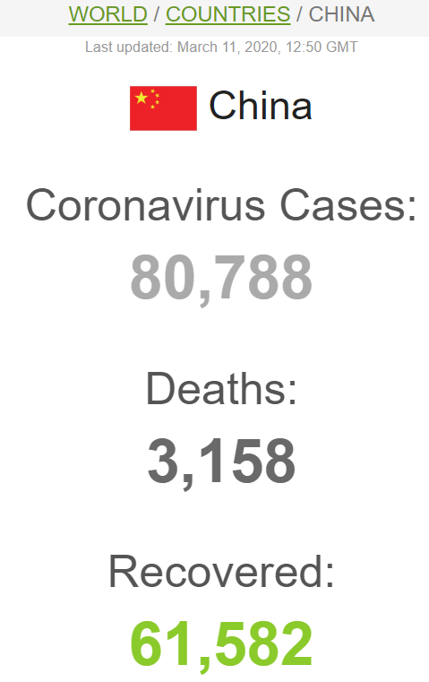
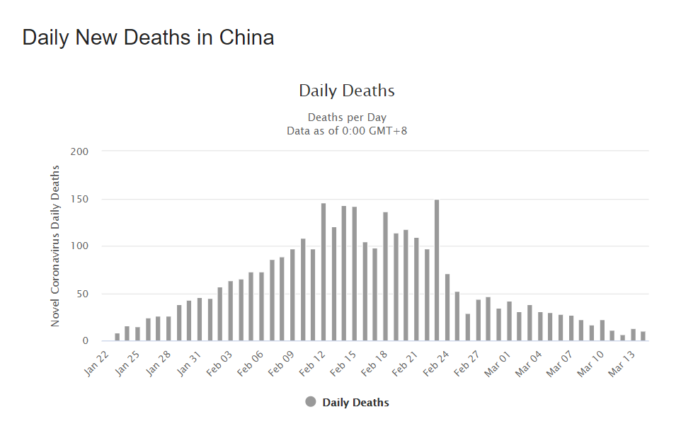

Slide 69
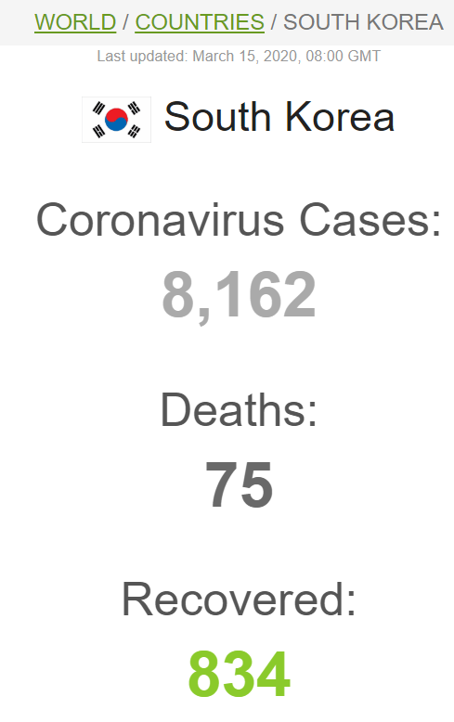
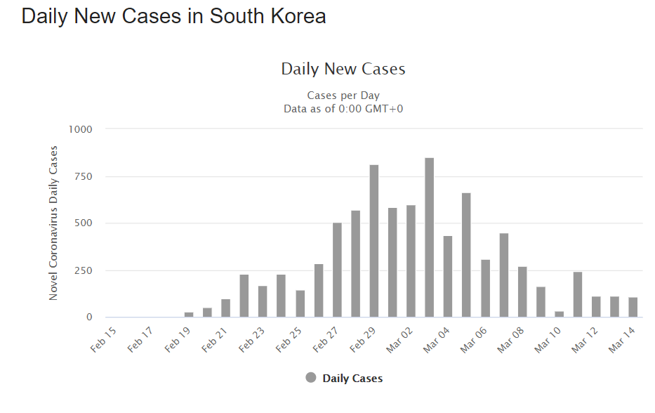
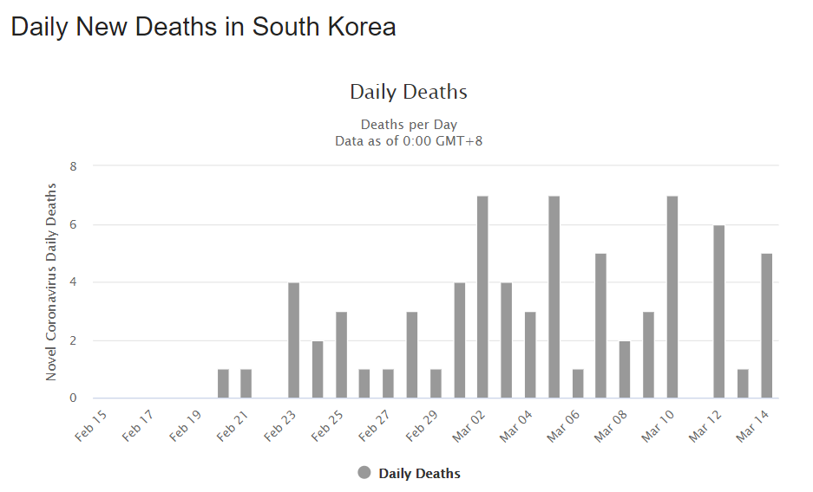

Slide 70
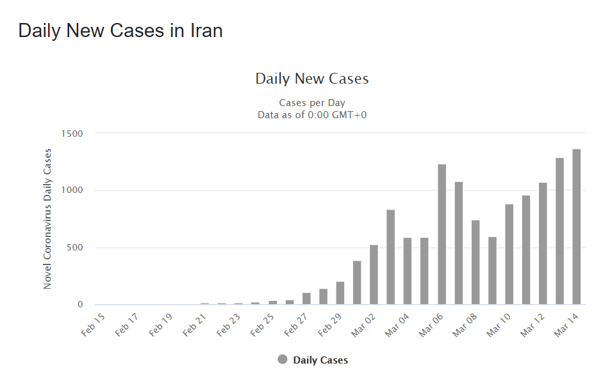
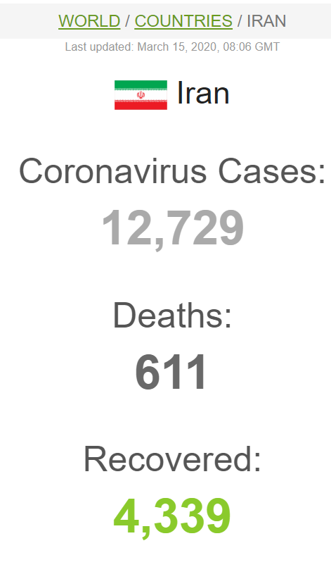
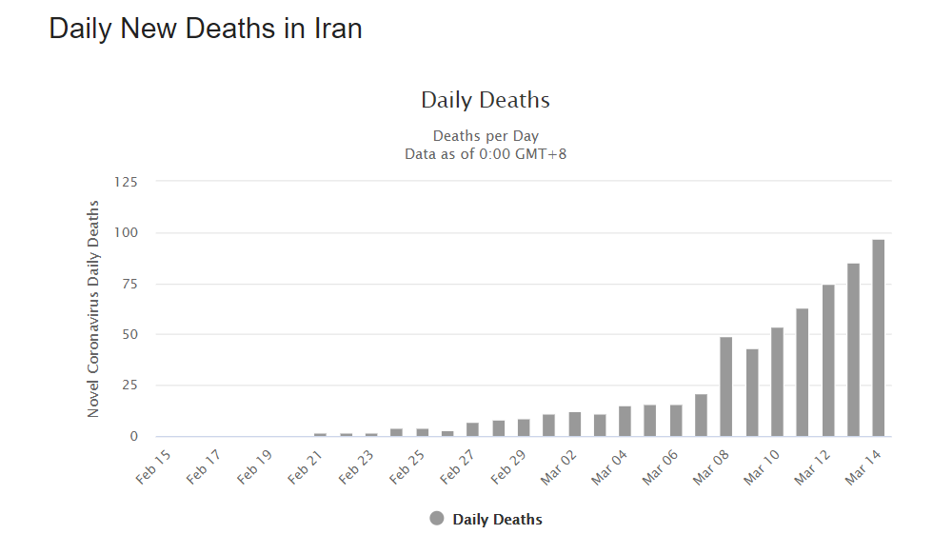

Slide 71
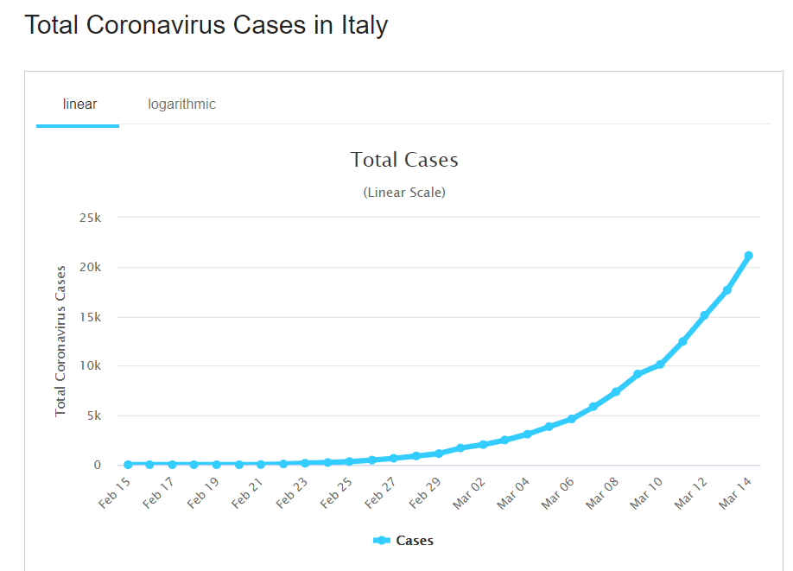
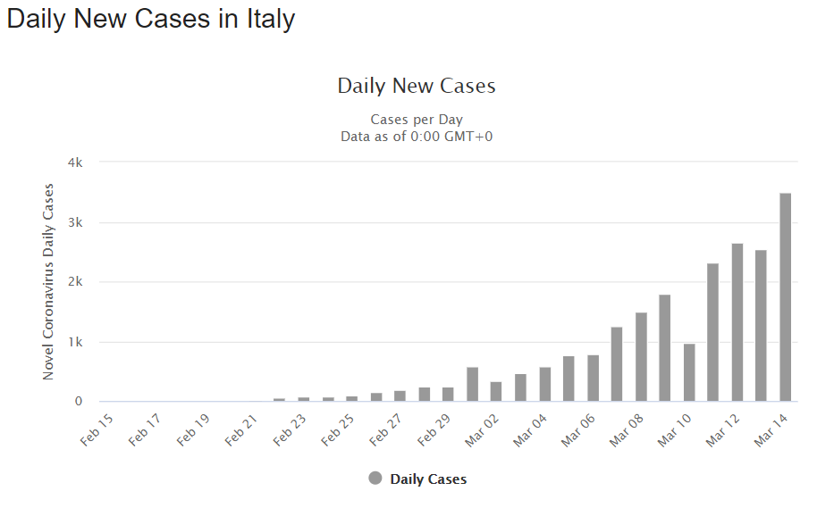
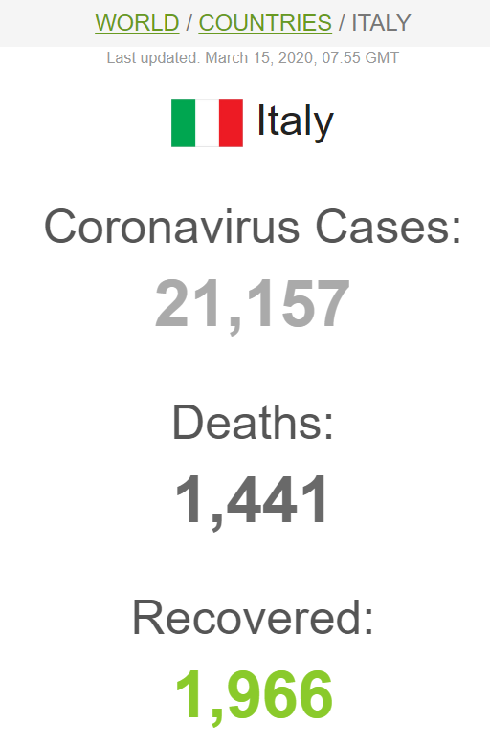
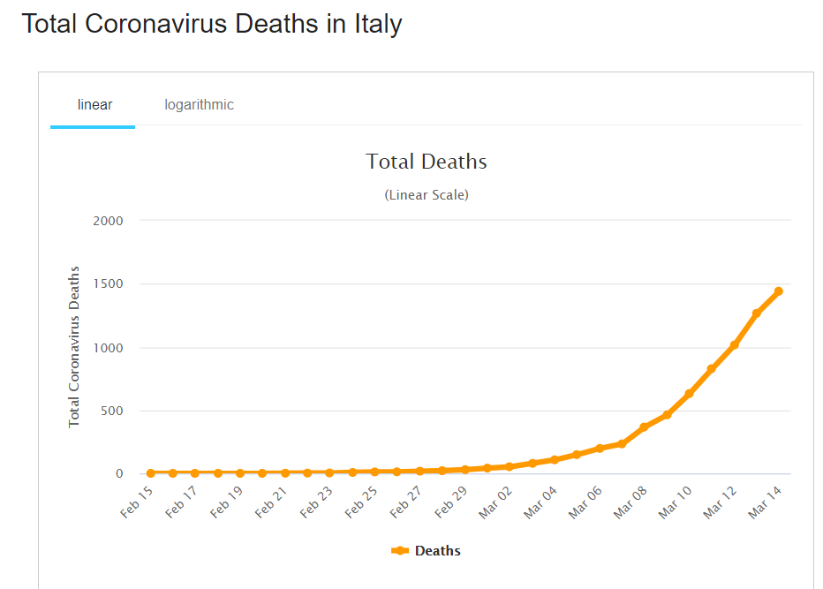

Slide 72
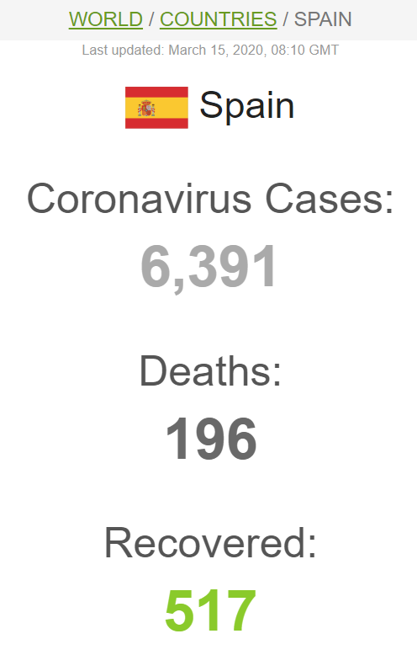
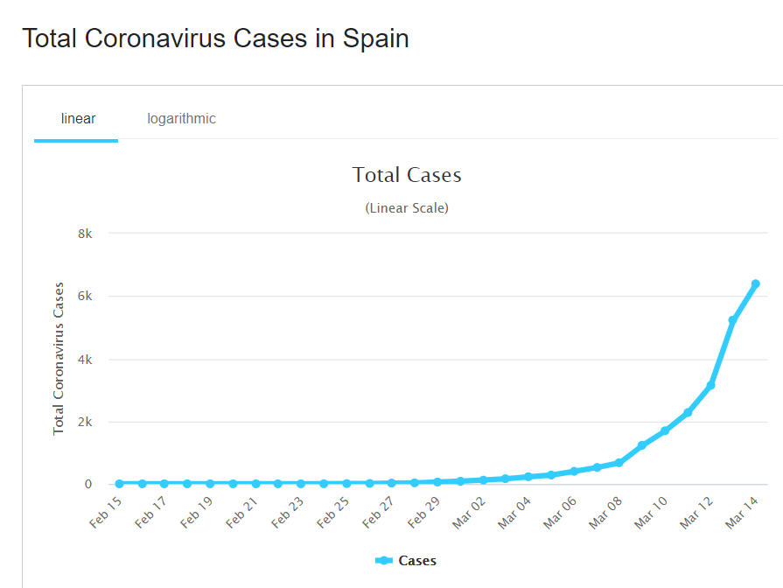

Slide 73
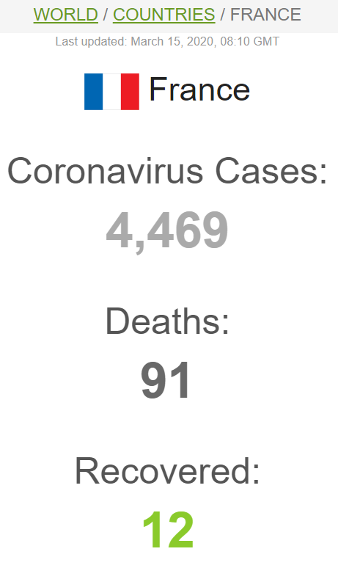
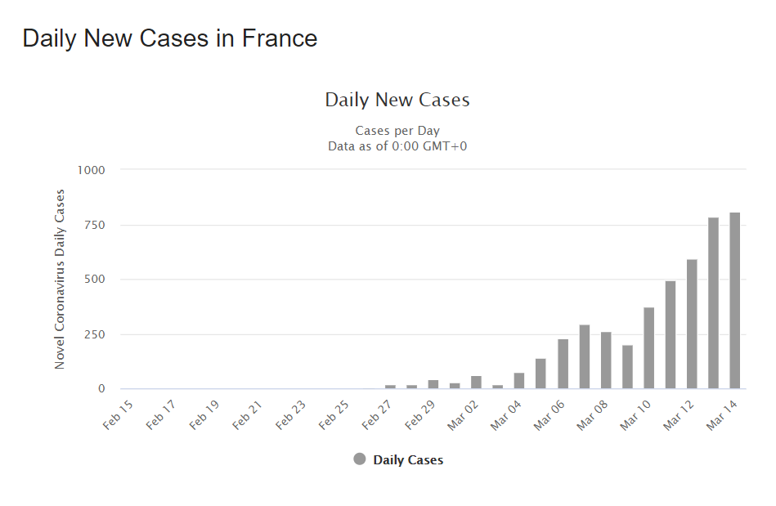

Slide 74
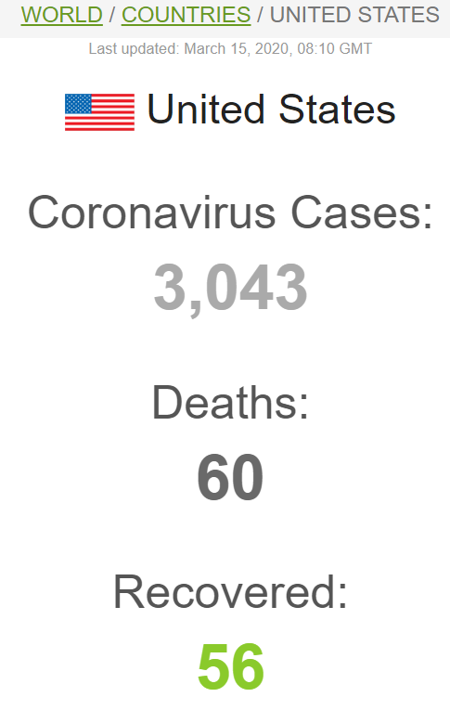
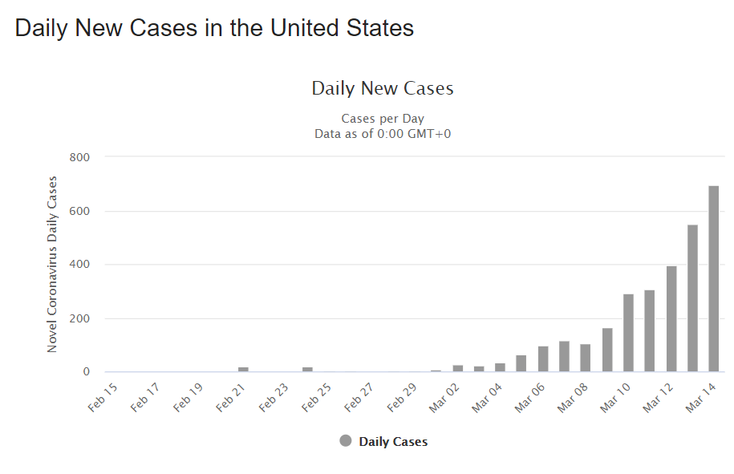

Slide 75
India as on 15/3/2020
Total cases-110
Recovered-13
Deaths-2
KARNATAKA-7, DEATH-1

Slide 76

WHO Risk Assessment
China | Very High
Regional | Very High
Global | Very High

Slide 77

PREVENTION- CONTAINMENT
Myth busters

Slide 78


Slide 79


Slide 80


Slide 81


Slide 82


Slide 83


Slide 84


Slide 85


Slide 86


Slide 87


Slide 88


Slide 89


Slide 90


Slide 91


Slide 92
Personel protective equipments and face masks- what WHO says???
Countries’ abilities are compromised by the severe disruption of global supply of PPEs(such as gloves, medical masks, respirators, goggles, face shields, gowns, and aprons)– caused by rising demand, hoarding and misuse.
Leaving doctors, nurses and other frontline healthcare workers dangerously ill-equipped to care for COVID-19 pts
Prices of surgical masks have increased six-fold, N95 respirators have tripled, and gowns cost twice as much.
WHO urges people to use them wisely.
Notes:
WHO estimates that each month, 89 million medical masks will be required for the COVID-19 response; 76 million examination gloves, and 1.6 million goggles.

Slide 93

If you are not ill or looking after someone who is not ill then you are wasting a mask.
There is a world-wide shortage of masks,
WHO advises rational use of medical masks to avoid unnecessary wastage of precious resources and misuse of masks .
The most effective ways are to frequently clean your hands, cover your cough with the bend of elbow or tissue and maintain a distance of at least 1 meter (3 ft) from people who are coughing or sneezing
Notes:
Only wear a mask if you are ill with COVID-19 symptoms (especially coughing) or looking after someone who may have COVID-19. Disposable face mask can only be used once.

Slide 94
WHO-Major Recommendations for countries with imported cases and/or outbreaks of COVID-19
1. Immediately activate the highest level of national Response Management protocols to ensure the all-of-government and all-of-society approach needed to contain COVID-19 with non-pharmaceutical public health measures;
2. Prioritize active, exhaustive case finding and immediate testing and isolation, painstaking contact tracing and rigorous quarantine of close contacts;
3. Fully educate the general public on the seriousness of COVID-19 and their role in preventing its spread;

Slide 95
4. Immediately expand surveillance to detect COVID-19 transmission chains, by
  Testing all pts with atypical pneumonias,
  Conducting screening in some pts with URTIs and/or recent COVID-19 exposure,
  Adding COVID-19 virus testing to existing surveillance systems (e.g. systems for flu-like-illness and SARI)
5. Deployment of even more stringent measures to interrupt transmission chains as needed (e.g. the suspension of large-scale gatherings and the closure of schools and workplaces).

Slide 96
WHO Director-General's opening remarks on COVID-19 – 5th March 2020
People are afraid and uncertain.
Fear is a natural human response to any threat, especially when a threat we don’t completely understand.
But as we get more data, we are understanding this virus, and the disease it causes, more and more.
This virus is not SARS, it’s not MERS, and it’s not influenza.
It is a unique virus with unique characteristic

Slide 97
Both COVID-19 and influenza cause respiratory disease and spread the same way, via small droplets of fluid from the nose and mouth of someone who is sick.
The fight against rumours and misinformation is a vital part of the battle against this virus.
Make sure people get accurate information, and how to protect themselves and others.
Notes:
A total >one lakh reported cases globally, and 3281 deaths.
In the past 24 hours, China reported 143 cases.
Most cases continue to be reported from Hubei province,
8 provinces have not reported any cases in the last 14 days.
Outside China, 2055 cases were reported in 33 countries.
Around 80% of those cases continue to come from just three countries.

Slide 98
This epidemic can be pushed back.
  Only with a collective, coordinated and comprehensive approach that engages the entire machinery of government.
We are deeply concerned about the increasing number of cases, especially those with weaker health systems.
This epidemic is a threat for every country, rich and poor.
Even high-income countries should expect surprises.

Slide 99
The solution is aggressive preparedness.
There’s still a lot we don’t know, but every day we’re learning more, and we’re working around the clock to fill in the gaps in our knowledge.
Ultimately, how deadly this virus will be depends not only on the virus itself, but on how we respond to it.
It is not deadly to most people, but it can kill.

Slide 100
Conclusions
COVID-19 respiratory pathogen, easily transmissible from person to person
Elderly and co-morbid are at higher risk
Cases rising outside China, including in India.
China has a principle of early identification, early isolation, early diagnosis and early treatment.
Containment for elimination possible with
  Case management
  Contact tracing
  Health system strengthening (isolation wards, medical supplies)
  Public awareness
It is not deadly to most people, but it can kill.

Slide 101

Be Aware,
Do not Panic
THE END

