Slide 1
WELCOME

Slide 2
AYURVEDA MAHAVIDYALAYA & HOSPITAL HUBLI DEPARTMENT OF SWASTHVRITTA
PREVENTIVE AND PROTECTIVE MEASURES FOR
COVID – 19 CORONA VIRUS.
BY:DR.MAHESH SALIMATH

Slide 3
PREVENTIVE ASPECTS

Slide 4
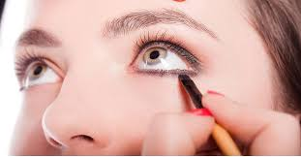
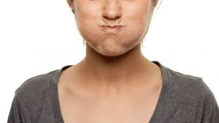
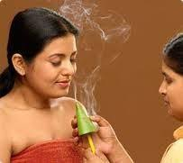
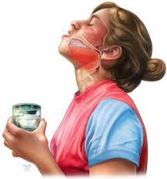
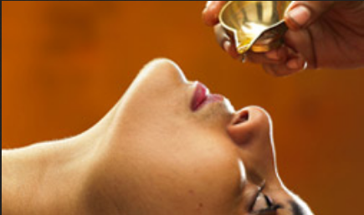
D
I
N
A
C
H
A
R
Y
A
DANTA DHAWANA
ANJANA
KAVALA
DHOOMAPANA
GANDHOOSHA
NASYA

Slide 5
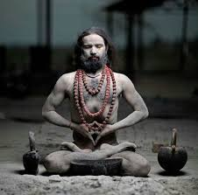
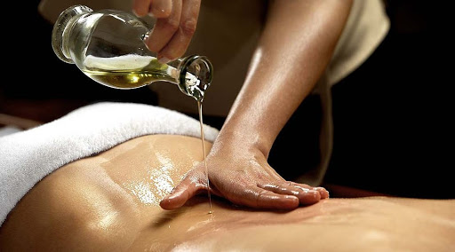
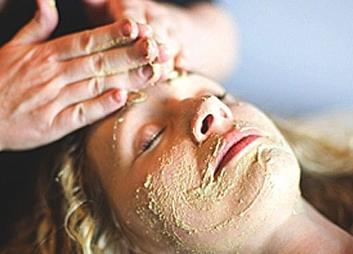
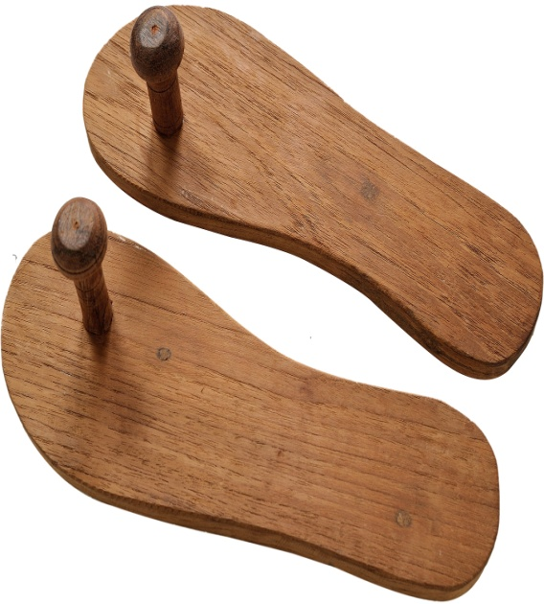
PROTECTIVE
ASPECTS

Slide 6
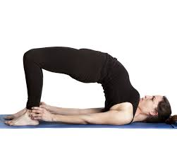
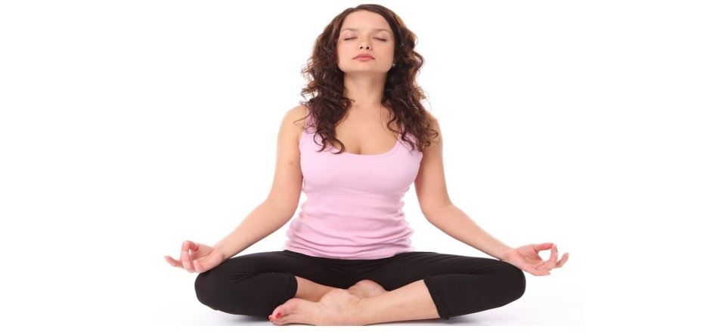
Y
O
G
A
JALA NETI
SETUBANDHASANA
KAPALABHATI
MARJARASANA
HASTA PADASANA
DHYANA

Slide 7
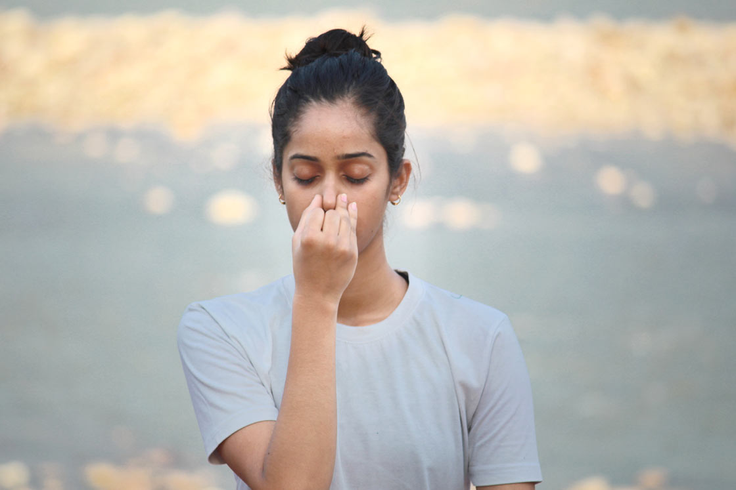
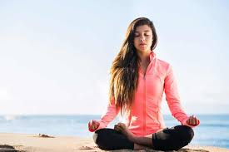
NADI SHUDDHI PRANAYAMA
SURYABHEDI PRANAYAMA
BHASTRIKA PRANAYAMA

Slide 9
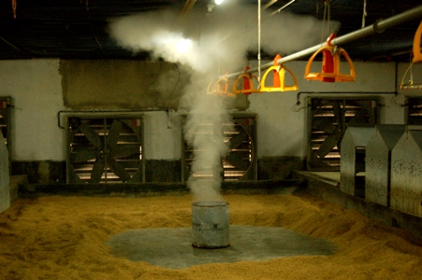
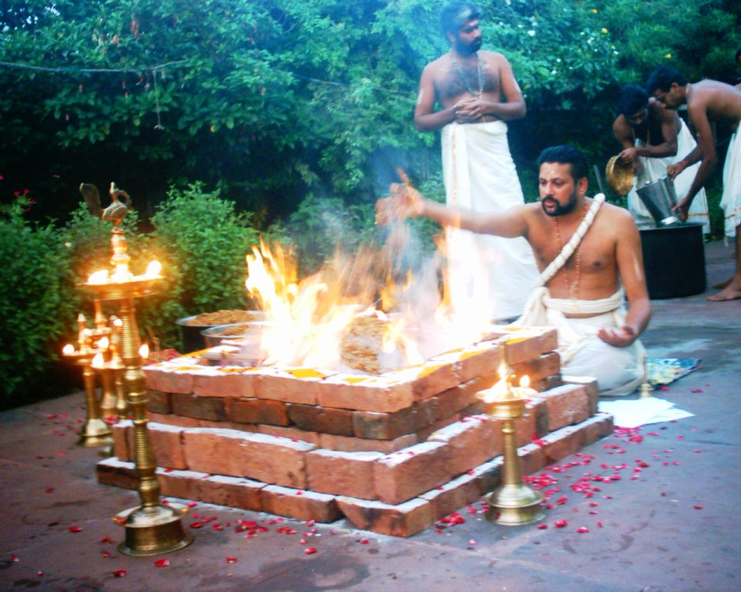
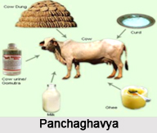
ALKALINE/ CITROUS JUICES
WEARING LEMON GARLAND
TRADITIONAL PREVANTIVE PRACTICE
HOUSE FUMIGATION
HOMA – HAVANA- YAGHNYA
PANCHAGHAVYA

Slide 10
REPLACEMENTS

Slide 11
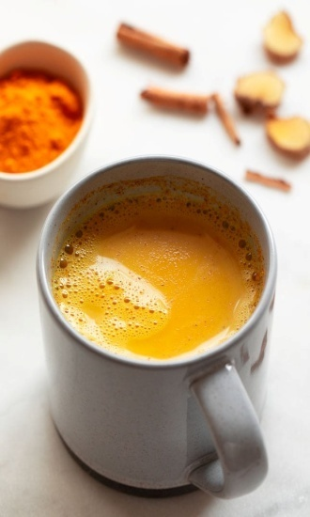
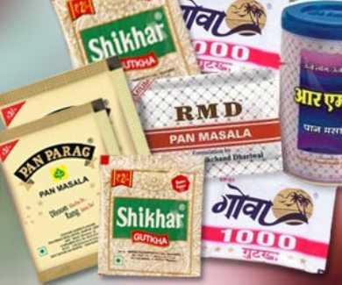
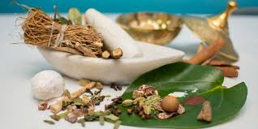
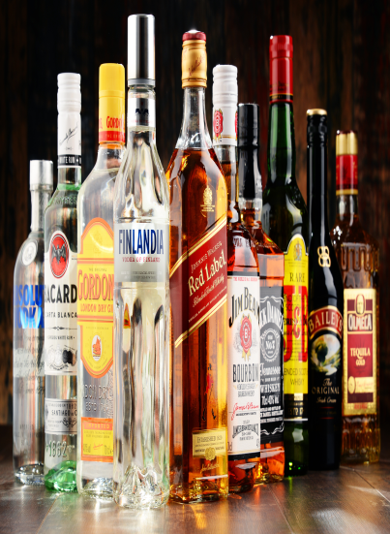
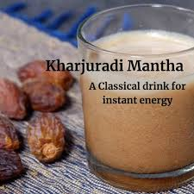
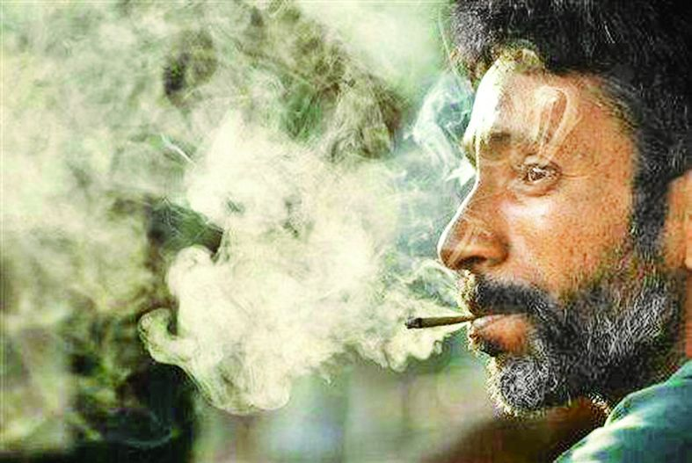
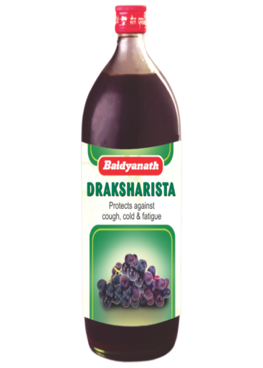
TOBACCO / GUTKA
TAMBOOLA
TEA / COFFEE
KASHAYAS
ALCOHOL
ARISHTA
SMOKING
MEDICATED DHUMAPANA

Slide 12
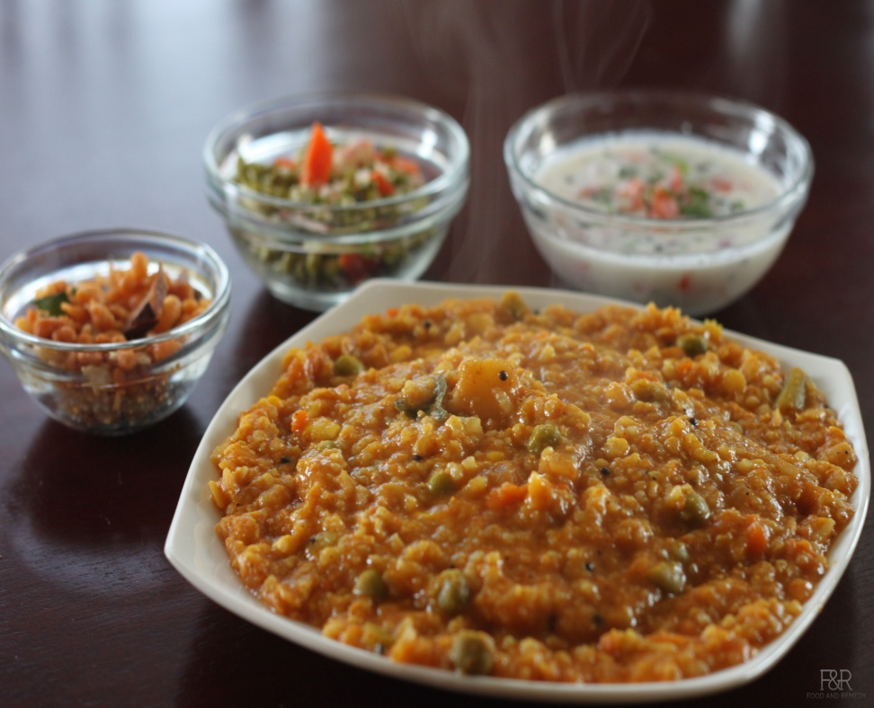
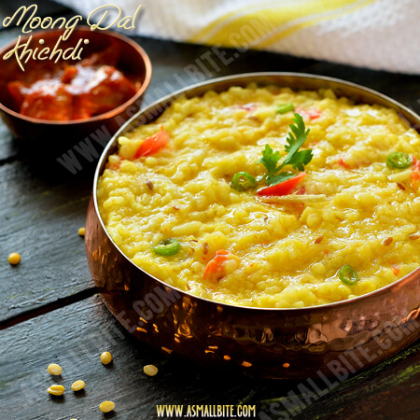
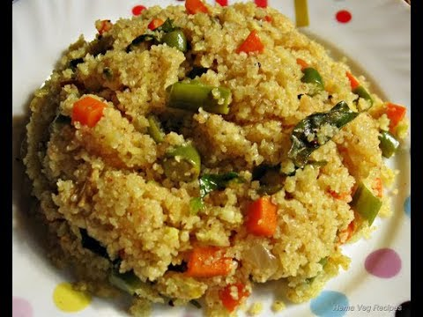
BISI BELE BATH
GANJI
DAAL KICHIDI
MASALA UPMA

Slide 13
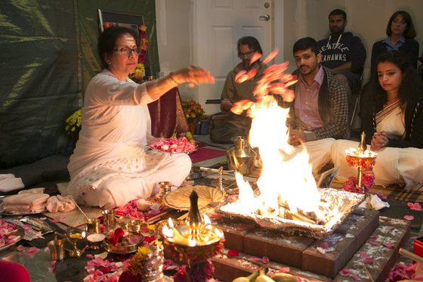
FUMIGATION
HOUSE
PUBLIC

Slide 14
PROTECTIVE MEDICAMENTS
HAND WASH & BODY LOTION
MADE UP OF
PUDINA
AJAMODA
KARPOORA VALLI
NIMBA
KARANJA ETC..

Slide 15
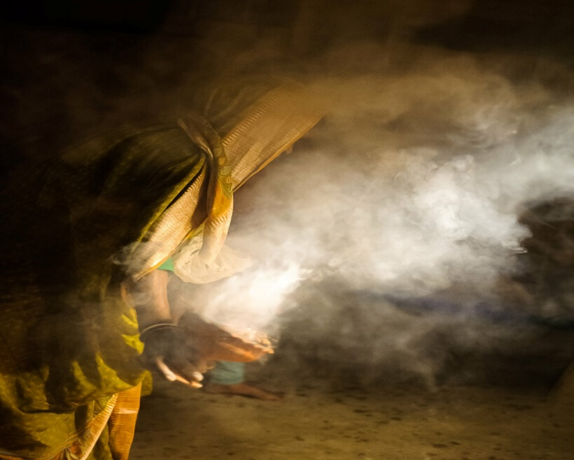
SNANA CHOORNA
MADE UP OF
SHIRISHA
TULASI
HARIDRA
VIDANGA
TAGARA
ELA
KUSHTA
SHWETHA SHARSHAPA ETC..
DHOOPANA
MADE UP OF
GUGGULU
SARSHAPA
JATAMANSI
SARJARASA
VIDANGA
NIMBA
DHARUHARIDRA
KHADIRA ETC..

Slide 16
TREATMENT
IMMUNO BOOSTER
CHAVANPRASH AVALEHA
AGASTYA HARITHAKI AVALEHA
VYAGHRI HARITHAKI AVALEHA
FOR ORAL HEALTH
USHNODHAKA PANA
ELADI GUTIKA
KHADIRADI VATI
TRIKATU WITH MADHU
YASTIMADHU WITH MADHU
KARPOORADI TAILA ETC..

Slide 17
FOR KASA
KANTAKARI
KASAMARDA
HARIDRAKHANDA
FOR JWARA
GUDUCHI
MUSTHA
SHUNTI
BHOOMIAMLAKKI
TULASI
JAYAMANGALA RASA
KASTHURABAIRAVA RASA
MRUTHUNJAYA RASA

