Slide 1
मासानुमासिक-गर्भ-वृद्धि:
Dr Manjula Vastrad
Asst Professor
Dept of Rachana Shareera
SMVVS RKM AMC VIJAYAPUR
Email : manjula.prasad2010@gmail.com

Slide 2
प्रथम मास
तत्र प्रथमे मासे कललं जायते । (अ.सं.शा २/७)
तत्र प्रथमे मासि कललं जायते ।(सु.सं.शा ३/१८)
स सर्वगुणवान् गर्भत्वमापन्नः प्रथमे मासि संमूर्च्छितः सर्वधातुकलुषीकृतः खेटभूतो भवति अव्यक्तविग्रहः सत असद्भूताङ्गावयवः॥ (च.सं शा ४/९)
अव्यक्तः प्रथमे मासि सप्ताहात् कलली भवेत् ॥ (अ.ह्र.शा १/३७)

Slide 3
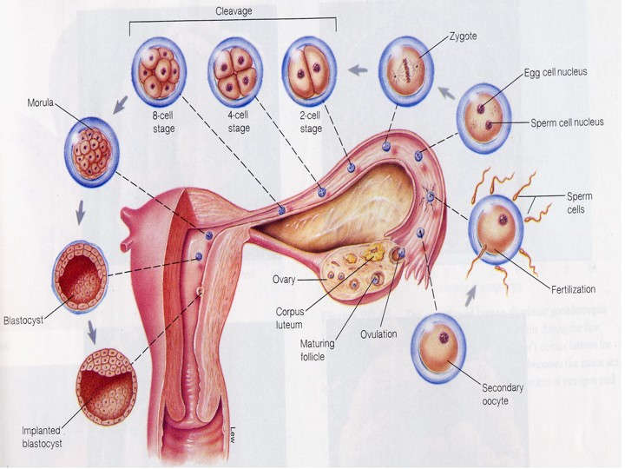
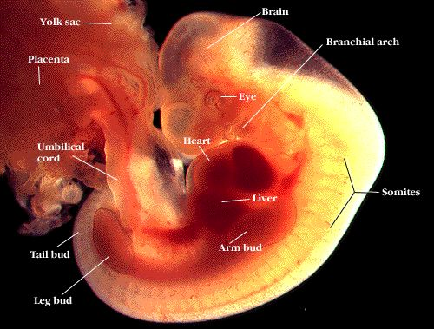
Harita –
1st day –कलल
10th day – बुद्बुद
15th day- घन solid mass
20th day – मांसपिंड mass of flesh
25th day – more conspicuous
Bhavamishra – dravibhuta.
Events include –
Day 1st –union of sperm & ovum to form 1cell smaller than grain salt.
Days 3-4 – zygote travels down the fallopian tube into uterus.
Days 5-9 – implantation of zygote & begins to draw the nourishment.
Day 10-14 – developing embryo signals its presence through chemicals & hormones, preventing mother from menstruating.
Day 20 – foundations of brain, spinal cord & nervous system
Day 21 – heart begins to beat.
Day 28 – back bone & muscles are forming arms, legs, eyes & ears begun to show.

Slide 4
द्वितीय मास
द्वितीये घनः पेश्यार्बुदं वा तेभ्यः क्रमात् पुंस्रीनपुंसकानि। (अ.सं.शा २/७)
द्वितीये शीतोष्म अनिलैः अभिप्रपच्यमानानां महाभूतानां सङ्घातो घनः सञ्जायते,यदि पिण्डःपुमान्, स्री चेत् पेशी, नपुंसकं चेत् अर्बुदमिति॥ ( सु.सं शा ३/१८)
द्वितीये मासि घनः संपद्यते पिण्ड: पेश्यर्बुदं वा ।
तत्र घन: पुरूषः, पेशी स्त्री, अर्बुदं नपुंसकम् ॥ (च.सं.शा ४/१०)
द्वितीये मासि कललात् घनः पेश्यथवा अर्बुदम् ।
पुंस्रीक्लीबाः क्रमात् तेभ्यः…………..॥ (अ.ह्र.शा १/४९-५०)

Slide 5
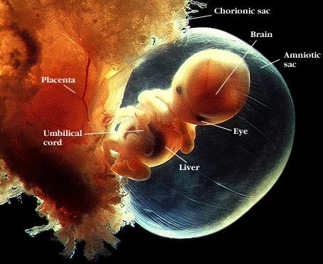
Harita –
by the beginning of 5th wk अन्कुर formed.
Modern view - 2nd month
All major organs and external body structures have begun to form.
Baby's heart beats with a regular rhythm.
The arms and legs grow longer, and fingers and toes have begun to form.
The sex organs begin to form.
The eyes have moved forward on the face and eyelids have formed.
The umbilical cord is clearly visible.
At the end of 8 weeks, baby is a fetus and looks more like a human.
Now baby is nearly 1 inch (2.5cm) long and weighs less than 1/8 of an ounce( 3-4gms).

Slide 6
तृतीय मास
तृतीये पञ्चधा प्ररोहति; तद्यथा- सक्थिनी बाहू शिरश्च ।
सक्थ्यादि प्ररोहैककालमेव च सर्वाङ्गावयवेन्द्रियाणि युगपत् सम्भवन्ति ॥ (अ.स.शा २/७)
तृतीये हस्त पाद शिरसां पञ्च पिण्डिका निवर्तन्ते अङ्ग प्रत्यङ्ग विभागश्च सूक्ष्मो भवन्ति ॥ (सु. सं शा ३/१८)
तृतीये मासि सर्वेन्द्रियाणि सर्वाङ्गावयवश्च यौगपद्येन अभिनिवर्तन्ते ॥ (च.सं शा ४/११)
मूर्धा द्वे सक्थिनी बाहु सर्वसूक्ष्माङ्गजन्मा च ।
सर्वमेव हि मूर्भाद्यैः ज्नानं सुखदुखयोः॥( अ.ह्र शा १/५४-५५)
तृतीये मासि युगपत् निवर्तन्ते यथा क्रमं ।
प्रस्पन्दते चेतयति वेदनाश्च अवबुद्ध्यते ॥
सूक्ष्म प्रव्यक्तकरण तृतीये तु मनो अधिकः॥( का.सं.शा २/४-५)

Slide 7
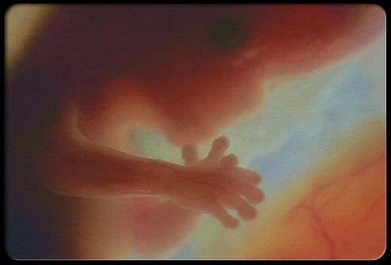
Modern view: 3rd month
The nerves and muscles begin to work together.
Baby can make a fist.
The external sex organs show if the baby is a boy or girl.
Eyelids close to protect the developing eyes.
They will not open again until the 28th week.
Head growth has slowed, and baby is much longer. Now, at about 3 inches (7.5cm) long, baby weighs almost an ounce (30gm).

Slide 8
चतुर्थ मास
चतुर्थे अङ्गप्रत्यङ्ग विभागः प्रव्यक्तो गर्भस्य स्थिरो भवति। (अ.स.शा २/१३)
चतुर्थे सर्वाङ्गप्रत्यङ्ग विभागः प्रव्यक्तो भवति, गर्भ ह्रदय प्रव्यक्त भावात् चेतना धातुः अभिव्यक्तो भवति; कस्मात् तत् स्थानत्वात् तस्मत्त् गर्भ चतुर्थे मस्यभिप्रायमिन्द्रियर्थेशु करोति द्विह्र्दया च नरि दौह्र्दिनिमचक्शते ॥ (सु.सं शा ३/१८)
चतुर्थे मासि स्थिरत्वं आपद्यते गर्भः। (च.सं शा.४/२०)
चतुर्थे ओयक्तता अङ्गानां………….। (अ.ह्र शा १/४७)
चतुर्थे स्थिरतां याति गर्भाः कुक्षौ निरामयाः। ( का.सं शा २/४)

Slide 9
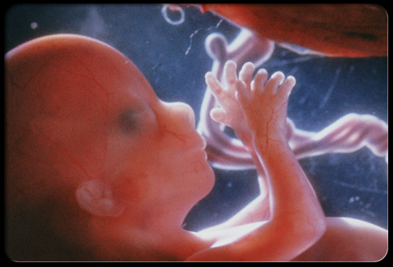
Harita –
Sara – shiratva & Loma sambhava
Modern view : 4th month
Muscle tissue and bone continue to form, creating a more complete skeleton.
Skin begins to form.
Meconium develops in the baby's intestinal tract.
This will be the baby's first bowel movement.
Baby makes sucking motions with the mouth (sucking reflex).
Baby reaches a length of about 4 to 5 inches( 10-12.5cm) and weighs almost 3 ounces (90gm).

Slide 10
पञ्चमे मास
पञ्चमे मनः प्रतिबुद्धतरं भवति मांसशूणित उपचयश्च। (अ.सं शा २/१३)
पञ्चमे मनः प्रतिबुद्धतरं भवति॥ ( सु. सं शा. ३/३०)
पञ्चमे मासि गर्भस्य मांसशोणितोपचयो भवत्यधिकं अन्येभ्यो मासेभ्यः तस्मत् तद गर्भिनि कश्यामपद्यते विशेशन॥ ( च. सं शा ४/२१)
…………………..चेतनाश्च पञ्चमे॥ (अ. ह्र शा १/५७)
मांसशोणितव्रुद्धिस्तु पञ्चमि मासि जीवक॥ (का. सं शा २/६)

Slide 11
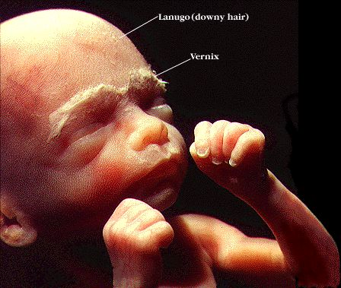
Harita - fetus becomes more sujeeva
Modern view: 5th month
Sensual perception
Perception of sound & touch develops
Baby is more active, might feel slight movement, (quickening)
Baby is covered by fine, downy hair called lanugo and a waxy coating called vernix. This protects the forming skin underneath.
Eyebrows, eyelashes, fingernails, and toenails have formed
Baby can hear & starts recognizing voice.
gets startled by loud noise
Baby is about 6 inches (15cm) long and weighs about 9 ounces(255gm).

Slide 12
षष्टेमास
षष्टे केश रोम नख अस्थि स्नाय्वादि अन्य अभिव्यक्तानि बल वर्ण उपचयश्च। (अ.सं शा २/१३)
षष्टे बुद्धिः॥ (सु सं.शा ३/३०)
षष्टि मासि गर्भस्य बलवर्ण उपचयो भवत्यधिकं अन्येभ्यो मासेभ्यः॥ (च.सं शा ४/२२)
षष्टे स्नायु सिरा रोम बल वर्ण नख त्वचाम्॥
(अ.ह्रु शा १/४७)
बल वर्ण ओजसां व्रुद्धिः षष्टे………………………….॥
(का.सं शा २/७)

Slide 13
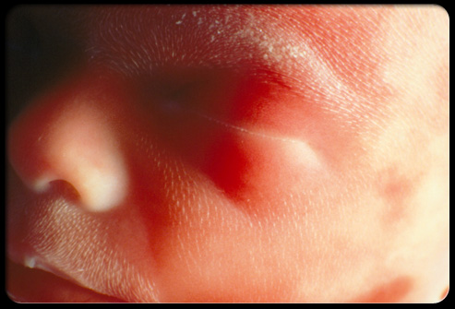
Modern view. 6th month
Skin of fetus is reddish and has a wrinkled appearance.
Neuron begins to develop, establish synaptic connections.
Eyebrows and eyelids are visible.
Bone marrow begins to make blood cells.
Taste buds form on baby's tongue.
Footprints and fingerprints have formed.
The lungs are formed, but do not work.
Baby sleeps and wakes regularly.
If baby is a boy, his testicles begin to move from the abdomen into the scrotum. If baby is a girl, her uterus and ovaries are in place, and a lifetime supply of eggs have formed in the ovaries.
Baby stores fat and has gained quite a bit of weight. Now at about 12 inches (30cm) long, baby weighs about 1½ pounds ( 680gms).

Slide 14
सप्तममास
सप्तमे सर्वाङ्ग सम्पूर्णता। (अ.सं शा २ /१३)
सप्तमे सर्वाङ्ग प्रत्यङ्ग विभागः प्रव्यक्ततरः॥
( सु सं शा ३/३०)
सप्तमे मासि गर्भः सर्वैः भावः आप्याय्यते तस्मात्तदा गर्भिणी सर्वाकारै क्लान्ततमा भवति॥( च सं शा ४/२३)
सर्वे सर्वाङग सम्पूर्णो भावैः पुष्यति सप्तमे॥(अ.ह्रु शा १/५८)
सर्व धात्वाङ्ग सम्पूर्णो वातपित्त कफान्विता: ।
सप्तमे मासि…………………………………………………॥
(का.सं शा २/८)

Slide 15
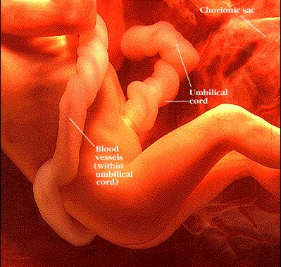
Mondern view : 7th month
Baby weighs about 2 kg and is about 30–38 cm long.
Storing the fat on the body.
Rhythmic breathing movements occur, but lungs are not fully mature.
Thalamic brain connections, which mediate sensory input, form.
Bones are fully developed, but are still soft and pliable.
The fetus begins storing iron, calcium, and phosphorus.
His body is well-formed.
Fingernails cover his fingertips
Fetus can survive with the assistance of medical technology.

Slide 16
अष्टमे मास
अष्टमे अस्थिरी भवेत् ओजः, जातश्चेत्र जीव निरोजस्त्वात् नैरुतभागत्वात् च॥ (सु.सं शा ३/३०)
ओजो अष्टमे संचरति माता पुत्रौ महुः क्रमात्।
तेन तौ म्लानमुदितौ तत्र जातो न जीवति।
शिशुरोजो अनवस्थानात् नारी संशयिता भवेत्॥( अ. ह्र् शा १/६२-६३)
अष्टमे मासि गर्भश्च मातृतो गर्भतश्च माता रसहारिणिभिः संवाहिनिभि: मुहुर्मुहुः ओजः परस्परत आददाते गर्भस्य असम्पूर्णत्वात्। तस्मात् तदा गर्भिणी मुहुर्मुहुर्मुदा युक्ता भवति मुहुर्मुह्र्श्च म्लान,तथा गर्भ:; तस्मात् तदा गर्भस्य जन्म ओयापत्तिं उद्भवुत् ओजसो अनवस्थितत्वात्। तं चैवार्थं अभिसमीक्ष्य अष्टमं मासमगण्यं इत्याचक्षते कुशलाः। (च सं शा ४/२४)

Slide 17
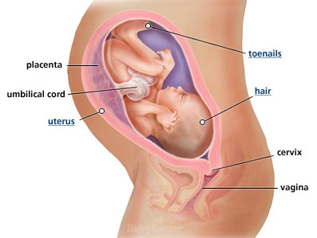
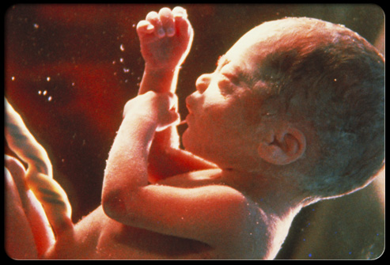
Modern view: 8th month
Baby's bones are fully formed, but still soft.
Baby's kicks and jabs are forceful.
The eyes can open and close and sense changes in light.
Lungs are not fully formed, but practice "breathing" movements occur.
Baby's body begins to store vital minerals, such as iron and calcium.
Lanugo begins to fall off.
Baby is gaining weight quickly, about ½ pound ( 226gm) a week. Now, baby is about 38-43 cm long and weighs about 1816gms.

Slide 18
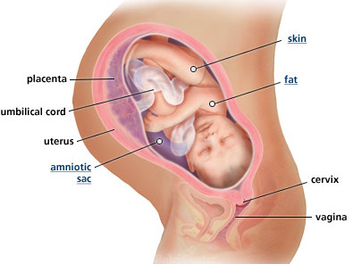
9th month
Baby is about 16 to 19 inches long and weighs about 2.5 – 3 kg
The protective waxy coating called vernix gets thicker.
Body fat increases.
Fetus begins to gain wt more rapidly.
Lanugo begins to disappear.
Finger nails reach the end of the finger tips.
A baby born at 9th month has a high chance of survival.

Slide 19
Thank you

