Slide 1
RESPIRATORY SYSTEM
Vd. Mrinal N Rudragoudar
Asst Professor Dept Of Kriya Sharir
SMVVS RKM AMC & RESEARCH CENTER
Email-drmnr1991@gmail.com
Mobile -9036632670

Slide 2
Introduction
Respiration is a phenomenon in which air moves in and out through respiratory tract.
Normal adult RR 12-16/min.
Respiration types: external( between lungs & blood), internal( between blood & tissues ).
Phases of respiration: inspiration & expiration

Slide 3
Respiratory tract

Slide 4
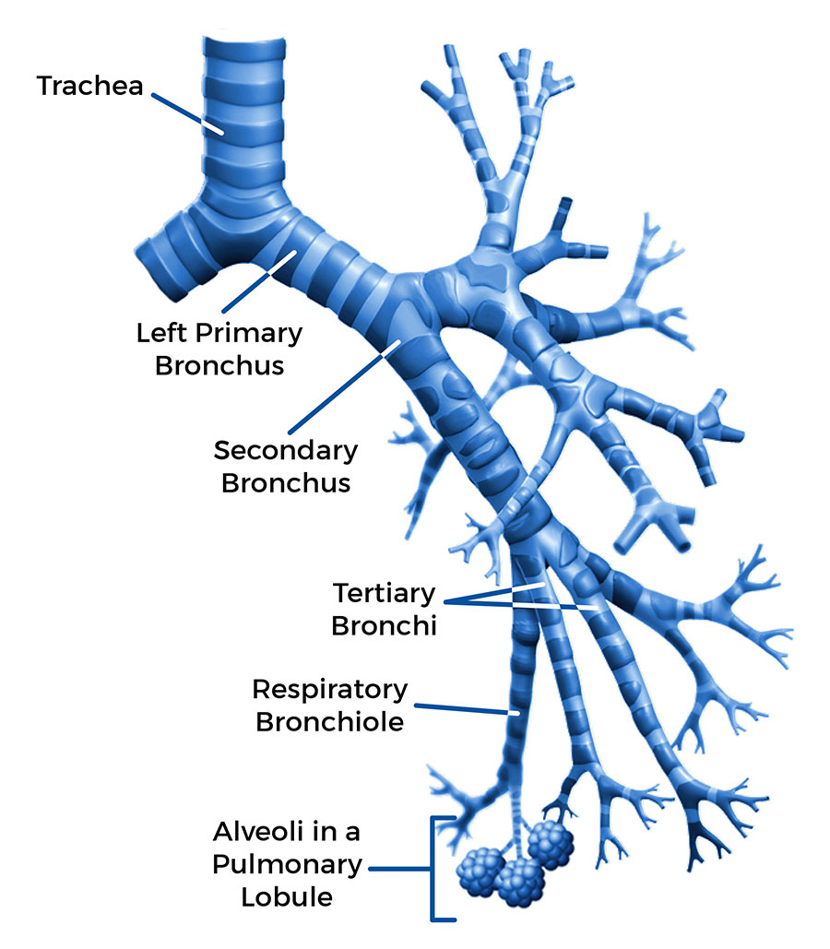
Tracheobronchial Tree.

Slide 5
Pleura

Slide 6
Upper & Lower RT

Slide 7
Respiratory Unit

Slide 9
Respiratory Membrane

Slide 10
Non Respiratory Function
Olfaction
Vocalization
Prevention of dust particles
Defenses mechanism

Slide 11
Ctd….
Maintenances of water balance
Regulation of body temperature
Regulation of acid base balance
Anticoagulant function
Secretion of ACE
Synthesis of hormones

Slide 12
Respiratory protective reflex
Cough reflex
Sneezing reflex
Swallowing reflex

