Slide 1
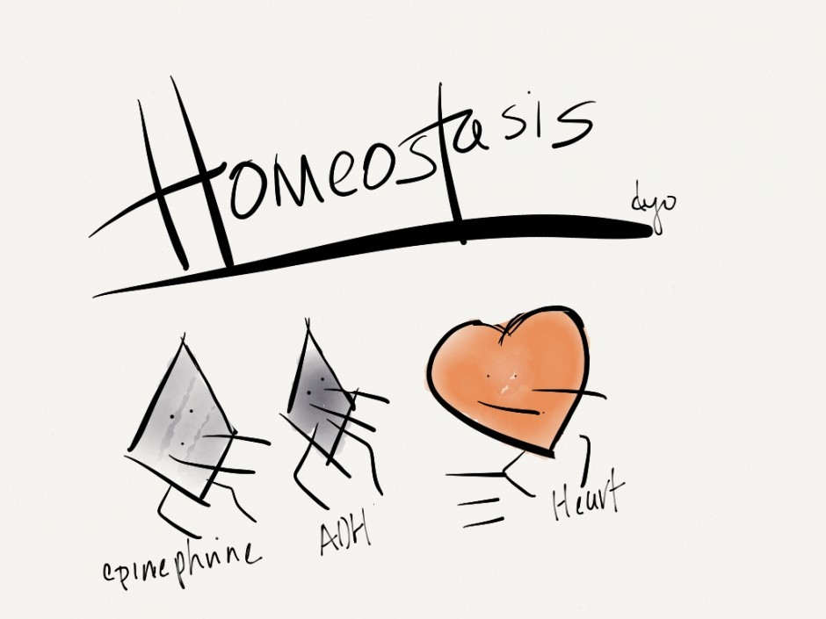
Vd. Mrinal N Rudragoudar
Asst Professor Dept Of Kriya Sharir
SMVVS RKM AMCH & RESEARCH CENTER
Email-drmnr1991@gmail.com
Mobile -9036632670
Notes:
Both the adreline and ADH both acts as the one which wl combinely have effects on the heart

Slide 2
It refers to constant internal environment.
Internal environment refers to ECF.it contains mainly nutrients, ions and all substances necessary for survival of cells.
The word HOMEOSTASIS was introduced by Harvard Professor WALTER B CANNON in 1930.

Slide 3
HOMEOSTASIS
Homeo = same
Stasis = Standing

Slide 4
Components Of Homeostasis
Normal
Deviation
Sensor
Control centers
Effector
Correction
Information may be an electrical process i.e impulses or chemical process i.e hormones through blood and body fluids.

Slide 5
Mechanism
Homeostasis is achieved my feedback signals.
Feedback is process in which some proportion of output signals of a system is given.
Negative feedback
Positive feedback

Slide 6
Negative feedback
It is the one to which the system reacts in such a way as to arrest the changes or reverse the direction of changes.
Negative feedback signals will be generated.
Homeostasis will be maintained.
Examples as maintenance of water balance, body temperature .

Slide 8
Positive Feedback
It is one to which the system reacts in such a way as to increase the intensity of the changes in same directions.
It is less common than negative feedback.
It has its own significances during emergency.

Slide 11
Role of various systems in homeostasis
Respiratory system
Skin
Kidney
Glands
GIT
CNS
Blood etc…..

