Slide 2
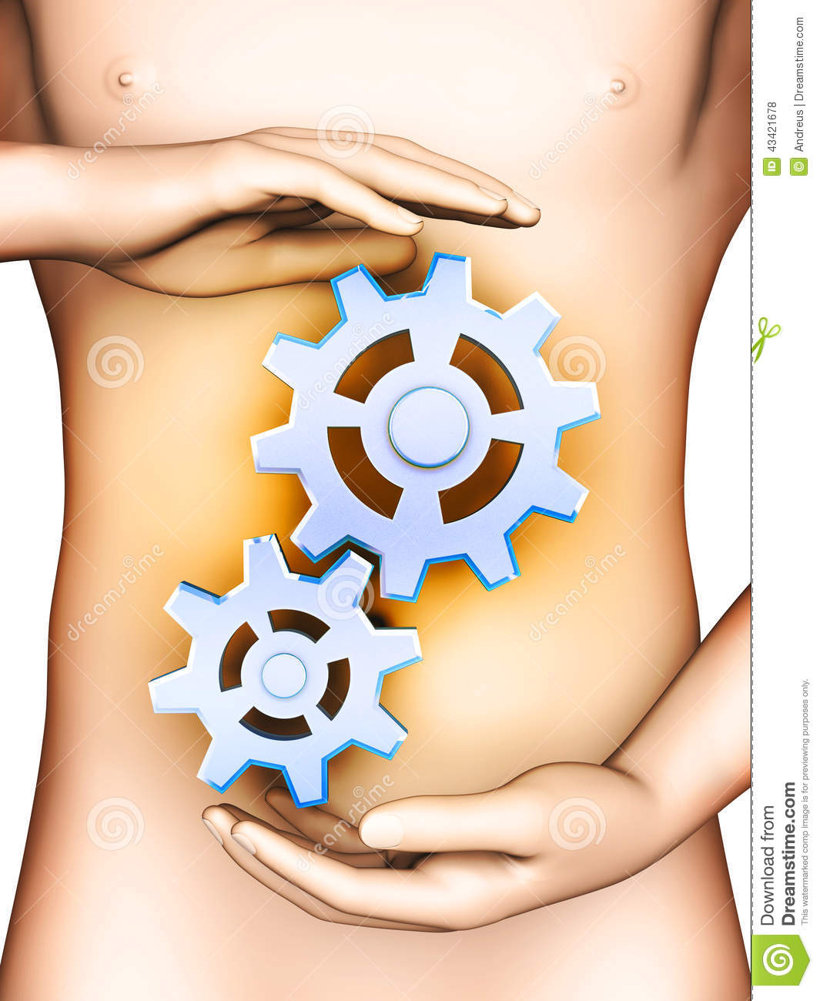
Notes:
By seeing this image we can come to known that today we r discussing about the mechanism which is related to the git ….so the topic of presentation is

Slide 3
THE PROCESS OF AHARA PAKA AND DIGESTION
Vd. Mrinal N Rudragoudar
Asst Professor Dept Of Kriya Sharir
SMVVS RKM AMCH & RESEARCH CENTER
Email-drmnr1991@gmail.com
Mobile -9036632670

Slide 4
CONTENTS
Introduction
Factors responsible for Paka
Digestion
Discussion
Conclusion

Slide 5
INTRODUCTION
Ahara is one of the three significant pillars of Ayurveda.
According to Ayurveda "Sarvam dravyam Panchabhautikam" i.e all creation arises out of five great elements known as Mahabhutas.
In this Pancabautika Sharira various Paka (metabolic transformations) are going on continuously.

Slide 6
Cotn..
Paka is digestion of ingested food materials. It involves changing from structure and taste .
Agni is a key factor in transformation of consumed Ahara.
Digestion involves the breakdown of food into smaller and smaller components, until they can be absorbed and assimilated into the body.
Notes:
Paka =pakaha pachanam dravyanam swarupa rsayo paravritthi (ch su 25)

Slide 7
Aahara To Be Consumed
तत्र पाञ्चभौतिकस्य चतुर्विधस्य षड्रसस्य ^{[२]} द्विविधवीर्यस्याष्टविधवीर्यस्य वाऽनेकगुणस्योपयुक्तस्याहारस्य सम्यक्परिणतस्य यस्तेजोभूतः सारः परमसूक्ष्मः स `रसः’ इत्युच्यते||
Su su 14/3
Notes:
Before moving to ahara paka krama …let us know what type of ahara should be consumed

Slide 8
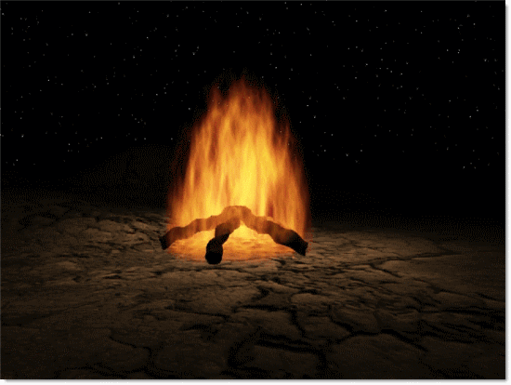
AHARA
4
5
6
2/8
∞
Notes:
Rasa- Pure, minute essence of well digested ingested food.
Formed from 4 types of food composed of Five Mahabhutas, 6 tastes, 2/8 Viryas(Sheeta- Ushna; Snigdha- Ruksha; Vishada- Pichhila; Mridu- Teekshna) and many properties.

Slide 9
Paka krama
अन्नमादानकर्मा तु प्राणः कोष्ठं प्रकर्षति| तद्द्रवैर्भिन्नसङ्घातं स्नेहेन मृदुतां गतम्||६|| समानेनावधूतोऽग्निरुदर्यः पवनोद्वहः| काले भुक्तं समं सम्यक् पचत्यायुर्विवृद्धये||७|| एवं रसमलायान्नमाशयस्थमधः स्थितः| पचत्यग्निर्यथा स्थाल्यामोदनायाम्बुतण्डुलम्||८|| ch.ci 15/6-8

Slide 10
Paka krama
Anna
Praana vayu
Amashaya
Kledakha kapha
Kledatha of the anna
Samana vayu
Grahani
Pachaka pitta
Ahara pachana
Notes:
shl0ka

Slide 11
FACTORS RESPONSIBLE FOR PAKA
Doshas
Agni
Kalaa
Parinamakara bahavas
Srotas

Slide 12
FACTORS RESPONSIBLE FOR PAKA
DOSHAS
Vata dosha : Prana , Samana and Apana
Pitta dosha : Pachaka
Kapha dosha: Bodaka and Kledaka

Slide 13
Agni
Jataragni
Bhutagni(5)
Dhatvagni(7)
Notes:
Due to its sukskma , teeksha , sara guna it helps the food gets digested easily

Slide 14
kala
Pittadhara kala
This Kala holds the food that passes down from Amashaya and above the Pakawashaya, till it is completely digested by the Pachakapitta.
It holds all four types of foods.

Slide 15
Cont…..
This kala can also be considered as Grahani because of its 1) Apakwa Ahara Dharana
2) Pakwa Visarjana
Notes:
1 it helps in retension of indigestrd ahara
2 Further processing , absorbition , excrestion

Slide 16
Parinamakara bavas
Ushma – digests
Vayu – movement of food
Kleda – converts food into small particles
Kaala – allows the food to properly digested and absorbed
Sneha – makes the food soft and slimy
Samayoga – brings about daathu samya
Notes:
Factors responsible for digestion:
Ushma pachati
Vayurapakarshathi
Kledah saithilya maapadayathi
Kalah paryapti mabhi nirvarthayati
Sneho mardhavamjanayathi
Samyogastwesham dhatusamya karah sampadyate

Slide 17
Rice – Food
Placing Rice In The Vessel – Swallowing
Vessel – Stomach
Water In The Vessel – Kledhaka Kapha
Stove – Pachaka Pitta
Blower - Udana+samana Vatas

Slide 18
Srotas
अन्नवहानां स्रोतसामामाशयो मूलं वामं च पार्श्वं
Ch vi 5/7
Moola sthana of Annavaha srotas is Amashaya.
Location of amashaya is in between umbalicus and breast.
Notes:
नाभिस्तनान्तरं जन्तोरामाशय इति स्मृतः| अशितं खादितं पीतं लीढं चात्र विपच्यते||१७| ch vi 2/27

Slide 19
Notes:
So till now we studied about what type of ahara should br consumed , its paka kraka n factors responsible for it

Slide 20
Digestion
Digestion is defined as the process by which food is broken down into simple chemical substances that can be absorbed and used as nutrients by the body.

Slide 21
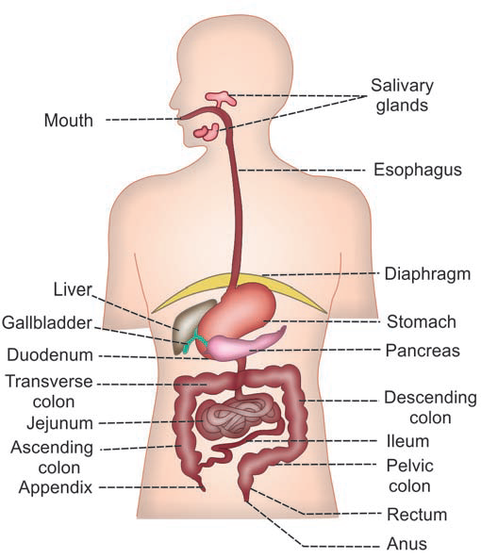
GI Tract Is Formed By Two Types Of Organs
1. Primary digestive
organs.
2. Accessory digestive organs.
Notes:
Primary organs =
i. Mouth
ii. Pharynx
iii. Esophagus
iv. Stomach
Small intestine
vi. Large intestine.
Teeth
ii. Tongue
iii. Salivary glands
iv. Exocrine part of pancreas
v. Liver
vi. Gallbladder.

Slide 22
The Functions Of Digestive System Include:
Ingestion or consumption of food substances
Breaking them into small particles
Transport of small particles to different areas of the digestive tract
Secretion of necessary enzymes and other substances for digestion

Slide 23
Cont…
Digestion of the food particles
Absorption of the digestive products (nutrients).
Removal of unwanted substances from the body.

Slide 24
WALL OF GASTROINTESTINAL TRACT
In general, wall of the GI tract is formed by four layers which are from inside out:
Mucus layer
Sub mucus layer
Muscular layer
Serous or fibrous layer

Slide 25
NERVE SUPPLY TO GASTROINTESTINAL TRACT
GI tract has two types of nerve supply:
Intrinsic nerve supply
Extrinsic nerve supply
Notes:
1. Auerbach plexus :Auerbach plexus is also known as myenteric nerve
plexus. It is present in between the inner circular muscle
layer and the outer longitudinal muscle laye
2. Meissner plexus:Meissner plexus is otherwise called submucus nerve
plexus. It is situated in between the muscular layer and
submucosal layer of GI tract.

Slide 26
Digestion
Mouth – ingestion of food; chewing (mastication) & swallowing
Bolus – portion of food swallowed at one time
2. Saliva - water, salts, enzymes,mucus secreted by salivary glands :
a. Moisten food & aids swallowing
b. Begins carbohydrate digestion

Slide 27
Secretions of Digestion

Slide 28
Digestion
Esophagus – connects mouth to stomach
1. Epiglottis – closes airway
2. Bolus moved along by peristalsis
3. Cardiac sphincter – keeps food from backing up into esophagus

Slide 29
Digestion
Stomach – collecting & churning
1. Gastric glands secrete: gastric juice (water, enzymes,hydrochloric acid) that kills most bacteria and begins protein digestion and mucus to protect lining.
2. Chyme – semi-liquid mass of partially digested food
3. Pyloric sphincter – regulates passage of chyme into small intestine

Slide 30
Digestion
Small Intestine – 3 segments:
1. Duodenum – opening from common bile duct
secretes fluids from:
a. Liver & Gallbladder – bile emulsifies fat
b. Pancreas – amylase break down
carbohydrate, sodium bicarbonate
neutralizes the acidic chyme and lipase
2. Jejunum
3. Ileum
a. Ileocecal valve – sphincter that regulates
passage of chyme into large intestine

Slide 31
Digestion
Large intestine (colon) - reabsorbing & eliminating
1. Fermentation of undigested residues by bacteria occurs.
2. Terminates at rectum, where water some minerals are absorbed.
3. Anus – sphincter that controls defecation (excretion of fiber residue, wastes and some water)

Slide 32
The Final Stage

Slide 33
Digestion
Muscular action helps to propel liquefied food through the G.I. tract by:
1. Peristalsis – muscular contractions that push contents forward
2. Segmentation – inward squeezing for greater mixing of secretions
3. Sphincter contractions

Slide 34
Peristalsis

Slide 35
Segmentation

Slide 36
Sphincter Contractions

Slide 37
Applied Aspects
Aadhmaana- Distenstion Of Abdomen
Arochaka- Anorexia
Shula-pain In Abdomen
Anna Dwesha- Aversion Towards Food
Chardhi-vomiting
Pipasa- thirst
Aandhya-blindness
Maranam - death
Notes:
Some are immediate response and some are later …ch su ..arsha, pureesha vaha srotas diseases
Sharangadhara comment

Slide 38
Discussion
The Aahara Paka Krama takes place in Annavaha Srotas.
In the same way the digestion takes place in gastro intestinal tract .
Here Ahara Paka Referes as breakdown of Aahara taken
Digestion also refers the same as break down of food taken into micro substances that they can be absorbed .

Slide 39
VATA DOSHA AS MOVEMENTS
The Gati of Aahara in Aahara Paka Krama is governed by Prana, Samaana, Apana Vayu.
On the other hand the movements of food in the GIT governed by enteric nervous system , deglutition & defecation reflex's.

Slide 40
Pitta dosha as enzymes/secretions
The pachana of consumed aahara is taken by paachaka pitta and pitta dhara kala .
On the other hand the digestion of consumed food is taken by enzymes

Slide 41
Kapha dosha as mucus membarane
Aahara gets kledatha due to kapha .
In the same way the food gets moistening by mucus.
And gets breakdown easily.

Slide 42
The functions of Samana Vata is said to be Grahana, Pachana, Vivechana, Munchana of the ingested food.
The myenteric plexus, or plexus of Auerbach, is located between the longitudinal and circular smooth muscle layers of the muscularis, this plexus controls GI tract motility, particularly the frequency and strength of contraction.

Slide 43
Agni converts food in the form of energy, which is responsible for all the vital
functions of our body.
Agni is the invariable agent in the process of ahara paka (metabolic transformations).
Agni means it is a substance responsible for digestion and metabolism
Ayurveda signifies its relevance with modern physiology of digestion and metabolism

Slide 44
To conclude
The aahara paka krama is nothing but the digestion of food .
Ahara paka mainly depends on agni, doshas,kalaa ,parinamakara bahavas and srotas.
Hences the factors responsible for aahara paka and the factors responsible for digestion can be related to each other.

Slide 45
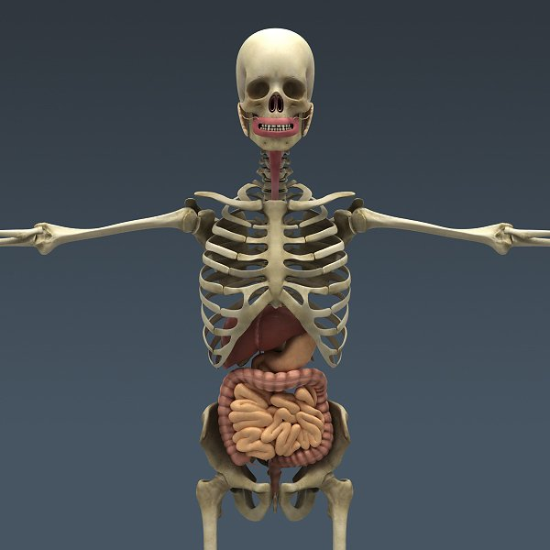
Decide what u wan to B

