Slide 1
VISUAL PATHWAY Dr. A M Madni Associate professor Dept of Shalakya Tantra SMVVS RKM AMC, H & PG RC Vijayapur

Slide 2
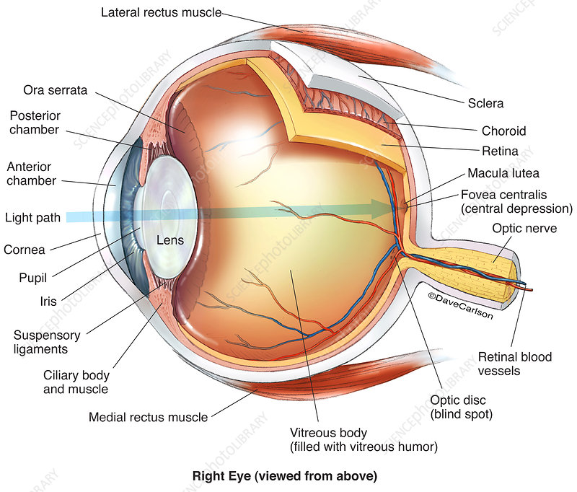
Eye

Slide 3
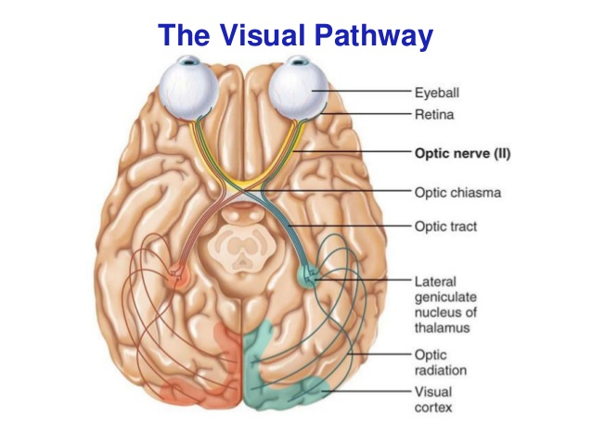
Visual Pathway
Components:
A. Retina
B. Optic nerve
C. Optic chiasma.
C. Optic tract
D. Lateral geniculate body
E. Optic radiations
F. Visual cortex

Slide 4
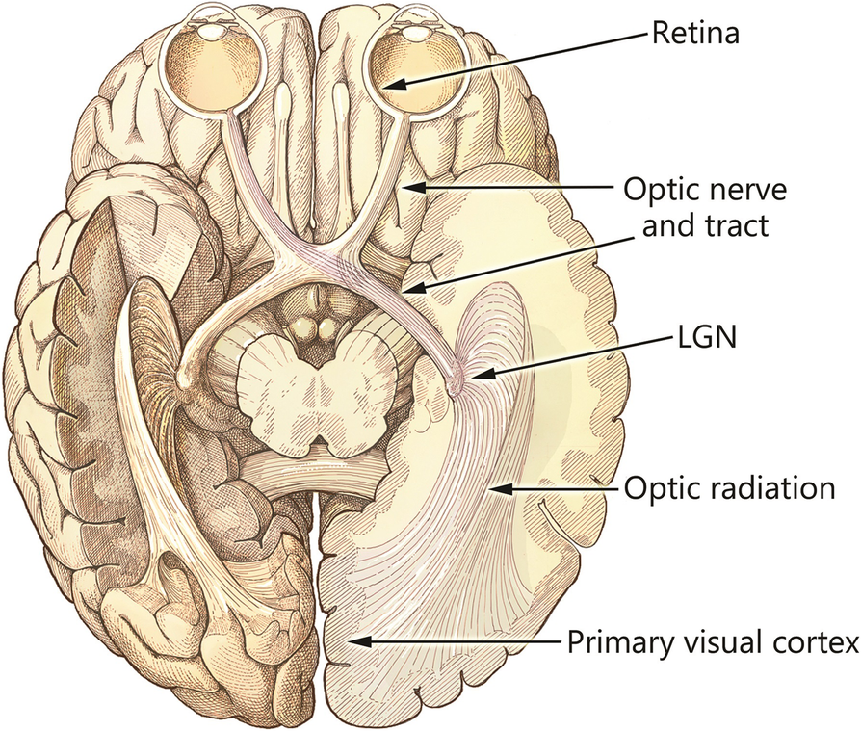
Optic Nerve
The optic nerve begins anatomically at the optic disc but physiologically and functionally within the ganglion cell layer that covers the entire retina
Optic chiasma
The optic chiasm measures approximately 12 mm wide, 8 mm long in the anteroposterior direction, and 4 mm thick.
Within the chiasm, the fibers coming from the nasal retina (approximately 53% of total fibers) cross to the opposite side to join the corresponding contralateral fibers.

Slide 5
Lateral Geniculate Body:
Lateral Geniculate Body or Nucleus
The LGN is a peaked, mushroom-shaped structure that is divided into 6 levels
Axons originating in the contralateral eye terminate in layers 1, 4, and 6; the ipsilateral fibers innervate 2, 3, and 5.

Slide 6
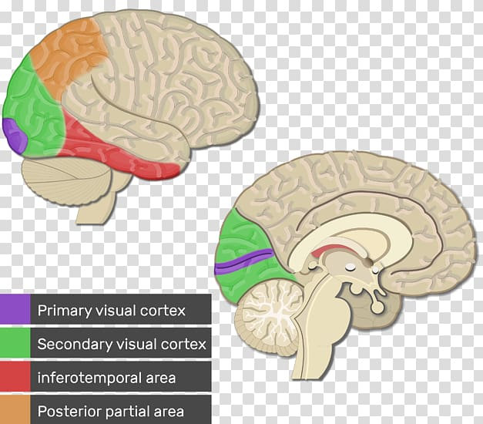
Optic Radiation:
Following a synapse in the LGN, the axons travel posteriorly as the optic radiations to terminate in the primary visual (calcarine) cortex in the occipital lobe
Visual Cortex
The visual cortex, the thinnest area of the human cerebral cortex.
It occupies the superior and inferior lips of the calcarine fissure.

Slide 7
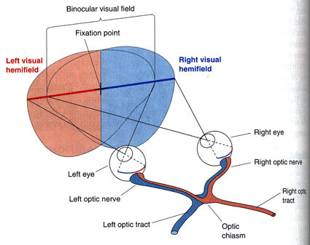
Visual field
Definition:
The visual field refers to the total area in which objects can be seen in the side (peripheral) vision as you focus your eyes on a central point.

Slide 8
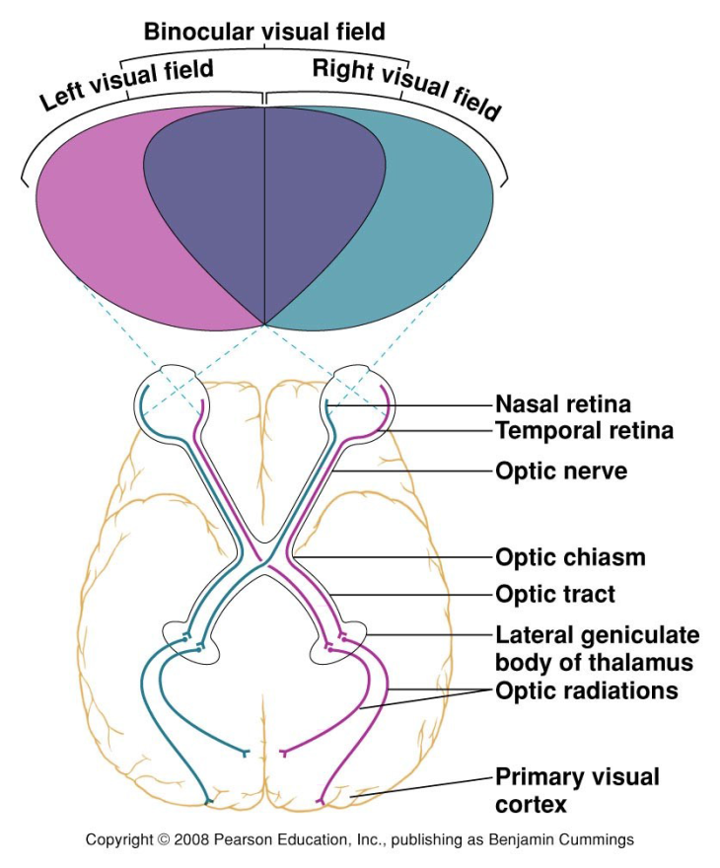
Physiology

Slide 9
Lesions

Slide 10
THANK YOU

