Slide 1
Astanga Hridaya Sutrasthana 10th Chapter Rasabhediya Adhyaya
By,
Dr. Pushpa A. Biradar
Assistant Professor
Department of Samhita Siddhanta
RKM Ayurvedic Medical College
Vijayapur - 586101

Slide 6
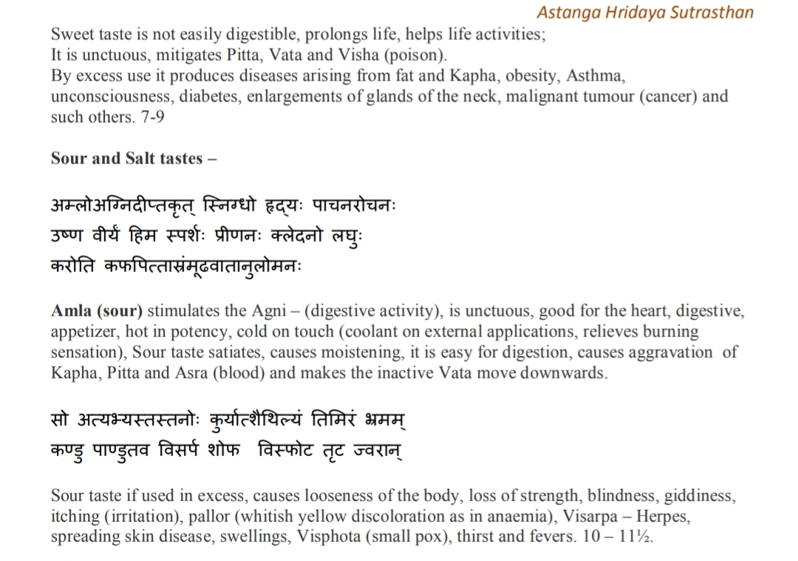

Slide 11
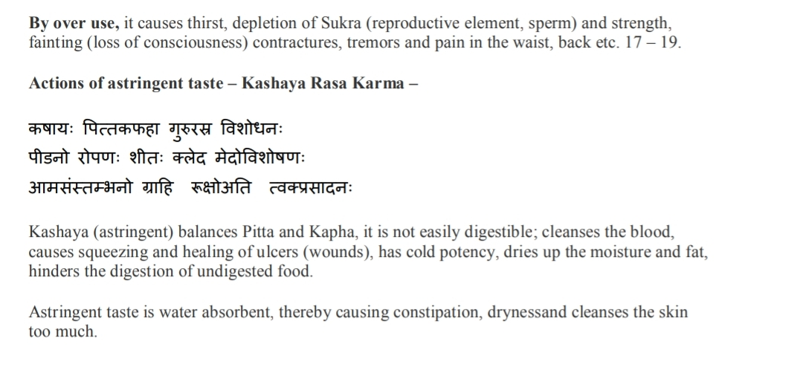

Slide 15
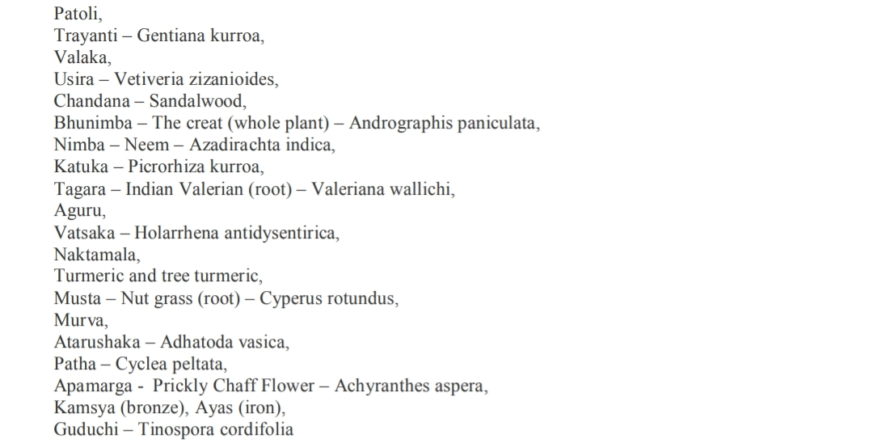

Slide 24
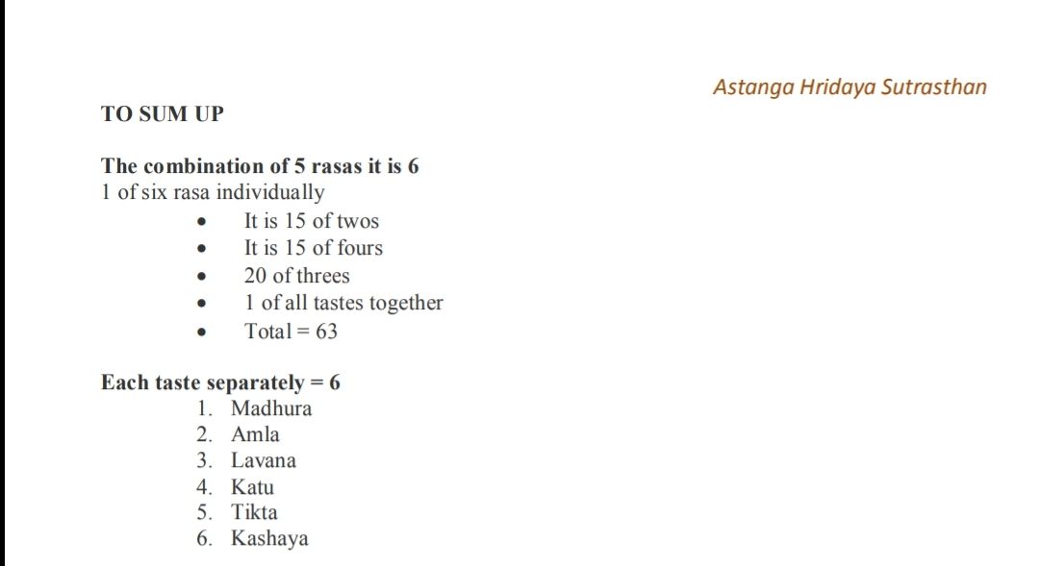

Slide 25
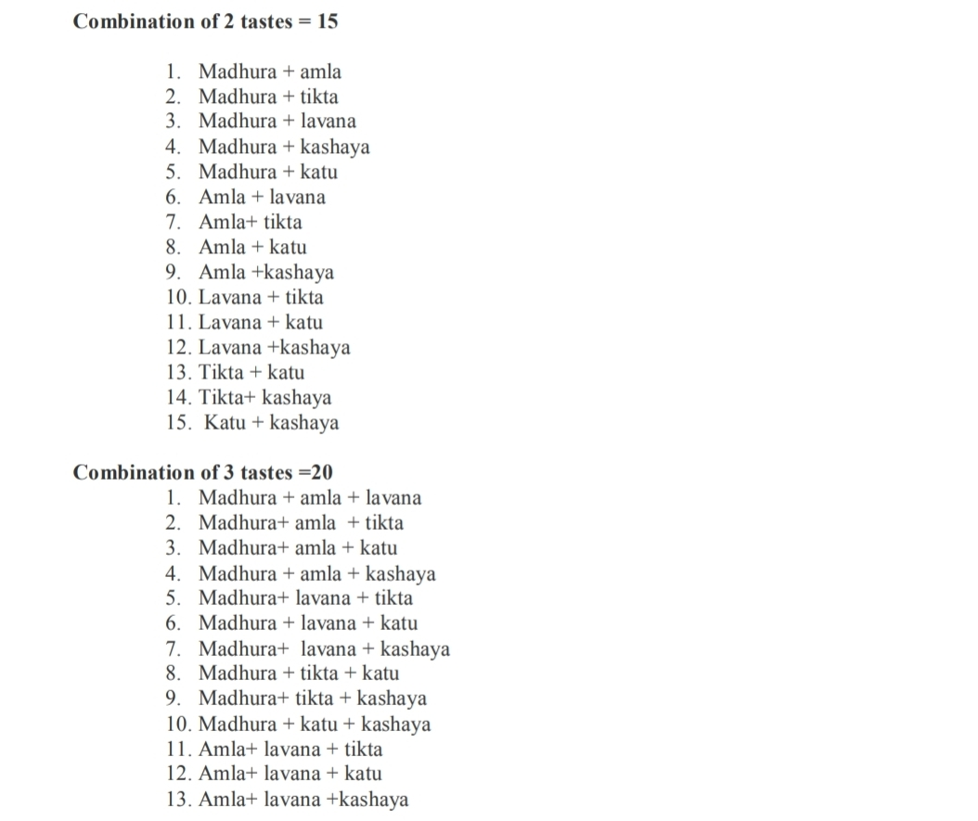

Slide 26
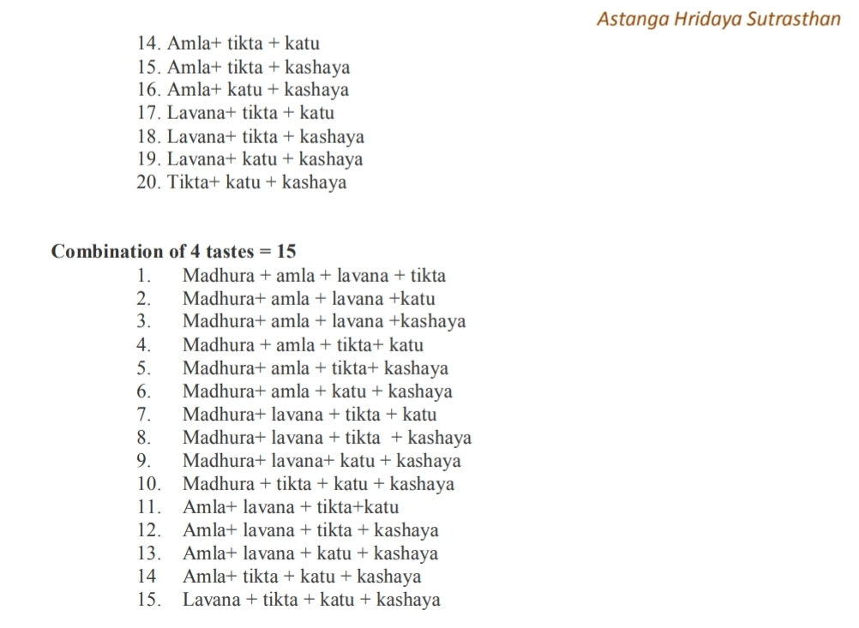

Slide 28
Thank You

