Slide 1
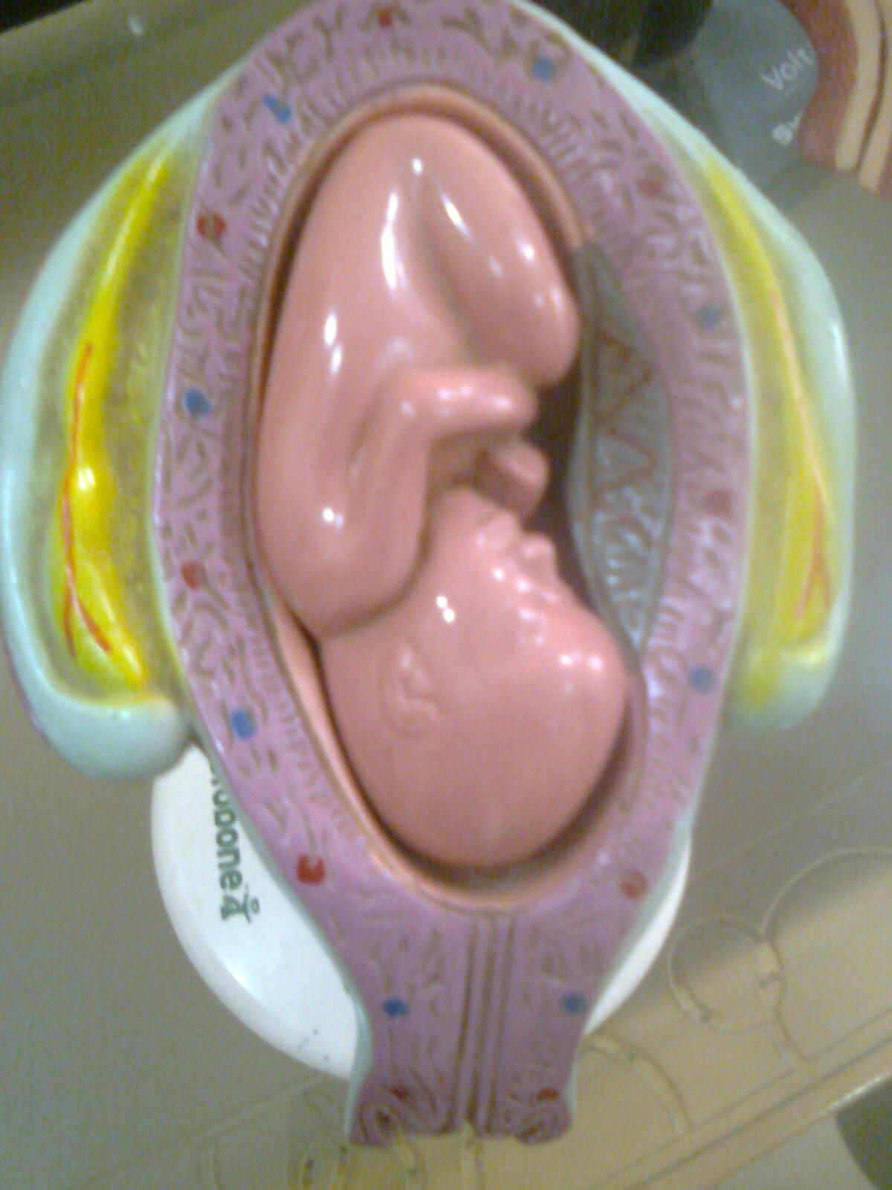
CLINICAL APPLICATION OF PANCHABHOTIKA SIDDHANTA IN Garbhavakranti (Fertilization and developmental factors)
Presented By
Dr. Hidayatulla khan A. Pathan
ASSISTANT PROFESSOR,
DEPARTMENT OF BASIC PRINCIPLES,
SMVVS,
RKMAMCH PG&RC
VIJAYAPUR.

Slide 2
CONTENTS:
1)INTRODUCTION
2)DEFINITION OF BHOOTA
3) CONCEPT OF SRUSTIUTPATTIKRAMA.
4)PANCHAMAHABHOOTA AND ITS PROPERTIES.
5)GARBHAVAKRANTI
6)CLINICAL APPLICATION OF PANCHMAHABHOOTA IN GARBHAVAKRANTI.
7)CONCLUSION.

Slide 3
Introduction:
Ayurveda is the Science that Imparts all the knowledge of life.It Defines Health and factors Responsible for its Maintainance and Promontion.Health is Essential for Enjoyment of all the Worldly Pleasures in a righteous Manner.

Slide 4
definition.
BHOOTA IS DEFINED AS THE MINUTEST MATTER WHICH WILL PROVE ITS EXISTANCE THROUGH CERTAIN CHARECTERISTICS OR IT IS THE FACTOR WHICH PRODUCES ALL THE ORGANIC &INORGANIC MATERIALS.

Slide 5
सर्वं द्रव्यं पाञ्चभौतिकमस्मिन्नर्थे।
The entire Universe and Man is made up of PANCHBHOUTA…
च.सू.26.

Slide 6
SRUSTIUTPATTI KRAMA
ACC TO SAMKHYA
AVYAKTA(UNKNOWN COSMIC ENERGY)
MAHAT(HIGHLY CHARGD UNSTABLE PARTICLES)
AHANKAR(MORE STABLE ENERGY PARTICLES)
SATVA RAJAS TAMAS
EKADASHENDRIYA
(5 GNANENDRIYA, 5KARMENDRIYA, MANAH)
5TANMATRAS (SHABDA,SPARSHA
RUPA, RASA, GANDHA)
PANCHAMAHABHOOTA (PRITHVI, AAPA, TEJA,
VAYU, AAKASH)

Slide 7
ACCORDING TO SUSRUTA ACHARYA,SRUSHTI UTPATTI KRAMA VARIES FROM SANKHYAS VIEW AND JUSTS MATCHES WITH TODAYS MODERN CONCEPT OF EVOLUTION
इन्द्रियेणॆन्द्रियार्थं तु स्वं स्वं ग्रिहणाति मनवः!
नियतं तुल्ययोनित्वान्नान्येनान्यमिति स्थिति!! Su sha ch 1/15
The person perceives respective sense objects by sense organs positively because of similar causative source and the other by other.
Each of sukshmahabhuta originates from mixture of components of sthulamahabhuta.

Slide 8
गर्भावक्रन्ती
गर्भ -शुक्रशोणित गर्भाशयस्थमात्मप्रक्रिति विकार सम्मुर्छितम् गर्भ इत्युच्यते॥
सु शा 5/1
The union of sukra and shonita along with
influence of various factors in which
chetana takes its seat and leads to further
development and is called as garbha.

Slide 9
SOURCES OF PANCHA MAHABHOOTAS..
मात्रूज-THROUGH SONITHA OR OVUM
पित्रूज-THROUGH SUKRA OR SPERMS
आहार रस-RASA DERIVED FROM MATERNAL DIET
आत्मा-DUE TO THE EFFECTS OF THE DEEDS OF PREVIOUS LIFE.

Slide 10
खुड्डीकाम् गर्भावक्रन्ति (Factors influencing the viability of feotus) भाव
मातृज पितृज आत्मज सात्म्यज रसज सत्वज
त्वक् केश आयु आरोग्य शरीर उत्पत्ति भक्ति
रक्त श्मश्रु आत्मञन अनालस्य शरीर वृद्धि शील
मांस नख प्राण लोलुपत्व तृप्ति शौच
मेद लोम अपान इन्द्रिय सौष्ठ्व पुष्ठि स्म्रुति
नाभि दन्त प्रेरणा स्वरसम्पत् उत्साह मोह
हृदय अस्थि आक्रुति बीज सम्पत् त्याग
क्लोम धमनि स्वर शौर्य
स्नायु वर्ण भय
क्रोध

Slide 11
Properties of panchamahabhoota akasha | shabdha ,sotra, sukshamata, viveka
Vayu | Sparsha, rukshata,prenana, dhatu vyuhana
Agni | Rupa,darshanam, prakasha, pachana, ushanata
Jala | Rasa ,seeta mardava, sneha kleda
Prutwi | Gandha, gourava, sthirya, swarupa

Slide 12
Charaka and vagbhatta opine about teja bhuta in skin colour.
Gaura | Akasha jala teja
Krushna | Vayu pritvi teja
Syama According to susruta acharya, तत्र द्ष्टीभागमप्रतिपन्न्ं तेजो जात्यन्धं करोति! सु शा १/३६ if teja mahabhuta is absence in eyes,than baby born will be blind in nature | All mahabhutas

Slide 13
Application of panchamahabhoota in garbhavakranti..
शुक्रशोणितंगर्भाशायस्थ्मात्मप्रक्रितिविकारसम्मुरच्छित्ं गर्भ इत्युचते! तं चेतनावस्थितं वायुर्विभजति तेजं एन पचति,आप् क्लेदयन्ति,प्रिथ्वि संह्न्ति,आकाश् वीवर्धयति!एवंवीवर्धितःसयदाहस्थपादजिह्वाघ्राणकर्णनितम्बादिभिरान्गैरुपेतस्तदा शरीरमिति सञा लभते!! Su sha 5/1
combined shukra and shonita in womb mixed with ashta prakriti and 16 vikaras in presence of aatma is called as garbha.
Vaayu = divides cells
Teja = metabolism
Aapa = maintains liquid state(electrolyte balance)
Prithvi = causes solidification of different tissues(ossification of bones)
Aakash = contributes growth and development.

Slide 14
Clinical aaplication of panchabhoutika siddhanta:
बिजेऽन्तर्वायुना भिन्ने द्वौ जिवौ कुक्षिमागतौ! यमावित्यभिधियते धर्मतरपुरः सरौ!!su sha 2/37
Excess deranged vayu in nature divides the fertilised ovum into twins within kukshi.
eg:twins,triplets,siami babies,CTEV.

Slide 15
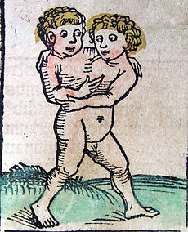
SIAMI BABIES:
Conjoined twins are identical twins joined inutero. A rare phenomenon,the occurrence is estimated to range from 1 in 50,000 births to 200,000 births.
Region -Southwest Asia&AfricaApproximately half are stillborn and smaller fraction of pairs born alive have abnormalities.
overall survival rate- for conjoined twins is approximately 25%.The condition is more frequently found among females, with a ratio of 3:1.

Slide 16
Two contradicting theories exist to explain the origins of conjoined twins. The older theory is
Fission- Here the fertilized egg splits partially.
Fusion- More generally accepted theory. Here fertilized egg completely separates, but stem cells (which search for similar cells) find like-stem cells on the other twin and fuse the twins together.Conjoined twins share a single common chorion, placenta, and amniotic sac..

Slide 17
Types of conjoined twins:
Thoraco-omphalopagus (28% of cases): Two bodies fused from the upper chest to the lower chest.
Thoracopagus (18.5%): Two bodies fused from the upper thorax to lower belly..
Omphalopagus (10%):Two bodies fused at the lower chest. Unlike thoracopagus, the heart is never involved in these cases; however, the twins often share a liver, digestive system, diaphragm and other organs.
Craniopagus (6%): Fused skulls, but separate bodies.

Slide 18
पित्रोरत्यल्प बिजत्वासेक्यः पुरुशो भवेत्!
स शुक्रं प्राश्य लभते ध्वजोच्छ्रयमसंशयम!!su sha 2/38
Deranged decreased vaayu causes less sexual desire in men and is called as aasekya.
eg:oligospermia,azoospermia,decreased motility of sperms.

Slide 19
Azoospermia is the medical condition of a man not having any measurable level of sperm in his semen.
1 Classification
1.1 Pretesticular azoospermia
1.2 Testicular azoospermia
1.3 Posttesticular azoospermia

Slide 20
Classification:
Pretesticular azoospermia .
Pretesticular azospermia is characterized by inadequate stimulation of testes to produce sperm,otherwise normal testicles and genital tract. Typically, follicle-stimulating hormone (FSH) levels are low (hypogonadotropic).
Examples - hypopituitarism (for various causes), hyperprolactinemia, and exogenous FSH suppression by testosterone. Pretesticular azoospermia is seen in about 2% of azoospermia.

Slide 21
Testicular azoospermia.
In this situation the testes are abnormal, atrophic, or absent, and sperm production severely disturbed to absent. FSH levels tend to be elevated (hypergonadotropic),The condition is seen in 49-93% of men with azoospermia.Testicular failure includes absence of failure production as well as low production and maturation arrest during the process of spermatogenesis.
Causes -congenital issues such as in certain genetic conditions (e.g. Klinefelter syndrome), some cases of cryptorchidism (orchitis), surgery or other causes.
Generally, men with unexplained hypergonadotropic azoospermia need to undergo a chromosomal evaluation.

Slide 22
Posttesticular azoospermia.
In posttesticular azoospermia sperm are produced but not ejaculated, a condition that affects 7-51% of azoospermic men.
Cause: physical obstruction (obstructive azoospermia) of the posttesticular genital tracts or acquired, such as ejaculatory duct obstruction for instance by infection.

Slide 23
वाताभिपन्न एव शुष्यति गर्भ! स मातुः कुक्षि न पुरयति मन्दः स्पन्दते तं ब्रिहणियै पयोभिर्मांसरसैश्चोपचरेत! su sha 10/60
Atrophy of foetus in womb is due to deranged vayu,uterus felt empty and hollow.
eg:oligohydraminos.
chikitisa:brimhaniya dravyas used.

Slide 24
conclusion
Panchamahabhuta plays very important role in formation of garbha, variation in composition of this Panchabhoutika constituents causes severe abnormal and genetically challenged progeny like congenital anamolies, siami babies etc.
Present Concept aims to show Significance of Panchamahabhuta in the development of garbha with healthy factors which actually contribute to union, further division of Zygote.
Panchabhoutika siddhanta concentrate on Healthy and Successful life along with critical care in ante-natal period.

Slide 25
Conclusion
THANK YOU

