Slide 1
Astanga Hridaya Sutrasthana 8th Chapter Matrashitiya Adhyaya
By,
Dr. Pushpa A. Biradar
Assistant Professor
Department of Samhita Siddhanta
RKM Ayurvedic Medical College
Vijayapur - 586101

Slide 17
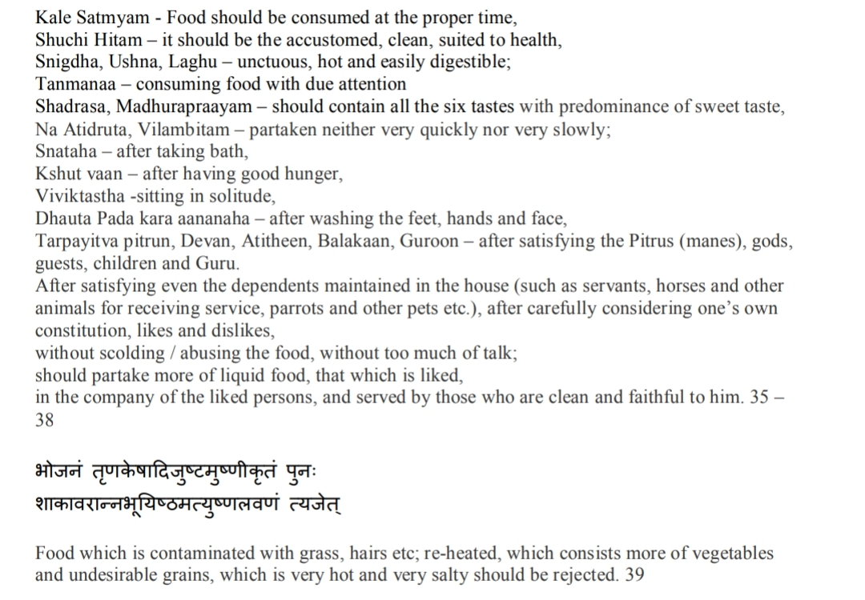

Slide 23
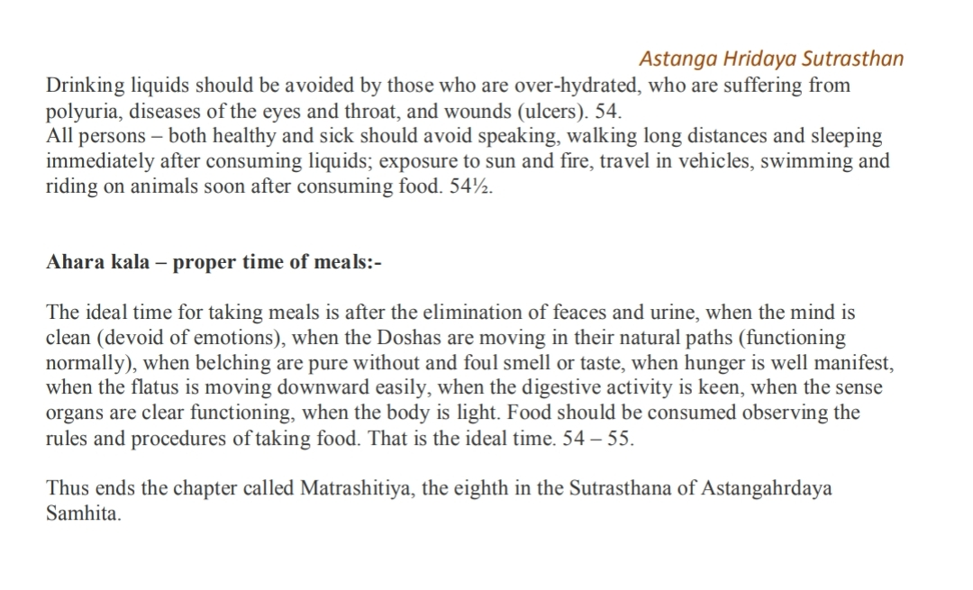

Slide 24
Thank You

