Slide 1
Astanga Hridaya Sutrasthana 9th Chapter Dravyadhi Vijnaneeya Adhyaya
By,
Dr. Pushpa A. Biradar
Assistant Professor
Department of Samhita Siddhanta
RKM Ayurvedic Medical College
Vijayapur - 586101

Slide 3
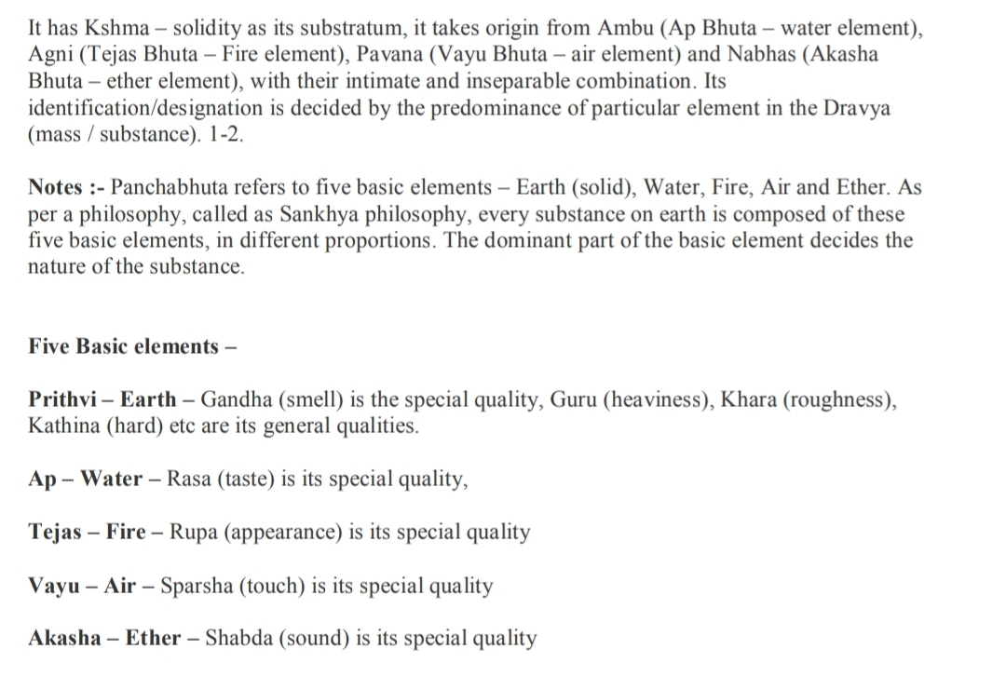

Slide 5
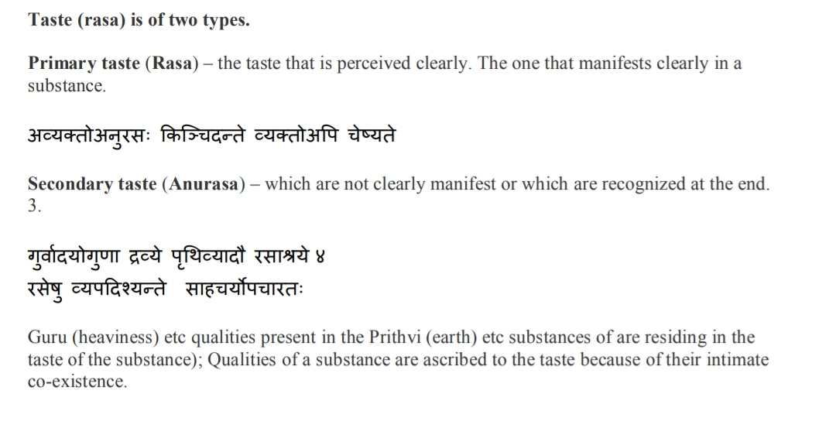

Slide 14
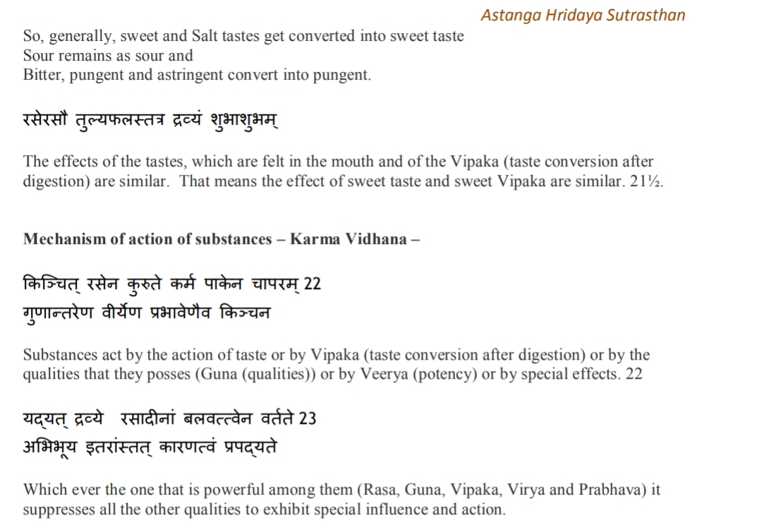

Slide 18
Thank You

