Slide 1
WELCOME TO THE DEPARTMENT OF KAUMARABRITYA
Presented by: Dr. R.S .Biradar _{Reader}

Slide 2
OBJECTIVES
To make the students understand the meaning, importance and usage or scope of kaumarabritya in ayurveda.

Slide 3
INTRODUCTION:
For a family, for a society the greatest assets are the healthy children.
A family or a society or a nation can become strong only with healthy children.
So kaumarabritya aims at nurturing and developing healthy children.
Kaumarabritya is one among the 8 branches of ayurveda and is well explained by all the major samhitas of ayurveda. Mainly kashyapa samhita a classical text explains the topic kaumarabritya in detail.

Slide 4
DEFINITION:
MüÉæqÉÉUpÉ×irÉÇ lÉÉqÉ MÑüqÉÉUpÉUhÉkÉÉ§ÉÏ¤ÉÏUSÉåwÉxÉÇzÉÉåkÉlÉÉjÉïqÉç þ
SÒ¹xiÉlrÉaÉëWûxÉqÉÑirÉÉlÉÉÇ cÉ urÉÉÍkÉlÉÉqÉÑmÉzÉqÉlÉÉjÉïqÉç þþ xÉÑ.xÉ.xÉÑ.1/7
The branch of ayurveda which deals with following catagories is termed as kaumarabritya , they are
a)kumara bharana.(properly cherished kid)
b)kshreera dosha shodhana kriya of dhrati/mother.
c) Treatment of dushta stanyaja disorders.
d)Treatment of grahaja vyadhis.(infectious diseases)

Slide 5
IMPORTANCE:
Children being the building blocks of the nation as most vulnerable group in the community, require to be handled with utmost care and concern hence pediatricians are specially educated and trained in diagnosing and treating illness in infants,children and adolescents.........
kaumarabritya has many procedures and treatment which ensure the all round well being of children. Our classical texts have details of many preventive methods and procedures as well as many corrective treatments.

Slide 6
Let us have a glance over some of such procedures and treatment.
swarna prashana
panchkarma in kaumarabritya
Nutrition.
Infectious diseases.
Neonatal disorders
Concept of child care in ayurveda.
Neonatal care.
Neurological disorders.
Umbilical cord disorders.
Urinary disorders.
Psychological disorders.
Emergency treatment.
Dentition and dentition disorders.
Congenital malformations.etc.....

Slide 7
SWARNA PRASHANA:
Swarna prashana is one of the oldest procedures explained in Indian medical science.kashyapa samhita lehana adhyana explains this procedure and it’s benefits in detail.

Slide 8
WHAT IS SWARNA PRASHANA:
Swarna prashana sanskara is a method mentioned in the ancient classics of ayurveda. swarna prashana means administering swarna/gold bhasma to children by mixing it in honey, ghee etc.

Slide 9
AGE GROUP:
0 to 16 years of age.
METHOD:
Administer early in the morning in empty stomach ,facing towards east direction,mixing swarna bhasma with grita or honey, anudina or on the day of pushya nakshatra.

Slide 10
BENEFITS

Slide 11
PANCHAKARMA IN KAUMARABRITYA

Slide 12
The childhood is very crucial period where the most of mental and physical development takes place. The abundant of doshas ,dushya, and mala are less in children body as compare to adult which make them more susceptible towards disease. As per ayurveda in ksheerada avasta ,the shodhana should be done both in dhatri and shishu as preventive measure. Some traditional text consider bala as anarha for panchakarma therapies up to 7 years of age while kashyapa advised panchakarma from 1st year of life ; however ayurveda also suggests a few precautions along with proper drug and dose for bala panchkarma.

Slide 13
NUTRITION

Slide 14
Nutrition is nourishment or energy that is obtained from food consumed or the process of consuming the proper amount of nourishment and energy.

Slide 15
DISORDERS
Bala shosha(PEM)
Parigarbhika(malnutrition during infancy)
Karshya(emaciation)
Kasa,vamana(cough, vomitting)
Bharama ,Tandra(psychologically dull)
Koshta vridhi(distention of abdomen)

Slide 16
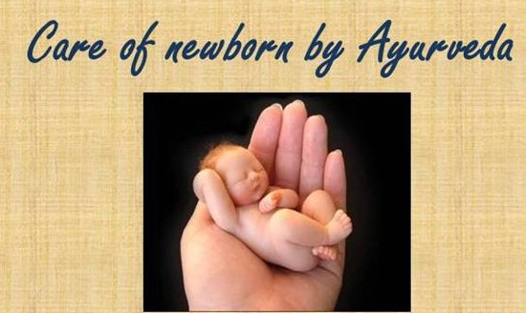
NEONATAL CARE

Slide 17
care of newborn right from just after birth till the first feeding. The steps included in neonatal care are , -neonatal resuscitation, -cleaning of the vernix caseosa, -cutting of umbilical cord, neonatal bath, -cleaning of oral cavity, -clearing of neonate’s stomach, protection of baby.

Slide 18
CONCLUSION
So in the light of the study made above, we can conclude that Kaumarabritya is indeed a very useful, interesting and highly rewarding branch of study in ayurveda.

Slide 19
Dr.R.S.Biradar

