Slide 1
Digital Eye Strain
Dr. A M Madni Associate professor Dept of Shalakya Tantra SMVVS RKM AMC, H & PG RC Vijayapur

Slide 2
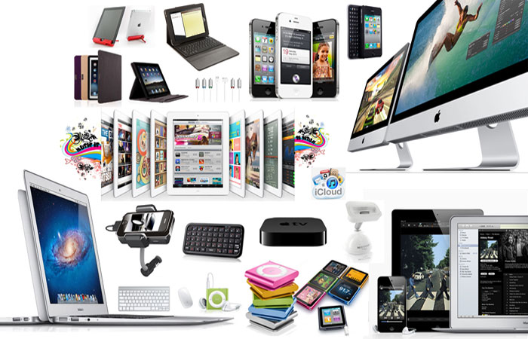
Electronic gadgets have become an integral part of our lives

Slide 3
On average, we spend about five hours daily browsing the internet and using apps. When you add all this screen time to a full day’s work in front of a computer, it is not difficult to conclude that we are addicted to technology.

Slide 4
Do you feel any of this symptoms while using
your digital device:
• Eyestrain
• Headaches
• Blurred vision
• Dry eye
• Neck and shoulder pain
IF YOUR ANSWER IS (YES),
You may be suffering from DIGITAL EYE STRAIN
or COMPUTER VISION SYNDROME

Slide 5
■ Whether you use a computer for work or at home (or both), you’re more than likely spending at least 2 hours at a time staring at the screen.
■ Computers and smart digital devices, have bought so much enrichment into our lives as well as increased productivity.
■ The problem is that This digital age has come to put a greater stress on our eyes.
■ Our eyes can’t tolerate such close activity for hours, and as a result, Computer Vision Syndrome or digital Eye Strain has become a very common complaint.

Slide 6
Definition:
Computer Vision Syndrome,
also referred to as Digital Eye
Strain is the physical eye discomfort
after two or more hours in front of
digital screen.
According to the 2014 Vision Watch
Survey results:
Nearly 3 in 10 adults (29.8%) are high
users, spending more than hours each
day using digital devices.
One in 4 children use these devices
more than three hours a day.

Slide 7
Common symptoms

Slide 8
These Symptoms May Be Caused By:
• Poor lighting
• Glare on a digital screen
• Improper viewing distances
• Poor seating posture
• Uncorrected vision problems
• In addition, recently, there is increased concern
by the eye care providers by the effect of excess
exposure to the Blue Light or the high-energy
visible light wavelengths.

Slide 9
We as humans can only see a small percentage of the electromagnetic spectrum called visible light. These wavelengths are between about 390 nanometers (nm) to 700 nm.
Smartphones, tablets and computer screens emit blue light, which has a wavelength of 380 nm to 500 nm. These short, high-energy waves can cause anything from eye discomfort to retinal damage.
Blue light creates a glaring effect on the eyes that can lead to symptoms like dry eye, blurred vision, headaches, nearsightedness, and eye fatigue. This condition is commonly called digital eye strain.
Prolonged exposure to blue light can actually contribute to photochemical damage, which can potentially harm your retinal cells and make you susceptible to conditions like age-related macular degeneration.” The age group that is the most at-risk is children

Slide 10
WHAT IS BLUE LIGHT?
The band of blue-violet light considered potentially most harmful to retinal cells ranges from 415 to 455 nm.
Light that appears white can have a large blue light component, exposing the eye to hidden spikes in intensity at wavelengths within the blue portion of the spectrum. these wavelengths range from 380 to 500 (nm).

Slide 11
Blue Light Impact On The Eye:
Emerging Research suggests that it may be related to increased incident of retinal cells oxidation & Age related macular degeneration & Cataract

Slide 12
How to avoid ?

Slide 13
1. Get an Eye Exam
Any underlying visual or ocular problem will
exaggerate the digital eye strain
Correct any refractive error:
myopia, hypermetropia, or astigmatism.

Slide 14
2. Use Proper Lighting
• When you use a computer, your ambient lighting should be about half as bright as that typically found in most offices.
• Eliminate Exterior Light by:
closing drapes, shades or blinds.
• Reduce Interior Lighting by using fewer or lower intensity light bulbs or tubes.
• If possible, position your computer monitor or screen so Windows are to the side, & not in front or behind it.

Slide 15
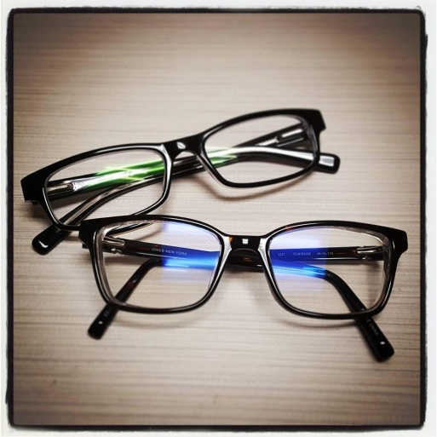
3. Minimize Glare
If you wear glasses, choose lenses with:
- anti-reflective (AR) ,
- & amber - yellow coating.
This minimizing the amount of light
reflecting off the front and back surfaces
of your eyeglass lenses. & block the
excess blue light
Glare on walls and finished surfaces, & also on your computer screen can
cause computer eye strain.
Use anti-glare screen on your monitor and, if possible, paint bright white walls a
darker color with a matte finish & cover the windows

Slide 16
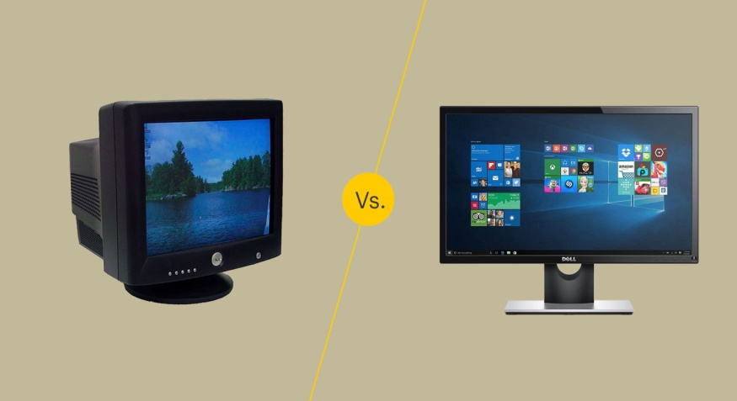
4. Upgrade your display:
• LED & LCD screens are easier on the eyes and usually have an anti-reflective surface.
• Old-fashioned CRT screens can cause a noticeable "flicker" of images, which is a major cause of computer eye strain especially when refresh rate <75hz
• When choosing a new flat panel display, select a screen with the highest resolution possible.
• Flicker is not an issue with LCD screens.
• Finally, choose a relatively large display.

Slide 17
5. Adjust Your Device Display Settings.
• Adjust the Brightness your display so it's approximately the same as the brightness of your surrounding workstation.
• As a test, look at the white background of a Web page. If it looks like a light source, it's too bright. If it seems dull and gray, it may be too dark.
Adjust the text size and contrast for comfort, especially when reading or composing long documents.
• Usually, black print on a white background is the best combination for comfort

Slide 18
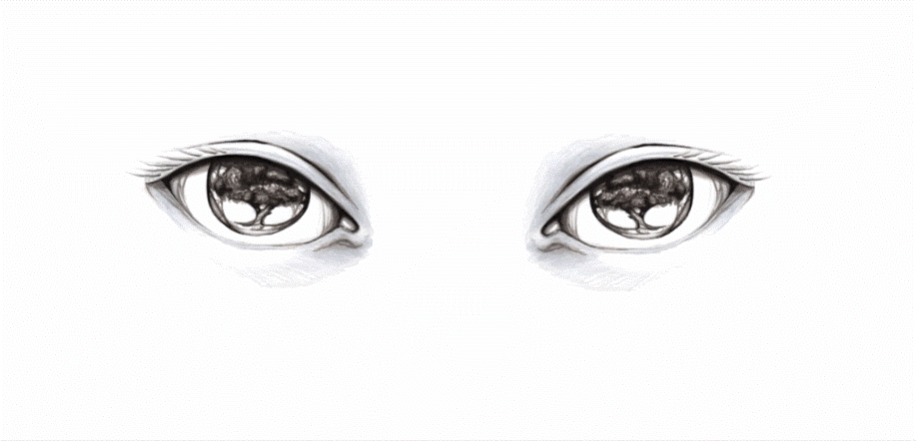
6. Blink more often.
Blinking is very important when working at a
computer; blinking moistens eyes to prevent
dryness and irritation.
When working at a computer, blink rate is less
In frequency & in amplitude, about one-third
the normal rate with only partial lid closures,
according to studies.
Tears coating the eye evaporate more rapidly
during long non-blinking phases & this will
exaggerate dry eye symptoms.
If there is any dry eye symptoms,
artificial tear eye drops can be prescribed.

Slide 19
7. Exercise your eyes

Slide 20
8. Take frequent breaks.
To reduce your risk for computer
vision syndrome and neck, back and
shoulder pain, Take Frequent Breaks
during your computer work day.
During your computer breaks,
stand up, move around and stretch
your arms, legs, back, neck and
shoulders to reduce tension and
muscle fatigue.

Slide 21
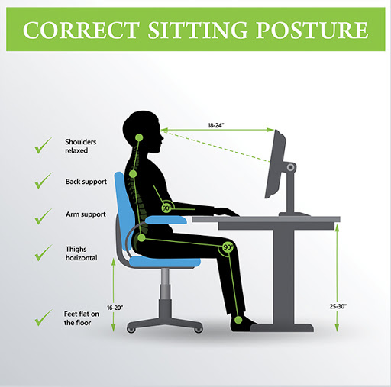
9. Modify your workstation
• Improper posture during computer
work also contributes to computer
vision syndrome. Adjust your
workstation and chair to the correct
height.
• Purchase Ergonomic furniture to
enable you to position your computer
screen 20 to 24 inches from your eyes.
• The center of your screen should be
about 10 to 15 degrees below your
eyes for comfortable positioning of
your head and neck.

Slide 22
10. Don’t Over Use Your
Digital Devices
If you can, Avoid using it
during the last hour before
sleeping at Night.
Try reading from Books instead
of the digital screen when
possible.

Slide 23
Thank you
Thank you

