Slide 1
Basic Understanding of pharmacology- P’kinetics
Vd. Shweta yaragatti
Asst Professor Dept Of Dravyaguna
SMVVS RKM AMCH & RESEARCH CENTER
Email-shwetayaragatti@gmail.com

Slide 2
Contents
Introduction
Pharmacokinetics
Absorption
Distribution
Biotransformation
Excreation
Plasma half life

Slide 3
The Word pharmacology derived from the Greek word Pharmacon (drug=remedy=to do good) and logos(Study)
Definition- Pharmacology is a subject of medical science which deals with the study of drugs or medicine that interact with living system through chemical processes, specifically by binding to regulatory molecules and activating or inhibiting body process.

Slide 4
Medical pharancology : Branch of pharmacology deals with the use of drugs in human body for diagnosis, prevention, suppression and treatment of the diseases.
Clinical Pharamcology: deals with the scientific study of drugs (Pharmacodynamics & Pharmacokinetics) in the patients also in the healthy persons for the safe & effective use of drugs (Therapy).

Slide 5
DRUG
Drug exerts some effect on body
Administered in the body
Body exerts some effects on drug
P’dynamics
P’kinetics

Slide 6
PHARMACOKINETICS—(Greek: Kinesis—movement)What the body does to the drug.
This refers to movement of the drug in and alteration of the drug by the body; includes absorption, distribution, binding/localization/storage, bio-transformation and excretion of the drug.
Pharmacodynamics (Greek: dynamis—power)—What the drug does to the body.
This includes physiological and biochemical effects of drugs and their mechanism of action
at organ system/subcellular/macromolecular levels.
Drug (French: Drogue—a dry herb) It is the single active chemical entity present in a medicine that is used for diagnosis, prevention, treatment/cure of a disease.

Slide 7
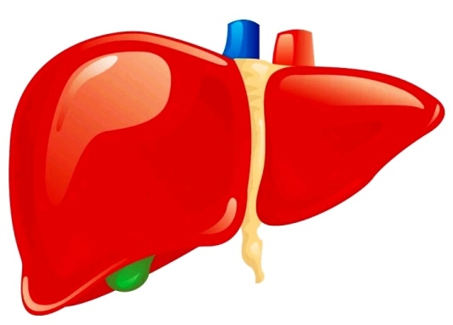
ABSORPTION & DISTRIBUTION OF DRUGS
7

Slide 8
ABSORPTION
Movement of a drug from its site of administration into the central compartment.
Bioavailability ➔ the fractional extent to which a dose of drug reaches its site of action.
Rate & efficiency of absorption ➔ environment where the drug is absorbed, drug’s characteristics & route of administration.

Slide 9
Mechanism of Absorption
Passive transfer
Simple diffusion
Filtration
Carrier-mediated transport
Facilitated diffusion
Active transport
Endocytosis

Slide 10
Mechanism of Absorption
Passive transfer
Simple diffusion
transfer of drugs ➔ simple diffusion ➔across the membrane ➔ highly lipid soluble drugs get absorbed
Filtration
transfer of drugs ➔ aqueous pores ➔ drugs size ➔ less than diameter of membrane pores.

Slide 11
Mechanism of Absorption
Carrier-mediated transport
Facilitated diffusion
needs transporter ➔ no energy required ➔ mechanism based on electrochemical gradient ➔ helpful for poorly diffusible substrate
e.g. absorption of glucose

Slide 12
Mechanism of Absorption
Carrier-mediated transport
Active transport
requires energy➔ may be inhibited by metabolic poisons➔ substrate against electrochemical gradient.
e.g. absorption of levodopa by aromatic amino acid transporters.
Endocytosis ~ Pinocytosis
process ➔ small droplets are engulfed by the cell.
Applicable to absorb large molecules e.g. Vit. B ₁₂.
New attempt using this system ➔ delivery of some anti cancer drugs ➔ CDDS & Targeted DDS

Slide 13
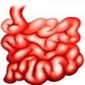
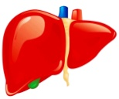
Factors influencing absorption
Disintegration
Dissolution
Formulation
Particle size
Lipid solubiliy
Area of Gut
ABSORPTION
GI motility
Route of administration
Presence of Food
pH & Ionization
Vascularity
Disease
Metabolism

Slide 14
Factors influencing absorption
First pass metabolism
metabolism of drug in gut or liver ➔ reduces bioavailability .
_{SIGNIFICANCE}
Individualization of drug therapy
Administration of route can be changed
Adjustment of dose e.g. Morhine

Slide 15
BIOAVAILABILITY
It is defined as the amount or percentage of an active drug that is absorbed from a given dosage form following its non vascular administration and reaches systemic circulation, to be available at the desired site of action .
When drug is supplied via the iv route then drug directly passes into blood stream .
Bioavailability of drugs in IV route is 100 %.

Slide 16
Pharmacokinetics of Drug Absorption (oral)
Absorption phase: absorption rate more than elimination rate
Post absorption phase: elimination rate more than absorption rate
Elimination phase:
no significant absorption occur (only elimination process)

Slide 17
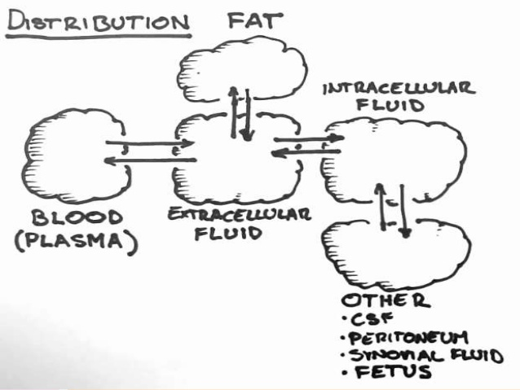
Distribution
Drug absorbed drug in blood stream distributed in tissues.
Depends on:
Lipid solubility e.g. Morphine
Physiological pH e.g. levo dopa
Extend of binding to tissues & plasma proteins
Blood flow e.g. liver

Slide 18
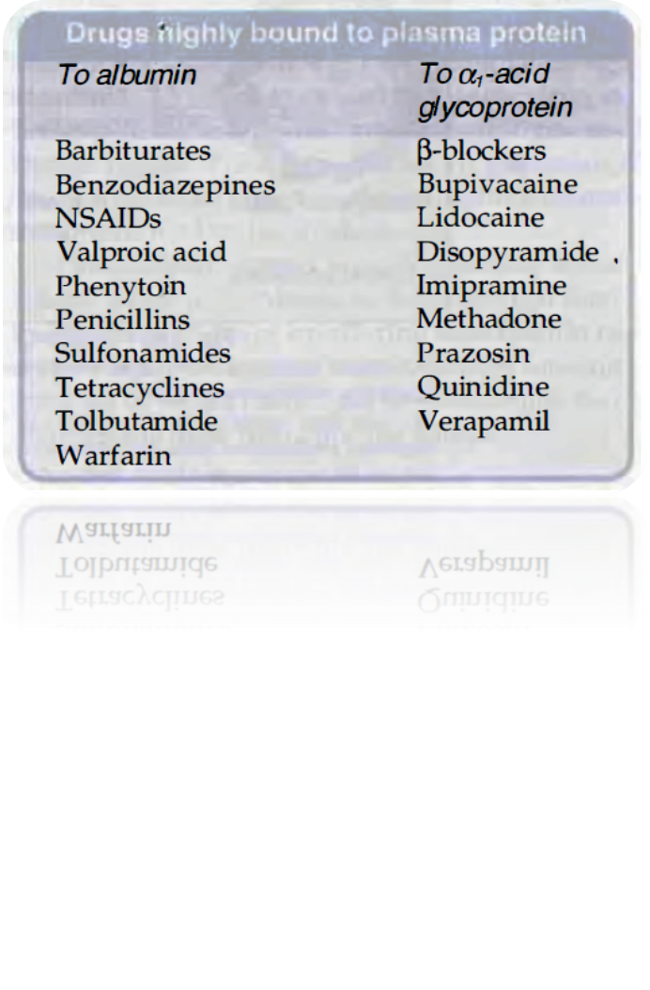
Plasma protein binding & its significance
Acidic drugs - albumin
Basic drugs - alpha- acid glycoproteins
drugs | Extent of binding
Warfarin | 99%
Morphine | 35%
Ethosuximide | Zero%
Lithium | Zero%

Slide 19
Free drug shows action, metabolism & excretion
Protein binding serves as store of drug
Protein binding ↑ the duration of action
Compete for the same binding site. e.g. warfarin & indomethacin
Use of drugs in chronic renal failure & chronic liver disease in hypoalbuminemia

Slide 20
Tissue binding ➔ delays elimination & ↑ duration of action.
Tissue | Binding drugs
Adipose tissue | Thiopentone sodium, Benzodiazepines
Muscles | Emetine
Bone | Tetracyclines, lead
Retina | Chloroquine
Thyroid | Iodine

Slide 21
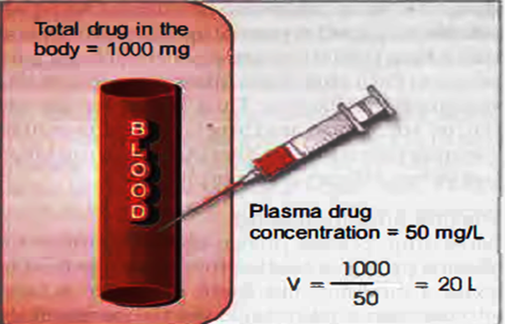
Presuming ➔ whole body ➔ single compartment➔ volume required for uniform distribution of drugs.
It is defined as the volume into which the total amount of a drug in the body appears to be uniformly distributed. It is calculated as
V_{d}= ^{Amount of drug in the body} ^{Plasma concentration of drug}

Slide 22
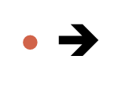
↓ drug concentration in plasma ↑ Vd e.g. aspirin & aminoglycosides
Important in treatment of drug poisoning. ↑ Vd drugs are not removed by hemodialysis
E.g. pethidine.
Vd varies depending upon the disease condition.
High plasma protein binding drugs ↓ Vd.
E.g. Phenylbutazone

Slide 24
High lipid soluble drugs initially distributed with high blood flow organs. E.g. brain, heart, kidney.
Later drugs perfuse to more bulky tissues e.g. muscles plasma drug concentration falls drug gets withdrawn from highly perfused sites.
SIGNIFICANCE
IV anesthetic thiopental sodium induces anesthesia in 10-20 sec. but effect increases in 5-15 min. due to redistribution

Slide 25
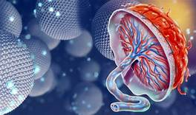
Placental Barrier
placental membrane ➔ free passage for lipophilic drugs.
placenta ➔ site for the metabolism of drugs ➔ avoids unwanted side effects & modifies the dose of drug.
However supply of some drugs for a long time may create adverse effects in fetus or neonates
e.g. morphine tolerance

Slide 26
Blood brain Barrier
capillary endothelial layer in brain ➔ lack paracellular space ➔ blood brain barrier.
highly lipid soluble drugs ➔ easily cross barrier e.g. morphine
more aqueous soluble drugs ➔ do not cross barrier.
e.g. aminoglycosides
*BBB looses during meninges inflammation*

Slide 27
What is Biotransformation (Metabolism)?
The changes that a drug undergoes in the body and its ultimate elimination are considered as the fate of the drug. Alteration of a drug within a living organism is known as biotransformation.
Biotransformation- chemical alteration of drug in body that converts Non-polar, lipid soluble compounds to polar, lipid insoluble compounds through a specialized enzymatic system.

Slide 28
Need Of Drug biotransformation
Effective absorption – drug sufficiently lipid soluble but this physicochemical property hinders excretion of same drug.
Only water soluble, polar compounds undergo renal excretion, lipid soluble compounds- passively reabsorbed from renal tubules.
This accumulates drug in body- toxicity.
Hence lipophilic, non-polar drugs transformed by metabolic system to water soluble, polar compounds - easily excreted from kidney.
Biotransformation – detoxification process.

Slide 29
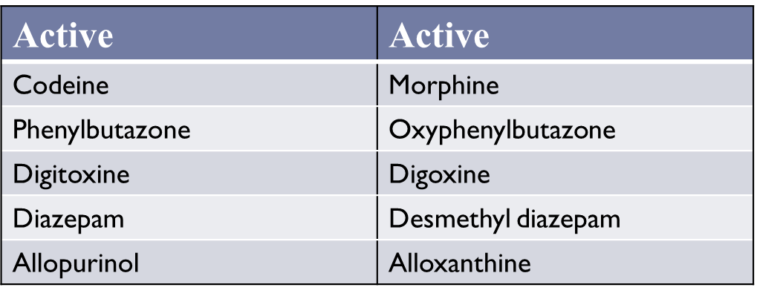
Biotransformation leads to..
Pharmacological Inactivation:
No change in pharmacological activity:

Slide 30
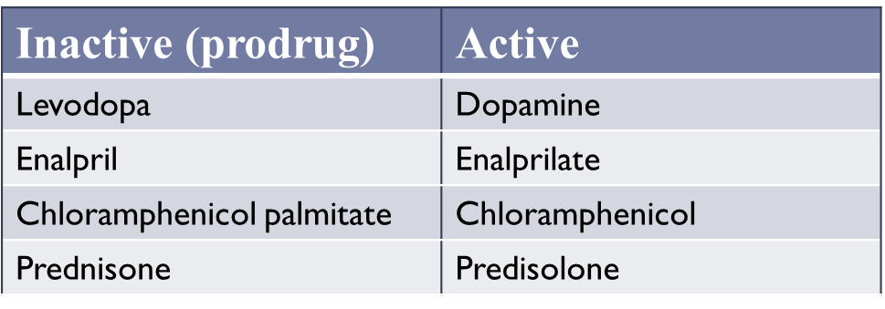
Pharmacological activation
Change in pharmacological activity:
:

Slide 31
Organ Sites of drug metabolism
Liver – primary site for metabolism – rich in variety of enzymes.
Ability of other organs of drug metabolism.
Liver>Lungs>Kidneys>Intestine>placenta>Adrenals>Skin
Cellular sites of drug metabolism:
Cytosol
Mitochondria
Lysosomes
Smooth Endoplasmic reticulum (microsomes)

Slide 32
Drug Metabolising Enzymes
Microsomal enzymes:
CYP450 monooxegenases.
Flavin monooxegenases.
Microsomal enzymes catalyse a majority of drug biotransformation reactions.
Microsomes – small vesicles isolated from endoplasmic reticulum homogenate.
Large variety of microsomal enzymes catalase number of oxidative, reductive, hydrolytic, glucoronide conjugation reactions.
Lipid soluble substrates interact nonspecifically with microsomal enzymes, water soluble endogenous substances do not interact.

Slide 33
Non Microsomal Enzymes
Alcohol dehydrogenase
Aldehyde dehydrogenase
Monoamine and diamine oxidases
Non Microsomal enzymes include those present in soluble form in cytoplasm, attached to mitochondria, but not to endoplasmic reticulum.
These catalase few oxidative, number of reductive , hydrolytic , conjugation reactions other than glucoronidation.

Slide 35
1st Pass Metabolism
Drug metabolism occuring before entering the systemic circulation.
Drug absorbed via GIT circulated to liver via hepatic portal vein.
Liver then acts as a filter.
Only a part of drug is circulated systematically.

Slide 36
Chemical pathways of drug biotransformation.
Phase I reactions:
Phase II reactions

Slide 39
Factors affecting Drug Metabolism
Age and sex
Genetic determinants
Nutritional status
Hypothermia
Route and duration of administration
Environmental determinants
Simultaneous administration of other drugs
Presence of disease- hepatic/ renal damage

Slide 40
Excretion
Process where drugs and /or their metabolite irreversibly transferred from internal to external environment.
Principal organ KIDNEY (renal excretion), other Non-renal excretion.
Agents excreted in urine:- water soluble, non volatile, small molecular size.
Functional unit of kidney – Nephron
Process
Glomerular filtration
Active tubular secretion
Active / passive tubular reabsorption
Rate of excretion = rate of filtration + rate of secretion – rate of reabsorption

Slide 41
Glomerular filtration
Non-selective, unidirectional process.
Ionized, unionized, unbound drugs filtered.
Driving force- hydrostatic pressure of blood flowing in capillaries.
Glomerular filtration rate: Out of 25%/ 1.2lt of cardiac output, blood/min goes to kidney – only 10% i.e 90 to 120ml/min filtered through glomerulli – GFR
Determined by agents excreted exclusively by filtration, neither secreted nor reabsorbed – Inuline, Creatinine.

Slide 42
Active tubular secretion
Many weak acids and weak bases are actively secreted by proximal tubules by carrier mediated systems involving transporters such as p-glycoprotein and multidrug-resistance associated protein type 2. These transporters are also responsible for excretion of conjugated metabolites of drugs.

Slide 43
Tubular Reabsorption
Occurs after glomerular filtration along renal tubules.
Reabsorption indicated when excretion rate value < GFR eg: glucose
Reabsorption result in increase in half life.
Active tubular reabsorption:
Commonly seen in endogenous substance/ nutrients need to be conserved. Eg- electrolytes, glucose, vitamines, amino acids.
Passive tubular reabsorption
Large no. of exogenous substances, drugs.
Driving force – concentration gradient – reabsorption of water along with Na ions.
Lipophilic substances extensively reabsorbed

Slide 44
Urine pH: Changing pH of urine via chemicals, inhibit/enhance tubular reabsorption, enhance renal clearance during toxicity.
pH varies between 4.5 – 7.5 slightly acidic favors excretion of basic drugs.
Weak acid drugs – unionized in acidic urine – reabsorbed.
Weak basic drugs – unionized in basic urine – reabsorbed.
Most of the acidic drugs will be reabsorbed in body.

Slide 46
Clearance
Hypothetical volume of body fluids containing drug from which drug removed/cleared completely in specific period of time.
Expressed in ml/min
Constant for any given plasma drug concentration.
Clearance (Cl) = Elimination rate
Plasma drug concentration

Slide 47
First order kinetics
The rate of elimination is directly proportional to the drug concentration, CL remains constant; or a constant fraction of the drug present in the body is eliminated in unit time.
This applies to majority of drugs which do not saturate the elimination processes (trans-porters, enzymes, blood flow, etc.) over the therapeutic concentration range. However, the dose is high enough, elimination pathways of all drugs will get saturated.
Zero order kinetics
The rate of elimination remains constant irrespective of drug concentration, CL decreases with increase in concentration; or a constant amount of the drug is eliminated in unit time, e.g. ethyl alcohol. This is also called capacity limited elimination or Michaelis-Menten elimination.

Slide 49
Plasma half life
“Time required for the concentration of a drug to fall to half of its initial concentration after reaching its peak.
Half life = 0.693 / k
where k = first order rate constant
Example: 40 mg drug is administered (I/V) and after 2hr, concentration becomes 20mg, i.e. reduced by 50% of its original value. So the half life of the drug is 2 hours

Slide 50
Plasma half life depends on:
Routes of administration
Dose of the drug
Dosage schedule
Tissue binding - The more the tissue binding of a drug, the longer the half life of that drug.
Distribution - The more widely distributed a drug is the longer the half life.
Excretion - The faster the excretion, the shorter the half life.
Age of the patient
Genetic factors - Determines whether a person is fast or slow acetylator.
Plasma protein binding of the drug - The more the plasma protein binding the longer is the half life of a drug and vice versa.
Drug biotransformation

Slide 51
Examples for half life of some drugs
Long half life | Short half life
Digoxin 1-5 day | Dopamine 2 minute
Digitoxin 7 day | Benzylpenicillin 30 minute
Warfarin 25-60 hour | Insulin 10 minute
Phenylbutazone 60 hour | Tubocurarine 60 minute
Doxycycline 18 hour | Lidocaine 2 hour
Diazepam 40-50 hour

Slide 52
Clinical significance of increased half life
1. Diminished renal blood flow due to
Cardiogenic shock
Haemorrhage
Heart failure
2. With addition of 2nd drug that displaces the first drug from albumin and thus increases the volume of distribution
eg. phenylbutazone + OHA. Phenylbutazone displaces OHA from binding site, thus increases the half life of OHA.
3. With decreased extraction ratio in renal disease
Drug entering the kidney at concentration = c1
Drug exiting the kidney at concentration = c2
So extraction ratio = c2/c1

Slide 53
Importance of Half-life
1. Half life gives a gross idea about the pharmacokinetic and pharmacodynamic of a drug
2. To predict the duration of action of a drug
3. To formulate a dosage schedule (amount of drug and frequency of interval) long half life : Should be given once/twice daily to prevent accumulation short half life : Should be give repeatedly
4. To handle a case of overdose of a drug
5. To determine the time to achieve steady state plasma concentration
6. It also give general knowledge:
Whether the drug is metabolized or eliminated unchanged.
Whether the drug itself is active or converted into active metabolite or both eg. Diazepam
Whether the drug has irreversible action or not eg. Reserpine.
Presence of disease in the organ of metabolism or excretion

Slide 54
References
Essentials of pharmacokinetics and pharmacodynamics – K. D Tripathi.
Goodman and Gilman – the pharmacological basis of therapeutics
Biopharmaceutics and pharmacokinetics by R.S. Satoskar

Slide 55
THANK YOU

