Slide 1
Astanga Hridaya Sutrasthana 6th Chapter Annaswaroopa Vijnaneeya Adhyaya – Part V
By,
Dr. Pushpa A. Biradar
Assistant Professor
Department of Samhita Siddhanta
RKM Ayurvedic Medical College
Vijayapur - 586101

Slide 11
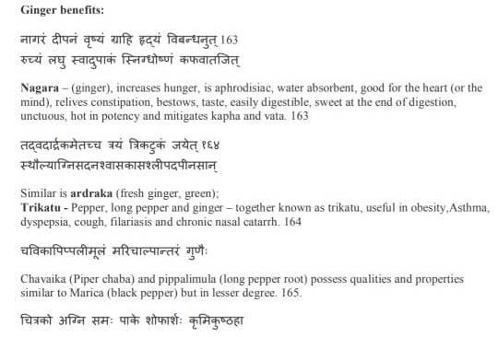

Slide 14
Thank You

