Slide 1
Astanga Hridaya Sutrasthana 6th Chapter Annaswaroopa Vijnaneeya Adhyaya – Part III
By,
Dr. Pushpa A. Biradar
Assistant Professor
Department of Samhita Siddhanta
RKM Ayurvedic Medical College
Vijayapur - 586101

Slide 10
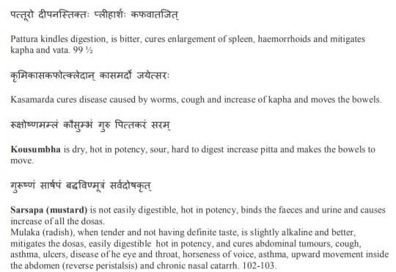

Slide 11
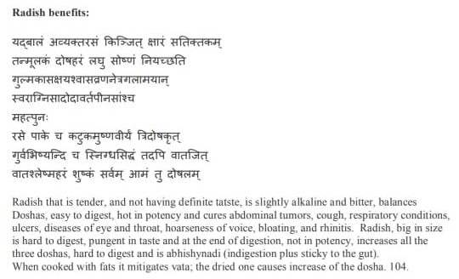

Slide 15
Thank You

