Slide 1
Astanga Hridaya Sutrasthana 6th Chapter Annaswaroopa Vijnaneeya Adhyaya – Part II
By,
Dr. Pushpa A. Biradar
Assistant Professor
Department of Samhita Siddhanta
RKM Ayurvedic Medical College
Vijayapur - 586101

Slide 5
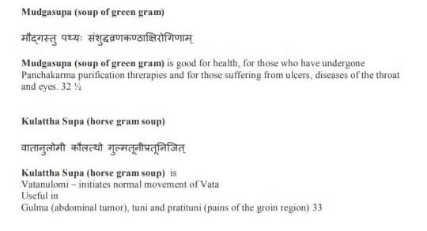

Slide 6
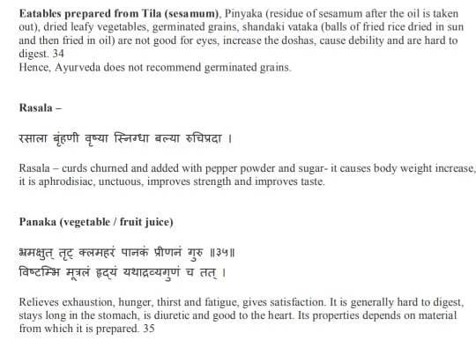

Slide 8
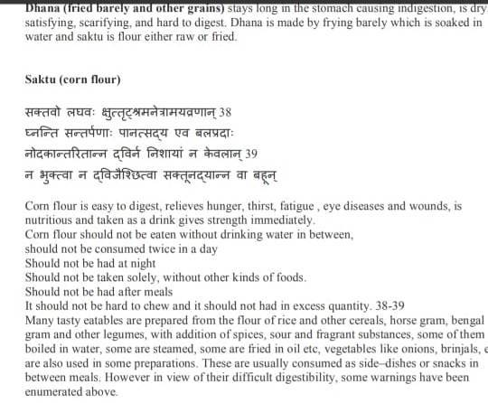

Slide 10
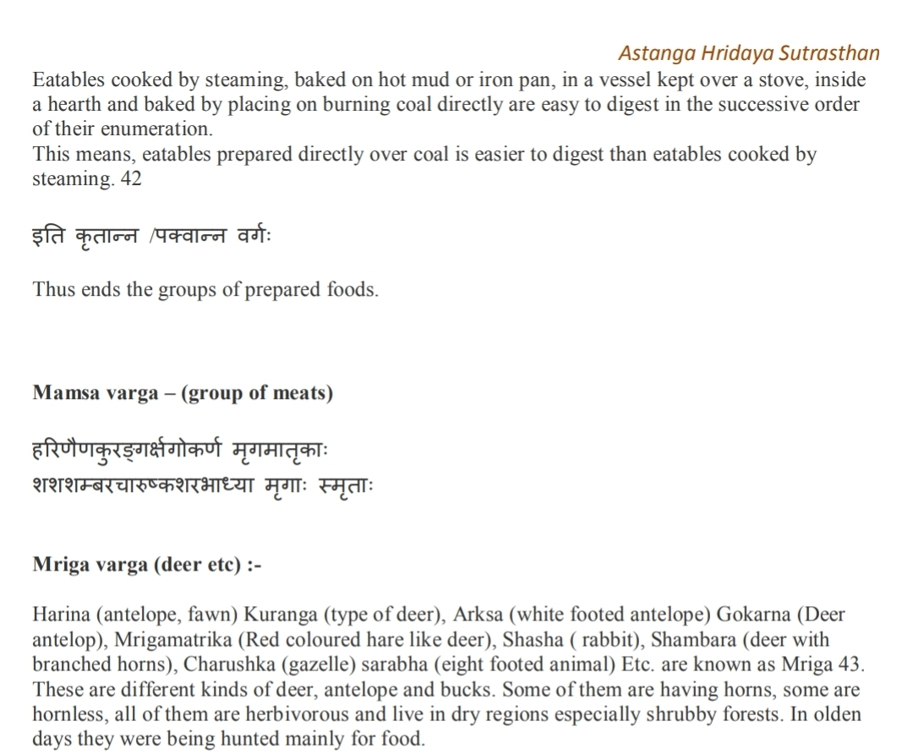

Slide 13
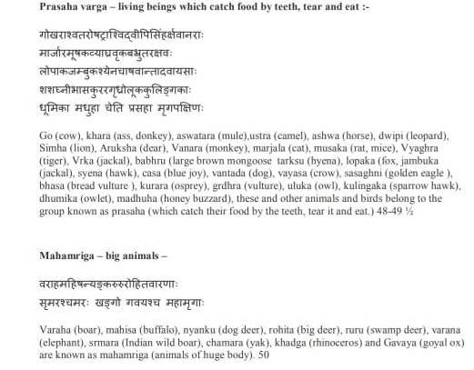

Slide 14
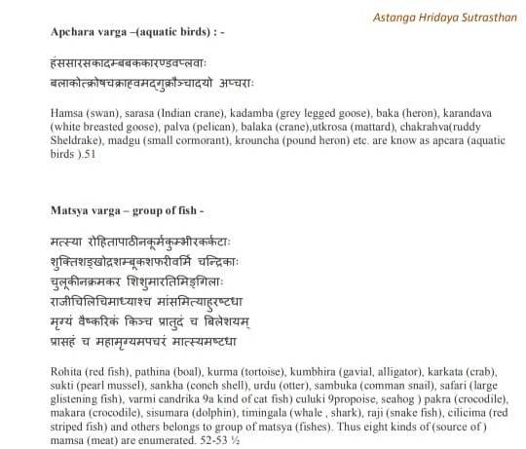

Slide 19
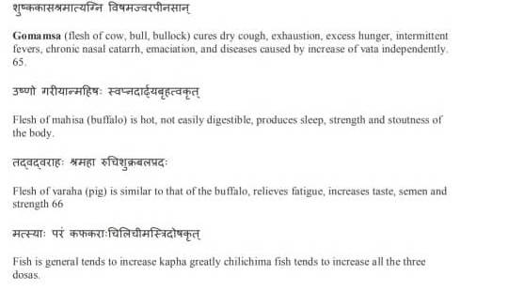

Slide 21
Thank You

