Slide 1
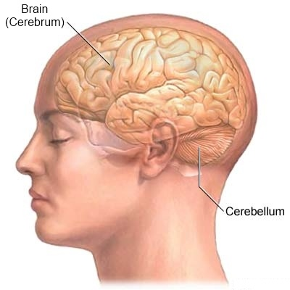
Sulcus & gyrus of cerebrum
SULCUS & GYRUS OF CEREBRUM
By:
Dr Manjula Vastrad
Asst Prof
Dept of Rachana Shareera
SMVVS RKM AMC
Vijayapura.

Slide 2
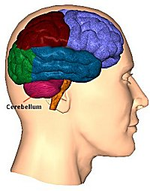
CEREBRUM
It is the largest part of the Forebrain.
It is highly developed in human.
It is derived from the Telencephalon.
The 2 cerebral hemisphere are incompletely separated by the median or greater longitudinal fissure.
They are connected by the corpus callosum.
Each hemisphere has a cavity called the lateral ventricle.

Slide 3
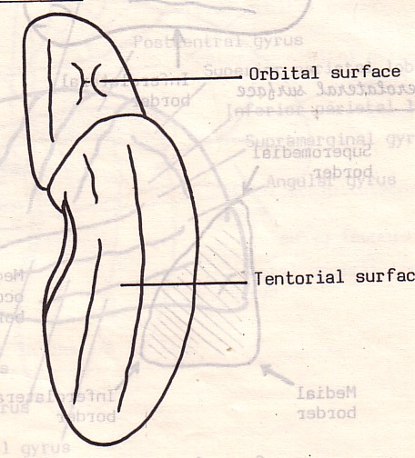
CEREBRUM : SURFACES
Each hemisphere has
3 surfaces,
3 poles,
4 borders,
4 Lobes.
Surfaces:
Lateral or superolateral: Convex and related to the skull vault.
Medial:
Flat & vertical and related to the falx cerebri & median longitudinal fissure.
Inferior:
Divided into orbital and tentorial parts by the stem of lateral sulcus.

Slide 4
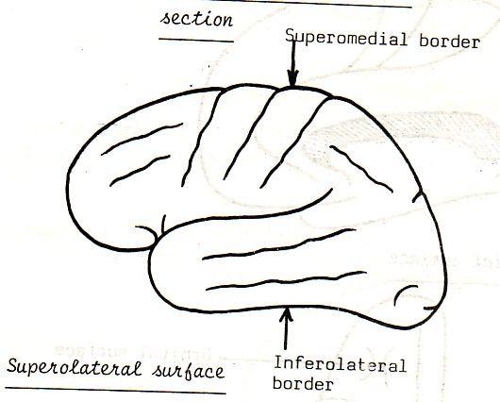
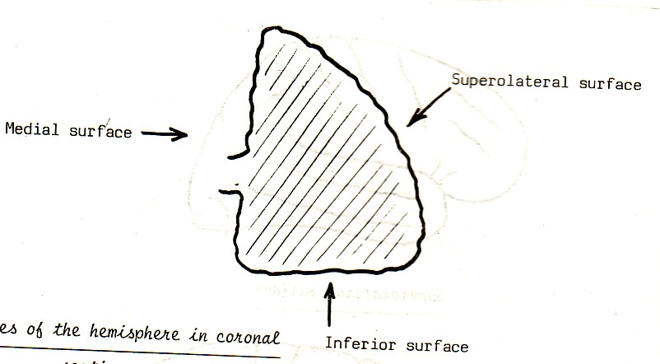
CEREBRUM: BORDERS
Four borders:
1- Medial or Superomedial border: Between lateral & medial surfaces.
2- Inferolateral border: Between lateral & inferior surfaces.
3- Medial orbital border.
4- Medial occipital border.

Slide 5
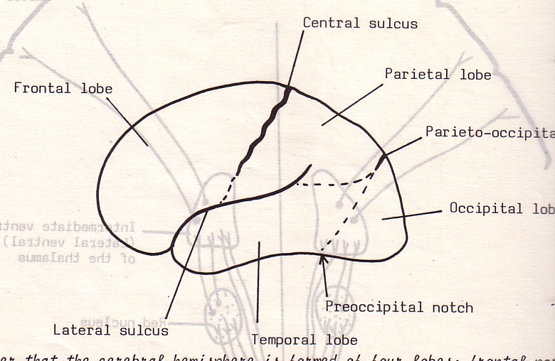
CEREBRUM 3 POLES & 4 LOBES
Each hemisphere has 3 poles:
1- Frontal pole.
2- Occipital pole.
3- Temporal pole.
Also, each hemisphere has 4 lobes:
1- Frontal lobe.
2- Temporal lobe
3- Parietal lobe.
4- Occipital lobe.

Slide 6
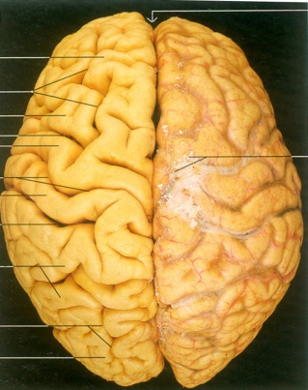
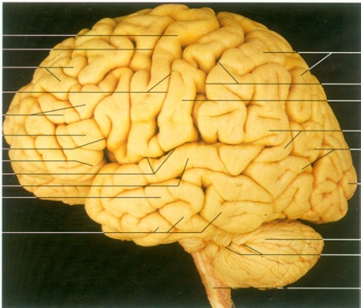
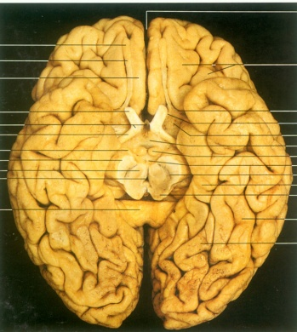
The Telencephalon
External features:
2 Cerebral hemispheres
(separated by longitudinal cerebral fissure)
Transverse cerebral fissure intervenes between
the hemispheres and cerebellum.

Slide 7
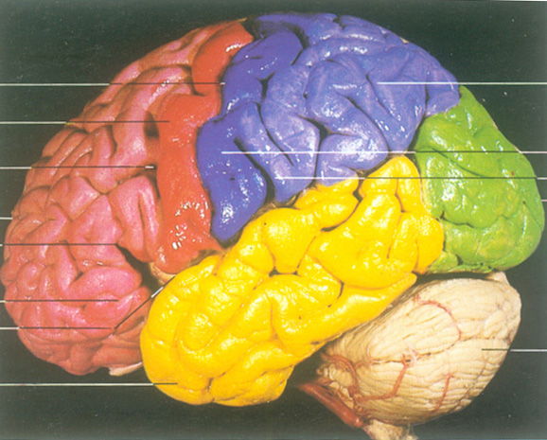
5 Lobes:
The Frontal lobe
The Parietal lobe
The Occipital lobe
The Temporal lobe
The Insular lobe (insula)

Slide 8
Main gyri and sulci

Slide 9
Cerebral Hemispheres
Ridges called Gyri (gyrus)
Shallow grooves called Sulci (sulcus)
Deeper grooves called Fissures

Slide 10
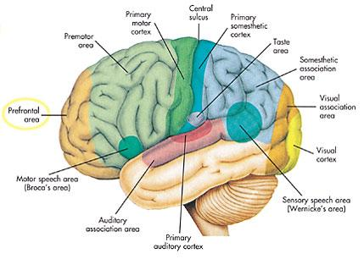
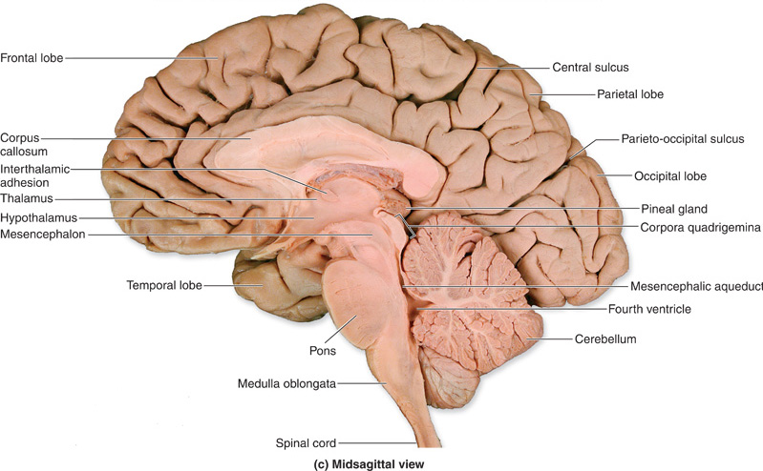
The Telencephalon
External features:
3 Main fissures on surface of each hemisphere:
The Lateral fissure
The Central fissure
The Parietooccipital fissure

Slide 11
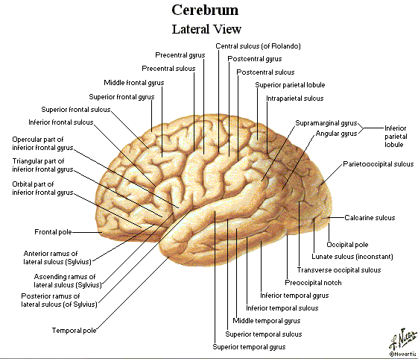
14 Major Sulci
Main sulci are formed early in development
Fissures are really deep sulci
Typically continuous sulci
Interhemispheric fissure
Sylvian fissure
Parieto-occipital fissure
Collateral sulcus
Central sulcus
Calcarine Sulcus
Typically discontinuous sulci
Superior frontal sulcus
Inferior frontal sulcus
Postcentral sulcus
Intraparietal sulcus
Superior temporal sulcus
Inferior temporal sulcus
Cingulate sulcus
Precentral sulcus

Slide 12
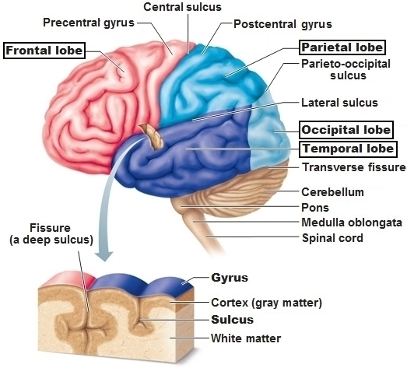
Frontal lobe:
— Precentral sulcus, Superior and Inferior frontal sulcus Precentral gyrus
Superior frontal gyrus
Middle frontal gyrus
Inferior frontal gyrus

Slide 13
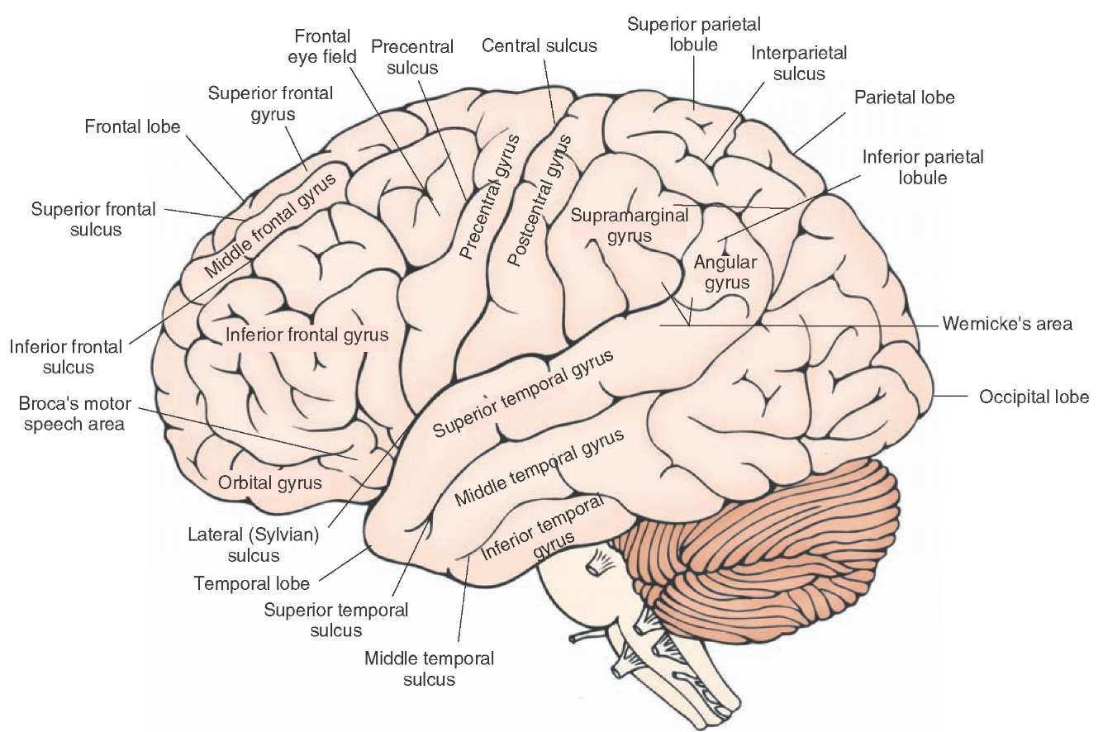

Slide 14
Parietal lobe:
Parito-occipital sulcus
Postcentral sulcus
Intraparietal sulcus
Postcentral gyrus —
superior and inferior parietal lobule
Supermarginal gyrus
Angular gyrus
Sup.parietal lobule
Inf. Parietal lobule

Slide 17
Temporal lobe:
superior temporal sulcus
Inferior temporal sulcus
superior temporal gyrus
middle temporal gyrus
Inferior temporal gyrus
Transverse temporal gyrus

Slide 19
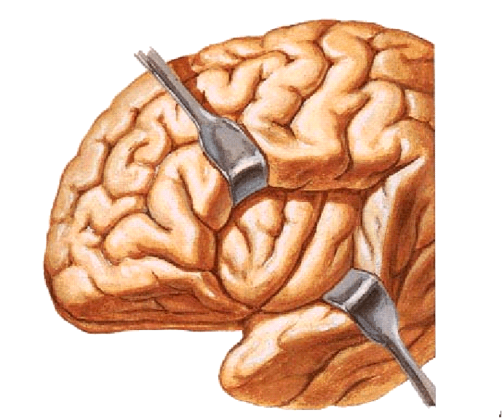
Transverse temporal gyri

Slide 20
Occipital lobe
Lat.occipital sulci
Lunate sulcus
Transverse occipital sulcus
Paritoboccipital sulcus

Slide 22
Sulci & gyri of medial surface
Cingulate sulcus
Callosum sulcus
Parieto-occipital sulcus
Calcarine sulcus
Cingulate gyrus
Medial frontal gyrus
Superior frontal gyrus

Slide 23
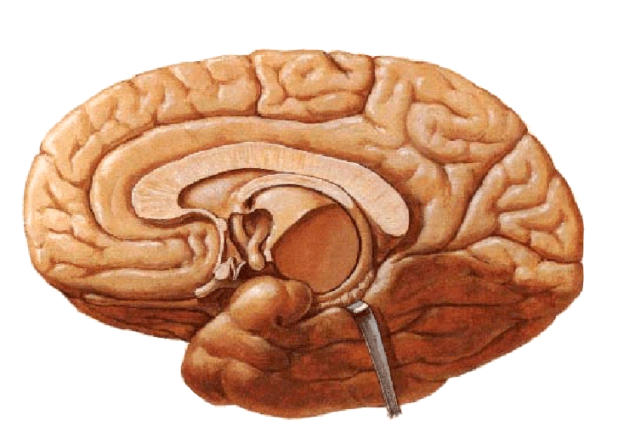
Corpus callosum
Paracentral lobule
Callosal sulcus
Marginal ramus
cingulate gyrus
Parietooccipital sulcus
Cingulate sulcus
Cuneus
Calcarine sulcus
Lingual gyrus

Slide 24
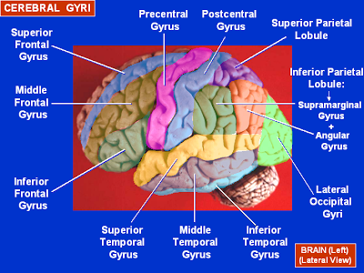

Slide 25
Inferior surface
Orbital part-
Olfactory sulcus
Gyrus rectus
Ant.,Post.,Medial & Lat.orbital gyri
Tentorial surface-
Collateral sulcus
Occipito temporal sulcus
Lingunal gyrus
parahippocampal gyrus
Medial occipitotemporal gyrus
Inf.temporal gyrus

Slide 27
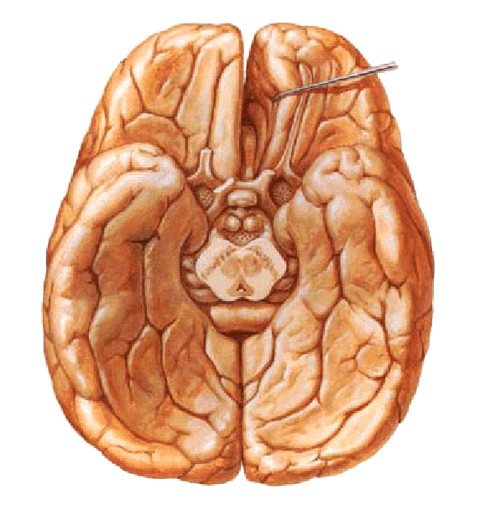
Olfactory bulb
Olfactory tract
Uncus
Olfactory trigone
Occipitotemporal sulcus
Anterior perforated
substance
Parahippocampal
gyrus
Medial and lateral
occipitotemporal
gyri
Collateral sulcus

Slide 28
Few type of sulci given
1.Limiting sulcus
2.Axial sulcus
3.Operculated sulcus
4.Secondary sulcus
5.Complete sulcus

Slide 29
THE END

