Slide 1
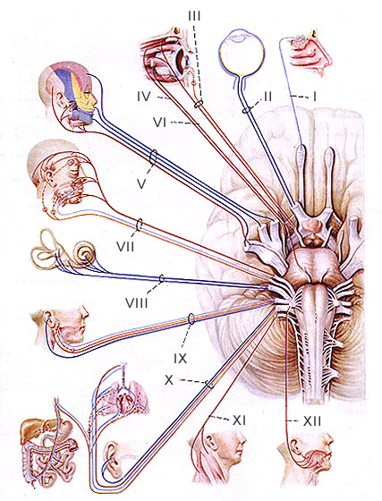
CRANIAL NERVES
By
Dr.Manjula vastrad
Asst Prof
Dept of Rachana Shareera
SMVVS RKM AMC Vijayapur
Email : manjula.prasad2010@gmail.com

Slide 2
introduction
Arise from the brain & pass through or into the cranial bones (thus cranial nerves)
Each cranial nerve has both a number, designated by a roman numeral, and a name..
Numbered I to XII roughly in order from anterior to posterior, in which the nerves arise from the brain.
The names designate a nerve’s distribution or function..
All the nerves are distributed in the head and neck except the X , which also supplies the structures of thorax & abdomen

Slide 3
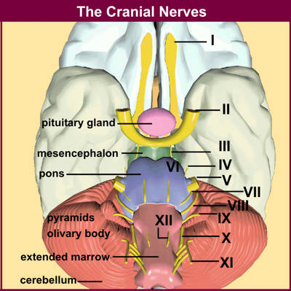

Slide 4
Names Of The Cranial Nerves
OLFACTORY NERVE
OPTIC NERVE
OCCULOMOTOR NERVE
TROCHLEAR NERVE
TRIGEMINAL NERVE
ABDUCENS NERVE
FACIAL NERVE
VESTIBULOCOCHLEAR NERVE
GLOSSOPHARYNGEAL NERVE
VAGUS NERVE
ACCESSARY NERVE
HYPOGLOSSAL NERVE

Slide 5
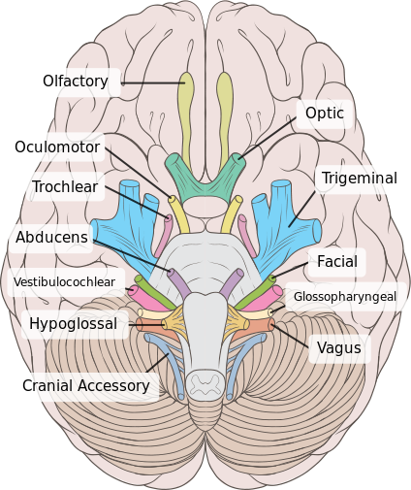

Slide 6
CLASSIFICATION
Three cranial nerves (I,II &VIII) carry axons of sensory neurons and thus called special sensory nerves and are associated with the special senses of smelling, seeing and hearing..
Five cranial nerves(III,IV,VI,XI &XII) are classified as motor nerves because they contain only axons of motor neurons..
The remaining four cranial nerves(V,VII,IX & X)are mixed nerves-they contain axons of both sensory neurons entering the brain stem and motor neurons leaving the brainstem.

Slide 7
CRANIAL NERVES: CLASSIFICATION
SENSORY/
AFFERENT
OLFACTORY
OPTIC
MOTOR/
EFFERENT
OCCULOMOTOR
ACCESSARY
MIXED
TROCHLEAR
TRIGEMINAL
VESTIBULO
COCHLEAR
HYPOGLOSSAL
ABDUCENS
FACIAL
GLOSSO-PHARYNGEAL
VAGUS

Slide 8
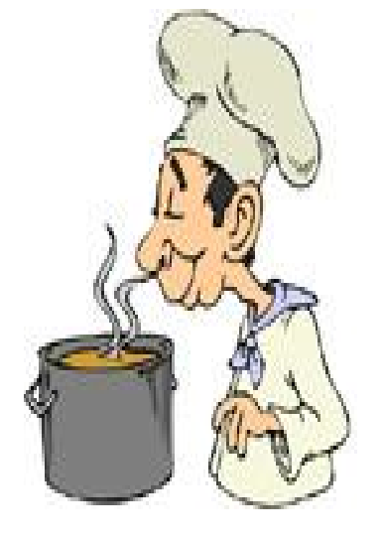
OLFACTORY NERVE

Slide 9

I. Olfactory Nerve
Component: Sensory
Function: Smell
Origin: Olfactory receptor nerve cells
Opening to the Skull: Openings in cribriform plate of ethmoid bone.

Slide 10
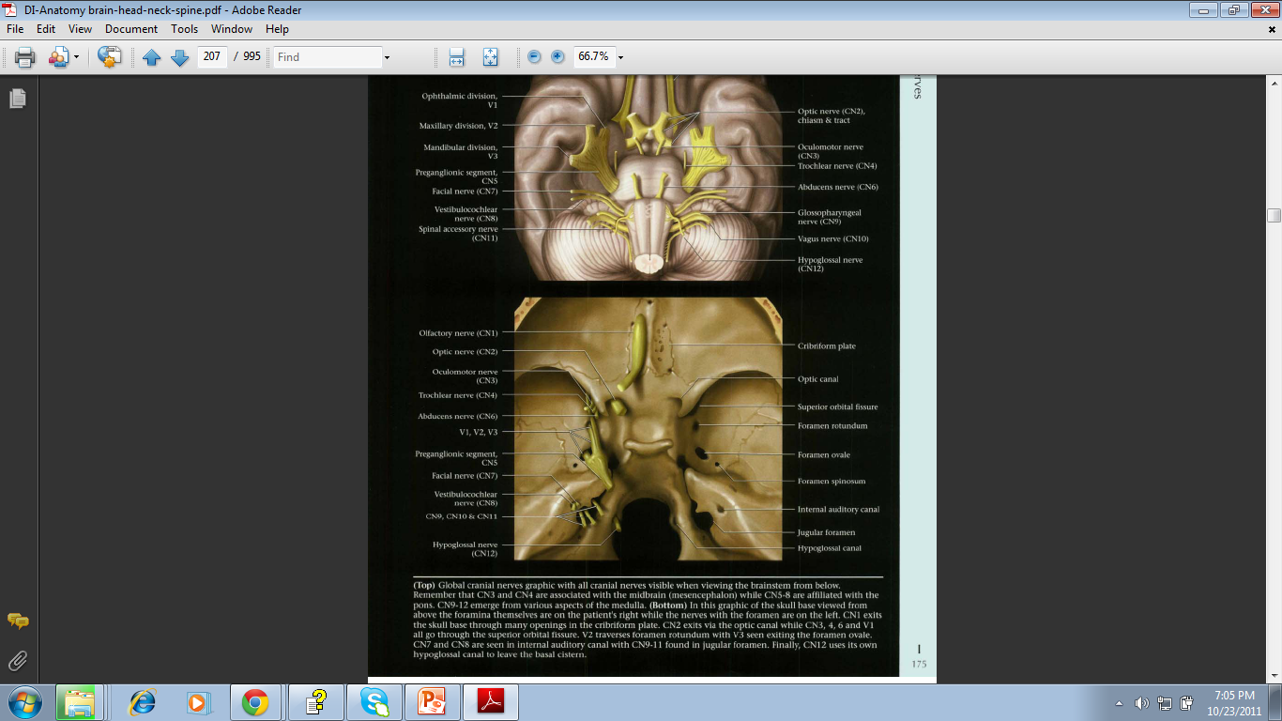

Slide 11
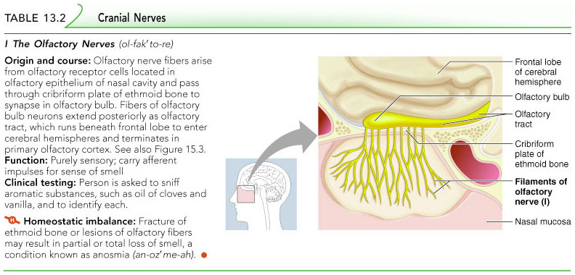

Slide 12
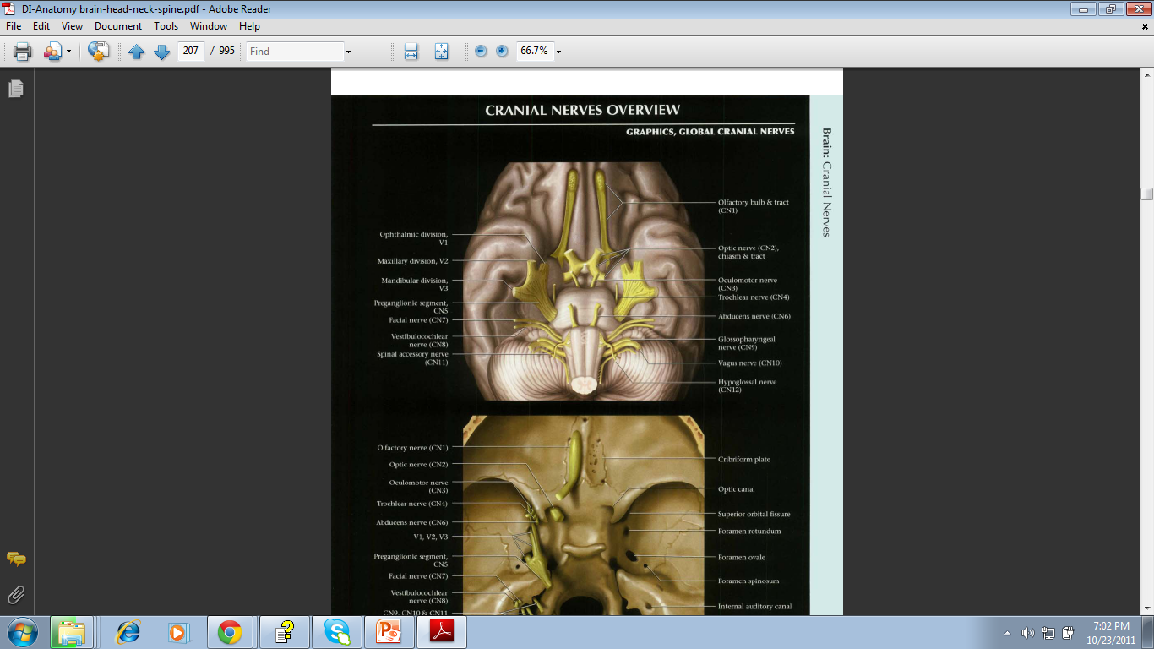

Slide 13
CLINICAL ANATOMY
Anosmia
-Loss of smell (injury to anterior cranial fossa)
Cerebrospinal fluid rhinorrhoea

Slide 14

OPTIC NERVE

Slide 15

II. Optic Nerve
Component: Sensory
Function: Vision
Origin: Back of the eyeball
Opening to the Skull: Optic Canal

Slide 16
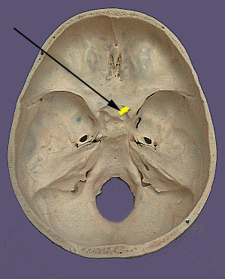
Optic canal

Slide 17
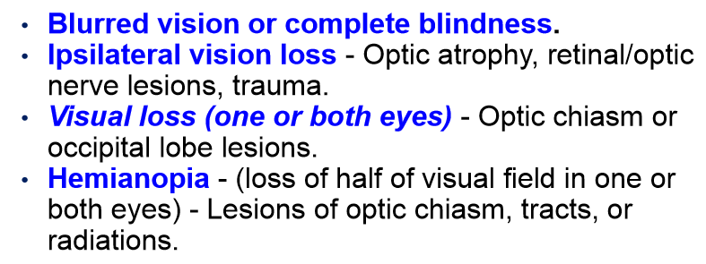
Applied anatomy

Slide 18
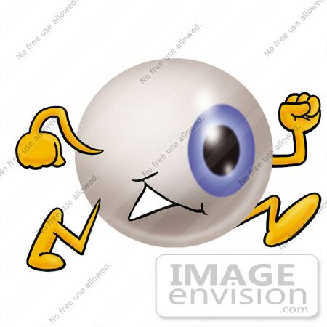
OCCULOMOTOR NERVE

Slide 19
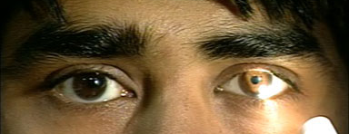
III. Occulomotor Nerve
Component: Motor
Origin: Anterior surface of the midbrain
Opening to the Skull: Superior orbital fissure
Function:
  Raises upper eyelid
  Turns eyeball upward, downward and medially
  Constricts pupil
  Accommodates the eye

Slide 20
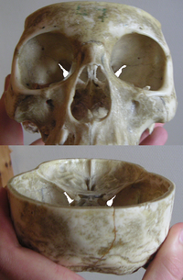
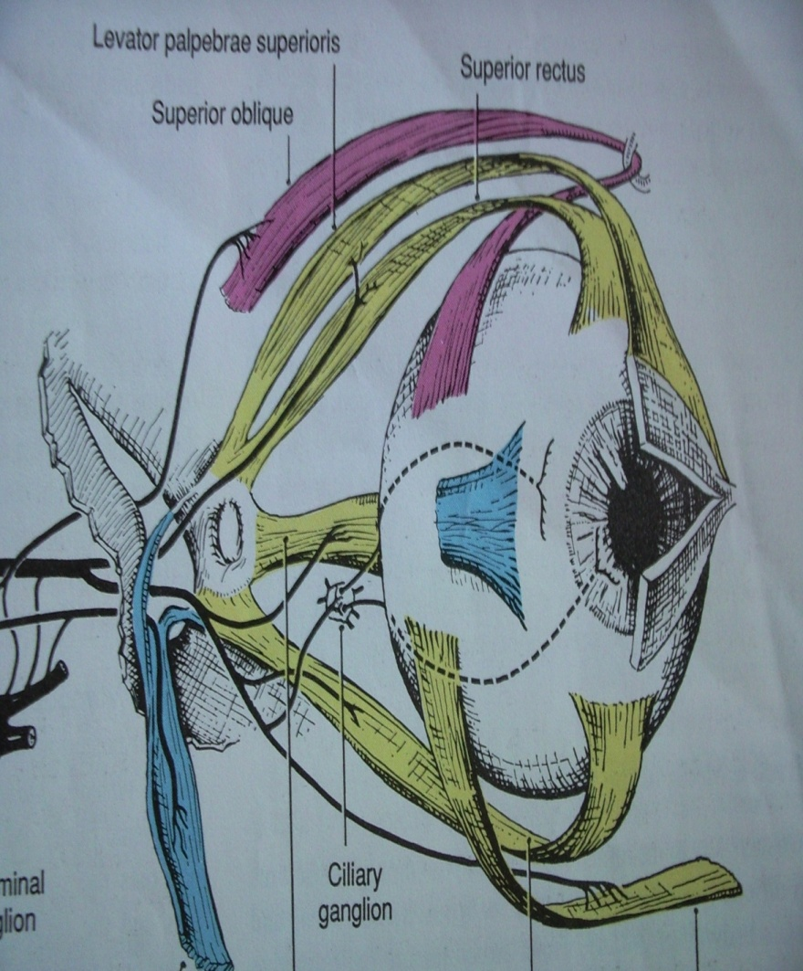

Slide 21
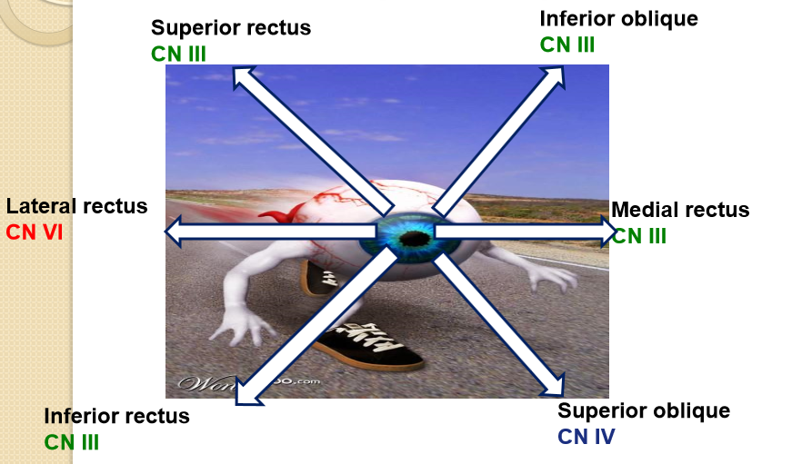
Innervates :
- Extra-Occular Muscles :
1)Superior, Inferior & Medial Recti Muscles
2)Inferior oblique Muscle
- Also Levator Palpabre Superioris

Slide 22
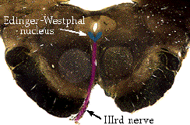
Edinger-Westphal Nucleus
It has an accessory nucleus situated medial to the main nucleus, it is called as EW nucleus/Edinger Westphal nucleus, it is parasympathetic nucleus for sphincter pupillae.
Constrict the pupil and accommodate the lens.
The fibers travel in the IIIrd nerve, so damage to that nerve will also produce a dilated pupil.

Slide 23
Applied anatomy
Lateral strabismus- medial rectus is paralysed & lateral rectus is unopposed.
Inability to move the eye medially laterally.
Ptosis – as ipsilateral levator palpabre superioris is paralysed.
Mydriasis (dilated pupil of affected side) and unresponsiveness to light as the sphincter pupillae is non- functional and

Slide 24
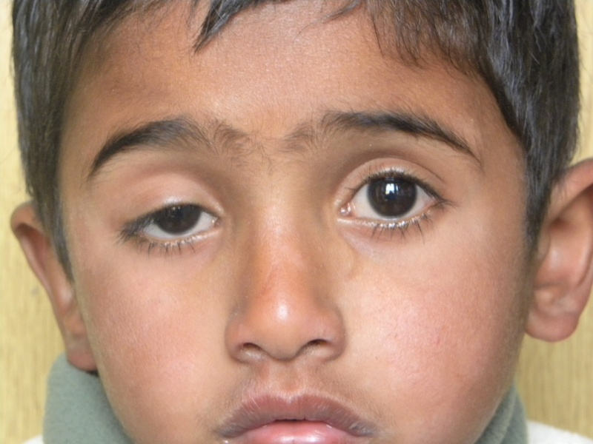

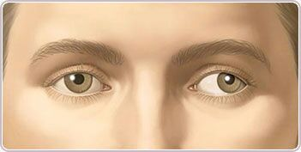
PTOSIS
MYDRIASIS
STRAMISMUS

Slide 25

TROCHLEAR NERVE

Slide 26
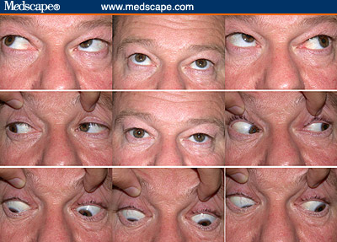
IV. Trochlear Nerve
Component: Motor
Origin: Posterior surface of the midbrain
Opening to the Skull: Superior orbital fissure
Supply : Superior oblique muscle
Function: Assisting in turning eyeball downward and laterally

Slide 27
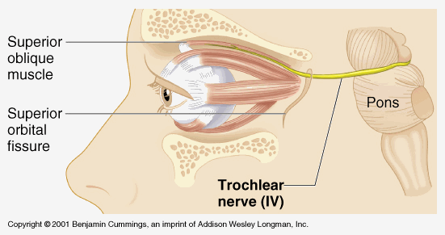
IV. Trochlear Nerve

Slide 28
UNIQUE FEATURES:
It is the only cranial nerve attached to the dorsal aspect of the brainstem (exits the brainstem dorsally)
It is the thinnest & shortest and is particularly vulnerable to traumatic injury.

Slide 29
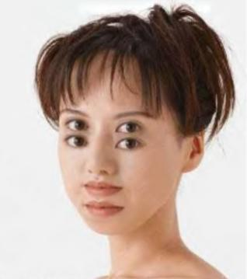
Applied anatomy
Eye points superolaterally.
Attempted movements in these directions (e.g., reading or walking down stairs) may cause diplopia.
This condition often causes vertical double vision as the weakened muscle prevents the eyes from moving in the same direction together.

Slide 30
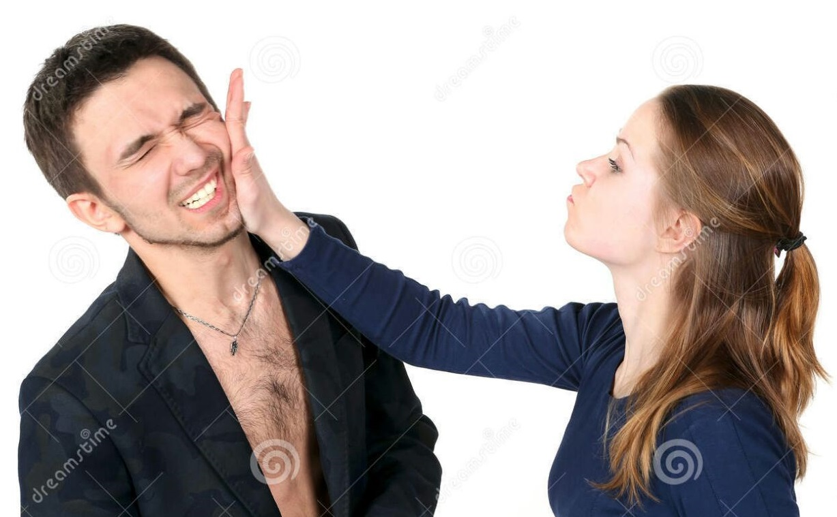
TRIGEMINAL NERVE
V1. Ophthalmic Nerve
V2. Maxillary Nerve
V3. Mandibular Nerve

Slide 31
Trigeminal nerve
It is the largest cranial nerve.
Composed of three divisions
  Ophthalmic (V₁)
  Maxillary (V₂)
  Mandibular (V₃)
Conveys sensory impulses from various areas of the face (V₁) and (V₂), and supplies motor fibers (V₃) for mastication.
Fibers run from the face to the pons via the Superior Orbital Fissure (V₁), Foramen Rotundum (V₂), and the Foramen Ovale (V₃)

Slide 32
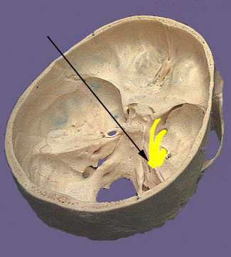

Slide 33
V1. Ophthalmic Nerve
Component: Sensory
Origin: Anterior aspect of the pons
Opening to the Skull: Superior orbital fissure
Function:
  Cornea
  Skin of forehead
  Scalp
  Eyelids and nose
  Mucuos membranes of paranasal sinuses and nasal cavity

Slide 34
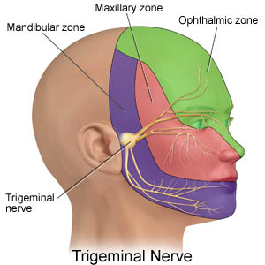

Slide 35
V2. Maxillary Nerve
Component: Sensory
Origin: Anterior aspect of the pons
Opening to the Skull: Foramena rotundum
Function:
  Skin of the face over maxilla
  Teeth of the upper jaw
  Mucous membrane of the nose, the maxillary sinus and palate

Slide 36
V3. Mandibular Nerve
Component: Mixed
Origin: Anterior aspect of the pons
Opening to the Skull: Foramen ovale
Motor Function:
  Muscles of mastication i.e.Massater $ Temporalis muscles.
  Sensory Function:
  Skin of cheek
  Skin over mandible and side of head
  Teeth of lower jaw and TMJ
  Mucous membrane of mouth and anterior part of tongue

Slide 37
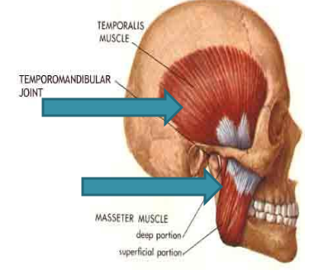

Slide 38
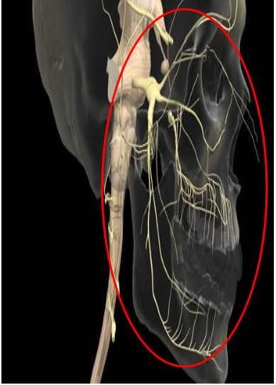

Slide 39
Applied anatomy
Trigeminal neuralgia: is a sensory disorder of CN V that is characterized by sudden attacks of excruciating, lightening like jabs of facial pain. A paraoxysm (sudden sharp pain) can last for 15 mins or more.
The cause of trigeminal neuralgia is unknown , but some investigators believe that it can be due to a anomalous blood vessel that compresses the nerve.
Injury leads to inability to bite down and chew, inability to close jaw.
In severe cases, nerve is cut; relieves agony but results in loss of sensation on that side of the face.

Slide 40
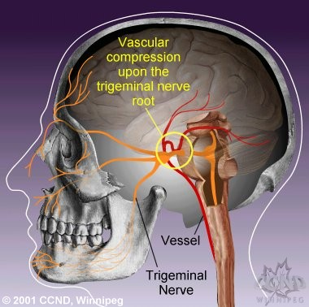

Slide 41

ABDUCENT NERVE

Slide 42
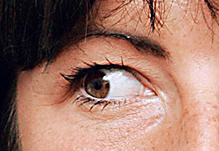
VI. Abducent Nerve
Component: Motor
Origin: Anterior Surface of hindbrain between pons and medulla
Opening to the Skull: Superior orbital fissure
Function: supply Lateral rectus muscle, turns eyeball laterally

Slide 43
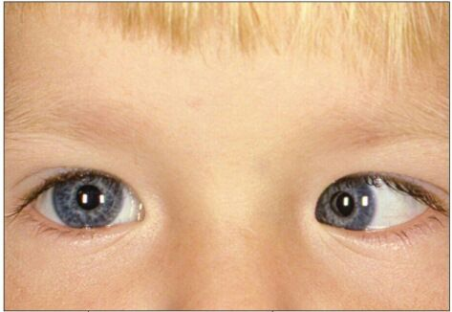
Applied anatomy
Medial strabismus: the affected eye deviates medially by the unopposed action of the lateral rectus muscle.
The individual may be able to move the affected eye to the midline, but no further, by relaxing the medial rectus muscle.

Slide 44
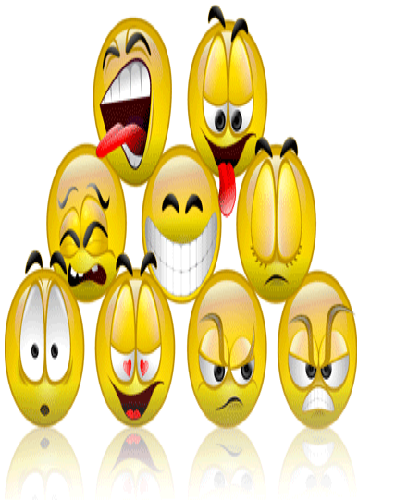
Facial nerve

Slide 45

Facial nerve
Component: Mixed
Origin: Anterior Surface of hindbrain between pons and medulla
Opening in the skull : Internal acoustic meatus, Facial canal, Stylomastoid foramen
Motor functions:
Facial expression
Transmit parasympathetic impulses to lacrimal and salivary glands (submandibular and sublingual glands)
Sensory function is taste from taste buds of anterior two-thirds of the tongue

Slide 46
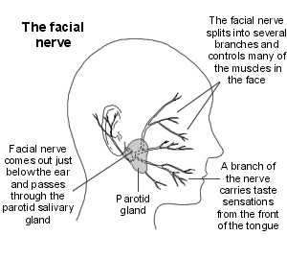

Slide 47
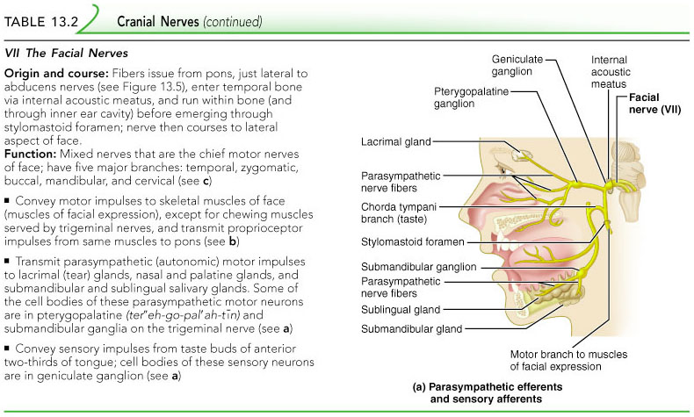
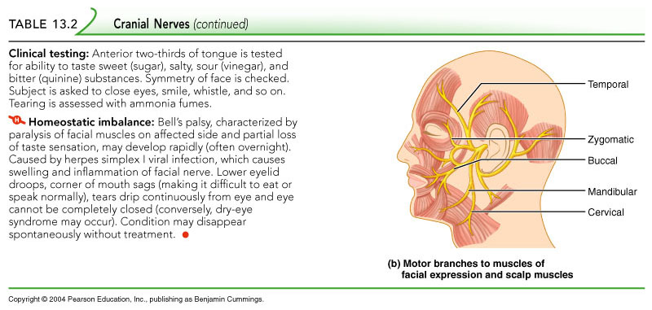
Cranial Nerve VII: Facial

Slide 48
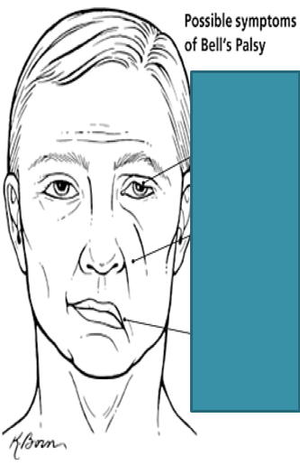
Facial nerve paralysis
Bell’s palsy: paralysis of facial muscles on affected side.
loss of taste sensation
Lower eyelid droops
Corner of mouth sags
Tears drip continuously and eye cannot be completely closed

Slide 49
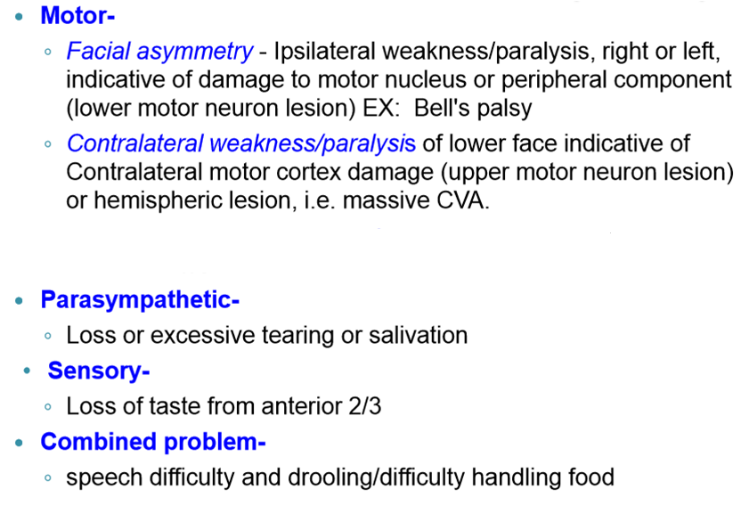
Applied anatomy

Slide 50
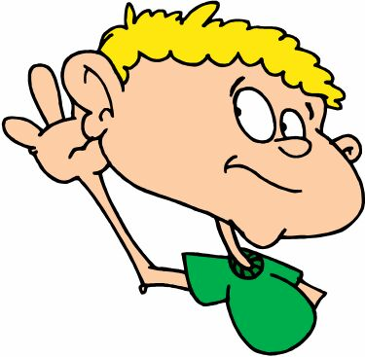
Vestibulocochlear nerve

Slide 51

Vestibulo-cochlear nerve
Other Names : Auditory / Acoustic Nerve
Component : Sensory
  Origin
  Vestibular – Saculae/saccule/semicircular canals
  Cochlear – Organ of Corti
Opening to the Skull: Internal acoustic meatus
Function:
  Vestibular – Saculae/saccule/semicircular canals – Balance position of head
  Cochlear – Organ of Corti – Hearing

Slide 52
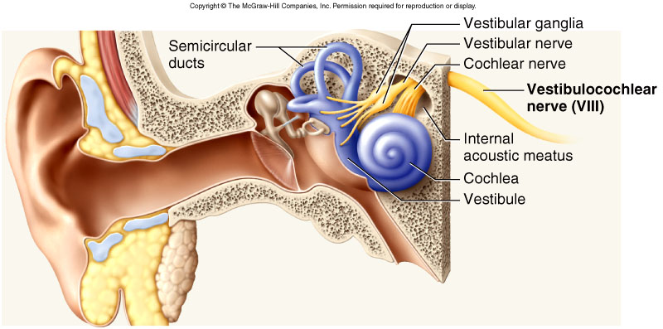
Vestibulo-cochlear Nerve

Slide 53
applied ANATOMY
Damage produces:
Deafness
Dizziness
Nausea
Loss of balance
Vertigo

Slide 54

Glossopharyngeal nerve

Slide 55
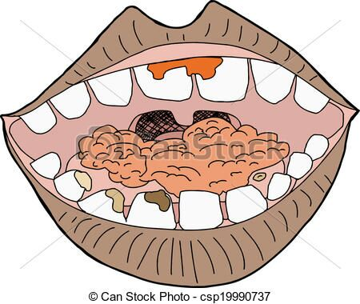
Glossopharyngeal nerve
Component : Mixed
Origin: Medulla oblongata
Opening to the Skull: Jugular foramen
Function:
  Motor
  Stylopharyngeus muscle – assists swallowing
  Sensory: carries sensory signals from tympanic cavity, auditory tube, posterior third of the tongue, pharynx, including the soft palate, tonsil.
  Also supply to Carotid sinus.
  Secretomotor: Parotid gland

Slide 56
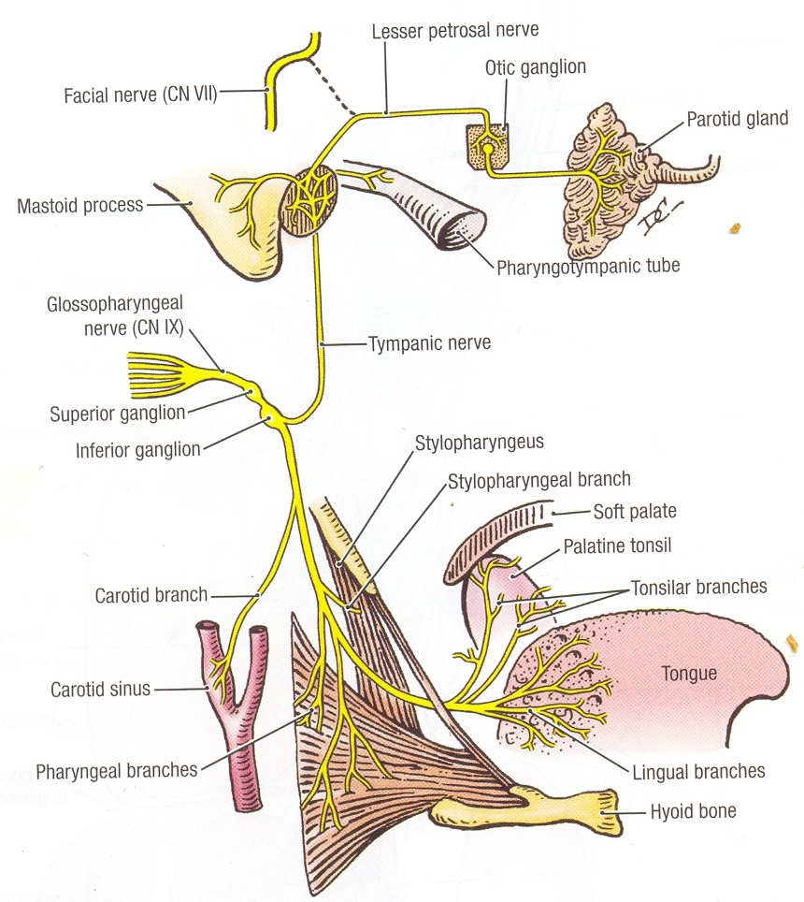

Slide 57
Applied anatomy
Complete lesion of the Glossopharyngeal nerve results in the following :
Loss of taste and common sensations over the posterior one third of the tongue.
Difficulty in swallowing
Loss of salivation from the parotid gland

Slide 58
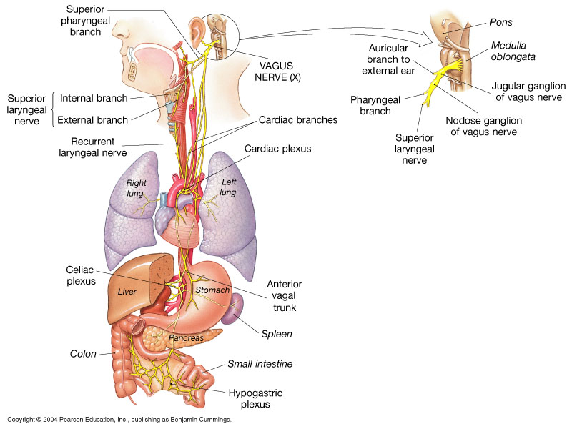
Vagus nerve

Slide 59
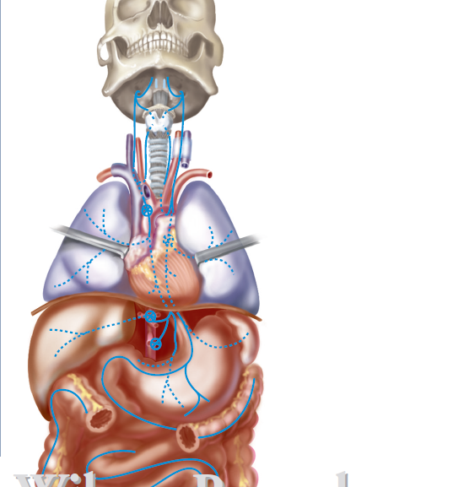
Vagus nerve
Vagus comes from the Latin word meaning “wandering.”
Component : Mixed Nerve( Longest Cranial Nerve)
Origin: Medulla Oblongata
Opening In The Skull: Jugular Foramena

Slide 60
Vagus nerve
Function:
Sensory:
carries sensory information from skin at the back
of the ear and in the external acoustic meatus, part of
the external surface of the tympanic membrane, the
Pharynx, larnyx, trachea, esophagus, thoracic & abdominal viscera
Motor:
One muscle of the tongue (palatoglossus).
Muscles of the soft palate.
Intrinsic muscles of larynx
Pharynx (except stylopharyngeus)
Smooth muscles of Esophagus, Stomach and Heart.
Parasympathetic:
To smooth muscle and glands of the pharynx, larynx, and thoracic and abdominal viscera

Slide 62
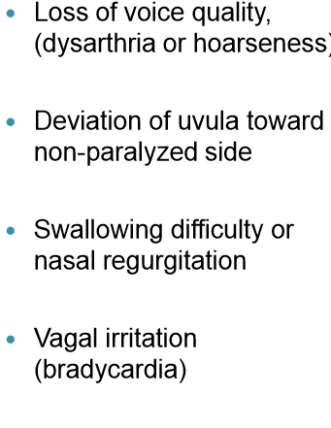
Applied ANATOMY
Lesion Of Vagus Nerve Leads To :
Dysphagia
Total destruction incompatible with life

Slide 63
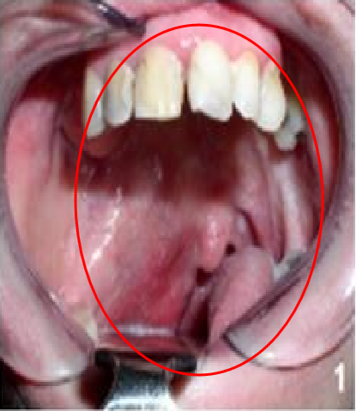

Slide 64

Spinal accessory nerve

Slide 65
Spinal accessory nerve
Component: Motor
Origin: Cranial root emerging from the medulla and a spinal root arising from the superior region of the spinal cord(C1-C6). Spinal root passes upward into the cranium via the foramen magnum
Opening in the skull: Jugular Foramena
  Function:
  Innervates the Trapezius and Sternocleidomastoid, which move the head and neck

Slide 66
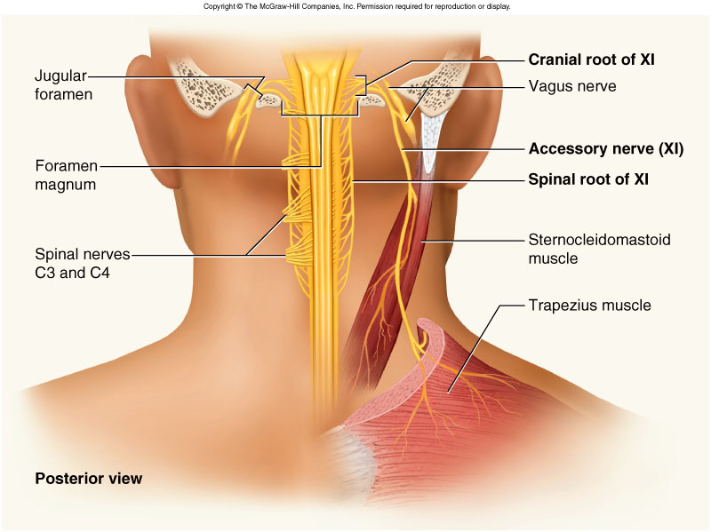
Cranial Nerve XI: Accessory

Slide 67
APPLIED ANATOMY
Lesion may result the followings :
Shoulder droop
Weakness turning head to opposite side.
Weakness & difficulty in raising the arm above horizontal

Slide 68
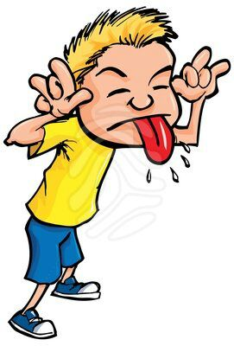
Hypoglossal nerve

Slide 69
hypoglossal Nerve
Component: Motor
Origin: Anterior Surface of medulla
Opening to the Skull: Hypoglossal canal
Function: Supply Extrinsic and Intrinsic muscles of the tongue, which contribute to swallowing and speech.( Except Palatoglossus)

Slide 71

Injury to Hypoglossal nerve
If damaged, difficulties in speech and swallowing.
Inability to protrude tongue.
The hypoglossal nerve accompanies the tonsillar artery on the laterial wall of the pharynx and this wall is vulnerable to injury during tonsillectomy.

Slide 72
Thank you

