Slide 1
ANATOMY OF TRACHEA By : Dr. Manjula Vastrad Asst Prof Dept of Rachana Shareera SMVVS RKM AMC VIJAYAPUR

Slide 2
INTRODUCTION
Trachea (In latin air vessel) is a wide tube Lying more or less in midline, in the lower part of neck and in the superior mediastinum

Slide 3
Its upper end is continuous with with the lower end of larynyx
Trachea in the neck is covered by isthmus of the thyroid gland and acts as a sheild for trachea
At its lower end the trachea ends by dividing into right and left principal bronchi

Slide 5
DIMENSIONS
Trachea is 10 – 15 cm in length
Its external diameter measures about 2cm in males and 1.5cm in females
The lumen is smaller in living than in cadever
Its about 3mm at one year of age
During childhood it corresponds to the age in years, with the max of about 12mm in adults i.e it increases 1mm per year upto 12 years

Slide 6
RELATIONS
The upper end of trachea lies at the lower border of cricoid cartilage, opp C6 vertebra
In the cadever its bifurcated lower end lies at the lower border of T4 vertebra, corresponding in front to sternal angle
However in living subjects, in the erect posture, the bifurcation lies at the lower border of T6 vertebra and descends still further during inspiration

Slide 8
COURSE
Over most of its length trachea lies in median plane
But near the lower end it deviates slightly to the right
As it runs downwards, the trachea passes slightly backwards following the curvature of spine

Slide 9
RELATIONS IN THORAX
Anteriorly
Manubrium sterni
Sternohyoid and Sternothyroid muscles
Remains of thymus
Left brachiocephalic and inferior thyroid veins
Aortic arch, brachiocephalic and left common carotid arteries
Some lymph nodes

Slide 10
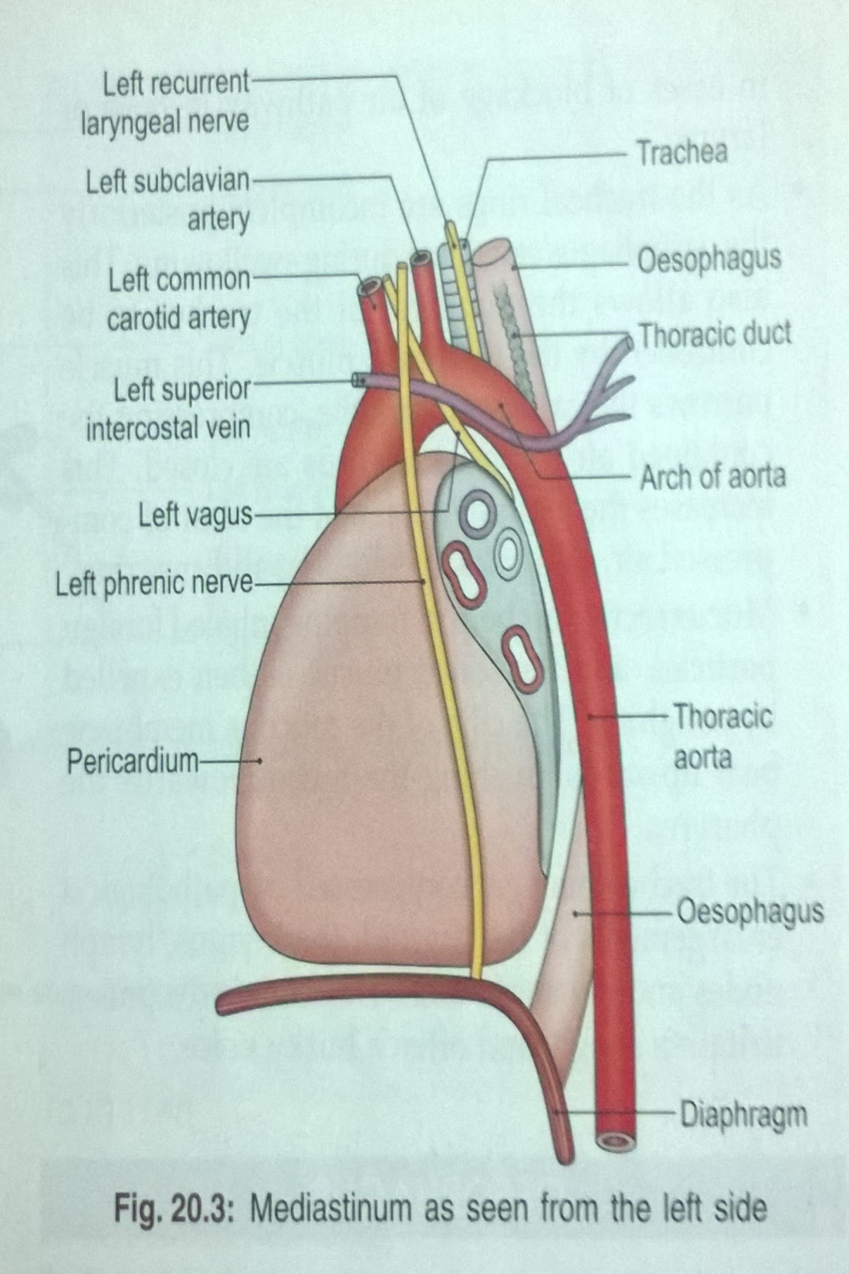

Slide 11
Posteriorly
Oesophagus
Vertebral column
Right side
Right lung and pleura
Right vagus
Azygous vein
Left side
Arch of aorta, left common carotid and left subclavian arteries
Left recurrent laryngeal nerve

Slide 12
STRUCTURE
Trachea has fibroelastic wall supported by a cartilagenous skeleton formed by C-shaped rings
Rings are about 16-20 in number and make the tube convex anterolaterally
Posteriorly there is a gap which is closed by fibroelastic membrane and contains transversely arranged smooth muscle known as trachealis
The lumen is lined by ciliated columnar epithelium and contains many mucous and serous glands

Slide 13
Widest ring – 1st ring
Carina – a hook shaped triangular process upwards from the lower part of last ring at the bifurcation and this ring surrounds the two bronchi
It presents a ridge in the interior of trachial bifurcation. This ridge is a guide to surgeon during bronchoscopic and other examination
Functions
Cartilages prevent collapsing of trachea and so keep the trachea patent
Posteriorly cartilages are deficient for allowing expansion of oesophagus during swallowing

Slide 14
ARTERIAL SUPPLY
Inf thyroid artery branch, of thyrocervical trunk
Bronchial arteries (at the bifurcation of trachea)
VENOUS DRAINAGE
Into inf thyroid venous plexus

Slide 15
LYMPHATICS
Pretracheal and paratracheal lymph nodes
NERVE SUPPLY
Parasympathetic
From rt and left vagus nerves
Recurrent laryngeal nerves
Sympathetic
From upper 4-5 thoracic segments of spinal cords

Slide 16
APPLIED ANATOMY
Tracheoesophageal fistula
Congenital anamoly where communication occur b/w the bifurcation of trachea and oesophagus

Slide 17
Carina present in the last ring of trachea helps in bronchoscopic examination
Foreign body in trachea
Any foreign body through trachea will enters into the right bronchus more easily, as it is more vertical

Slide 18
The posterior part is flattened which helps the passage of food bolus through the oesophagus
Tracheostomy
Is done by the midline incision with isthmus of thyroid gland retracted inferiorly
Indications
In adult: severe laryngeal damage
In infant : severe airway obstruction
Site
Through 2nd tracheal ring then tracheostomy tube is inserted

Slide 19
Trachea may get compressed by pathological enlargements of the thyroid , thymus, lymph nodes and the aortic arch. This causes dyspnoea, irritative cough, and often a husky voice

Slide 20
THANK
YOU

