Slide 1
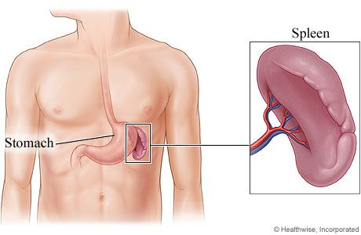
ANATOMY OF SPLEEN By : Dr. Manjula Vastrad Asst Prof Dept of Rachana Shareera SMVVS RKM AMC VIJAYAPUR

Slide 3
SPLEEN
SYNONYMES-
Latin name-Lien
Greek name-Splen

Slide 4
Definition
It is the largest ductless gland in the body & is also a heamo-lymph organ.
It acts as a filter for blood & plays an imp.role in the immune responses of the body.

Slide 6
LOCATION
SHAPE-
Wedge shaped ,it is tetrahedral in shape.
SITUATION-
left hypochondrium & partly in the epigastrium.
COLOUR-
dark purple in colour.
It is soft,highly vascular organ
AVERAGE-
Thick- 1 inch or 2.5cm
Broad- 3 inch or 7.5 cm
Long- 5 inch or 12.5 cm
Weight-7 ounce.
Normally spleen is not palpable.

Slide 7
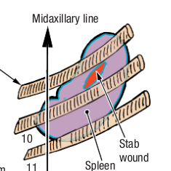
POSITION
It lies obliquely along the long axis of the 10th rib.
It is directed downwards,forwards & laterally.
Angle-45 degrees with the horizontal plane.

Slide 9
EXTERNAL FEATURES
2 ENDS- Anterior end
Posterior end
3 BORDERS- Superior border
Inferior border
Intermediate border
2 SURFACE- Diaphragmatic surface
Visceral surface

Slide 11
ENDS-
Anterior End-
Expanded
Directed downwards & forwards & reaches the midaxillary line.
Posterior End-
Rounded
Directed upwards,backwards & medially & rests on the upper pole of the left kidney.

Slide 12
3 BORDERS-
Superior border-
thin & convex
Inferior border-
Rounded
Intermediate border-
Rounded & directed to the right.
2 SURFACES
Diaphragmatic Surface-
Convex & smooth
Visceral Surface-
Concave & irregular

Slide 14
IMPRESSIONS
1] Gastric impression
2]Renal impression
3]Colic impression
4]Pancreatic impression

Slide 15
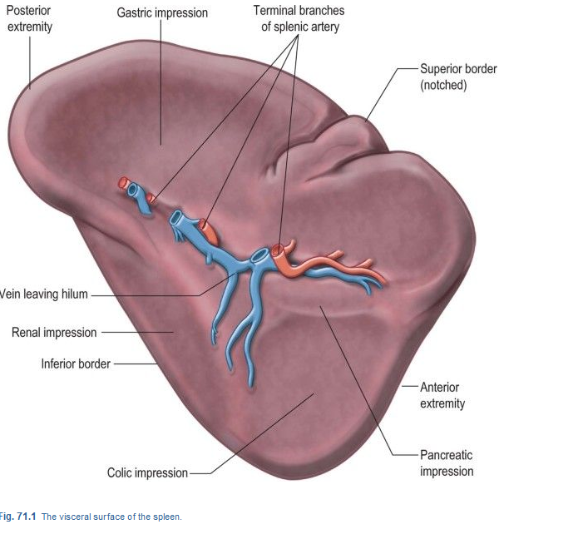
1]Gastric impression-
for the fundus of the stomach lies between the sup. & intermediate borders.
It is the largest & most concave impression on the spleen.
2]Renal impression-
for the left kidney,lies between the inf. & intermediate border.

Slide 16
3]Colic impression-
for the splenic flexure of the colon occupies a triangular area adjoining the ant.end of the spleen.
lower part is related to the phrenicocolic lig.
4]Pancreatic impression-
for the tail of the pancreas lies between the hilum & the colic impression.

Slide 17
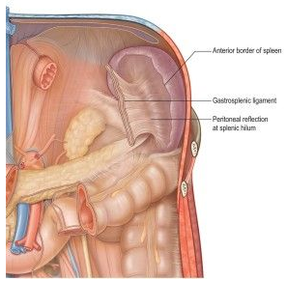
RELATIONS
PERITONEAL RELATION-
1]Gastrosplenic lig.-
Extend from the hilum of the spleen to the greater curvature of the stomach.
2]Iienorenal lig-
Extends from the hilum of the spleen to the ant. Surface of the left kidney.

Slide 18
3]Phrenicocolic lig.-
not attached to the spleen,but support its ant.end.

Slide 19
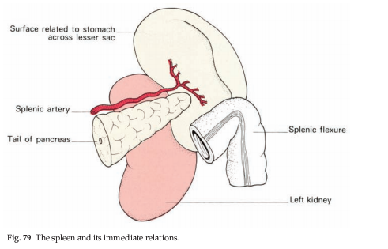
VISCERAL RELATION
Visceral surface-
Related to the fundus of the stomach,the ant.surface of the left kidney.the splenic flexure of the colon & the tail of the pancreas.
Diaphrgmatic surface-
It is related to the diaphragm which separates the spleen from the costodiaphragmatic recess of pleura,lung & 9th,10^{th &} 11th ribs of the left side.

Slide 20
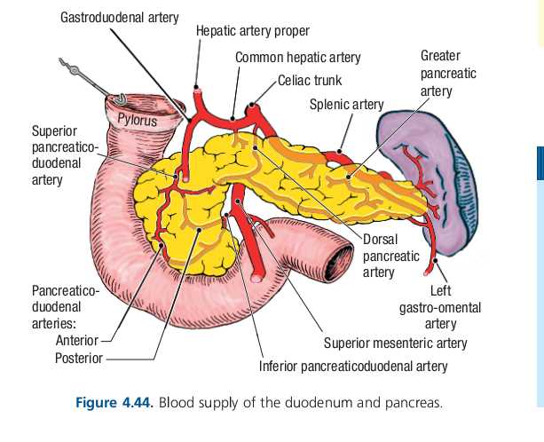
ARTERIAL SUPPLY-
Splenic artery

Slide 21
VENOUS DRAINAGE-
Splenic vein
LYMPHATIC DRAINAGE-
Splenic tissue proper has no lymphatic.
A few lymphatics arise from the connective tissue.

Slide 22
APPLIED ANATOMY
SPLENOMEGALY-
Enlargement of the spleen is called splenomegaly.

Slide 23
SPLENECTOMY
Surgical removal of the spleen is called splenectomy.

Slide 24
Splenic puncture
It can be done below 10 th rib,through the left midaxillary line by a lumbar puncture needle.

Slide 25
Thank you

