Slide 1
ANATOMY OF PANCREAS
BY :
Dr Manjula Vastrad
Asst Prof
SMVVS RKM AMC
Vijayapura

Slide 2
DEFN-
It is a soft,compound,recemose transversely situated retroperitoneal gland having endocrine & exocrine function.
EXOCRINE SECRETION- Pancreatic juice
ENDOCRINE SECRETION- Insulin & glucagon
EXTENT-
From the concavity of the duodenum to the hilum of spleen which crosses transversely with slightly upwards to the left through the post.abd.wall.
CONSISTENCY-
Soft
COLOR-Grayish pink
SHAPE-Retort flask shaped
MEASURMENT-
Length-12 to 15 cm
Breadth-3 to 4 cm
Thickness- 1.5 to 2 cm
Weight-average-85 gm
Situation-Epigastric & left hypochondric region.

Slide 3
SURFACE ANATOMY

Slide 4
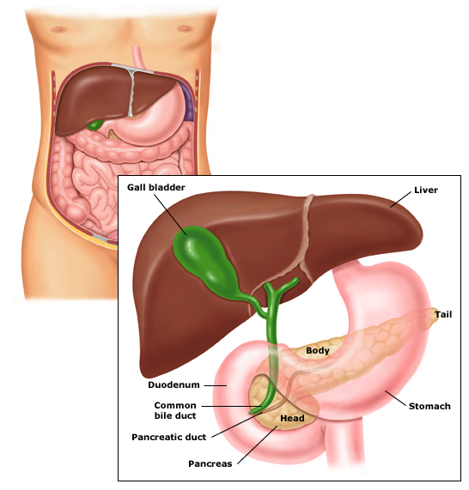
PARTS
1.Head
2.Neck
3.Body
4.Tail

Slide 5
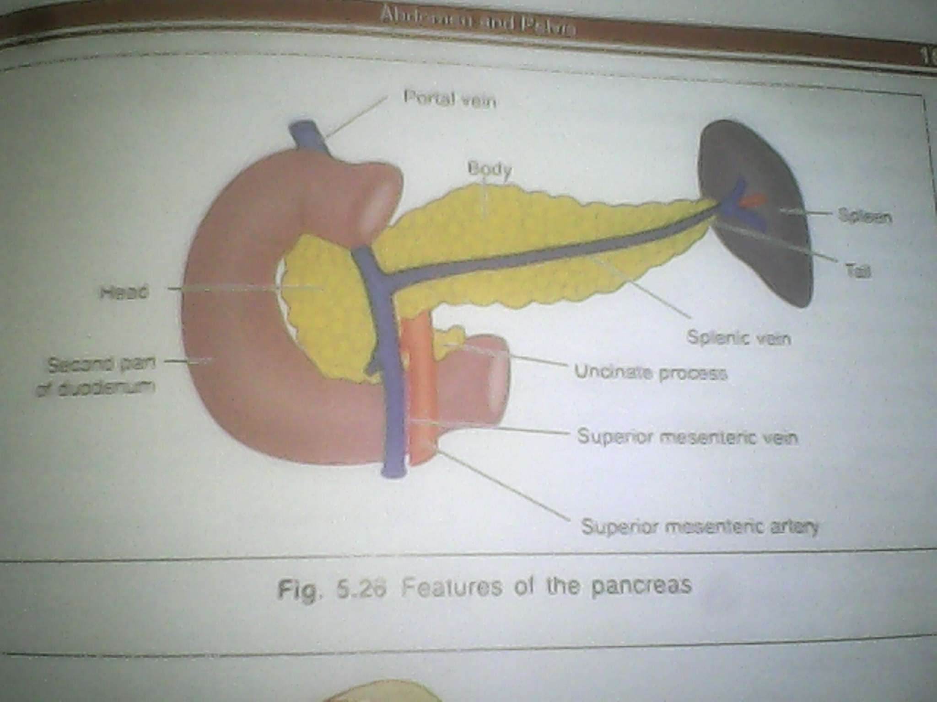
HEAD
It is the rt. Enlarged portion of the pancreas lodged in the duodenal curve.
Situation-
in the curvature of 1st,2nd & 3rd part of duodenum.
Vertebral level-
At the leval of L1 to L2 veretebra.
FEATURES-
3 Borders-
1.Superior b./upper b.
Relation-1st part of duodenum
2.Inferior b./lower b.
Relation-Uncinate process
3rd part of duodenum
3.Right b.
Relation-2nd part of duodenum
Anastomosis betn sup.& inf. Pancraticoduodenal vessels.

Slide 6
Surfaces-
1.Ant.s.-
Direction-Forwards,upwards & left.
Continuation-with the neck.
Relation-Ant.presents a groove for gastroduodenal artery.
Transverse colon
Loose connective tissue
Coils of jejunum
Peritoneal relation-Upper part is nonperitoneal up to the transverse colon,below that it is peritoneal.
2.Post.s.-
Inf.vena cava
Terminal parts renal veins
Rt.crus of the diaphargm
Bile duct it may embeded into the pancreatic substance
Peritoneal reln.:Non perotoneal

Slide 7
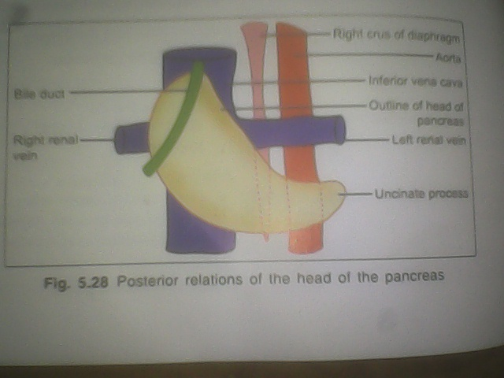

Slide 8
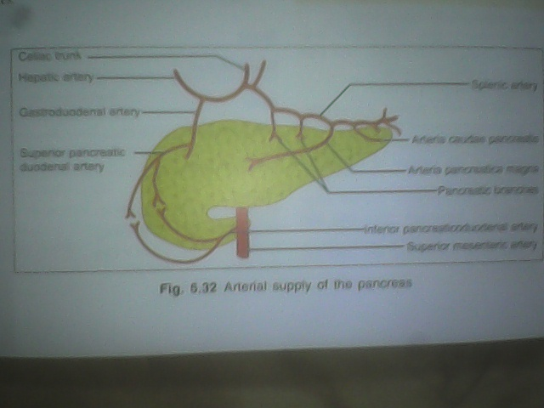
Arterial supply-
Sup.& Inf.pancreticoduenal artery.

Slide 9
UNCINATE PROCESS
The head consist of a process named as uncinate process.
It projects from the lower part of the head directed upwards & medially.
Relation-
Ant.-Sup.mesenteric vessels.
Post.-Abd.aorta.

Slide 10
NECK
Length- 2 cm
Direction-Forwards,Upwards & to the left where the neck meet with body
FEATURES-
Borders-
1.Sup.b.-
Relation-1sT part of duodenum
celiac plexus
2.Inf.b.-
Relation-Attachment of the root of the transverse mesocolon.

Slide 11
SURFACE-
1.Ant.s.-
Relation-peritoneum
divistion of gastroduodenal artery
pylorus of stomach
2.Post.s.-Relation-Superior mesenteric vein
Beginning of portal vein.
Arterial supply-
Sup.& inf.pancreaticoduodenal artery.

Slide 12
BODY
Intro-
1.The body is elongated & the largest part of the pancreas.
2.This extended from the front of aorta to the front of the left kidney
3.This passes towards the left with slight upwards & backwards inclination.
Shape- Prism shaped
Features-
Borders-
1.Sup.b.-
Relation-celiac artery
Splenic artery
Commom hepatic artery
At the rt. End of this border,there is a tuberosity called tuber omentale.

Slide 13
2.Inf.b.-
a.This border separates the post.surface from the inf.surface
b.The sup.mesenteric vessels emerge through its rt.extremity
3.Ant.b.-
It is the differentiating border betn the ant.& inf.surface.
Attachment-
It provides attachment of the 2 layer of transverse mesocolon.
SURFACE-
1.Ant.s.-
Direction-Anterosuperiorly
Relation-Peritoneum
Posteroinferior surface of stomach separated by the omental bursa
2.Post.s.-
Relation-
Peritineal relation-Nonperitoneal
Other relation-Abd.aorta.

Slide 14
Sup.mesenteric artery
Left crus of the diaphragm
Left suprarenal gland
Left kidney
Left renal vessels
Splenic vein
Inf.surface-
Relation-
Peritoneum
Duodenojejunal flexure
Coils of jejunum
Left colic flexure
Arterial supply-
Arteria pancreatica magna branch of splenic artery.

Slide 15
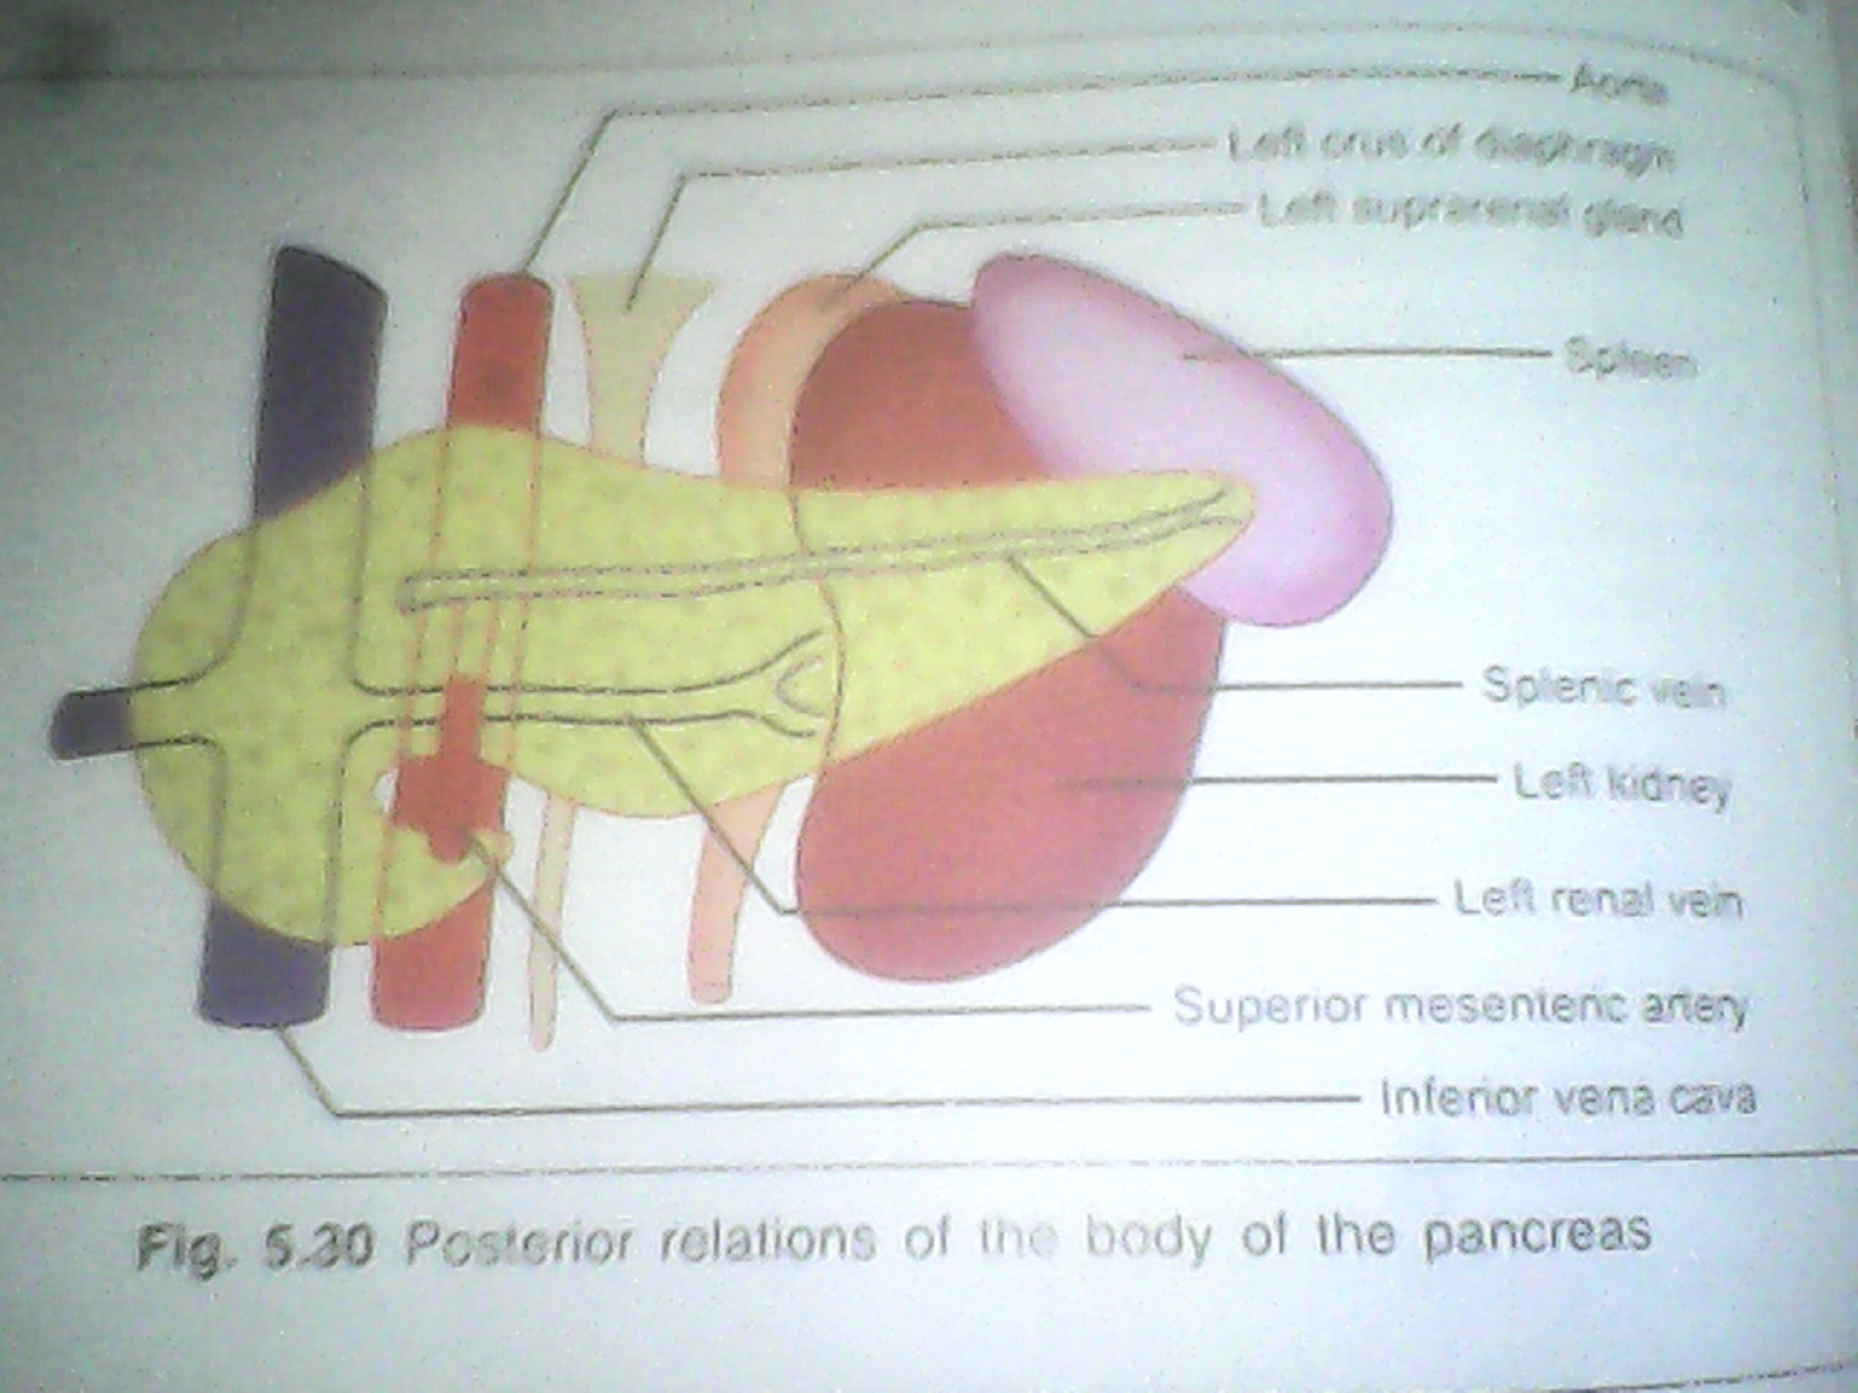

Slide 16
TAIL
Intro-
1.It Is the narrow left end of the pancreas
2.It passes betn. The layers of lienorenal lig.& extend up to the hilum of the spleen.
3.It is the most mobile part of the gland.
Situation-
In betn the 2 layers of the lienorenal lig.along with the splenic vessels,to reaches the spleen.
Relation-
Anteriorly-
Peritoneum of the lesser sac separates from the stomach.
Posteriorly-
Spleen & splenic vessels
Inferiorly-
Left colic flexure
Arterial supply-
branch from splenic artery.

Slide 17
Venous Drainage-
Splenic,sup.mesenteric & portal vein
Lymphatic Drainage-
Into the pancreaticosplienic lymph nodes & efferent vessels drained into celiac lymph nodes.
Nerve supply-
Sympathetic-
From the celiac & sup.mesenteric plexuses.
Parasympathetic-
Rt. & lf.vagus nerves.

Slide 18
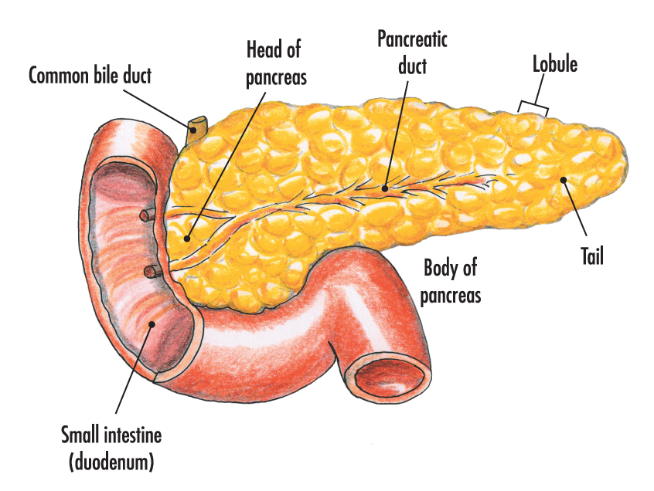
DUCTS OF PANCREAS
Main pancreatic duct
Beginning-
It commences from the tail of the pancreas by the union of numerous smaller ducts,which are open at rt. Angles & regular resembling herring bone pattern.
End-
At the posteromedial wall of the 2nd part of duodenum where it unites with the bile duct to form ampulla of vater,10 cm distal from the pyloric end of stomach at the summit of the major duodenal papilla.

Slide 19
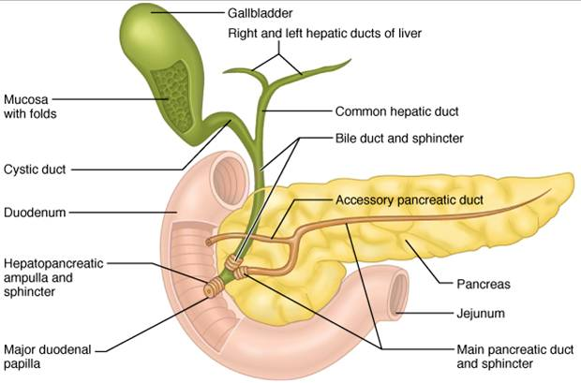
Accessory pancreatic duct-
1.It receives the secretion from the uncinate process & the lower part of the head.
2.It ends by piercing the medial wall of the 2nd part of duodenum,at the summit of minor duodenal papilla,2 cm proximal from the ampulla of vater.

Slide 20
DEVELOPMENT
It arises from the caudal end of the foregut by 2 sources-
1.Dorsal diverticulum-
Arises from the dorsal wall of the primitive duodenum cephalic to the hepatic bud.From dorsal diverticulum develops tail,body & upper part of the head.
2.Ventral diverticulum-
It develops from the stalk of hepatic diverticulum.From ventral diverticulum develops rest part of head & uncinate process.

Slide 21
FUNCTIONS
1.Digestive-
Pancreatic juice contains many digestive enzymes of which the important,
Trypsin breaks down proteins to lower peptides.
Amylase hydrolyses starch & glycogen to disaccharides.
Lipase breaks down fat into fatty acids & glycerol.
2.Endocrine-
Carbohydrates are the immediate source of energy.
Insulin helps in utilizations of sugar in the cells.
Deficiency of insulin results in hyperglycaemia.
The disease is called diabetes mellitus.
3.Pancreatic juice-
It provides appropriate alkaline medium(pH 8) for the activity of the pancreatic enzymes.

Slide 22
HISTOLOGY
It is made up of small clusters of glandular epithelial cells.About 99% of the clusters,called acini,constitute the exocrine portion of the organ.
The cells within acini secrete a mixture of fluid & digestive enzymes called pancreatic juice.
The remaining 1 % of the clusters,called pancreatic islets(islets of Langerhans),form the endocrine portion of the pancreas.
These cells secrete the hormones glucagon,insulin,somatostatic &pancreatic polypeptide.

Slide 23
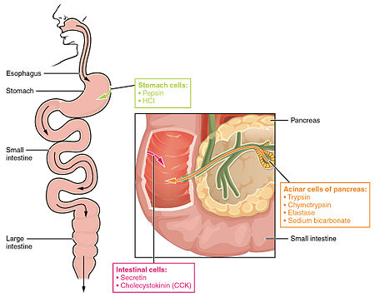
Exocrine function
Acinar cells - exocrine cells of the pancreas that produce and transport digestive enzymes
Amylase, lipase, phospholipase, proteases (trypsinogen, chymotrypsinogen)

Slide 24
Endocrine function
Islets of Langerhans - endocrine cells of the pancreas that produce and secrete hormones into the bloodstream
Glucagon - Alpha cells (A cells) - raises the level of glucose (sugar) in the blood
Insulin - Beta cells (B cells) - stimulates cells to use glucose
Somatostatin - Delta cells (D cells) - regulate the secretion of glucagons and insulin

Slide 25
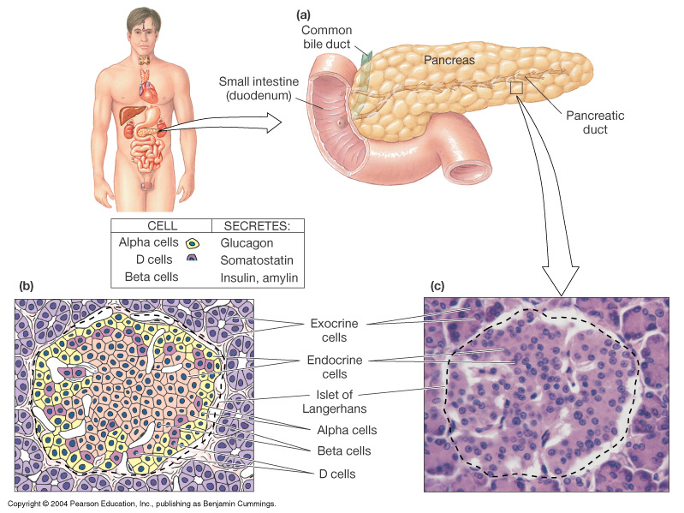
Pancreatic Hormones, Insulin and Glucagon, Regulate Metabolism

Slide 26
Pancreas

Slide 27
APPLIED ANATOMY

Slide 28
CYSTS IN PANCREAS
It may develop in the pancreas,which may press upon the duodenum & bile duct.

Slide 29
TRAUMA IN PANCREAS
Trauma in pancreas may be by the sudden blow to the abdomen,etc.can be compressed & tear the pancreas against the vertebral column.

Slide 30
RUPTURE OF THE PANCREAS
Pancreatic injury can result from sudden,severe,forceful compression of the abd.
Such as the force of a seat belt in an automobile accident.
Because the pancreas lies transeversaly,the vertebral column acts like an anvil & traumatic force may rupture the pancreas.
It frequently tears the pancreatic duct which causing digestion of the pancreatic parechyma & adjacent tissues due to release of pancreatic juice contain highly potent enzymes.

Slide 31
DAMAGE OF THE PANCREATIC TAIL
During splenectomy may cause serious result because tail of pancreas is rich in islets of langerhans cells.

Slide 32
ACUTE PANCREATITIS
It is Graves disease.It may be a complication of mumps.

Slide 33
PANCREATITIS
If pancreatic duct is blocked the pancreas may be inflamed this condition called……….
CAUSES-
1.Reflex of the bile from the ampulla of vater
2.Swelling of the head of the pancreas due to inflammation.
3.Spasm of the hepatopancreatic spincter present around the ampulla of vater.

Slide 34
ACCESSORY PANCREATIC TISSUE
1.It is not unusual for pancreatic tissue to develop in the stomach,duodenum,& ileum or Meckels diverticulum.The most commen site is stomach & duodenum.
2.The accessary pancreatic tissue may contain islets of Langerhans cells that produce insulin & glucagon.

Slide 35
BLOCKAGE OF THE AMPULLA OF VATER
Because the main pancreatic duct joins the bile duct to from the hepatopancreatic ampulla & pierces the duodenal wall,a gallstone passing along the extrahepatic bile passage may lodge in the constricted distal end of the ampulla,where it opens at the summit of the major duodenal papilla.
In this case,both the biliary & pancreatic duct systems are blocked & neither bile nor pancreatic juice can enter the duodenum.
However,bile may block up & enter the pancreatic duct.Asimilar refllux of the bile sometimes results from spasms of the hepatopancreatic sphincter.
Normally,the sphincter of the pancreatic duct prevents reflux of bile into pancreatic duct,however,if the hepatopancreatic ampulla is obstructed,the weak pancreatic duct sphincter may be unable to withstand the excessive pressure of the bile in the hepatopancreatic ampulla.

Slide 36
DIABETES MELLITUS
Deficiency of insulin causes the disease……..

Slide 37
CARCINOMA
It is commen head in pancreas.Pressure over the bile duct leads to persistent obstructive jaundice.It may press upon the portal vein,causing ascites or may involve the stomach,causing pyloric obstruction.

Slide 38
PANCREATECTOMIES
1.In some cases of chronic pancreatitis most of the pancreas is removed.
2.But arrangement of the blood supply between the head of the pancreas,bile duct & duodenum in such a pattern that is impossible to remove whole of the head of the pancreas.
3.Therefore,a rim of the head of the pancreas is retained along the medial border of the the 2nd part of the duodenum to maintain the duodenal blood supply.

Slide 39
THANK YOU

