Slide 1
WELCOME

Slide 2
ANATOMY OF FEMORAL TRIANGLE
BY:
Dr. Manjula Vastrad
Asst Prof
Dept of Rachana Shareera
SMVVS RKM AMC
VIJAYAPURA

Slide 3
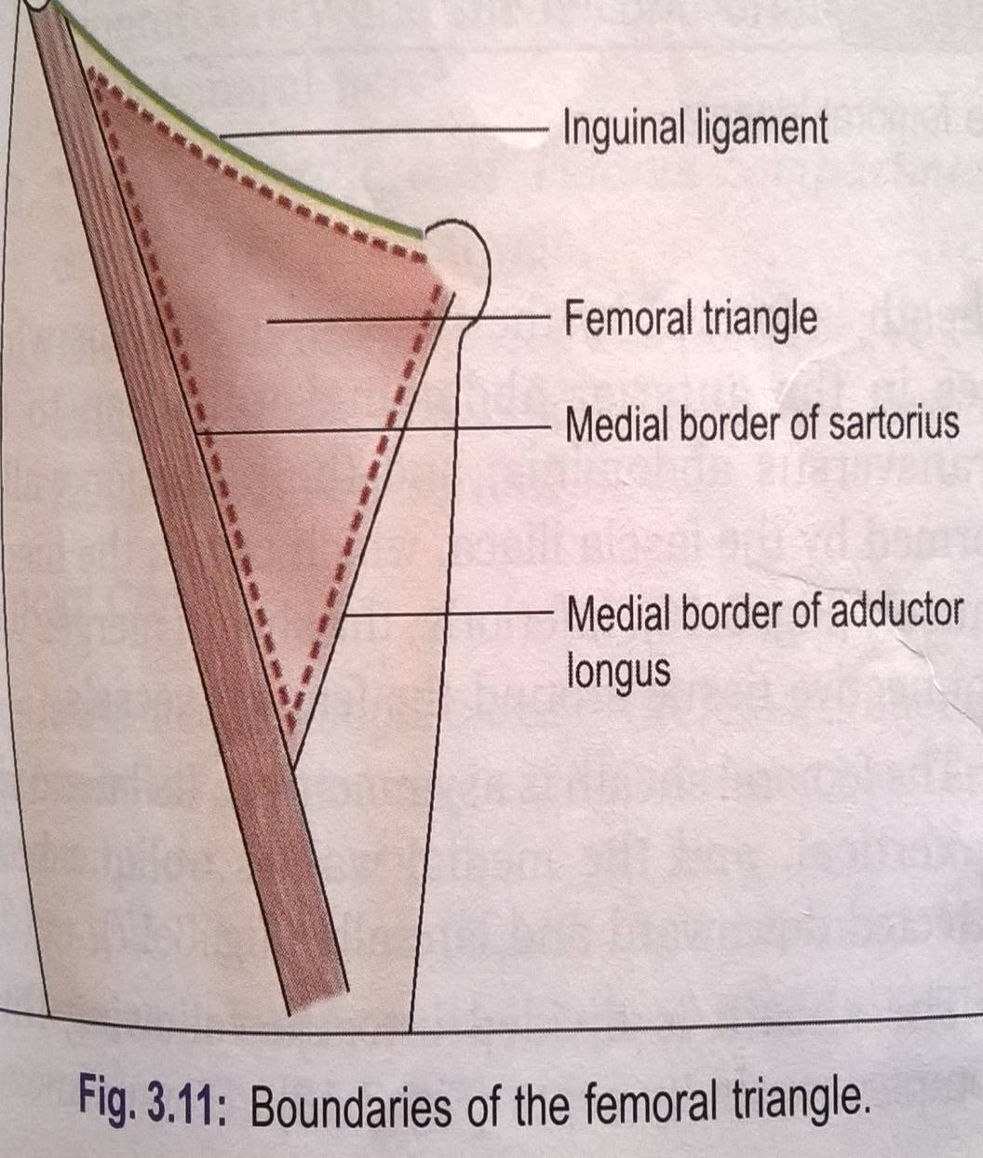
INTRODUCTION
Is a triangular depression on the front of upper one third of the thigh immediately below the inguinal ligament

Slide 4
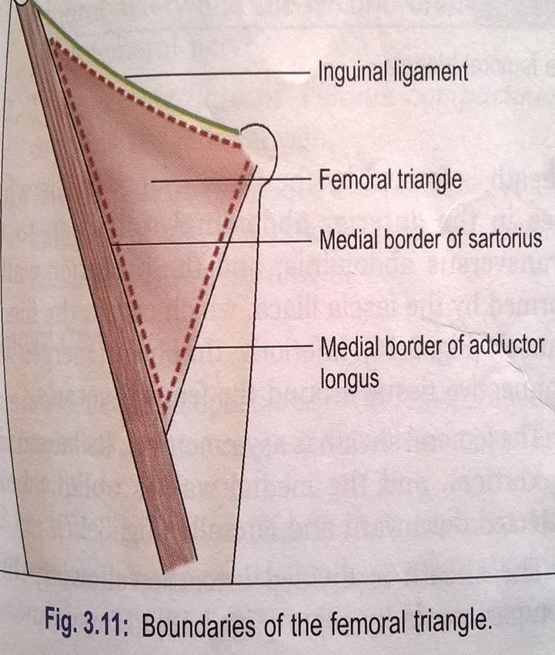
BOUNDARIES
Laterally - medial border of sartorius
Medially - medial border of adductor longus
Base - inguinal ligament
Apex - directed downwards, is formed by the point where medial & lateral borders meet.

Slide 5
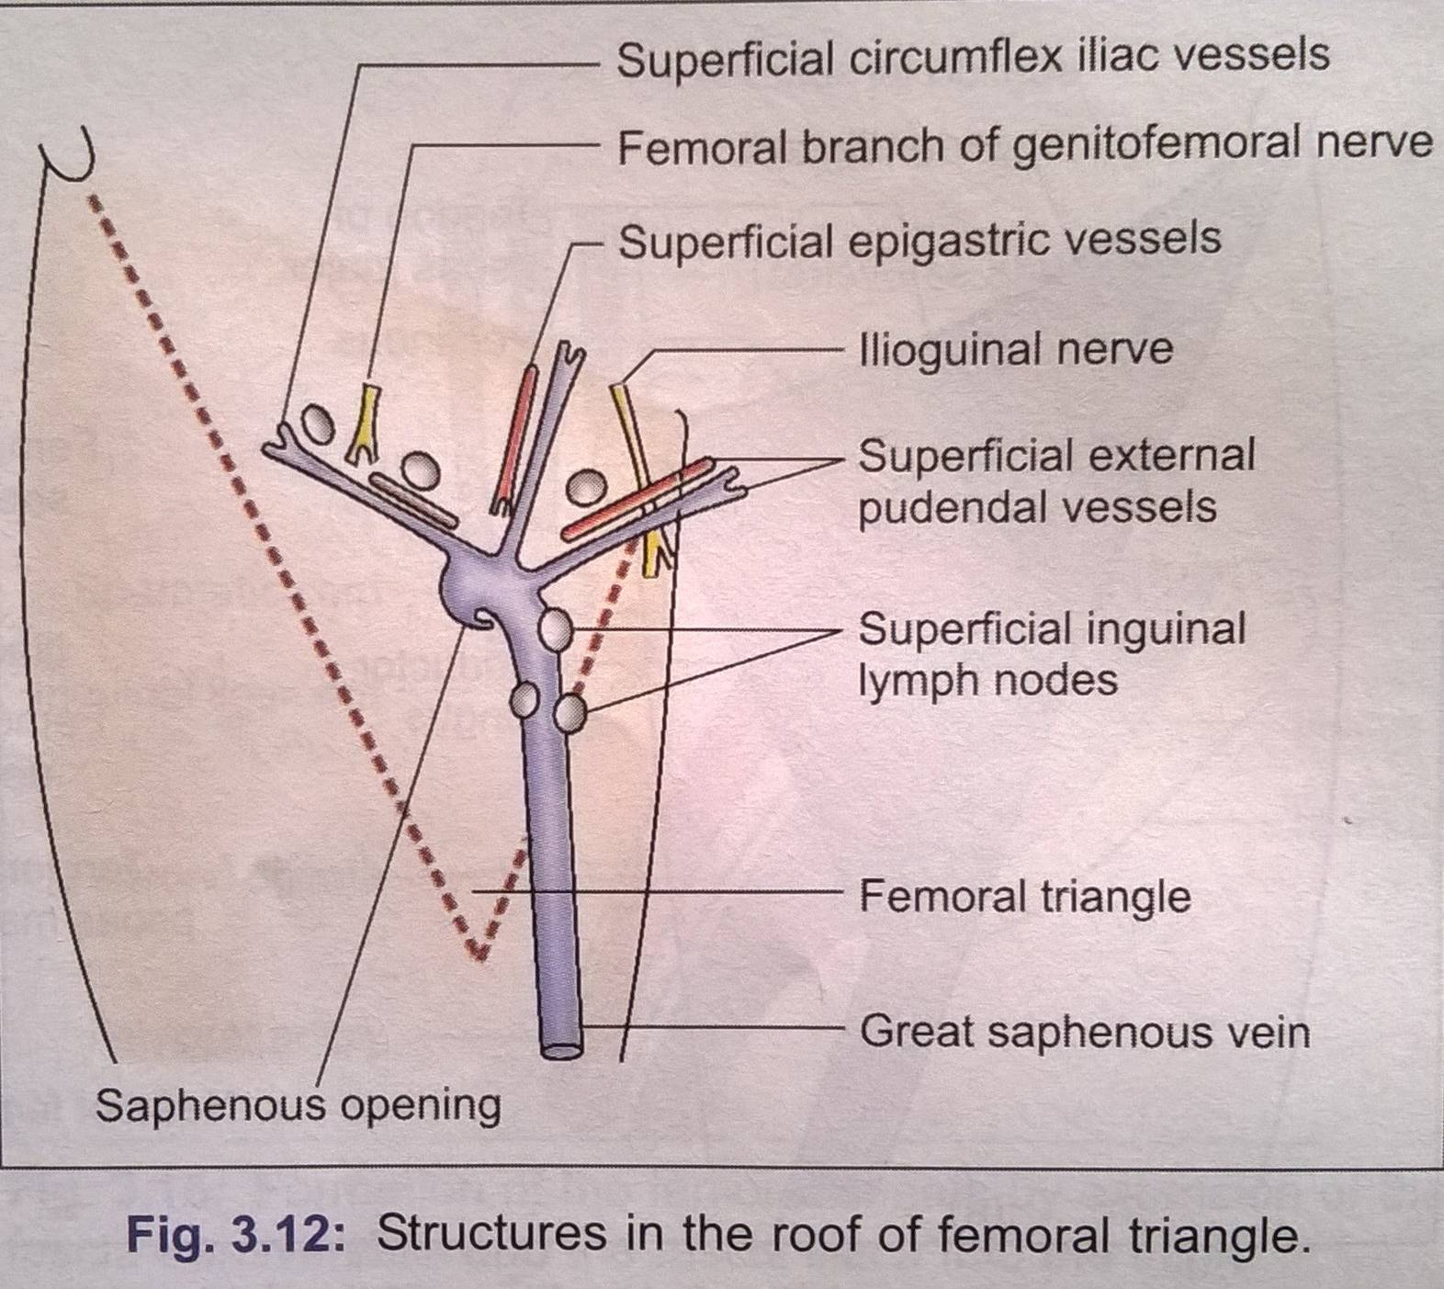
ROOF
Skin
Superficial fascia containing superficial inguinal lymph nodes
Femoral branch of genitofemoral nerve
Branches of ilioinguinal nerve
Superficial branches of femoral vessels
Upper part of great saphenous vein
Deep fascia with saphenous opening & cribriform fascia

Slide 6
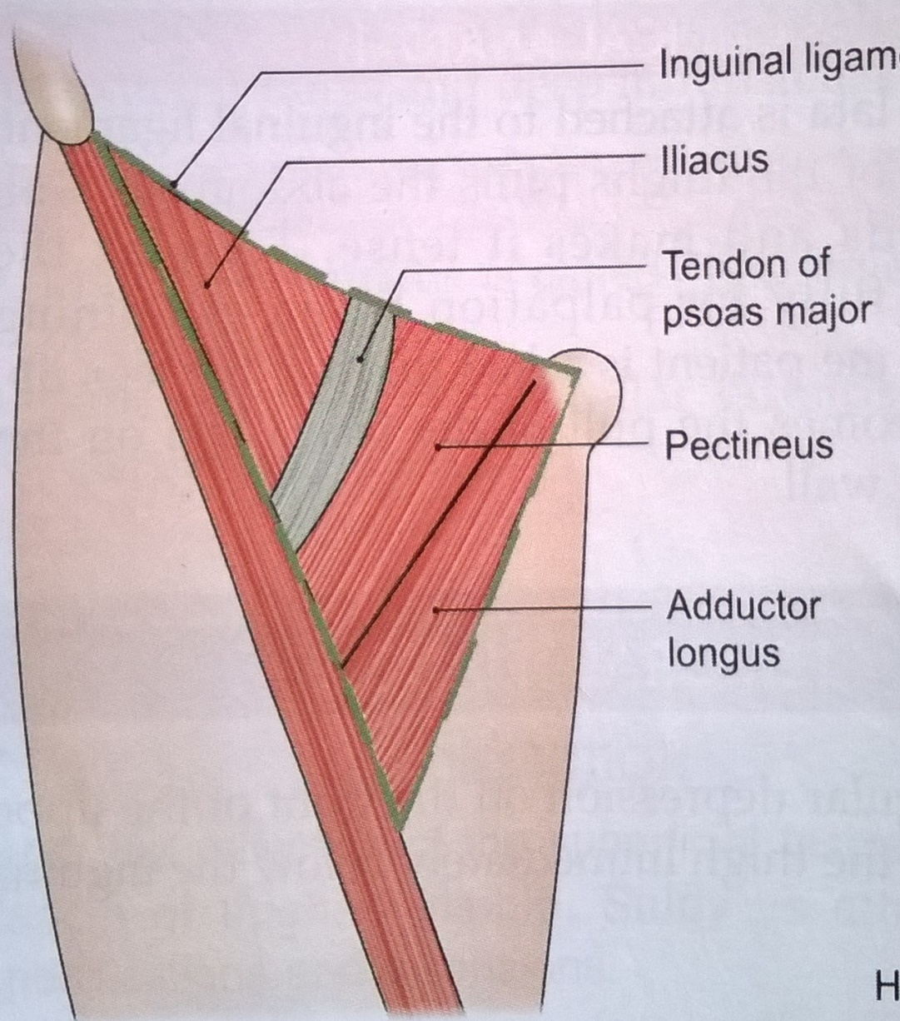
FLOOR
Medially-adductor longus & pectineus
Laterally-psoas major & iliacus

Slide 7
CONTENTS
1. Femoral artery & its branches
2. Femoral vein & its tributaries.
3. Nerves
Femoral nerve
Nerve to pectineus
Femoral branch of the gentiofemoral nerve
Lateral cutaneous nerve of thigh
4. Femoral sheath
5. Femoral canal
6. Deep inguinal lymph nodes

Slide 8
CONTENTS

Slide 9
FEMORAL ARTERY
ORIGIN
Is the continuation of external iliac artery
It traverses the triangle from its base at the mid inguinal point to the apex
EXTENT AND COURSE
Passes downwards and medially, first in femoral triangle and then in adductor canal
Then passes through an opening in adductor Magnus to become continuous with popliteal artery

Slide 10
RELATIONS IN FEMORAL TRIANGLE
Anterior - skin,superficial fascia, deep fascia and anterior wall of femoral sheath
Posterior - rests on psoas major, pectineus and adductor longus
Medially - Femoral vein
Laterally - Femoral nerve and its branches, nerve to pectineus, femoral branch of genito femoral nerve, lateral cutaneous nerve of thigh.

Slide 11
RELATIONS

Slide 12
BRANCHES
Gives 3 superficial and 3 deep branches in femoral triangle
SUPERFICIAL BRANCHES
Superficial external pudendal - supplies skin and external genital organs
Superficial epigastric for skin and fasciae of lower part of anterior abdominal wall
Superficial circumflex iliac for skin along iliac crest

Slide 13
BRANCHES

Slide 14
DEEP BRANCHES
Profunda femoris - largest branch
Arises from lateral side of femoral artery 4cm below inguinal ligament, supplies all 3 compartments of thigh
Branches
Medial circumflex femoral artery Supplies adductor muscles and head of femur
Lateral circumflex femoral artery Supplies Sartorius, rectus femoris, vastis lateralis.

Slide 15
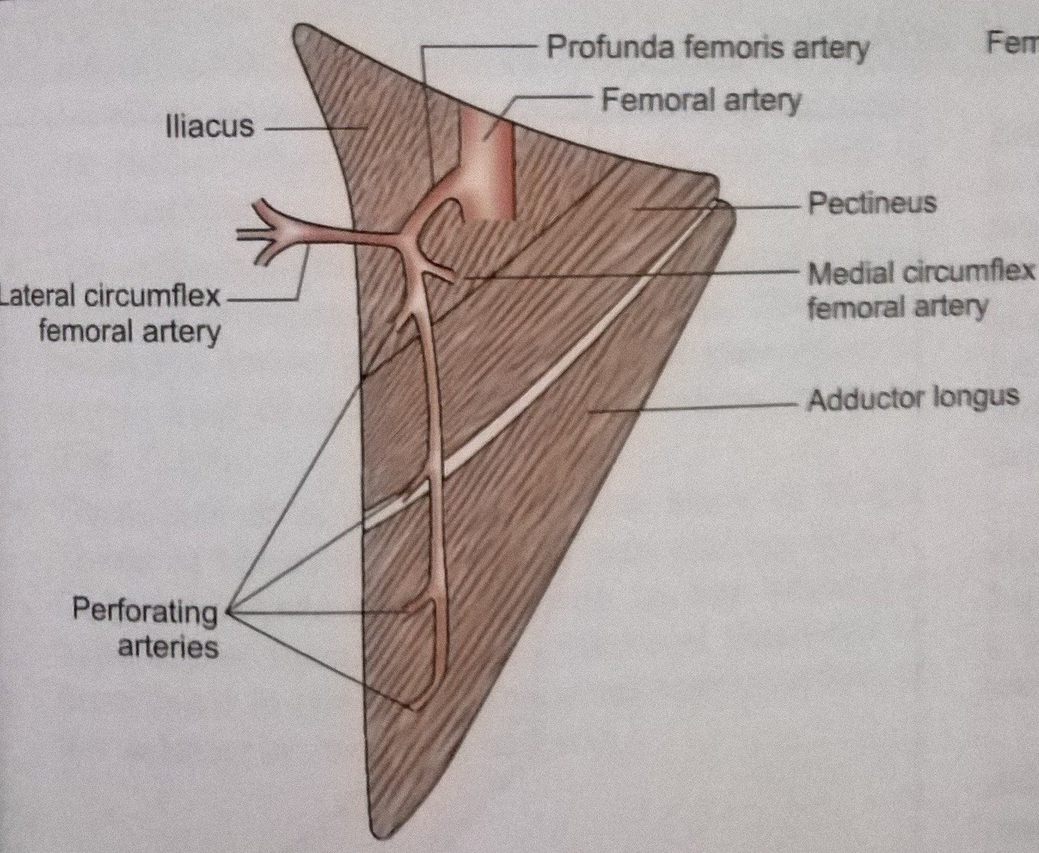
Four perforating arteries arise in front of thigh. Second perforating artery gives rise to nutrient artery to femur
1st at upper border of adductor brevis
2nd in front of adductor brevis
3rd immediately below adductor brevis
4th is the termination of profunda femoris artery

Slide 16
Deep external pudendal artery
Pass deep to spermatic cord / round ligament of uterus supplies scrotum or labium major
Muscular branches
Arise from femoral and profunda femoris artery or its branches to supply muscles of thigh

Slide 17
FEMORAL VEIN
ORIGIN
Begins as an upward continuation of the popleteal vein at the lower end of adductor canal.
TERMINATION
Ends by becoming continuous with the external iliac vein behind the inguinal ligament
COURSE
Accompanies the femoral artery, the vein is medial to artery in the base of the triangle ends at lower end of adductor canal.

Slide 18
TRIBUTARIES
It receives great sephenous vein
Veins accompanying three deep branches of femoral artery in femoral triangle, deep external pudendal and muscular.
Lateral and medial circumflex femoral veins
The descending genicular and muscular veins in adductor canal.

Slide 19
NERVES
Femoral nerve
Lies lateral to femoral artery, outside the femoral sheath, in the groove between ilicus and psoas major muscles.
Branches-
Muscular- ant supplies- sartorius & post supplies all the vasti and rectus femoris
Cutaneous- ant div gives 2 cut i.e intermediate & medial cut nerve of thigh and post div gives 1 i.e saphenous nerve
Articular branches- hip jt & knee jt
Vascular branches to femoral artery & its branches

Slide 20
Nerve to pectineus
Arises from femoral nerve just above the inguinal ligament. Passes behind femoral sheath to reach the surface of pectineus.
Femoral branch of genito femoral nerve.
Occupies the lateral compartment of femoral sheath along with femoral artery. It supplies most of skin over femoral triangle.
Lateral cutaneous nerve of thigh
Crosses lateral angle of triangle . Runs on lateral side of thigh dividing into anterior and posterior branches. Supplies anterolateral aspect of thigh and lateral aspect of gluteal region respectively

Slide 21
FEMORAL SHEATH
Is a funnel shaped sleeve of fascia enclosing upper 3-4cm of femoral vessels
Sheath is formed by downward extension of 2 layers of fascia of abdomen
Anterior wall of sheath is formed by fascia transversalis which lies in anterior abdominal wall deep to transversalis abdominis.
Posterior wall is formed by fascia iliaca, which covers the iliacus muscle.
Inferiorly sheath merges with connective tissue around femoral vessels

Slide 23
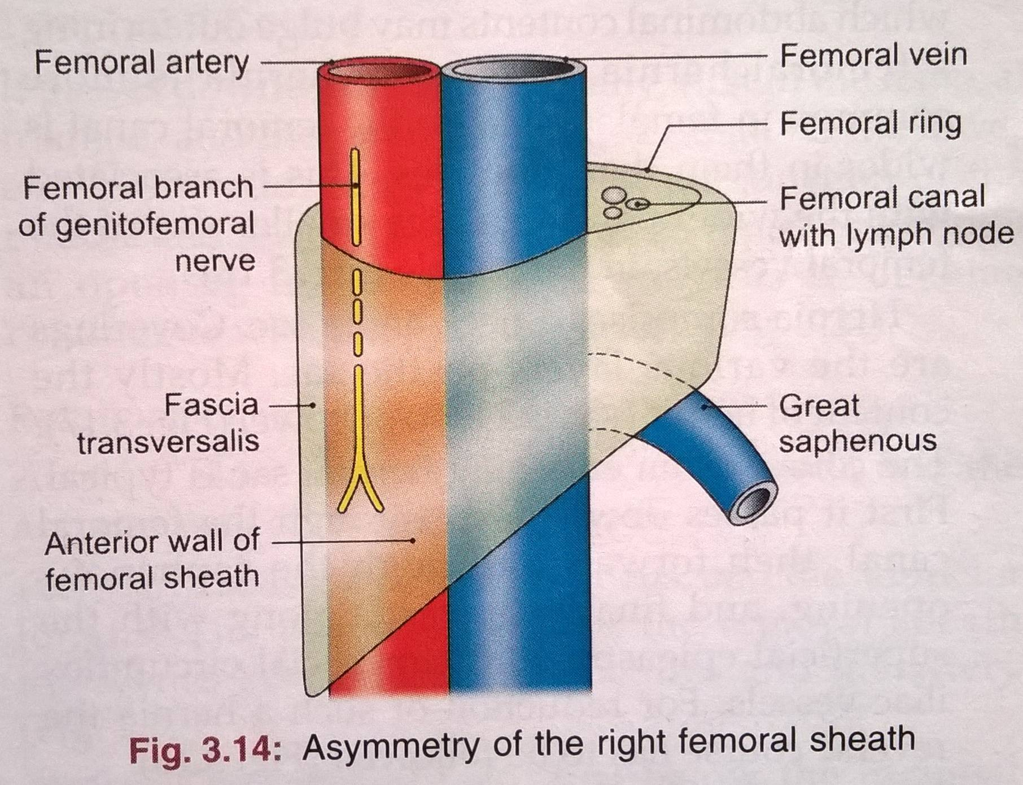
Femoral sheath is asymmetrical
Lateral wall is vertical
Medial wall is oblique being directed downwards and laterally
Sheath is divided into following 3 compartments by septa
Lateral or arterial - contains femoral artery and femoral branch of genito femoral nerve
Intermediate or venous - contains femoral vein
Medial or lymphatic - is smallest of all and is known as femoral canal

Slide 24
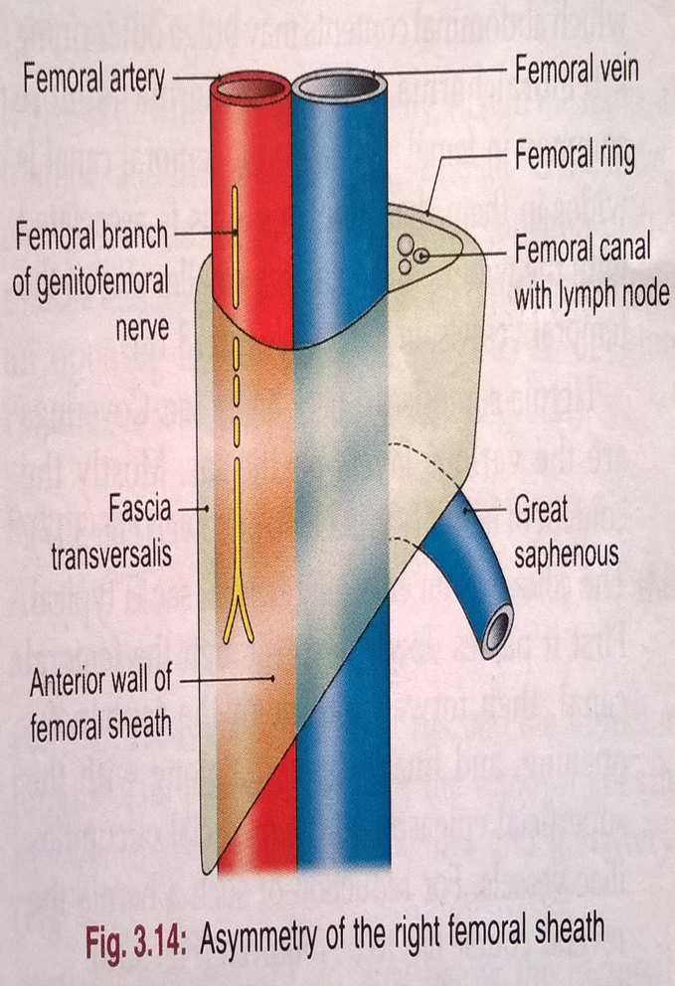
FEMORAL CANAL
This is medial compartment of femoral sheath, conical in shape
Being wide above or at base and narrow below
Is 1.5cm long and 1.5cm wide at its base.
Base or upper end of femoral canal is called femoral ring

Slide 25
FEMORAL RING
Boundaries of ring
Anteriorly inguinal ligament
Posteriorly pectineus and its covering fascia
Medially concave margin of lacunar ligament
Laterally a septum separating it from femoral vein
Femoral canal contains lymph node of colquet or of Rosen Muller, lymphatics and small amount of areolar tissue, lymph node drains glans penis in males and clitoris in females.

Slide 26
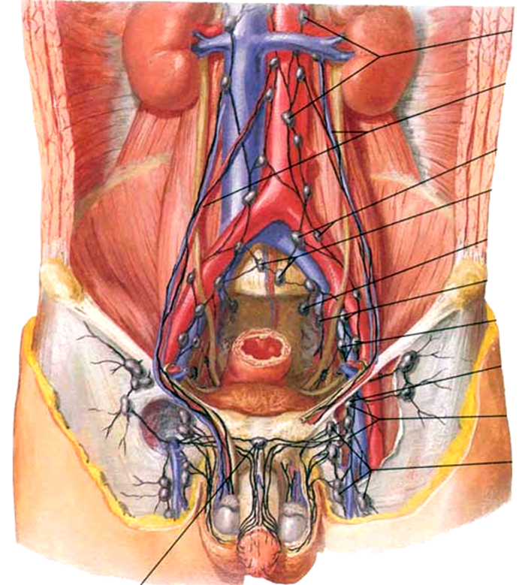
DEEP INGUINAL LYMPH NODES
Lie deep to deep fascia
Lie medial to upper part of femoral vein and receives lymph from superficial inguinal lymph nodes from glans penis or clitoris and deep lymphatics of lower limb

Slide 27
APPLIED
ANATOMY

Slide 28
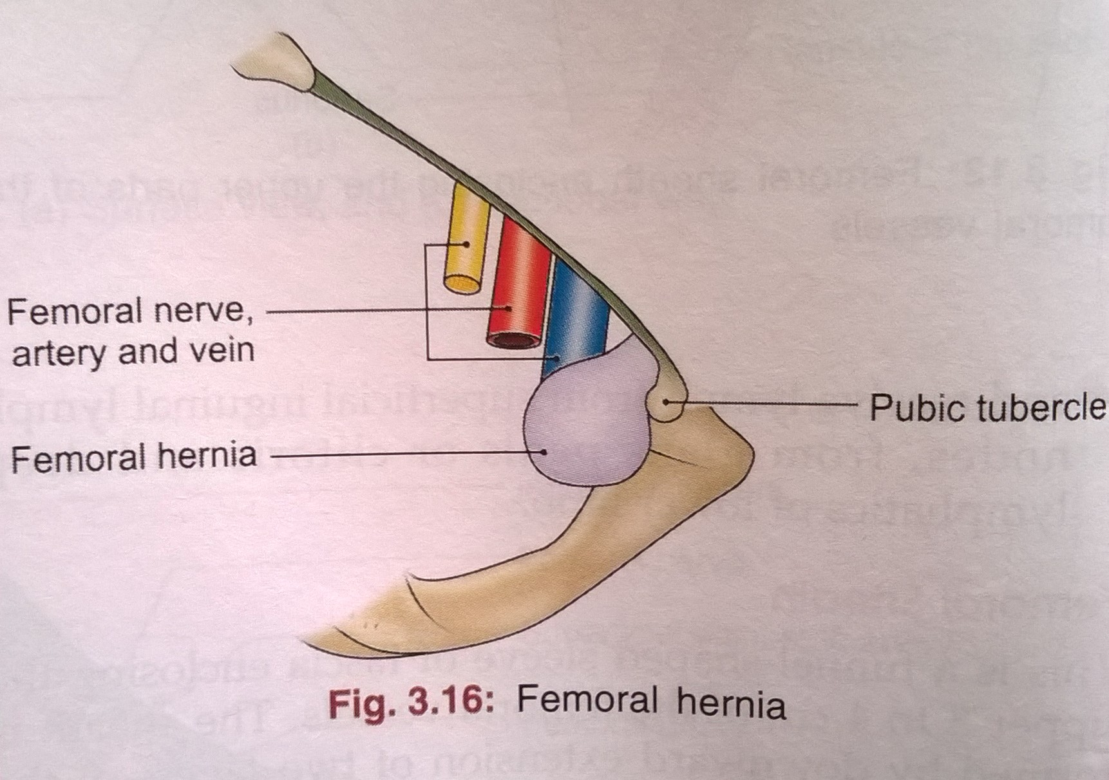
FEMORAL HERNIA
Femoral canal is an area of potential weakness in the abdominal wall through which abdominal contents may bulge out forming a femoral hernia.
Is more common in females because the femoral canal is wider in them than in males.
This is associated with wider pelvis, and the small size of femoral vessels in the females.
In cases of strangulation of the femoral hernia, the surgeon has to enlarge the femoral ring.

Slide 29
ABNORMAL OBTURATOR ARTERY
Normal obturator artery is the branch of internal iliac, occasionally this appears to be branch of inferior epigastric .
Usually the abnormal artery passes laterally to the femoral canal in contact with the femoral vein and is safe in an operation to enlarge femoral ring i.e along with the free margin of lacunar ligament.
Such an artery is likely to cut if an attempt is made to enlarge the femoral ring cutting lacunar ligament.

Slide 30
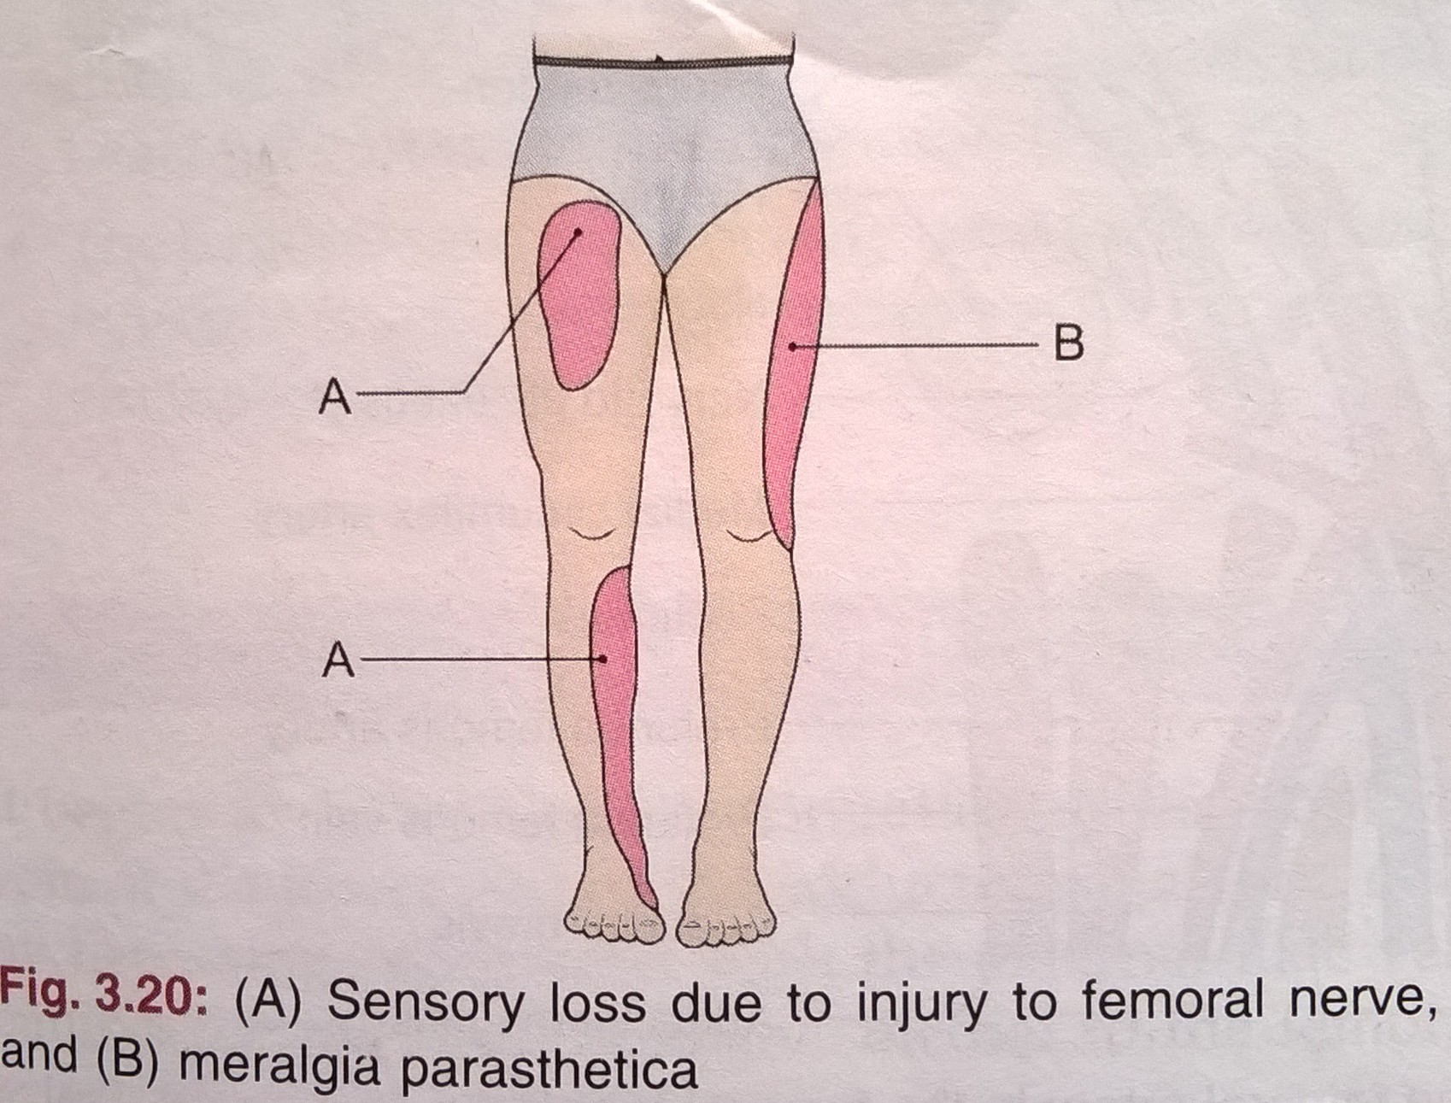
NERVE INJURIES
Injury to femoral nerve by wounds in the groin, though rare, causes paralysis of the quadriceps femoris and sensory deficit on the anterior and medial sides of thigh thigh and medial side of leg.
Lateral cutaneous nerve of thigh May get enlarged in the inguinal ligament. This leads to pain in on lateral side of thigh. It is called Meralgia parasthetica.

Slide 31
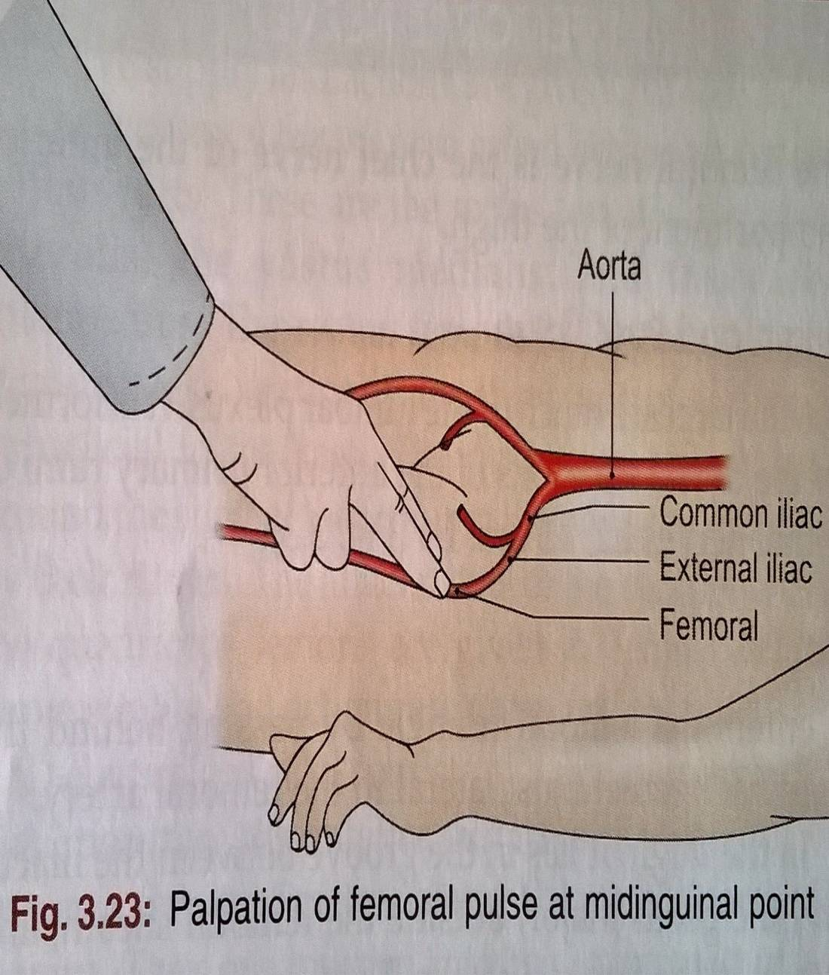
COMPRESSION OF FEMORAL ARTERY
At the mid inguinal point against the head of femur or against the superior ramus of the pubis to control bleeding from the distal part of the limb in the thigh or leg.
The femoral artery is exposed in the adductor canal for various surgical procedures.

Slide 32
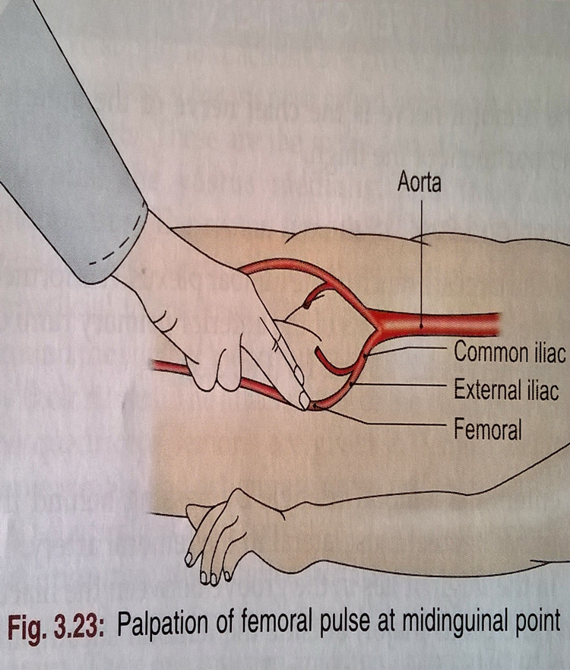
PULSATION OF FEMORAL ARTERY
Can be felt at mid inguinal point, against the head of femur and the tendon of psoas major.
A bilateral absence or feebleness of the femoral pulse may result from narrowing of aorta or thrombosis, i.e the clotting of blood within the aorta.

Slide 33
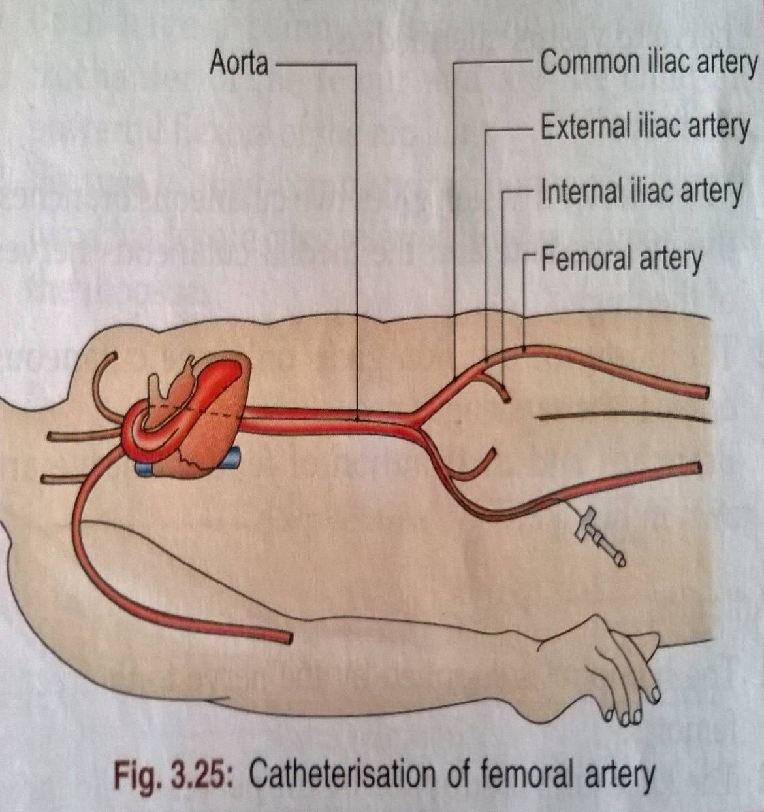
LIGATION OR CATHETERISATION
Since the femoral artery is quite superficial in femoral triangle, it can be easily exposed for ligation i.e tying or for passing a cannula or a thick needle. Catheters are passed upwards till the heart for certain minor operations.

Slide 34
STAB WOUNDS
At the apex of femoral triangle may cut all the large vessels of lower limb because the femoral artery and vein, and the profunda femoris artery and vein are arranged in one line from before backwards at this site. Injury to femoral vessels results in fatal haemorrhage.

Slide 35
INTRAVENOUS INFUSIONS
Femoral vein is commonly used for intravenous infusions in infants and in patients with peripheral circulatory failure.

Slide 36
THANK
YOU

