Slide 1
ANATOMY OF Diaphragm BY : Dr Manjula vastrad asst prof smvvs rkm amc vijayapura

Slide 2
contents
1. Introduction 2. Definition
3. Shape 4. Origin
5. Insertion 6. Openings
7. Relations 8. Arterial supply
9. Venous drainage 10. Nerve supply
11. Actions 12. Anamolies
13. Applied anatomy

Slide 3
INTRODUCTION
It is the chief muscle of respiration
Separates the thoracic and abdominal cavities
Gives passage to number of structures passing in both the directions

Slide 5
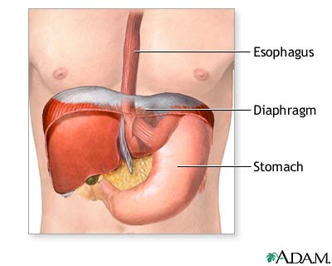
DEFINITION
It is a dome shaped musculofibrous partition between thorax and abdomen.

Slide 6
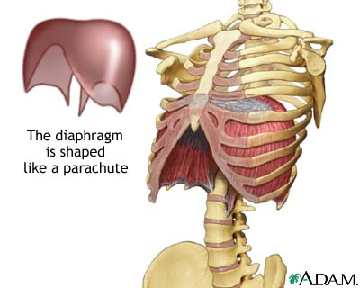
SHAPE
Its thoracic surface is convex on right and left but in the middle it is depressed.
Concave in its inferior or abdominal surface

Slide 7
ORIGIN
Origin of muscle fibres may be grouped into three parts
Sternal : By two fleshy slips, from the posterior aspect of the xiphoid process
Costal : From the inner surface of the lower 6 ribs with respective cartilages, interdigitating with transversus abdominis

Slide 9
Vertebral :
a} From a pair of crus i.e from right and left
Right crus
It is longer and also more muscular than left
Origin : From the front of bodies and intervertebral disks of L1 to L3 vertebrae
Left crus
Origin : From bodies and intervertebral disk of L1 and L2 vertebrae

Slide 11
b} From a pair of medial arcuate ligaments, which is attached to side of body of L1 or L2 vertebrae and laterally to the tip of transverse process of L1 vertebra
c} From a pair of lateral arcuate ligaments, which is attached medially to tip of transverse process of L1 vertebra and laterally to the lower border of 12th ribs near its mid point

Slide 12
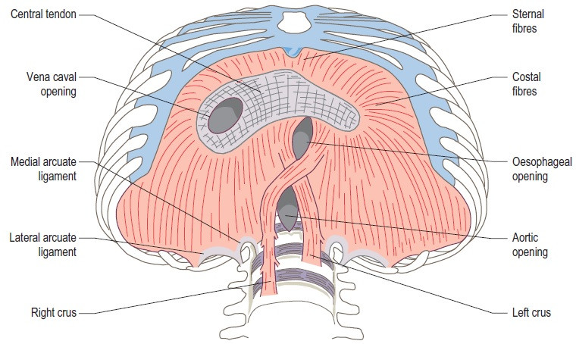
insertion
At the central tendon, situated in the middle depressed part of diaphragm near the sternum

Slide 13
openings
Major openings
Vena caval opening
Situation : lies in the central tendon of diaphragm
Vertebral level : T8 about 2.5cm right to the midline
Shape : Quadrilateral
Structures passing through it :
IVC
Some branches of rt phrenic nerve
Lymphatics of liver
Effects o contraction : dilates and helps in venous return

Slide 15
Oesophageal opening
Situation : located in muscular part of diaphragm
Vertebral level : T10 and about 1.25cm left to midline
Shape : elliptical
Structures passing through it :
Oesophagus
Gastric or vagus nerves
Oesophageal branches of left gastric vessels
Some lymphatics
Effects of contraction : constricts and prevents regurgitation of contents of stomach into oesophagus

Slide 16
Aortic opening
Situation : it is osseoaponeurotic opening situated behind the median arcuate ligament
Vertebral level : T12 and slightly left to midline
Shape : round
Structures passing through it :
Aorta
Thoracic duct
Azygous vein
Effects of contraction : no change

Slide 17
Minor openings
1. Each crus of diaphragm is pierced by greater and lesser splanchnic nerves. The left crus is pierced in addition by hemiazygous vein
2. Sympathetic trunk passes from thorax abdomen behind medial arcuate ligament
3. Subcostal nerve and vessels pass behind the lateral arcuate ligament
4. Superior epigastric vessels and some lymphatics pass between origins of diaphragm from xiphoid process and 7th costal cartilage. This gap is known as larry’s space or foramen of morgagni
5. Musculophrenic vessels pierce the diaphragm at the level of 9th costal cartilage

Slide 19
RELATIONS
Superiorly
Pleurae
Pericardium
Inferiorly
Peritoneum
Liver
Fundus of stomach
Spleen
Kidneys
Suprarenal glands

Slide 20
Arterial supply
Musculophrenic arteries
Pericardiophrenic arteries
Lower 3 posterior intercostal arteries (rt & lt)
Superior phrenic arteries
Superior epigastric arteries
Inferior phrenic arteries
Upper 3 rt lumbar arteries
Upper 2 left lumbar arteries

Slide 21
Venous drainage
Accompanied with arteries and drains into systemic vein

Slide 22
Nerve supply
Motor
Right and left phrenic nerves from C3, 4, 5
Sensory
Central part : by phrenic nerves
Peripheral part : by lower 6 or 7 intercostal nerves

Slide 23
actions
Principal muscle of respiration.
During inspiration diaphragm contracts:
In normal inspiration diaphragm moves about 1.5cm
In deep breathing diaphragm moves about 6 to 10cm.
It helps in expulsive function during the act of vomiting, micturation, defecation and parturation.

Slide 24
anamolies
Sometimes the diaphragm may fails to develop.
Sometimes foramen morgagni may be enlarged cause abdominal viscera to herniate into thorax.
Sometimes diaphragm fails to arise from both lateral arcuate ligaments on one or both sides forming a triangular gap known as costovertebral triangle or Bochdalek’s triangle. This triangle may be the site of diaphragmatic hernia.
Congenital hiatus hernia may be present.

Slide 26
APPLIED ANATOMY
Collection of pus may occur in sub-diaphragmatic abscess.
Hiccough is the result of spasmodic contraction of the diaphragm.

Slide 27
Irritation of the diaphragm may cause referred pain to shoulder due to same segmental nerve supply.
Acquired haitus hernia : is the commonest of all internal hernia, due to the weakness of phrenoesophageal ligament. It may often occur due to obesity or operation in this area.

Slide 29
Thank
you

