Slide 1
ANTERIOR ABDOMINAL WALL
Dr. Manjula Vastrad
Asst Professor
Dept of Rachana Shareera
SMVVS RKM AMC
VIJAYAPURA

Slide 2
INTRODUCTION
Anterior abdominal wall usually includes both the front as well as the side walls of the abdomen and needs to be called anterolateral abdominal wall
Abdomen is the lower part of the trunk lies below the diaphragm
It is bounded by large extent of muscles
Anterolateral abdominal wall
Anterior wall
Right lateral wall (Right Flank)
Left lateral wall (Left Flank)

Slide 3
This extended from the thoracic cage to the pelvis and bounded :
Superiorly
7th to 10th costal cartilages and xiphoid process
Inferiorly
Inguinal ligaments and the pelvic bones.

Slide 4
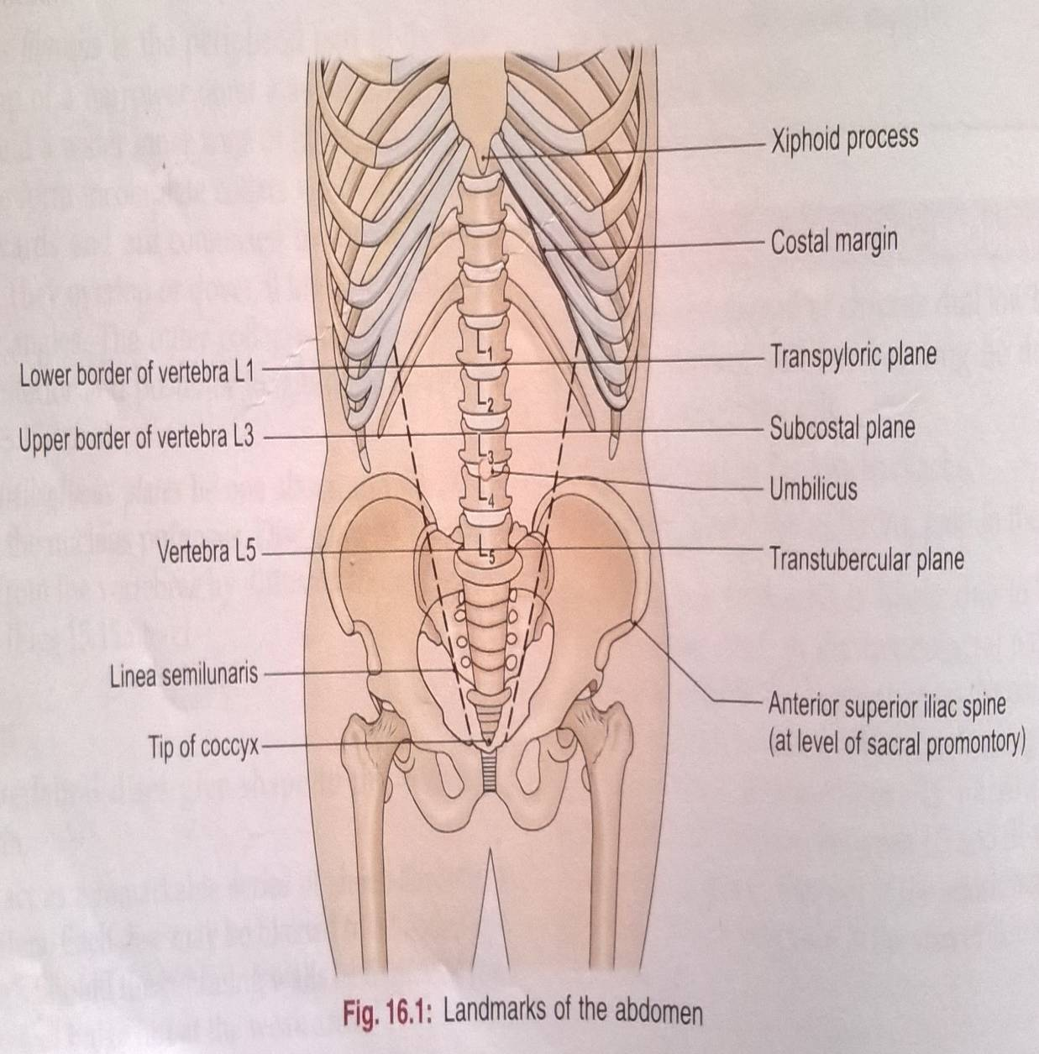
BONY LANDMARKS AROUND ABDOMEN
Iliac crest
Ant Sup iliac spine
Pubic crest
Inguinal ligament
Costal margin
Xiphoid process

Slide 6
CONTENTS
SKIN
SUPERFICIAL FASCIA
FATTY LAYER
MEMBRANOUS LAYER
DEEP FASCIA
MUSCULAR LAYER
TRANSVERSALIS FASCIA
PARIETAL PERITONEUM

Slide 7
THE SKIN
Capable of undergoing enormous stretching -
eg:- pregnancy, obesity, ascitis …..etc
Lineae albicantes –
whitish streakes in the skin

Slide 8
THE UMBLICUS
A little below the middle of the median furrow is an irragular depressed or elevated area called umblicus
It is the site at which the umbilical cord is attached in fetal life.
Position:- Disc between the 3rd & 4th lumbar vertebrae
ANATOMICAL IMPORTANCE:-
Water shed line
Caput medusae

Slide 9
Embryological importance
Meeting point of four folds of embryonic plate
Meeting point of 3 systems

Slide 10
SUPERFICIAL FASCIA
CAMPER’S FASCIA:-
Superficial fatty layer
Continuous with the fascia of thorax and thigh
Penis devoid of fat
In scrotum it is replaced by dartos muscle
SCARPA’S FASCIA:-
Deep membranous layer
Continuous as colles’ fascia

Slide 11
ANATOMICAL IMPORTANCE
The attachment of Scarpa’s fascia of the abdomen and Colles’ Fascia of the perineum are such that they prevent the passage of extravasated urine backwards into the ischiorectal fossa and downwards into the thigh.

Slide 12
In the median plane, the membranous layer is thickened to form the suspensory ligament and fundiform ligament of penis or clitoris.
The fascia contains
An extremely variable quantity of fat, which tends to accumulate in the lower part of the abdomen after puberty.
Cutaneous nerves
cutaneous vessels
Superficial lymphatics

Slide 14
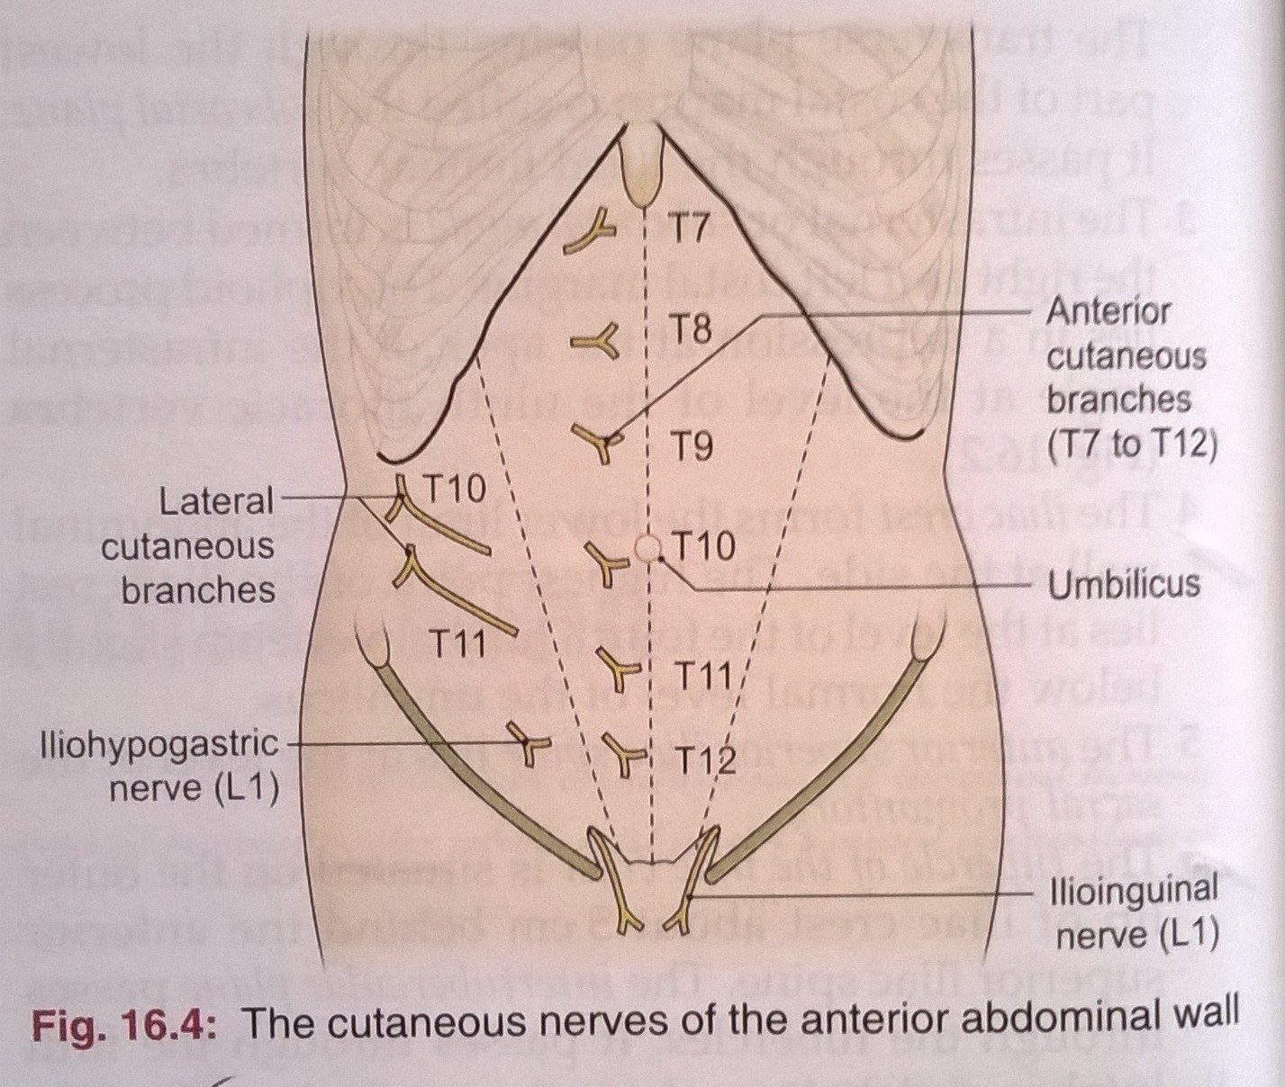
CUTANEOUS NERVE SUPPLY
Is derived from the anterior rami of the lower six thoracic and first lumbar nerves
Thoracic nerves are the lower five intercostal and the subcostal nerves
First lumbar nerve is represented by the iliohypogastric and ilioinguinal

Slide 15
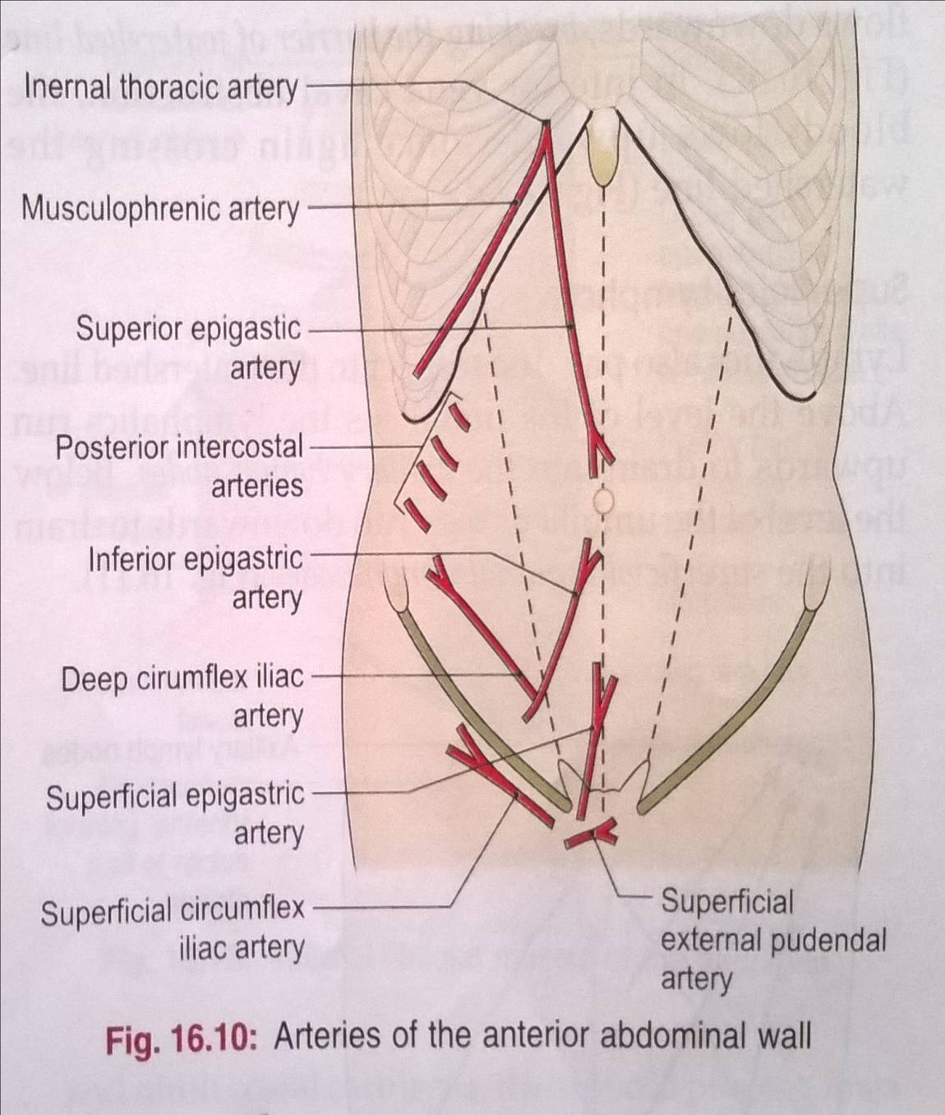
CUTANEOUS ARTERY SUPPLY
Skin near the midline is supplied by branches of the superior epigastric artery (br. of int. thoracic artery) and the inferior epigastric artery ( br. of external iliac artery)
Skin of the flanks is supplied by branches from the intercostal, lumbar, and deep circumflex arteries

Slide 16
CUTANEOUS VEINS
Venous blood is collected into a network of veins that radiate from the umbilicus
The network is drained above into the axillary vein via the lateral thoracic vein
Below into the femoral vein via the superficial epigastric and the great saphenous veins
Few small veins, the paraumbilical veins form a clinically important portal-system venous anastomosis

Slide 17
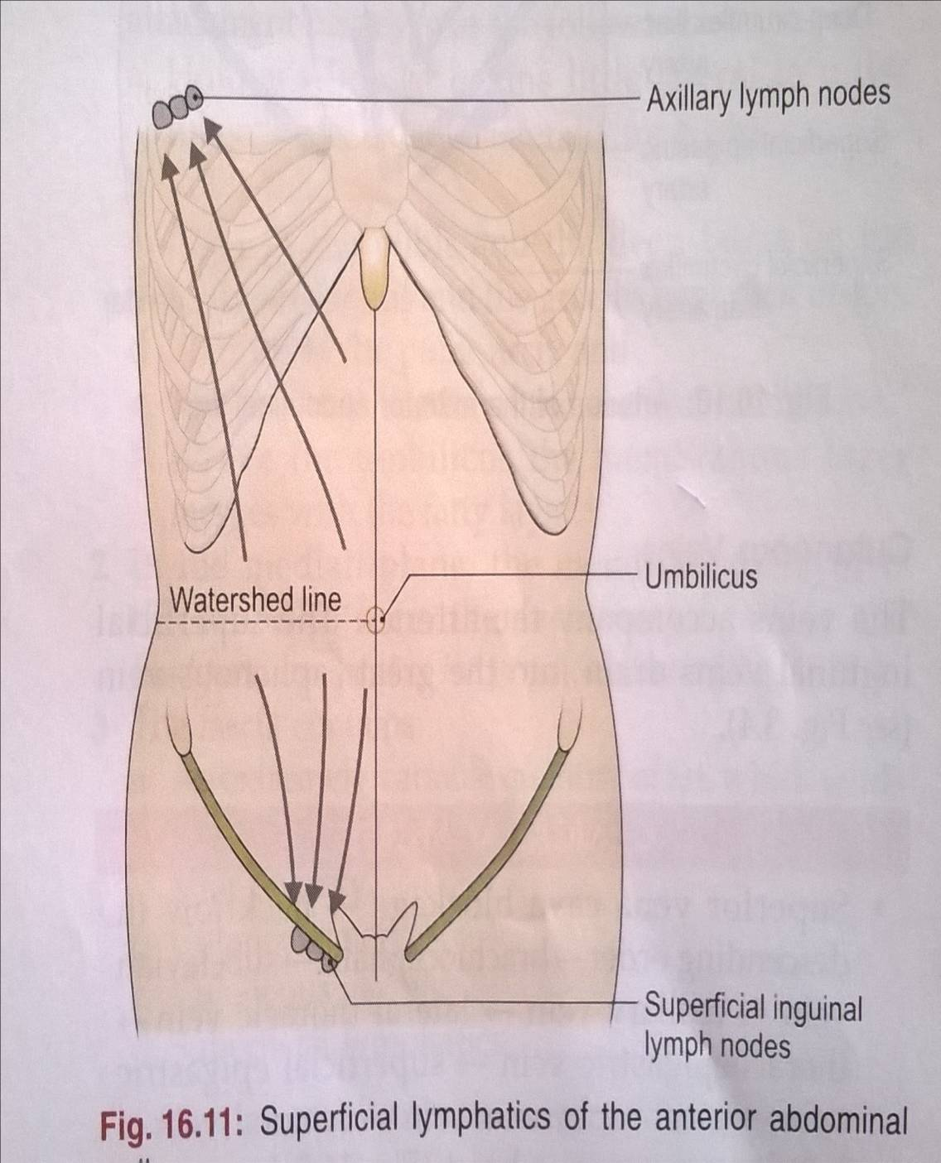
SUPERFICIAL LYMPHATICS
Lymph drainage of the skin of the anterior abdominal wall above the umbilicus is upward to the anterior axillary (pectoral group of nodes)
Below the level of umbilicus drains downward and laterally to the superficial inguinal nodes
Swelling in the groin is may be due to enlarged superficial inguinal node

Slide 18
DEEP FASCIA
Deep fascia in the anterior abdominal wall is merely a thin layer of connective tissue covering the muscles
It lies immediately deep to the membranous layer of the superficial fascia

Slide 19
ANT ABD WALL FUNCTIONS
Supports the abdominal viscera
Expulsive act –During micturation, parturition, defaecation, vomiting etc
Forcefull expiratory act – coughing, sneezing, shouting etc
Move the trunk and help to maintain posture.
Helps to maintain or increase the intra abdominal pressure.

Slide 20
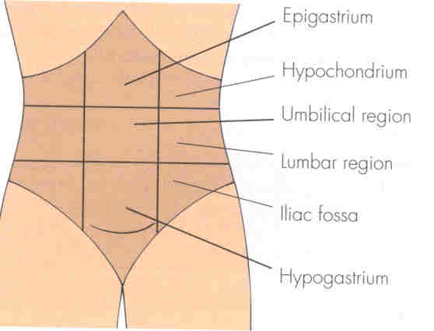
APPLIED ANATOMY
Abdominal Regions
Abdomen is divided into 9 regions via four planes:
Two horizontal [sub-costal (10th) and trans tubercules plane] (L5).
Two vertical (midclavicular planes).
They help in localization of abdominal signs and symptoms.

Slide 21
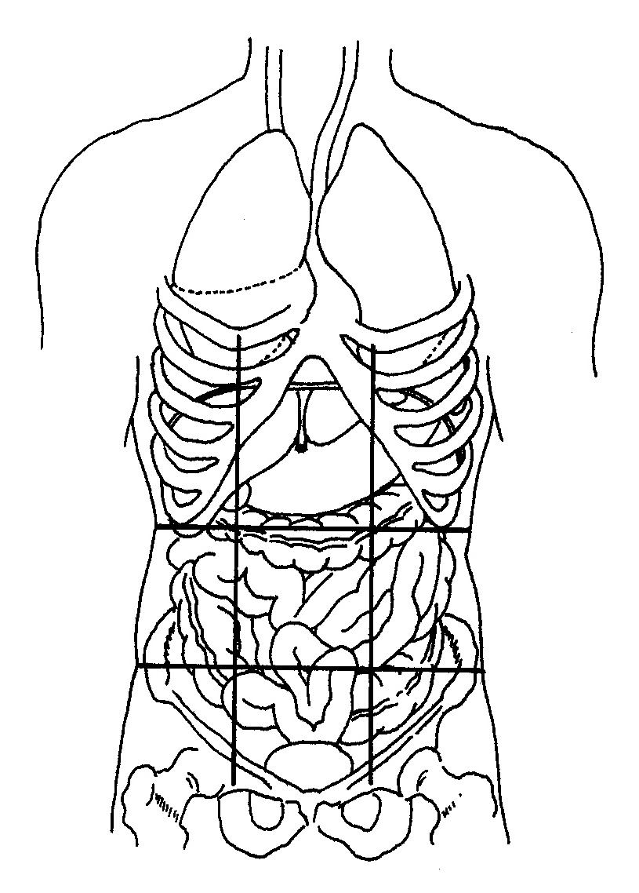
LOCATION OF THE ORGANS
Right and left hypochondriac:
Contain liver
Epigastric:
Contains: liver, stomach, pancreas
Right and left lateral (lumbar):
Right contains ascending colon.
Left contains descending colon.
Umbilical:
Contains small intestine and transverse colon.
Right and left inguinal:
Right contains ileocecal junction and appendix.
Left contains sigmoid colon.
Hypogastric:
Contains small intestine, urinary bladder (full), pregnant uterus.

Slide 22
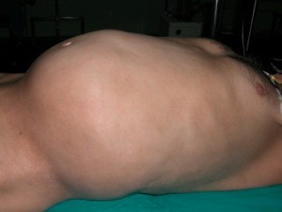
PROTUBERANCE OF THE ABDOMEN
The five common causes (5F)
Fat,
Faeces,
Fetus,
Flatus
Fluid

Slide 23
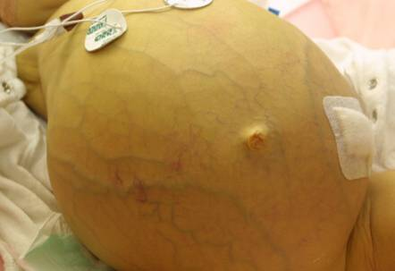
ASCITIS
FINDINGS IN ASCITIS:-
Smiling Umbilicus
Shiny skin
Engorgement of superficial veins

Slide 24
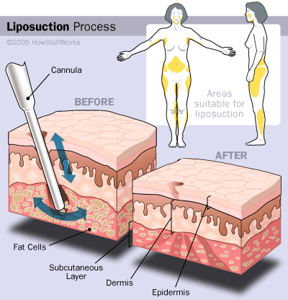
LIPOSUCTION
Surgical method of removing unwanted subcutaneous fat using a subcutaneously placed suction tube and high vaccum pressure

Slide 25
THANK
YOU

