Slide 1
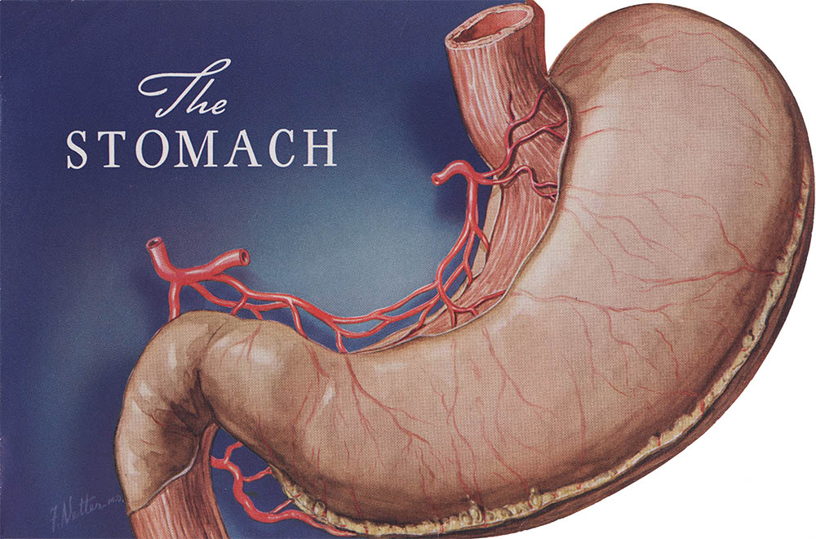
stomach
Dr.Manjula Vastrad
Asst.Prof
Dept of Rachana Shareera
SMVVS RKM AMC Vijayapur
Email: manjula.prasad2010@gmail.com

Slide 2
CONTENTS
INTRODUCTION
SURFACE ANATOMY
EXTERNAL & INTERNAL FEATURES
RELATIONS OF THE STOMACH
BLOOD SUPPLY
NERVE SUPPLY
LYMPHATIC DRAINAGE
CLINICAL ANATOMY

Slide 3
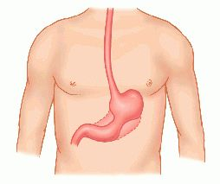
INTRODUCTION
The stomach is also known as GASTER or VENTER.
DEFINITION-
The stomach is a muscular bag forming the widest and most distensible part of digestive tube.
EXTENT
It is connected above to the lower end of Esophagus and below to the Duodenum.

Slide 4
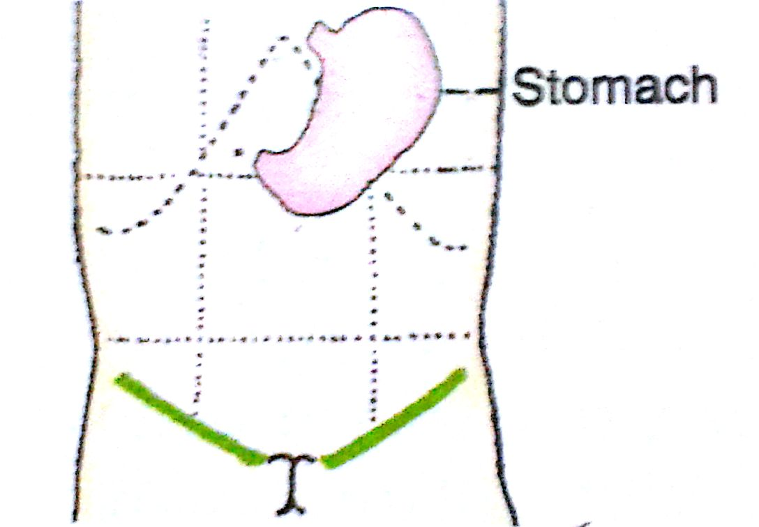
location of the stomach
The stomach lies obliquely in the upper and left part of the abdomen, occupying the EPIGASTRIC, UMBLICAL & LEFT HYPOCHONDRIAC REGIONS.
SHAPE OF STOMACH
Empty – J shaped (vertical)
Partially distended – Pyriform
In obese persons - Horizontal

Slide 5
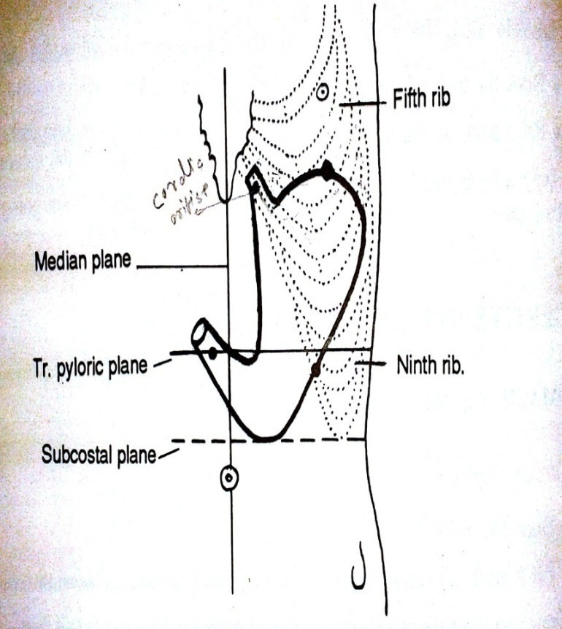
SURFACE ANATOMY
CARDIAC ORIFICE- A point on the 7th costal cartilage,2.5cm away from midline. It is represented by two lines 1.25cm apart.
PYLORIC ORIFICE- A point on the transpyloric plane and on the right side 1.25cm away from the midline.
LESSER CURVATURE- Join right margin of cardic orifice to the upper margin of pylorus by means of curved J shape line.
FUNDUS- Point in the left 5thintercostal space just below the nipple. Draw a line joining the left margin of cardiac orifice with above point.
GREATER CURVATURE- Draw subcostal plane. Put a pt. b/w the tip of 9th & 10th costal cartilage. Draw a curved line convex to the left from fundus to the point marked and reaching downwards to the subcostal plane and then reaching the lower margin of pylorus.

Slide 6
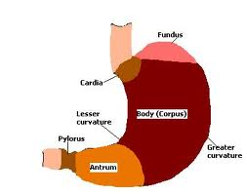
EXTERNAL FEATURES
THE STOMACH HAS-
(ii) TWO CURVATURES i.e lesser curvature and greater curvature.
(iii) TWO SURFACES i.e anterior & posterior surface.
(iv) PARTS OF STOMACH i.e fundus , body , pyloric antrum & pyloric canal.
(i) TWO ORIFICES i.e Cardiac orifice & pyloric orifice.

Slide 7
INTERNAL FEATURES
The stomach wall is composed of four basic layers :
MUCOSA
SUB-MUCOSA
MUSCULARIS
SEROSA
MUCOSA
Consist of (i) surface mucous cells
(ii) Lamina propria
(iii) Muscularis mucosa
Mucosa of empty stomach is thrown into folds termed RUGAE.
Mucosa form columns of secretery cells called GASTRIC GLANDS.

Slide 9
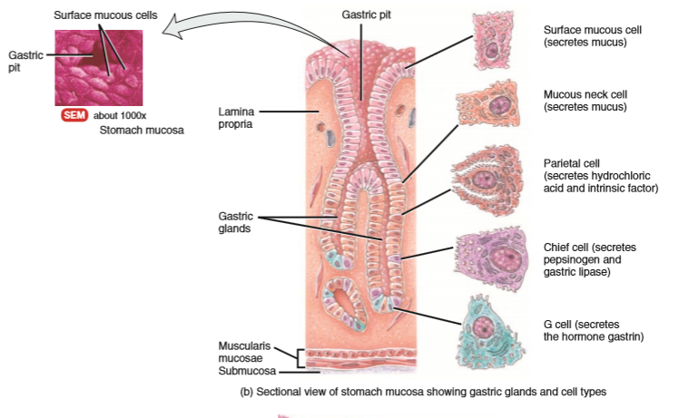

Slide 10
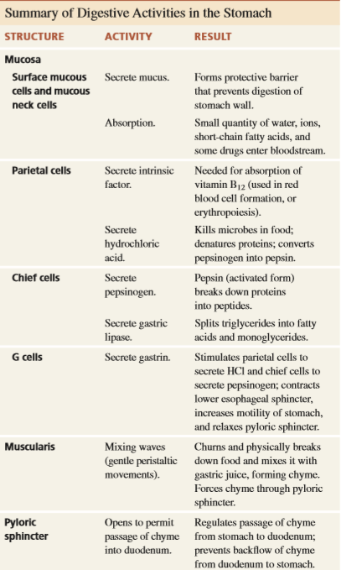

Slide 11
SUB-MUCOSA-
composed of areolar connective tissue
MUSCULARIS-
composed of three layers of smooth muscles i.e.
OUTER LONGITUDINAL
MIDDLE CIRCULAR
INTERNAL OBLIQUE
SEROSA-
composed of simple squomous epithelium

Slide 12
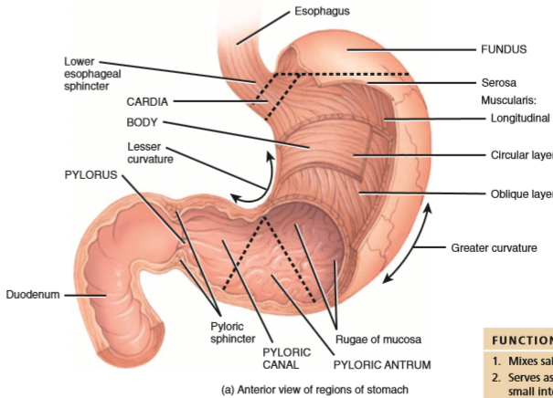

Slide 13
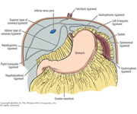
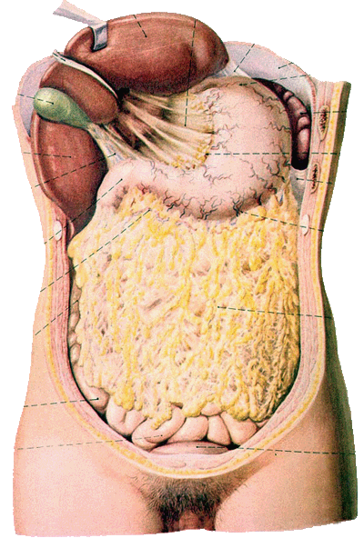
RELATIONS OF STOMACH
PERITONEAL RELATIONS
The stomach is lined by peritoneum on both it surfaces.
At lesser curvature, the layers of peritoneum lining the anterior and posterior surface meet and become continous with lesser omentum.
Along the greater part of greater curvature,the layers meet to form the greater omentum.
Near fundus, the two layers meet to form GASTRO-SPLENIC LIGAMENT.
Near cadiac end, the peritoneum on the posterior surface is reflected on the diaphragm as GASTROPHRENIC LIGAMENT.

Slide 14
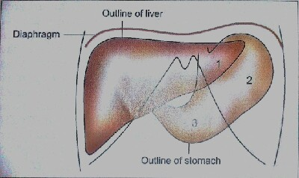
VISCERAL RELATIONS
ANTERIOR RELATIONS
The anterior surface of stomach is related to the:-
(i) LIVER
(ii) DIAPHGRAM
(iii) ANTERIOR ABDOMINAL WALL

Slide 15
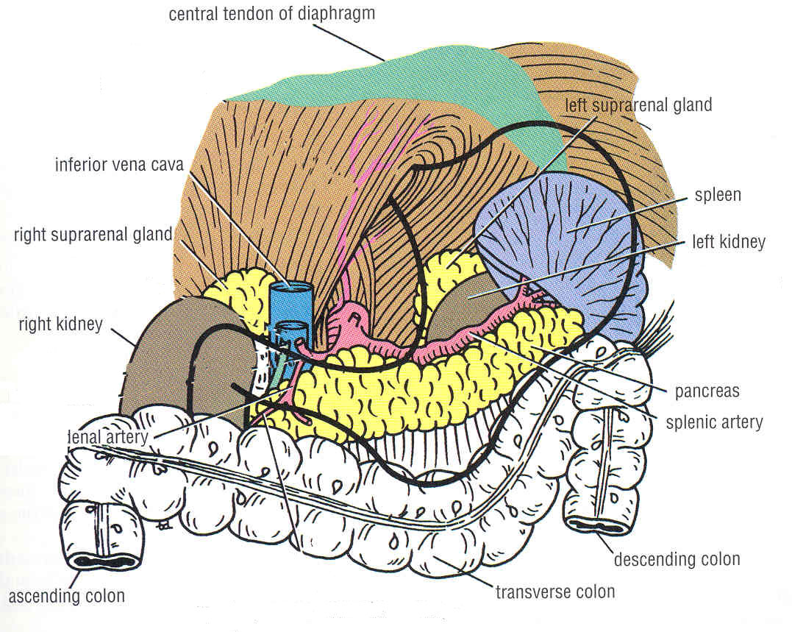
POSTERIOR RELATION
The posterior surface of stomach is related to structures forming the STOMACH BED.
These structures are:-
DIAPHRAGM
LEFT KIDNEY
LEFT SUPRA-RENAL GLAND
PANCREAS
TRANSVERSE MESOCOLON
SPLENIC FLEXURE OF COLON
SPLENIC ARTERY

Slide 16
BLOOD SUPPLY
The stomach is supplied by:-
The left Gastric Artery, a branch of COELIAC TRUNK.
The right Gastric Artery,a branch of COMMON HEPATIC ARTERY.
Right Gastro-epiploic artery, a branch of Gastro-deudonal artery
Left Gastro-epiploic artery, a branch of Splenic artery.
5-7 short gastric arteries.
VENOUS DRAINAGE
The veins of stomach drain into portal , Superior mesentric and Splenic veins.

Slide 17
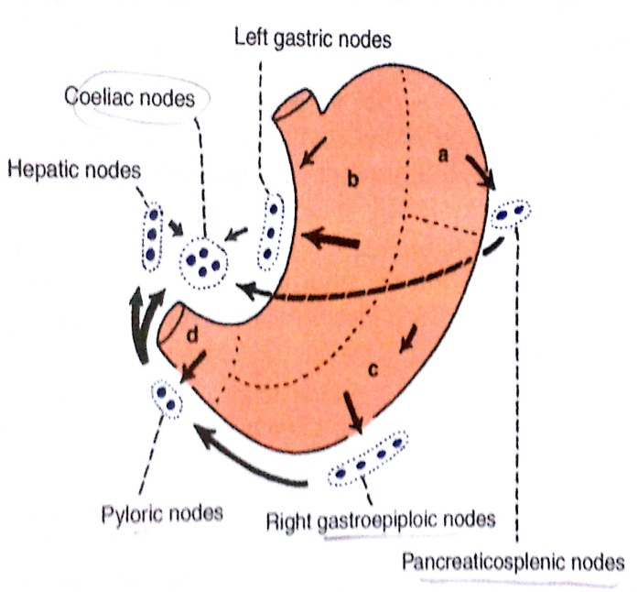
LYMPHATIC DRAINAGE
AREA A AREA B AREA C AREA D
PANCREATICO- DRAINS TO LEFT DRAINS INTO DRAINS INTO
SPLENIC AREA GASTRIC NODES RIGHT GASTRO- DIFFERENT
EPIPLO IC NODES DIRECTION
DRAINS INTO
PANCREATRCO- HEPATIC NODES
SPLENIC NODES
COELIAC NODES
INTESTINAL LYMPH TRUNK
CISTERNA CHYLI

Slide 18
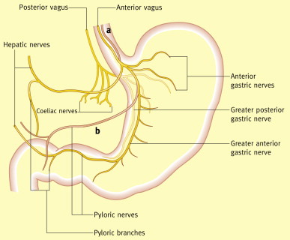
NERVE SUPPLY
STOMACH IS SUPPLIED BY
SYMPATHETIC PARASYMPATHETIC
(T6 to T9 via Coeliac Plexus) (Anterior & Posterior Vagus N.)

Slide 19
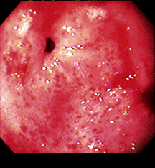
CLINICAL ANATOMY
GASTRITIS
Gastritis means inflammation of the gastric mucosa
In Gastritis, the gastric mucosal barrier become inflamed due to the ingestion of certain substances like Alcohal & Aspirin.
These substances when often ingested can be very damaging to the protective gastric mucosal barrier i.e to the mucous gland and tight epithelial junctions between the gastric lining cells leading to severe acute or chronic gastritis .

Slide 20
GASTRIC PAIN
Gastric pain is felt in the epigastrium because the stomach is supplied from segements T6-T9 of spinal cord, which also supply the upper part of abdominal wall.

Slide 21
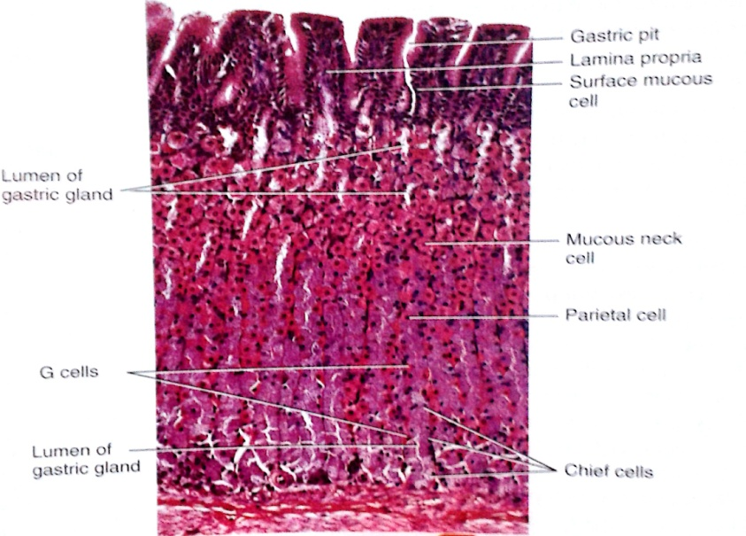
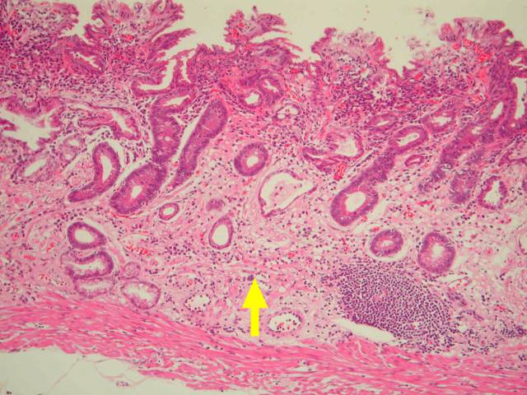
Gastric atrophy
Due to chronic gastritis, the mucosa gradually becomes atrophic until little or no gastric gland activity remains.
Loss of stomach secretions in gastric atrophy leads to achlorhydria and occasionally pernicious anaemia.

Slide 22
Pernicious anaemia
Pernicious anaemia is a common accompaniment of Achlorhydria and Gastric atrophy.
Normal gastric secretions contain intrinsic factor which is secreted by parietal cells which helps in the absorption of vitamin B12 from ileum.
NO INTRINSIC FACTOR NO ABSORPTION OF VIT B 12
AS A RESULT, MATURATION FAILURE OCCURS IN BONE MARROW , RESULTING IN PERNICIOUS ANAEMIA

Slide 23
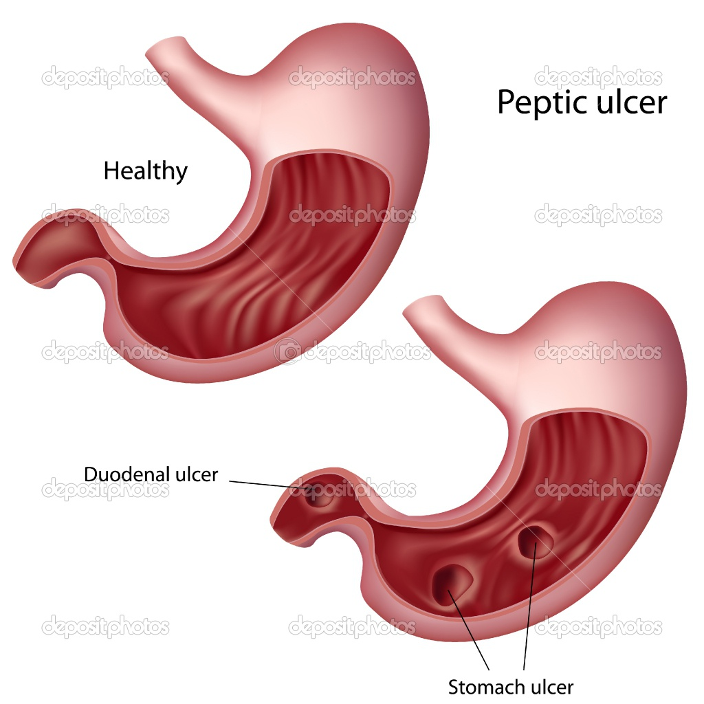
PEPTIC ULCERS
A PEPTIC ULCER is an excoriated area of the mucosa caused by the digestive action of gastric juice.
TYPES
The two main types of peptic ulcers–
(i) GASTRIC (II) DUODENAL
BASIC CAUSE:
Imbalance between the rate of secretions of gastric juice and the degree of protection afforded by GASTRODUODENAL MUCOSAL BARRIER as well as neutralisation of gastric acid by duodenal juices.

Slide 24
Peptic ulcer can be caused by two ways
Excess secreations of acid and pepsin by gastric mucosa.
Diminished ability of gastroduodenal mucosal barrier to protect against the digestive properties of acid-pepsin complex.

Slide 25
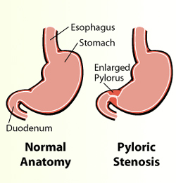
PYLOROSPASM
Abnormality of pyloric sphincter can occur in infants in which smooth muscle fibres of sphincter fails to relax normally, so food does not pass easily from stomach to doudenum
PYLORIC STENOSIS
Narrowing of pyloric sphincter that must be corrected surgically. The hallmark symptom is projectile vomiting- the spraying of liquid vomitus some distance from infant

Slide 27
DR.TANVI MAHAJAN 1 st YEAR P.G SCHOLAR
PRACTICAL PRESENTATION
ON STOMACH
PRESENTED BY-

Slide 28
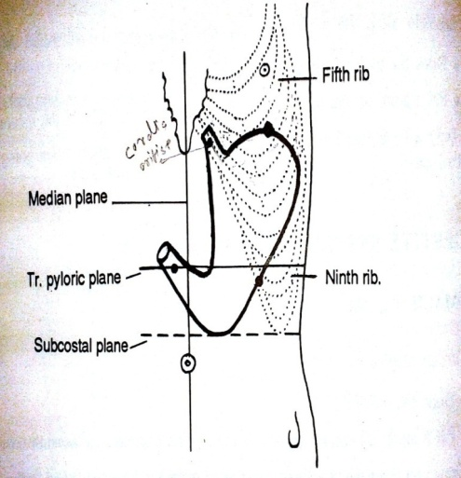
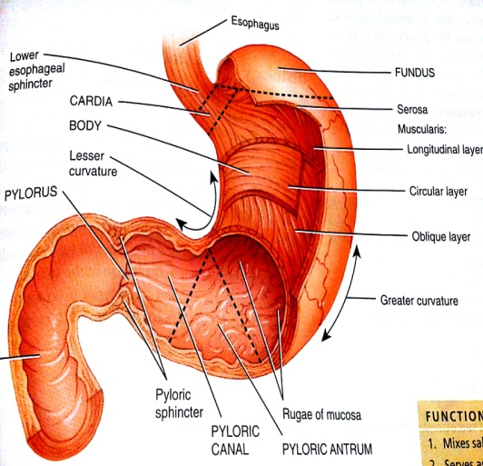
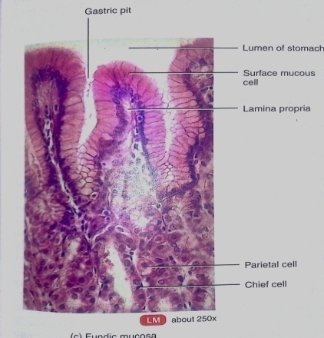
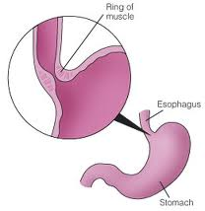
REVIEW

Slide 29
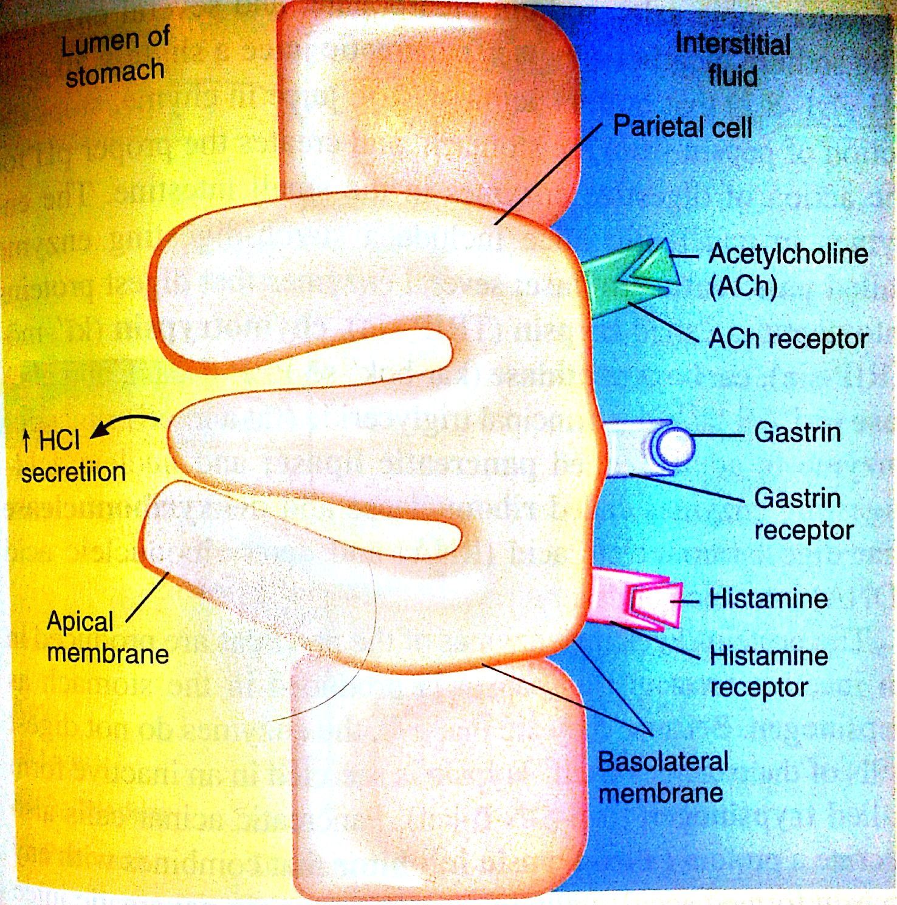
Regulation of hcl secreation

Slide 32
TREATMENT OF PEPTIC ULCERS
TREATMENT :
Reduction of stressful situation, that might lead to excessive acid secretions.
Administration of antacid drugs to neutralize much of the acid in stomach secretions.
Administration of Anti-Histaminic drugs that block the effect of Histamine on H2 receptors and thereby reduce gastric acid secretions by 70% - 80%.

