Slide 1
PITUTARY GLAND
DR.MANJULA.VASTRAD
ASST.PROF
DEPT OF SHAREERA RACHANA
SMVVS RKM AMC VIJAYAPUR
Email : manjula.prasad2010@gmail.com

Slide 2
DEFINITION
It is an endocrine gland of a neuroglandular body which hangs from the floor of 3rd ventricle by a stalk called infundibulum.
COLOUR – Reddish grey
SHAPE – Ovoid
MEASUREMENTS – Transversely 12mm
Anteroposteriorly 8mm
WEIGHT – 500mg

Slide 3
SITUATION – Situated in hypophyseal fossa of the sella turcica in the body of sphenoid bone covered by diaphragma sellae of duramater.
COVERINGS – Covered by pia mater and arachnoid mater which is adherent to capsule of the gland.
Pia mater and arachnoid mater are fused

Slide 4
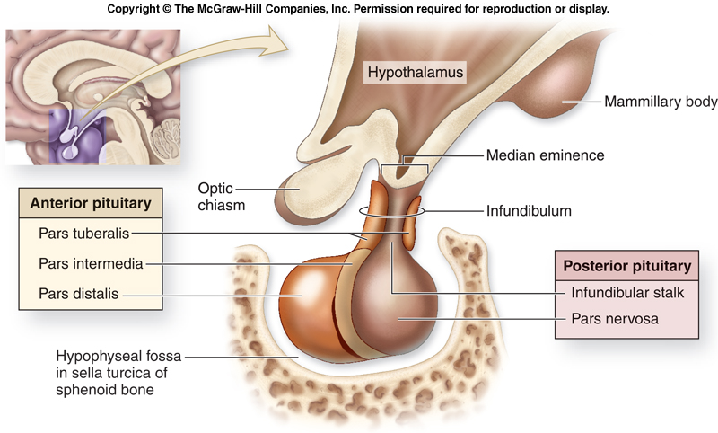

Slide 5
PARTS / LOBES
Consists of two parts
Adenohypophysis/ Anterior lobe
Further subdivided as - Pars anterior / distalis
Pars intermedia
Pars tuberalis
Neurohypophysis / Posterior lobe
Further subdivided as - Median eminence
Infundibular stem
Pars nervosa

Slide 7
RELATIONS
Anteriorly– anterior intercavernous sinus
Posteriorly – posterior intercavernous sinus
Superiorly – optic chaisma
anterior communicating artery
third ventricle
Inferiorly – sphenoidal air sinus
Laterally – cavernous sinus with structures passing through it
Internal carotid artery with sympathetic plexus
Abducent, occulomotor, trochlear, opthalmic and maxillary nerves

Slide 8
ARTERIAL SUPPLY – Supplied by two sets of arteries
Superior hypophyseal arteries
supplying median eminence, pitutary stalk and the adenohyposis
Inferior hypophyseal arteries
supplies the infundibular process and infundibular stalk

Slide 9
VENOUS DRAINAGE
Blood is drained by the short veins , into the cavernous sinus from adenohypophysis
And via the hypothalamo-hypophyseal portal system from neurohyposis

Slide 10
DEVELOPMENT
Anterior lobe – developed from ectoderm , from the roof of stomodium as an upgrowth dilation called Rathke’s pouch.
Posterior lobe – developed as a diverticulum grows downwards from the floor of diencephalon.

Slide 11
HARMONES
The pituitary is an important gland in the body and it is often referred to as the 'master gland', because it controls several of the other hormone glands
The anterior pituitary synthesizes and secretes hormones. All releasing hormones (-RH) referred to, can also be referred to as releasing factors (-RF).
Somatotrophins:
Human growth hormone (HGH), also referred to as 'growth hormone' (GH), and also as somatotropin, is released under the influence of hypothalamic growth hormone-releasing hormone (GHRH).

Slide 12
Thyrotrophins:
Thyroid-stimulating hormone (TSH), is released under the influence of hypothalamic thyrotropin-releasing hormone (TRH) and is inhibited by somatostatin.
Corticotropins:
Adrenocorticotropic hormone (ACTH), and Beta-endorphin are released under the influence of hypothalamic corticotropin-releasing hormone (CRH).

Slide 13
Lactotrophins:
Prolactin (PRL), also known as 'Luteotropic' hormone (LTH), whose release is inconsistently stimulated by hypothalamic TRH, oxytocin, vasopressin, vasoactive intestinal peptide, angiotensin II, and neurotensin, and inhibited by hypothalamic dopamine.
Gonadotropins:
Luteinizing hormone (also referred to as 'Lutropin' or 'LH').
Follicle-stimulating hormone (FSH), both released under influence of Gonadotropin-Releasing Hormone (GnRH)

Slide 14
These hormones are released from the anterior pituitary under the influence of the hypothalamus. Hypothalamic hormones are secreted to the anterior lobe by way of a special capillary system, called the hypothalamic-hypophysial portal system.

Slide 15
Intermediate
The intermediate lobe synthesizes and secretes the following important endocrine hormone:
Melanocyte–stimulating hormone (MSH). This is also produced in the anterior lobe.[6]When produced in the intermediate lobe, MSHs are sometimes called "intermedins".

Slide 16
Posterior
The posterior pituitary stores and secretes (not synthesize) the following important endocrine hormones:
Antidiuretic hormone (ADH, also known as vasopressin and arginine vasopressin AVP), the majority of which is released from the supraoptic nucleus in the hypothalamus.
Oxytocin, most of which is released from the paraventricular nucleus in the hypothalamus. Oxytocin is one of the few hormones to create a positive feedback loop. For example, uterine contractions stimulate the release of oxytocin from the posterior pituitary, which, in turn, increases uterine contractions. This positive feedback loop continues throughout labour.

Slide 17
FUNCTIONS
Hormones secreted from the pituitary gland help control the following body processes:
◾Growth
◾Blood pressure
◾Some aspects of pregnancy and childbirth including stimulation of uterine contractions during childbirth
◾Breast milk production
◾Sex organ functions in both males and females
◾Thyroid gland function
◾The conversion of food into energy (metabolism)
◾Water and osmolarity regulation in the body
◾Water balance via the control of reabsorption of water by the kidneys
◾Temperature regulation
◾Pain relief

Slide 18
All of the functions of the pituitary gland can be adversely affected by an over or under production of associated hormones.

Slide 19
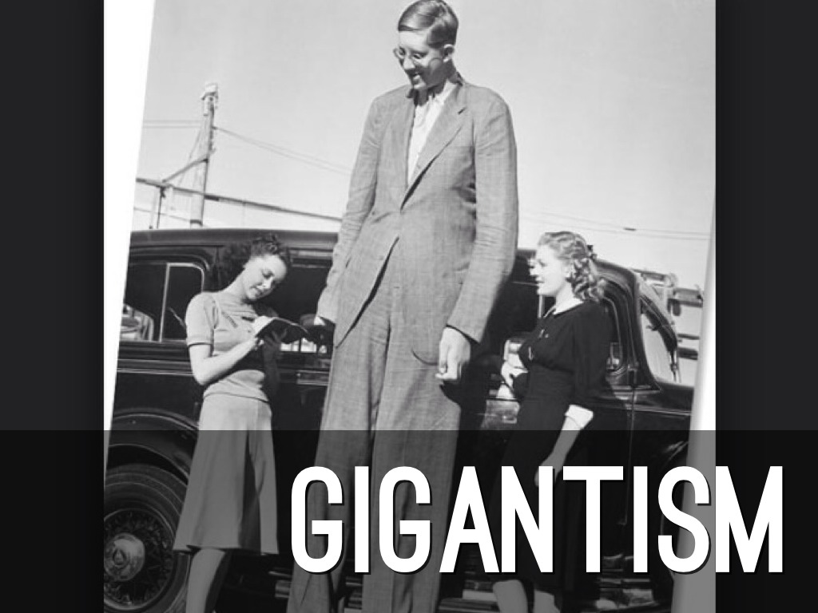
CLINICAL SIGNIFICANCE

Slide 20
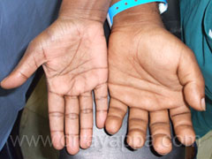
ACROMEGALY

Slide 21
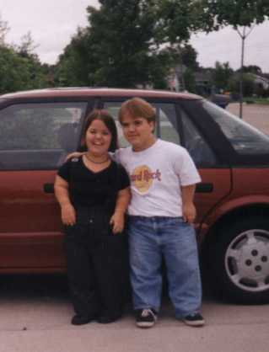
DWARFISM

Slide 22
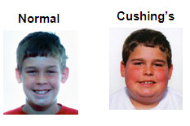
CUSHING’S SYNDROME

Slide 23
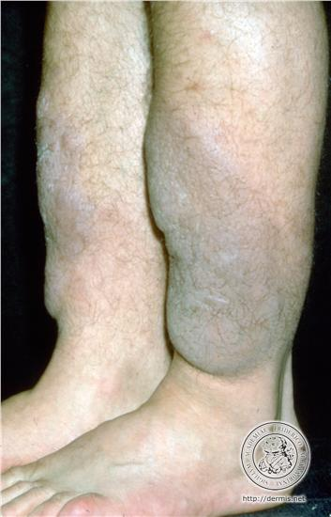
MYXOEDEMA

Slide 24
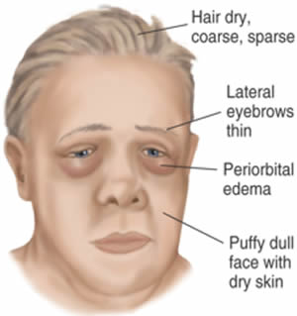
CRETINISM

Slide 25
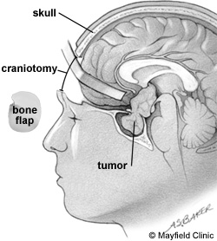
PITUTARY TUMOR

Slide 26
THANK
YOU

