Slide 1
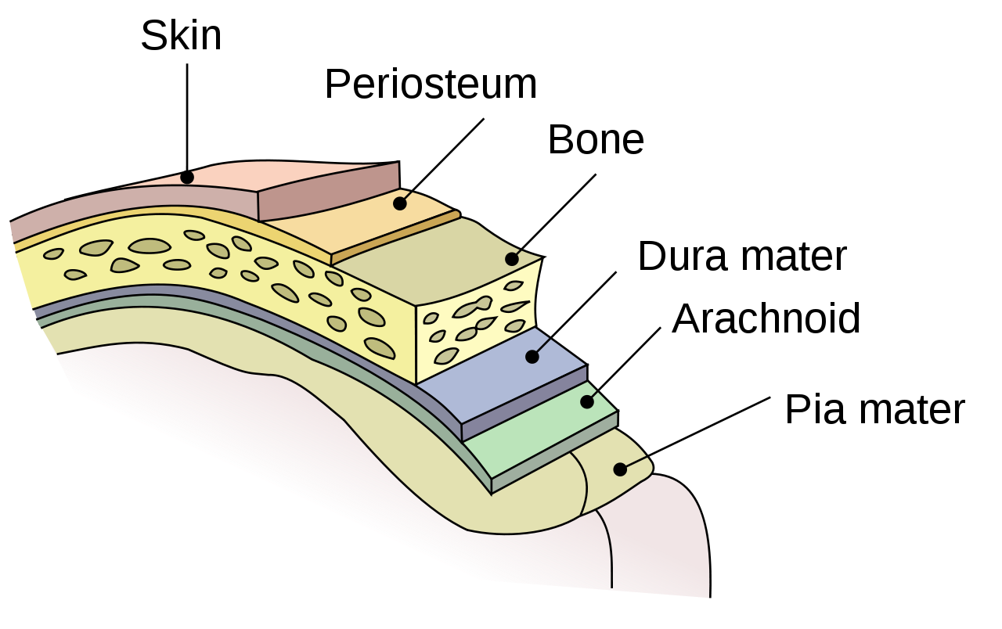
MENINGES OF THE BRAIN
BY:
DR. manjula.Vastrad
Asst.prof
DEPT. OF RACHANA SHAREERA
Smvvs rkm amc vijayapur
Email : MANJULA.PRASAD2010@GMAIL.COM

Slide 2
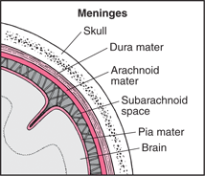
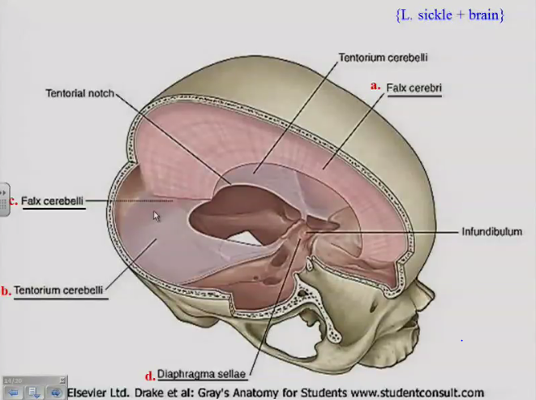
INTRODUCTION
Three meninges
Four dural septa
Two spaces

Slide 3
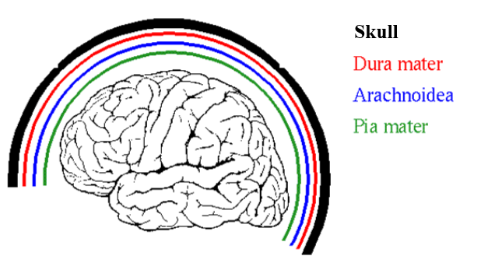
MENINGES
The Meninges are a system of membranes that envelop the complete central nervous system (brain and spinal cord).

Slide 4
MENINGES
DURA MATER
ARACHNOID MATER
PIA MATER

Slide 5
4 DURAL SEPTA
FALX CEREBRI
TENTORIUM CEREBELLI
FALX CEREBELLI
DIAPHRAGMA SELLAE

Slide 6
TWO SPACES
SUB-DURAL
SUB-ARACHNOID

Slide 7
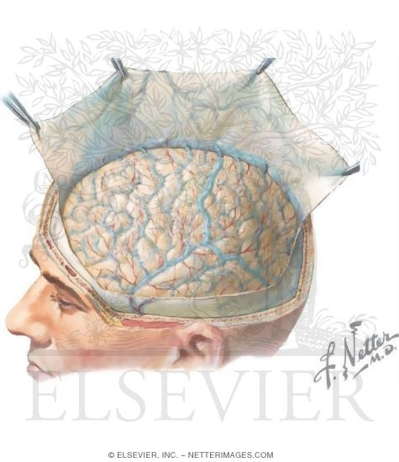
DURA MATER
It is the outermost thickest and toughest membrane covering the brain.
Also k/as Pachymeninx.

Slide 8
CEREBRAL DURA MATER
ENDOSTEAL LAYER
MENINGEAL LAYER

Slide 10
REFLECTIONS
FALX CEREBRI
TENTORIUM CEREBELLI
FALX CEREBELLI
DIAPHRAGMA SELLAE

Slide 11
FALX CEREBRI
Large sickle shaped fold of dura mater occupying the medial longitudinal fissure b/w two cerebral hemisphere.
2 ENDS:
Anterior end – narrow & attached to Crista Galli.
Posterior end – broad & attached to Tentorium cerebelli.

Slide 12
FALX CEREBRI

Slide 13
FALX CEREBRI
2 MARGINS :
Upper- convex & attached to lips of Sagittal Sulcus.
Lower- concave & free.
3 VENOUS SINUSES:
Superior sagittal sinus
Inferior sagittal sinus
Straight sinus

Slide 14
TENTORIUM CEREBELLI
It is a tent shaped fold of dura mater.
It separates the cerebellum from the occipital lobe of cerebrum.
It divides the cranial cavity into supra-tentorial & infra-tentorial compartments.
2 MARGINS:
1. ANTERIOR : ‘u’ shaped & free. Ends of ‘u’ are attached anteriorly to the
anterior clinoid process.
2. POSTERIOR :It is convex
-Posterolaterally attached to transverse sulci on occipital bone.
- Anterolaterally attached to superior border of petrous temporal
bone & posterior clinoid process.

Slide 15
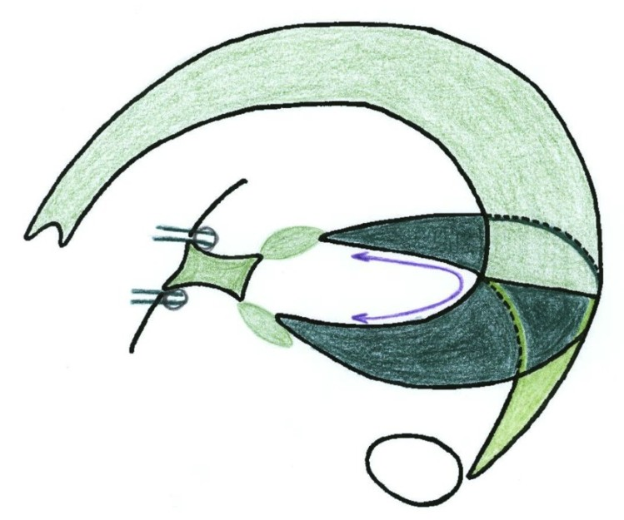
TENTORIUM CEREBELLI

Slide 16
TENTORIUM CEREBELLI
2 SURFACES:
SUPERIOR – Convex
- Gives attachment to falx cerebri in its midline
- Related to occipital lobes of cerebrum
INFERIOR – Concave
- Gives attachment to falx cerebelli to its posterior part
- It fits the upper superior surface of cerebellum.
2 VENOUS SINUSES:
Transverse sinus
Superior petrosal venous sinus

Slide 18
FALX CEREBELLI
Small sickle shaped fold of dura mater attached to internal occipital crest & project forwards b/w two cerebellar hemisphere.
Base of the sickle is attached to the posterior part of the inferior surface of tentorium cerebelli.
2 MARGINS:
Anterior – concave & free
Posterior – convex & attached to posteior occipital crest.
It encloses the Occipital Sinus.

Slide 19
FALX CEREBELLI

Slide 20
DIAPHRAGMA SELLAE
Small circular horizontal fold of dura mater, forming the roof of the hypophyseal fossa.
ATTACHMENTS:
- Anteriorly attached to tuberculun sellae.
- Posteriorly attached to dorsum sallae.
- On each side, continuous with the dura
mater of middle cranial fossa.
- Having central aperture through which the
stalk of pitutary passes.

Slide 22
Nerve supply and blood supply of duramater

Slide 23
ARACHNOID MATER
Thin transparent membrane that loosely surrounds the brain without dipping into sulci.
Bridges all the irregularities of the brain.
RELATIONS:
Separated from Dura by subdural space.
Separated from Pia by subarachnoid space containing CSF.

Slide 24
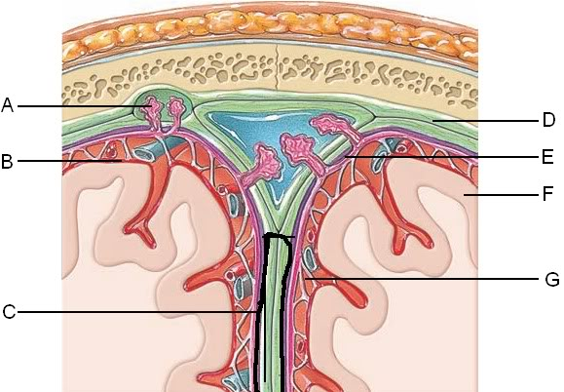
ARACHNOID MATER
PROLONGATIONS:
Provide sheath for the cranial nerves as far as their exit from the skull.
Arachnoid villi – small finger like projections of arachnoid tissue projecting into the cranial venous sinuses.
- They absorb CSF.

Slide 25
PIA MATER
Vascular membrane that closely invests the brain, dipping into various sulci and other irregularities of the surface.
On the cerebellum , Pia mater dips and forms folds in relation to larger fissures of cerebellum.
PROLONGAIONS:
Provides sheath for the cranial nerves
Also provide perivascular sheath for the minute vessels entering or leaving the brain
Folds of Pia mater enclosing tufts of capillaries, form the TELACHORIDEA.

Slide 26
PIA MATER

Slide 27
SUBDURAL SPACE
Potential space between the dura & arachnoid mater.
Becomes actual space in pathological conditions.
Traversed by cerebral veins on their path for draining into dural venous sinuses.

Slide 29
SUBARACHNOID SPACE
Space between arachnoid & pia mater.
Traversed by a network of arachnoid trabeculae that give it a sponge like appearence.
Contains CSF & large vessels of the brain
Cranial nerves pass through the space.

Slide 30
APPLIED
ANATOMY

Slide 31
HYDROCEPHALUS
Hydrocephalus also known as "water on the brain", is a medical condition in which there is an abnormal accumulation of cerebrospinal fluid (CSF) in the ventricles, or cavities, of the brain.
This may cause increased intracranial pressure inside the skull and progressive enlargement of the head, convulsion, tunnel vision, and mental disability.
Hydrocephalus can also cause death. It is more common in infants

Slide 33
CEREBRAL SHUNTS
Cerebral shunts are commonly used to treat hydrocephalus, the swelling of the brain due to excess build up of cerebrospinal fluid (CSF).
The cerebral shunt can be used to alleviate or prevent these problems in patients who suffer from hydrocephalus or other related diseases. Shunts can come in a variety of forms but most of them consist of a valve housing connected to a catheter, the end of which is usually placed in the peritoneal cavity

Slide 34
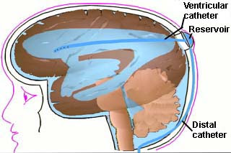

Slide 35
MENINGITIS
Meningitis is an acute inflammation of the protective membranes covering the brain and spinal cord, known collectively as the Meninges.
The inflammation may be caused by infection with viruses, bacteria, or other microorganisms.
The most common symptoms of meningitis are headache & neck stiffness associated with fever confusion or altered
consciousness, vomiting, and an inability to tolerate light (photophobia) or loud noises (phonophobia).

Slide 36
EXTRADURAL & SUBDURAL HAEMORRHAGE
A subdural haemorrhage (SDH) is a collection of blood accumulating in the potential space between the dura and arachnoid mater of the meninges around the brain.
The extradural haemorrhade is arterial due to injury to middle meningeal artery whereas subdural haemorrhage is venous in nature.
In an extradural haemorrhage, there is no blood in CSF while it is acommom feature of subdural haemorrhage.

Slide 38
THANK YOU

