Slide 1
DUODENUM
By
Dr. Manjula Vastrad
Asst.prof
Dept.of Rachana Shareera
SMVVS RKM AMC VIJAYAPUR
Email: manjula.prasad2010@gmail.com

Slide 2
Contents :
Introduction
Surface marking
Length & parts
Detail about parts & its relation
Arterial supply
Venous drianage
Lymphatic drianage
Nerve supply
Clinical anatomy

Slide 3
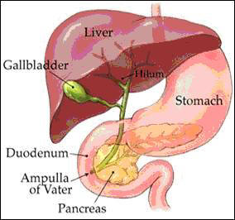
Introduction
Word meaning
Greek word duodenum – 12 fingers.
Shortest, widest, most fixed part of S.I.
Extends from – pylorus – duodenojejunal flexure.
Curves around the head of pancreas in the form of letter C.
Lies above the level of umbilicus, opposite to 1st , 2nd ,3rd lumbar vertebrae.

Slide 4
Surface marking
Mark transpyloric plane, subcostal plane, median plane, rt,lateral plane.
1st part – mark pyloric orifice by 2 short parallel lines, 2cm apart on the trnspyloric plane, & 1.25cm away from the midline, directed upwards slightly to the rt.
- mark a pt. 2.5cm above & to the rt.of pyloric orifice.
2nd part – put a pt. 7.5cm below the transpyloric plane & medial to rt.lateral plane.
- draw the 2 parallel lines 2.5cm apart.
3rd part – put a pt.just to lt.of median plane, at the level of subcostal plane.
- draw 2 parallel lines transversally.
4th part – put a pt.2.5cm to the lt.of the median plane & 1cm below the transpyloric plane to indicate duodenojejunal flexure.
- Join 3rd pt.with 4th pt. by 2 parallel lines.

Slide 5
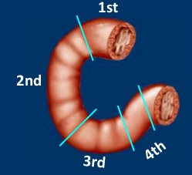
Length & parts
25cm long
4parts
1. Sup.part – 5cm long
2. Descending part – 7.5 cm long
3. Horizontal part – 10cm long
4. Ascending part – 2.5 cm long.

Slide 6
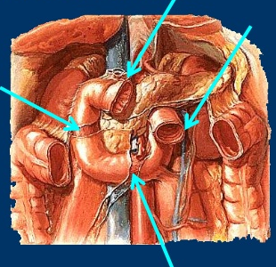
Relations
Peritoneal – mostly retroperitoneal & fixed.
Except at its 2 ends – suspended by fold of peritoneum & mobile.

Slide 7
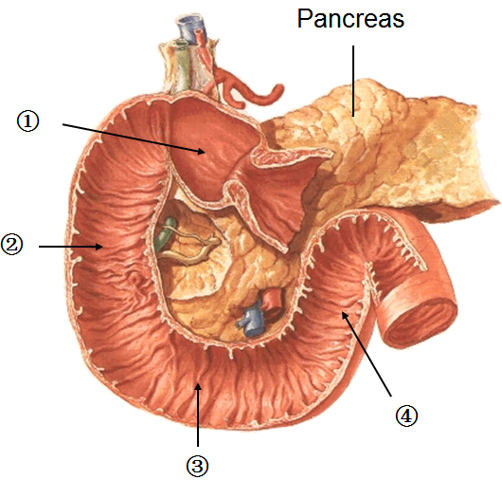
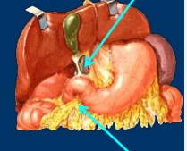
1st part
Begins at the pylorus & passes backwards, upwards & to the rt. Meet the 2nd part at the superior duodenal flexure.
5cm long.
Relations –
Peritoneal
Prox – 2.5cm is movable.
Attached to lesser omentum above & greature omentum below.
Dist- 2.5 cm is fixed.
- retroperitoneal.

Slide 8
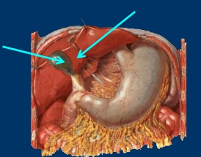
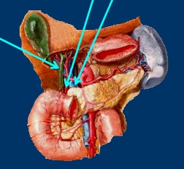
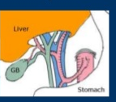
Visceral relations
Ant – quadrate lobe of liver , gall bladder.
Post – gastrodeuodenal artery, bile duct, portal vein.
Sup – epiploic foramen.
Inf – head & neck of pancreas.

Slide 9
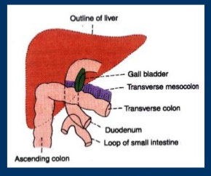
2nd part
about 7.5 cm long.
Begins at sup.duodenal flexure, passes downwards- curves towards lt. at the inf.duodenal flexure – cont. with 3rd part.
Peritoneal Relations -
Ant.surface- covered with peritoneum, except near middle. – related to colon.

Slide 10
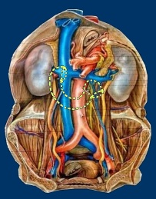
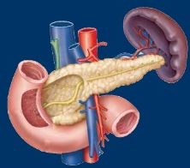
Visceral relations –
Ant- rt.lobe of liver
- trnsverse colon
- root of mesocolon
- small intestine.
Post – rt. Kidney near the medial border.
- rt.renal vessels
- rt.edge of inf.venacava
- rt.psoas major
Medial- head of pancreas, bile duct.
Lateral – rt. Colic flexure.

Slide 11
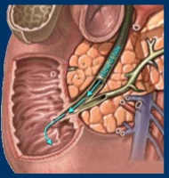
Interior of 2nd part of duodenum
1. Major duodenal papilla
- is an elevation present posteromedially,
- 8-10cm distal to pylorus.
- hepatopancreatic ampula opens at the summit of the papilla.
2. Minor duodenal papilla
- present 6-8cm distal to the pylorus.
- presents opening of accessory pancreatic duct.

Slide 12
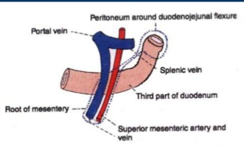
3rd part
Course – about 10cm long
Begins at inf.duodenal flexure, Passes almost horizontally & slightly upwards infront of inf.venacava - Ends by joining the 4th part – infront of abdominal aorta.
Peritoneal relations
- ant. Surface –covered with peritoneum
- except in the median plane – crossed by sup.mesenteric vessels & by root of mesentery.

Slide 13
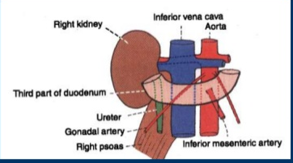
Visceral relations –
Ant. - sup.mesenteric vessels
root of mesentery
Post.- rt.ureter
- rt. Psoas major
- rt. Testicular / ovarian vessels.
- inf.venacava
- abdominal aorta with origin of inf.mesenteric artery.
Sup – head of pancreas with uncinate process
Inf – coils of jejunum

Slide 14
4th part
Course –
- 2.5 cm long.
- runs upwards on lt.of aorta – turns forwards to become cont. with the jejunum at the dueodenojejunal flexure.
Peritoneal Relations -
Terminal part is suspended by mesentery & is mobile.

Slide 15
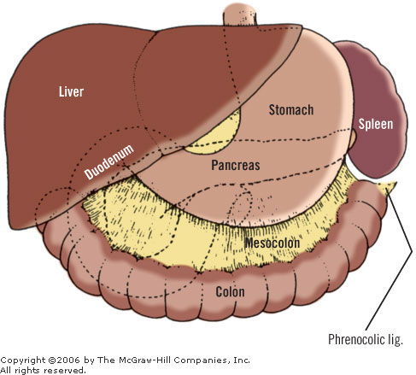
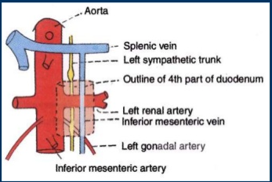
Visceral relations
Ant- transversecolon,
- trnsverse mesocolon
- lesser sac
- stomach
Post – lt.sympathetic trunk
- lt. psoas major
- lt. renal vessels
- lt. testicular vessels
- inf.mesenteric vein
To the rt. – root of mesentery
To the lt – lt.kidney, lt.ureter
Sup – body of pancreas

Slide 16
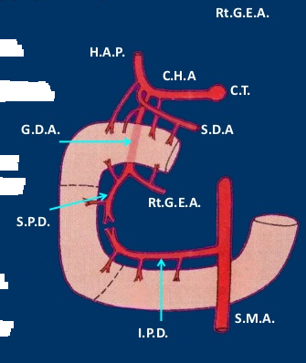
Arterial supply
From 1st part up to the opening in 2nd - supplied by sup. Pancreaticoduodenal artery.
Below – by inf.pancreatico duodenal artery.
1st part receives additional supply from-
1.rt.gasrtic artery
2.supraduodenal artery
3. gasrtoduodenal artery
4. rt. Gastroepiploic artery.

Slide 17
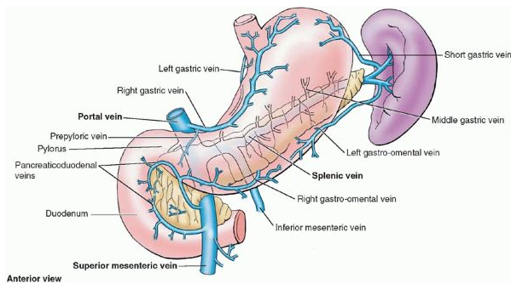
Venous drianage
Splenic vein
Sup.mesenteric vein
Portal vein

Slide 18
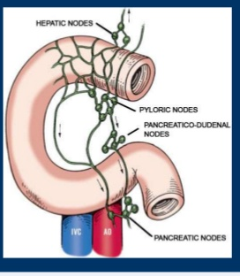
Lymphatic drainage
Most lymph vessels from duodenum – end in pancreaticoduodenal nodes – lies at the junction of pancreas & duodenum.

Slide 19
Nerve supply
Sympathetic nerves – from T9 &T10 spinal segments.
Parasympathetic nerves – from vagus

Slide 20
Clinical anatomy

Slide 21
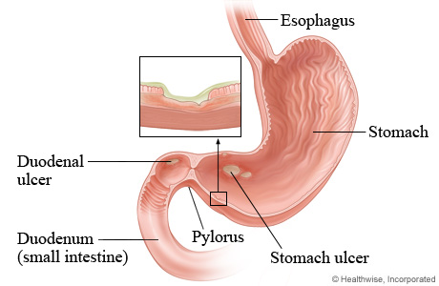
Duodenal ulcers
Duodenal ulcers (peptic ulcers) are inflammatory erosions of the duodenal mucosa.
Most (65%) duodenal ulcers occur in the posterior wall of the superior part of the duodenum within 3 cm of the pylorus.

Slide 22
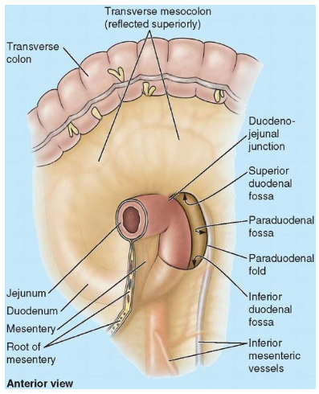
Paraduodenal Hernias
There are two or three inconstant folds and fossae (recesses) around the duodenojejunal flexure.

Slide 23
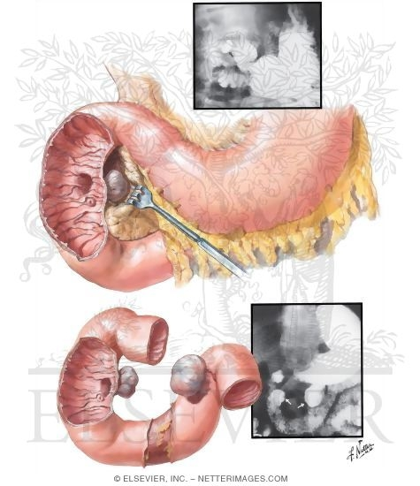
Duodenal diverticula
Seen along its concave border, generally at points where arteries enter the duodenal wall.

Slide 24
Congenital stenosis & obstruction of 2nd part
Occur at the site of opening of bile duct.
Other causes of obstruction-
1. An annular pancreas
2. Pressure by sup.pancreatic artery
3. Contraction of suspensory muscle of duodenum

Slide 25
THANK YOU

