Slide 1
ANATOMY OF
UTERINE TUBES
Dr Manjula Vastrad
Asst . Prof
Dept of Rachana Shareera
SMVVS RKMAMC Bijapur
Email: manjula.prasad2010@ gmail.com

Slide 2
CONTENTS
1.DEFINITION
2.SITUATION
3.DIMENSIONS
4.PARTS
5.HISTOLOGY
6.FUNCTIONS
7.ANATOMICAL RELATIONS
8.BLOOD & NERVE SUPPLY
9.LYMPHATIC DRIANAGE
10.APPLIED ANATOMY.

Slide 3
1.DEFINITION
They are tortuous ducts which convey oocyte from the ovary to the uterus.
Syn – fallopian tube, oviduct

Slide 4
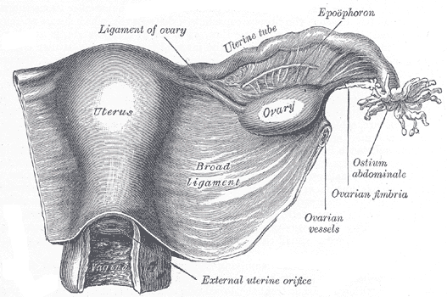
2.SITUATION
Uterine tubes are paired structures.
situated in the free upper margin of the broadligament of uterus.
Each tube has got 2 openings,
1. one communicating with the lat.angle of uterine cavity called uterine opening.
2. The other is on the lateral end of the tube ,called pelvic opening or abdominal ostium.
Tube connects the peritoneal cavity in the region of the ovary with the cavity of the uterus.

Slide 5
3.DIMENSIONS
Uterine tubes are measuring about 10cm long.
uterine opening measures about 1mm in dm.
Pelvic opening or abdominal ostium measures about 2mm in dm.

Slide 6
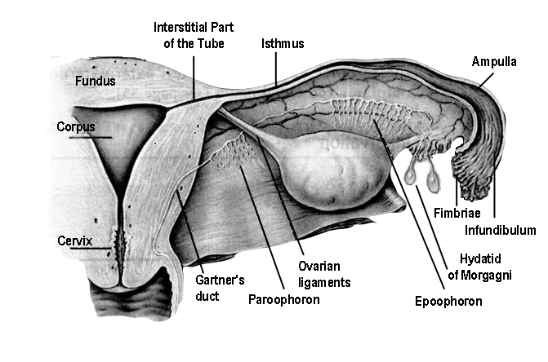
4.PARTS
The uterine tube is divided into four parts:
From medial to lateral are:
1. intramural or interstial
2. isthmus
3. ampulla
4. infundibulum

Slide 7
1. INTERSTITIAL PART
Lying in the uterine wall.
Measures 1.25cm in length
1mm in dm.

Slide 8
2.ISTHMUS
Almost straight
measures about 2.5 cm in length
2.5mm in dm.

Slide 9
3.AMPULLA
Tortuous part
Measures about 5cm in length
It ends in wide infundibulum.

Slide 10
4.INFUNDIBULUM
Measuring about 1.25 cm long.
6mm in dm.
The abdominal ostium is surrounded by a no.of radiating fimbriae, one of these is longer than the rest & is attached to the outer pole of the ovary called ovarian fimbriae.

Slide 11
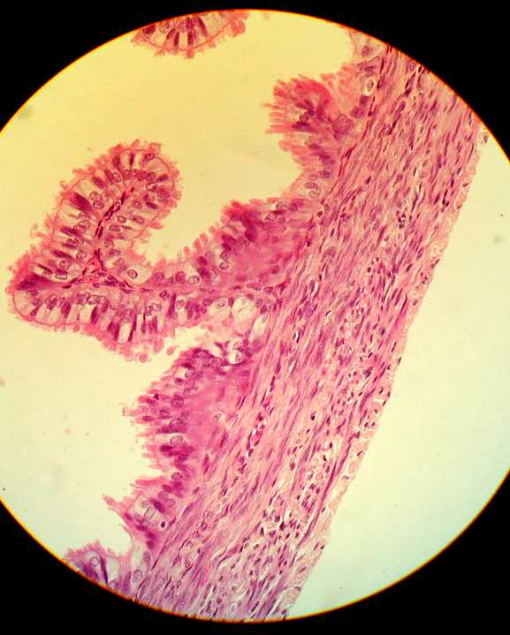
5.Histology of the Fallopian tubes
Serosa (peritoneal covering): covered by peritoneum in the upper margin of the broad ligament.
Muscle layer: Outer longitudinal and inner circular involuntary smooth muscles. It is thick at the isthmus and thin at the ampulla.
Mucosa (endosalpnix):
It is lined by columnar partially ciliated epithelium.
It is thrown into longitudinal folds.

Slide 12
6.FUNCTION
Ovum Pick Up, at the time of ovulation, by their free fimbrial end,
Transport Of The Ova through the tubal lumen, by their peristaltic and ciliary movements,
Production Of Secretions necessary for capacitation of the sperm and nutrition of the ova during their journey, by their lining cells.

Slide 13
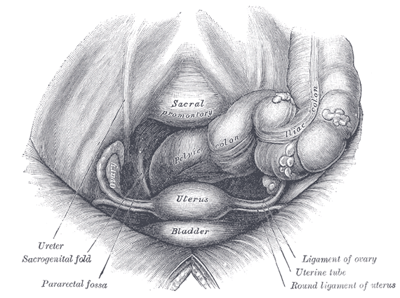
7.ANATOMICAL RELATIONS
Bounded
above by loops of intestine
below by the broad ligament and its contents.
medially they blends with cornu of the uterus while
laterally they are bounded by the lateral pelvic wall.
The ovaries lie posterior and inferior to the Fallopian tubes at each side.

Slide 14
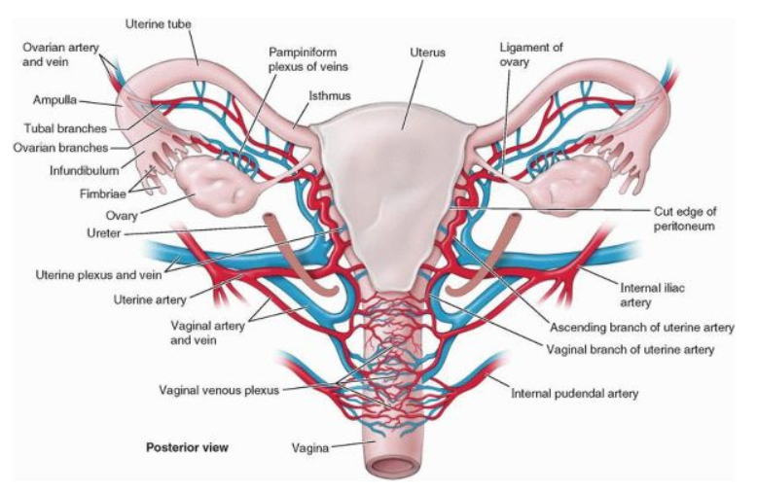
8.BLOOD SUPPLY
Arterial supply:
The uterine artery from the internal iliac artery and the ovarian artery from the abdominal aorta
Venous drainage:
Right ovarian vein drains directly into the IVC Left ovarian vein drains into the left renal vein.

Slide 15
Lymphatic drainage:
para-aortic LNs directly via ovarian lymphatics.
Nerve supply
sympathetic and parasympathetic nerve fibresfrom the inferior hypogastric plexuses

Slide 16
10.APPLIED ANATOMY
1.TUBAL PAIN:
Tubal pain is referred to the tubal points (On the lower abdominal wall 1/2 an inch above the midinguinal points).

Slide 17
2.THE UTERINE TUBE AS A CONDUIT FOR INFECTION
The uterine tube lies in the upper free border of the broad ligament and is a direct route of communication from the vulva through the vagina and uterine cavity to the peritoneal cavity.

Slide 18
3.PELVIC INFLAMMATORY DISEASE
The pathogenic organism(s) enter the body through sexual contact and ascend through the uterus and enter the uterine tubes. Salpingitis may follow, with leakage of pus into the peritoneal cavity, causing pelvic peritonitis. A pelvic abscess usually follows, or the infection spreads farther, causing general peritonitis.

Slide 19
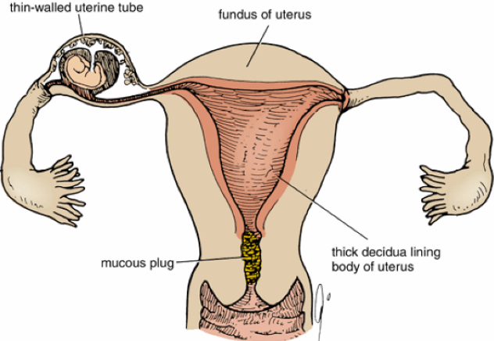
4.ECTOPIC PREGNANCY
Implantation and growth of a fertilized ovum may occur outside the uterine cavity in the wall of the uterine tube

Slide 20
5.TUBAL LIGATION
Ligation and division of the uterine tubes is a method of obtaining permanent birth control and is usually restricted to women who already have children. The ova that are discharged from the ovarian follicles degenerate in the tube proximal to the obstruction. If, later, the woman wishes to have an additional child, restoration of the continuity of the uterine tubes can be attempted, and, in about 20% of women, fertilization occurs.

Slide 22
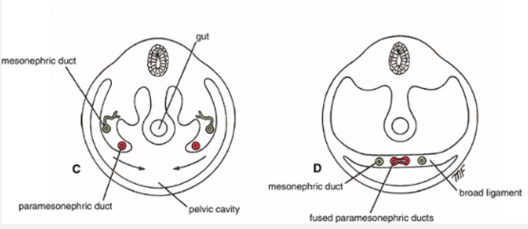
EmbryologicDevelopment of the Uterine Tube
Early on in development, the paramesonephric ducts appear on the posterior abdominal wall on the lateral side of the mesonephros.
The uterine tube on each side is formed from the cranial vertical and middle horizontal parts of the paramesonephric duct .
The tube elongates and becomes coiled; differentiation of the muscle and mucous membrane takes place; the fimbriae develop; and the infundibulum, ampulla, and isthmus are identifiable.

