Slide 1
BY:
DR.GEETA.G.
1ST YEAR MD SCHOULAR

Slide 2
ANATOMY OF UTERUS
(GARBHASHAYA)
Dr. Manjula Vastrad
Asst Prof
Dept of Rachana Shareera
SMVVS RKM AMC VIJAYAPUR
Email : manjula.prasad@gmail.com
BY:
DR.GEETA.G.
1ST YEAR MD SCHOULAR

Slide 3
CONTENTS:
1. INTRODUCTION
2. SIZE & SHAPE
3. POSITION
4. DIVISION
5. PARTS
6. RELATIONS
7. HISTOLOGY
8. ARTERIAL SUPPLY
VENOUS DRIANAGE
10. LYMPHATIC DRIANAGE.
11. NERVE SUPPLY
12. SUPPORTS OF UTERUS
13. AGE CHANGES IN UTERUS
14. APPLIED ANATOMY

Slide 4
INTRODUCTION
1.INTRODUCTION:
The uterus (womb) serves as part of the pathway for sperm deposited in the vagina to reach the uterine tubes.
It is also the site of implantation of a fertilized ovum, development of the fetus during pregnancy, and labor.
During reproductive cycles when implantation does not occur, the uterus is the source of menstrual ﬂow.
it is mobile, which means that its position varies with distension of the bladder and rectum

Slide 5
INTRODUCTION
2.SIZE & SHAPE
Pear shaped hollow muscular organ
Situated between the urinary bladder and the rectum.
In females who have never been pregnant,
7.5 cm (3 in.) long,
5 cm (2 in.) wide,
2.5 cm (1 in.) thick.
Wt. Varies from 50-80 gm.
Larger in females who have recently been pregnant,
Smaller in nullipara & when sex hormone levels are low, as occurs after menopause.

Slide 6
POSITION
3.POSITION
Its normal position is antiversion & antiflexion.
anteversion: In the adult nulliparous state the cervix tilts forwards relative to the axis of the vagina.
anteflexion: The body of the uterus tilts forward relative to the cervix.
Retroverted: In 10 to 15% of women the whole uterus leans backwards at an angle to the vagina
Retroflexed : A uterus that angles backwards on the cervix.

Slide 7
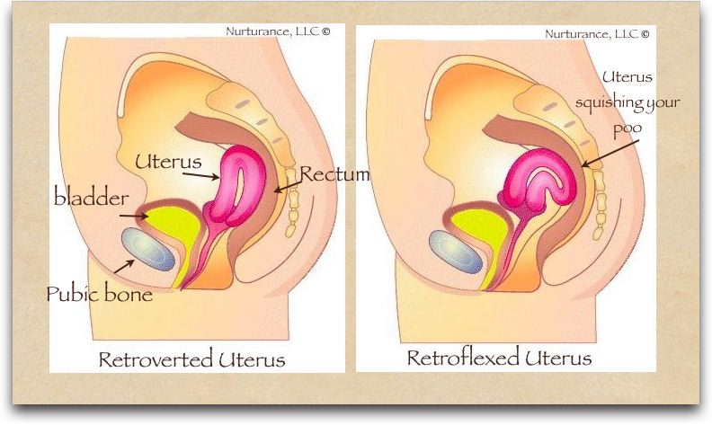

Slide 8
Measurements
4.DIVISION
uterus is divided into two main regions:
- body of the uterus (corpus uteri) forms the
upper two-thirds,
- cervix (cervix uteri) forms the lower third.

Slide 10
PARTS
5.PARTS :
fundus: a dome- shaped portion superior to the uterine tubes
(2) body: a tapering central portion
(3) cervix: an inferior narrow portion
it opens into the vagina.
Isthmus: Between the body of the uterus and
the cervix ,
a constricted region about 0.5 cm long.
uterine cavity : The interior of the body of the
uterus
cervical canal : interior of the cervix
internal os: The cervical canal opens into the uterine cavity
external os : The cervical canal opens into the into the vagina.

Slide 11
body
BODY:
Body is called the cornua of the uterus.
SHAPE: triangular
SITUATION: b/n openings of the tubes &
isthmus.
The superolateral angels of the body of uterus project outwards from the junction of the fundus.
ATTACHMENT: The uterine tube ,
round ligament &
ligament of the ovary.

Slide 13
Isthmus:
ISTHMUS:
Constricted part measuring about 0.5cm
SITUATION: b/n body & cervix.
LIMITATION:
Above by anatomical internal os & below by he histologial inernal os.
some consider it as part of lower portion of body of
uterus.

Slide 14
Isthmus:
CERVIX:
SHAPE: Cylindrical.
2.5cm long.
Extends from isthmus & ends at the extranal os.
It opens into vagina after perforating its anterior wall.
PARTS:
supravaginal part : The part lying above the vagina
vaginal part : which lies within the vagina

Slide 16
cavity
CAVITY:
FUNDUS: no cavity
BODY:
SHAPE:
cavity of uterine body is triangular on coronal section with the base above & apex below.
SIZE:
measures about 3.5cm.
CERVICAL CANAL:
SHAPE: is fusiform
SIZE: measures about 2.5 cm .
Thus the normal length of uterine cavity is usually 6.5 – 7 cm.

Slide 17
Relations
6.Relations of the Body of the Uterus
Anteriorly:
The bladder and vesicouterine pouch.
Posteriorly:
The pouch of Douglas.
Laterally:
The broad ligament on each side.

Slide 19
structures
Relations of the Supravaginal cervix
Anteriorly:
Urinary bladder.
Posteriorly:
Forms the anterior wall of Douglas pouch.
Laterally:
1/2 an inch lateral to the internal os the ureter is crossed by the uterine artery .
The uterosacral, cardinal, and pubocervical ligaments are attached to its posterior, lateral, and anterior surfaces respectively.

Slide 21
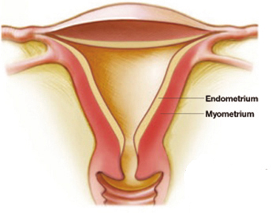
structures
7.HISTOLOGY:
BODY OF UTERUS
Three layers:
1. Endometrium: (mucosa)
2. Myometrium (musculosa)
3. The peritoneal covering or perimetrium

Slide 22
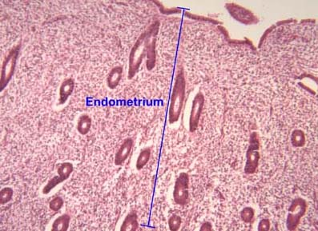
structures
Endometrium:
Lined by simple cubical or columnar epithelium
Contains tubular glands.
Shows cyclic changes with the menstrual cycle
under the influence of ovarian hormones

Slide 23
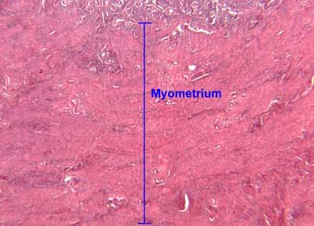
structures
Myometrium
Thick bundels of smooth muscle fibers.
Three layers
1.outer longitudinal muscle layer
2.middle interlacing layer
3.inner circular muscle layer

Slide 24
structures
Perimetrium:
Anteriorly:
firmly attached to the fundus and body till the isthmus where it becomes loose and is reflected on the superior surface of the urinary bladder forming the vesicouterine pouch.
Posteriorly:
firmly attached to the fundus, body, cervix, and posterior vaginal fornix then is reflected on the pelvic colon forming the Douglas pouch.
Laterally:
the anterior and posterior peritoneal coverings blend as the anterior and posterior layers of the broad ligaments.

Slide 26
Peritoneum in relation to the uterus
Histology of the Cervix
Endocervix:
Lined by simple columnar epithelium with compound racemose glands or crypts that are liable to chronic infection.
It secretes alkaline cervical mucus.
Muscle layer:
Outer longitudinal and inner circular muscles.
Ectocervix:
Formed of stratified squamous epithelium covering the outer portion of the cervix.

Slide 27
Blood supply:
8.Arterial supply:
UTERINE ARTERIES
Arise from the anterior division
of internal iliac artery.
2 branches:
An ascending
A descending branch
9.Venous drainage:
uterine and ovarian veins drains into internal iliac veins.

Slide 29
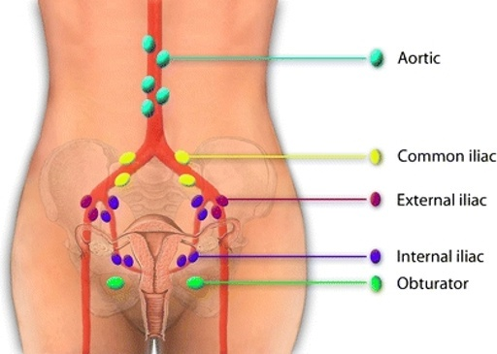
Nerve supply
10.Lymphatic drainage:
Fundus: To the pre aortic lymph nodes
Body: To the internal then external iliac lymp nodes
Isthmus: As that of the cervix.
Cervix: Two groups of lymphatics:
Primary groups: Paracervical, parametrial, obturator, internal and external iliac nodes.
Secondary groups: Common iliac, para-aortic, and lateral sacral lymph nodes.

Slide 30
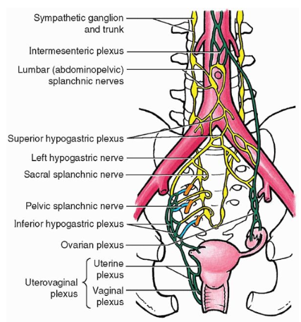
Nerve supply
11.NERVE SUPPLY:
Parasympathetic:
S2,3,4
Sympathetic:
motor -T5 and T6
sensory -T10, T11, T12, & L1
Both reach the uterus through branches of inferior hypogastric plexus.

Slide 31
12.SUPPORTS OF UTERUS:
Mainly by the tone of the leavatores ani muscles and
the condensations of pelvic fascia ,which form three important ligaments.
1.Transverse cervical ligament.
2.Pubocervical ligament.
3.Sacrocervical ligament.

Slide 32
13.AGE CHANGES IN UTERUS:
Uterus in the child
The fundus & body of the uterus remain small until puberty,
When they enlarge greatly in response to the estrogens secreated by the ovaries.
Uterus after the menopause:
After menopause,the uterus atrophies & becomes smaller & less vascular.
These changes occur because the ovaries no longer produce estrogens & progesterone.

Slide 34
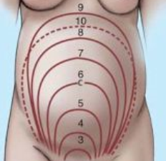
Uterus in pregnancy:
During pregnancy, uterus becomes greatly enlarged as a result of increasing production of estrogen & progesterone,First by the corpus luteum of the ovary & later by the placenta.
At first it remains as a pelvic organ,
by the 3rd month the fudus rises out of the pelvis,
By the 9th month it has reached the xiphoid process.
The increase in the size is largely a result of hypertrophy of smooth muscle fibers of the myometrium, although some hyperplasia take place.

Slide 35
APPLIED ANATOMY

Slide 36
UTERINE PROLAPSE
Prolapse - falling down or downward displacement
CAUSE:
weakening of supporting ligaments and pelvic
musculature associated with age or disease,
Traumatic vaginal delivery,
chronic straining from coughing or difﬁcult bowel
movements, or pelvic tumors.

Slide 37
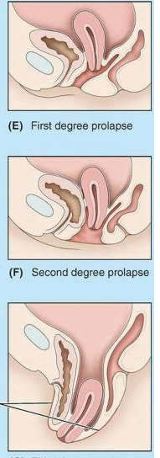
SYMPTOMS:
ﬁrst degree (mild), in which the cervix remains within the vagina;
second degree (marked), in which the cervix protrudes through the vagina to the exterior;
third degree (complete), in which the entire uterus is outside the vagina.

Slide 38
HYSTERECTOMY:
The surgical removal of the uterus, is the most common gynecological operation.
INDICATIONS:
Certain types of reproductive system cancers (uterine, cervical, ovarian, endometrium) or tumors, including uterine fibroids.
Severe and intractable endometriosis
Chronic pelvic pain,
Several forms of vaginal prolapse

Slide 39
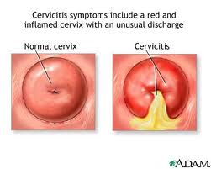
CERVICITIS :
inflammation of the uterine cervix
CAUSE:
many cases are caused by sexually transmitted infections
Non-infectious causes of cervicitis can include intrauterine devices, contraceptive diaphragms, and allergic reactions to spermicides or latex condoms

Slide 40
ENDOMETRITIS
Infection occurs in the endometrium.
SYMPTOMS:
A major symptom of endometriosis is recurring pelvic pain
dysmenorrhea
chronic pelvic pain
dyspareunia
dysuria

Slide 41
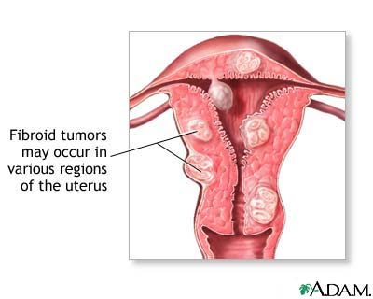
UTERINE FIBROIDS
It is a leiomyoma (benign (non-cancerous) tumor from smooth muscle tissue) that originates from the smooth muscle layer (myometrium) of the uterus
SYMPTOMS:
Important symptoms include abnormal gynecologic hemorrhage

