Slide 1
ANATOMY OF
INGUINAL CANAL
By :
Dr Manjula Vastrad
Asst Prof
Dept of Rachana Shareera
SMVVS RKM AMC
VIJAYAPUR

Slide 2
contents
1.Inguinal triangle
2.Inguinal ligament
3.Inguinal canal
4.Clinical anatomy

Slide 3
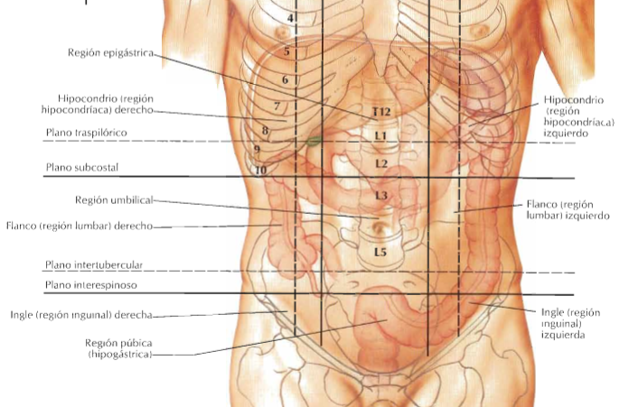
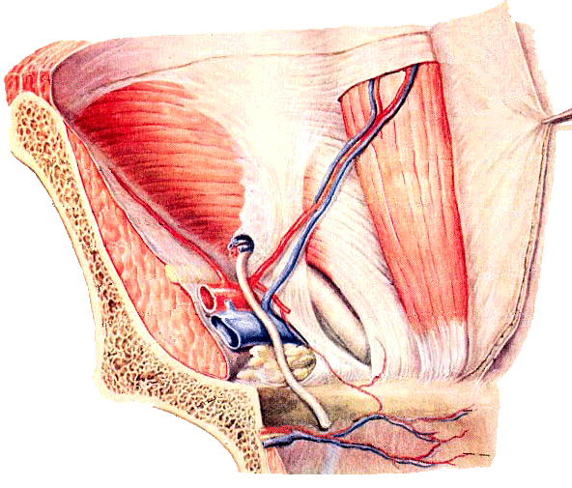
1. Inguinal Triangle ( Hesselbach)
Boundaries:
Medially: Lateral border of rectus abdominis
Laterally: Inferior epigastric artery
Inferiorly: Inguinal ligament

Slide 4
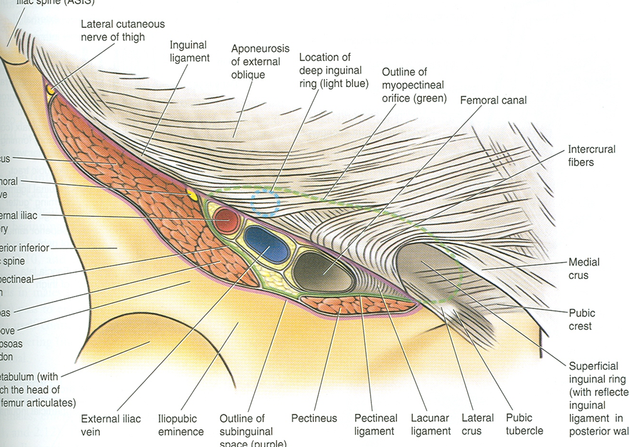
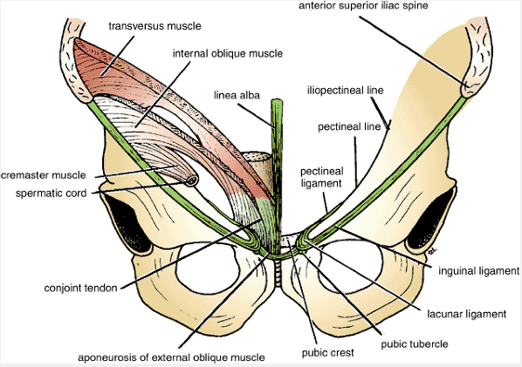
2.Inguinal ligament
1. Formation :
by lower border of aponeurosis of external oblique muscle.
-Thickned & folded backwards on itself.
2.Extension :
from ant.sup.iliac spine to pubic tubercle.
3.Situation:
beneath the fold of groin.
lat. ½ - rounded & oblique
Medial ½ -grooved upwards & more horizontal
Length – 12- 14 cm in adults

Slide 5
4. Attachments –
1. Fascia lata – to lower border
2. Upper surface gives origin to
- lateral 1/3 - trns.abdominis
- lateral 2/3 - int.oblique
- middle part - cremaster.
5. Relations-
1. Medial ½ of lig -floor of ing.canal
2. Lodges – spermatic cord or round lig. of uterus.

Slide 6
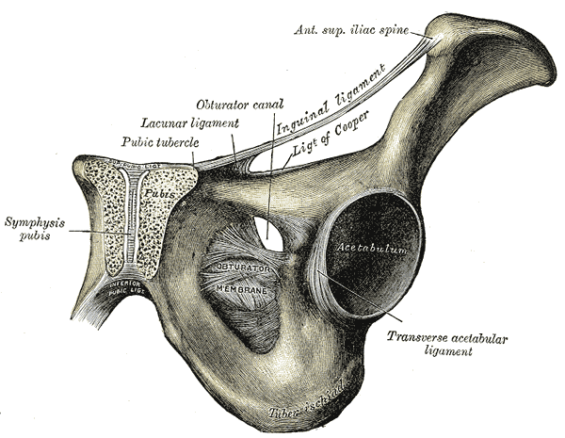
6. Extensions:
a. Pectineal part of inguinal lig.
or lacunar ligament.
b. Pectineal lig or lig.of cooper
c. Relected part of ing.ligament.

Slide 7
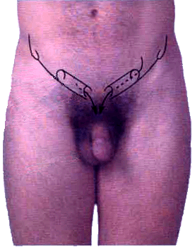
3.Inguinal canal
Defn-It is an oblique passage in the lower part of the anterior abdominal wall
Situation – just above the medial half of ing.lig.
length- 4cm long
Direction- directed down wards, forwards & medially.
Extension- from deep inguinal ring to sup.ing.ring.

Slide 8
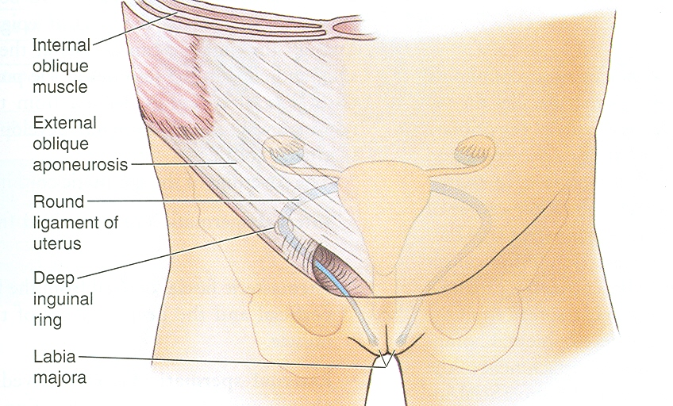
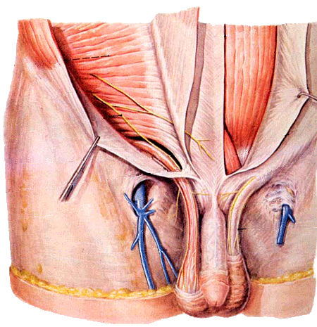
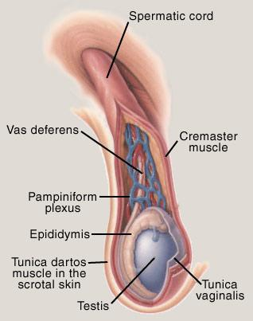
Contents
Male: spermatic cord:
3 arteries: artery to vas deferens, testicular artery, cremasteric artery;
3 fascial layers: external spermatic, cremasteric, and internal spermatic fascia;
3 nerves: genitofemoral nerve , sympathetic and visceral afferent fibres, ilioinguinal nerve .
3 other structures: pampiniform plexus, vas deferens , testicular lymphatics;
2. Female – round ligament of uterus
- ilioinguinal nerve

Slide 9
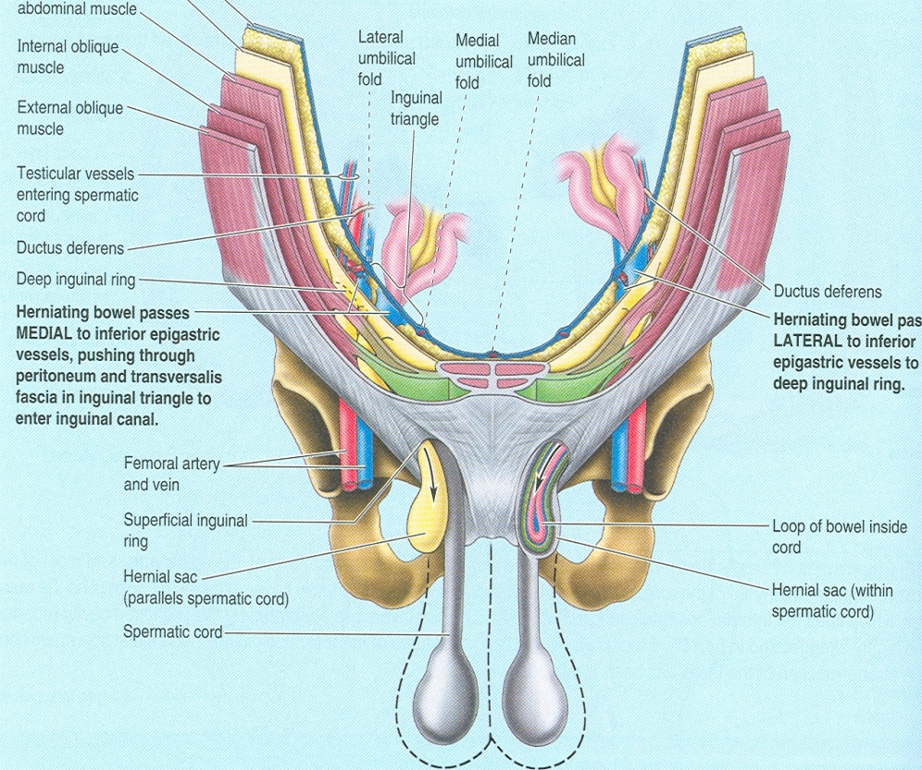
3.Abnormal contents
- undescended testis,
- intestine with peritoneum,
- supra renal cortex,
- accessory spleen.

Slide 10
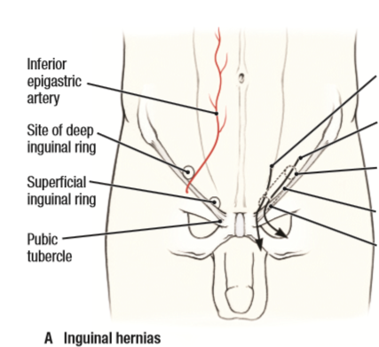
Deep inguinal ring
Is an oval opening in the fascia of transversalis
Lies - 1.2 cm above the mid inguinal point.
& lateral to inferior epigastric artery.
Margins – gives attachment to internal spermatic fascia

Slide 11
Superficial inguinal ring
Is a triangular gap – in the ext.obl.aponeurosis.
Situation- 1cm above & lateral to pubic tubercle.
Base – by pubic crest
2 sides – lateral & medial margins of the opening.
Margins are referred as crura.
Apex – by meeting point of 2 crura
2 crura united by intercrural fibres.
Length – 2.5 cm long & 1.3 cm broad at the base.
Margins – gives attachment to external spermatic fascia.

Slide 12
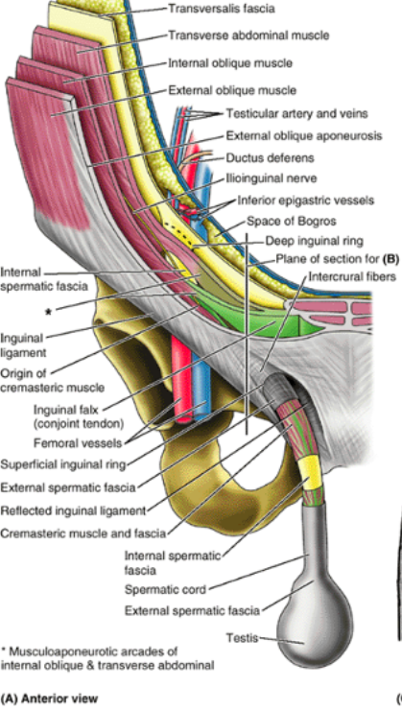
Boundaries
Anterior wall
a.In whole extent:
1. Skin
2. superficial fascia
3. aponeurosis of ext.oblique.
b. Lateral 1/3 rd- fleshy fibers of int.oblique muscle.

Slide 13
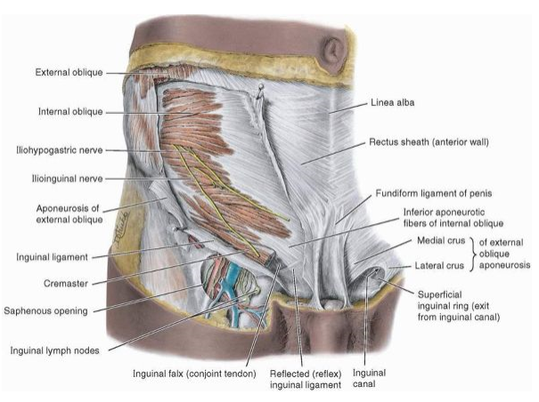
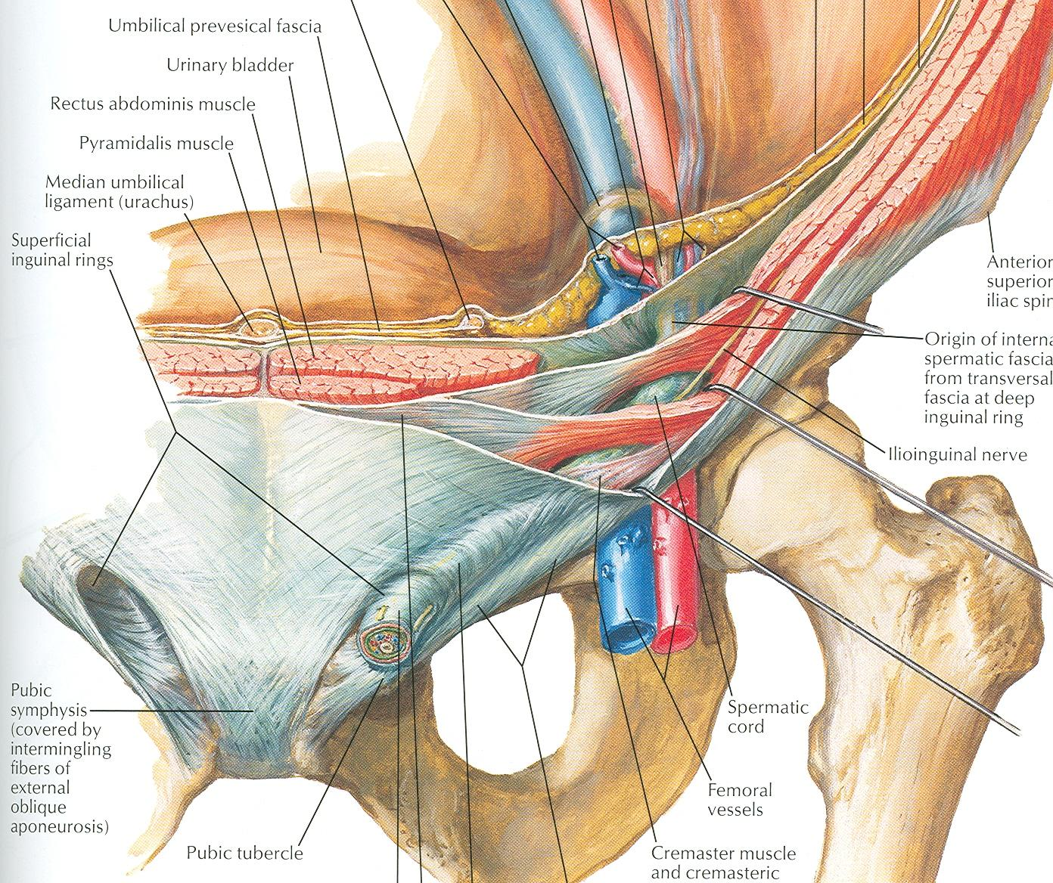
Posterior wall
a. In its whole extent
1. transversalis fascia.
2.extra peritoneal tissue.
3. parietal peritoneum
b. Medial 2/3rd - conjoint tendon
c. Lateral 1/3rd - interfoveolar ligament

Slide 14
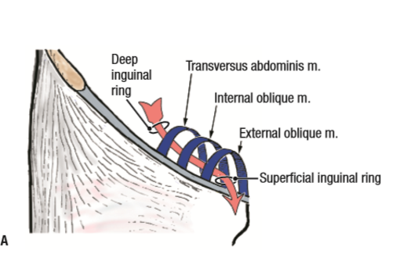
Roof
- Arched fibers of int.oblique
- Transverse abdominis muscle

Slide 15
Floor
inguinal lig.
lacunar lig.( at the medial end)

Slide 16
Sex difference-
inguinal canal is larger in males than in females.

Slide 17
Functions of Inguinal Canal
Male-
It allows structures of spermatic cord to pass from abdomen to testis
Female-
Permits the passage of round ligament of uterus from uterus to the labium majus

Slide 18
Mechanism of inguinal canal
The presence of inguinal canal is a cause of weakness in the lower part of the ant.abd.wall.
This weakness is compensated by following factors-

Slide 19
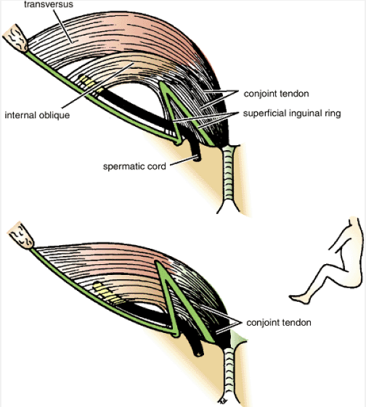
1. Oblique direction of inguinal canal
when intra abdominal pressure rises , the post.wall of canal is pushed forwards & comes in contact with ant.wall, the oblitering the canal like flap valve.

Slide 20
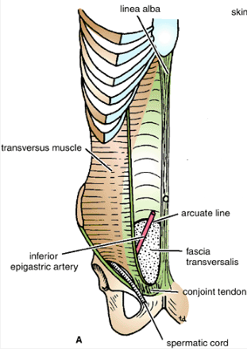
2. Superficial inguinal ring
strengthened posteriorly - by conjoint tendon & reflected part of inguinal lig.

Slide 21
3. Deep inguinal ring
Strenthened anteriorly by – fleshy fibers of internal oblique

Slide 22
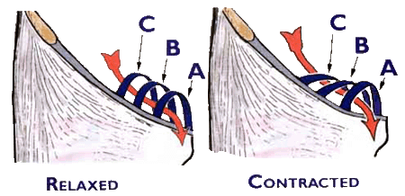
4.Shutter mechanism by internal oblique
- Internal oblique has triple relation with the inguinal canal.
- It forms ant.wall, roof, & post.wall of canal.
- When intra abdominal pressure is increased, the roof comes in contact with the floor, like a shutter.

Slide 23
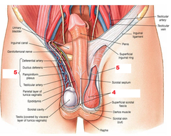
5. Cremasteric contraction
Male – contrction of cremasteric muscle helps to draw the spermatic cord upwards to plug the superficial inguinal ring. ( ball valve action)

Slide 24
6.Contraction of external oblique.
- it results in approximation of 2 crura of superficial inguinal ring. ( slit valve mechanism)
- Intigrety of superficial inguinal ring is greatly increased by intercrural fibers.

Slide 25
7.Hormonal control
Hormones may play a role in maintaining the tone of inguinal musculature.

Slide 26
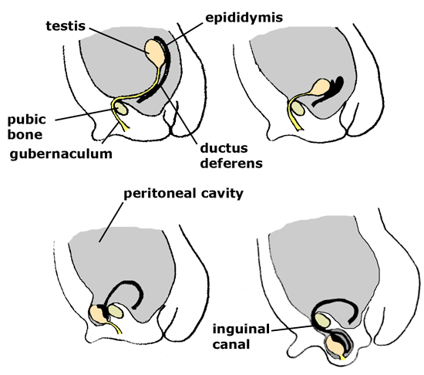
Development of inguinal canal
It represents the passage of gubernaculum through the abdominal wall.
In early life canal is very short.
As pelvis is increases in width, the deep inguinal ring is shifted laterally & adult dimensions of the canal are attained.

Slide 27
Clinical anatomy

Slide 28
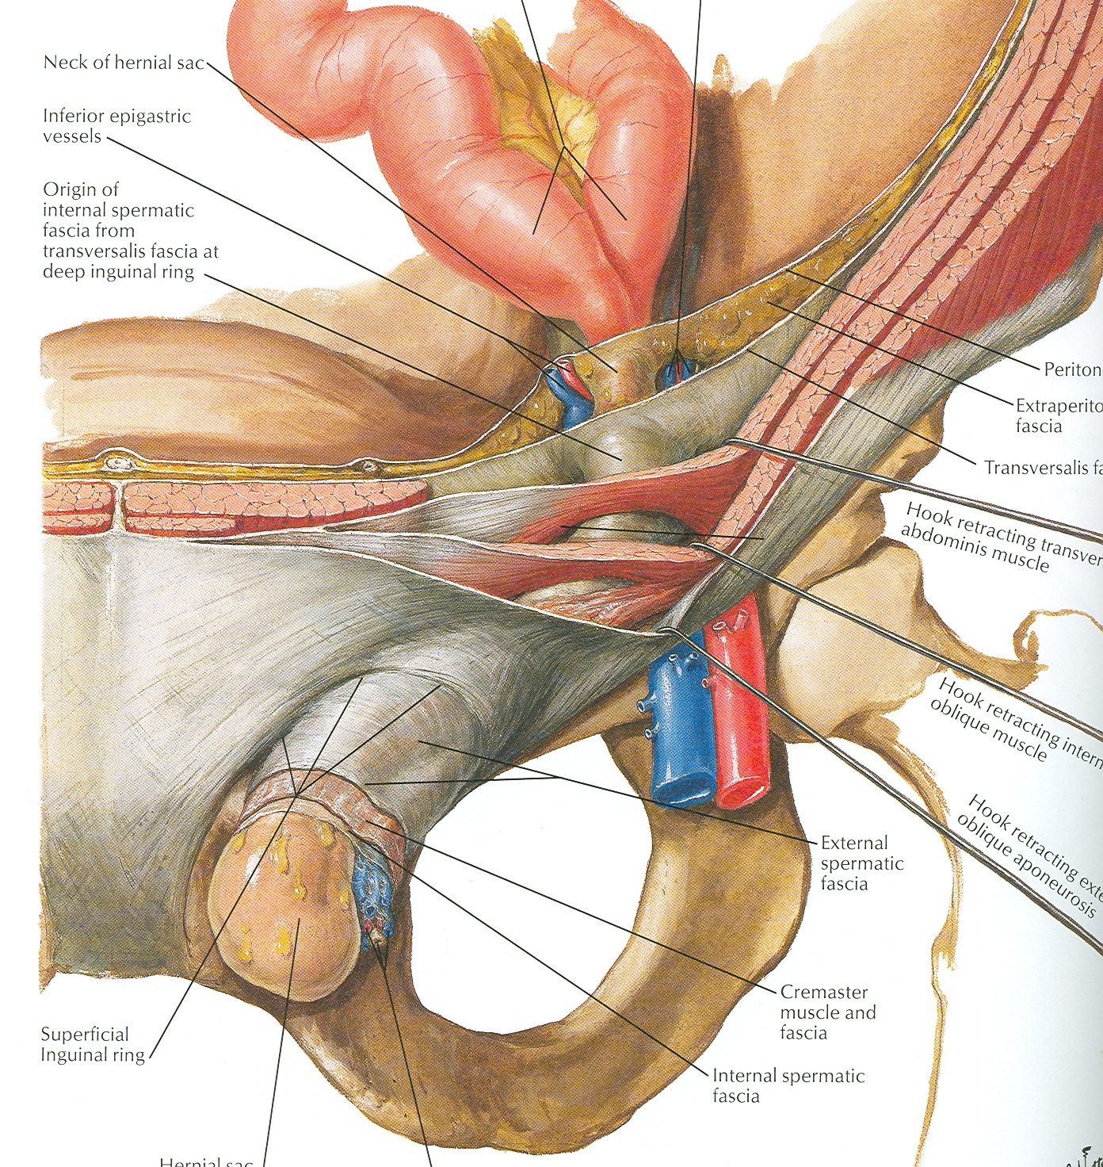
Inguinal hernia
Abnormal protrusion of abdominal contents into the inguinal canal.
Occur in the persons in whom intraabdominal pressure is frequently increased.
Ex- by chronic cough, by work involving frequent lifting of heavy wts etc..
Types – 2
Direct
Indirect

Slide 29
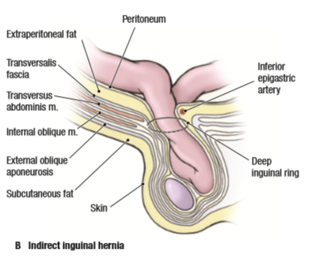
Indirect hernia
Defn – when the contents of hernia enter the inguinal canal by passing through the deep inguinal ring.
It is the most common form of hernia
Is believed to be congenital in origin
More common in male & also rt.side is more affected.

Slide 30
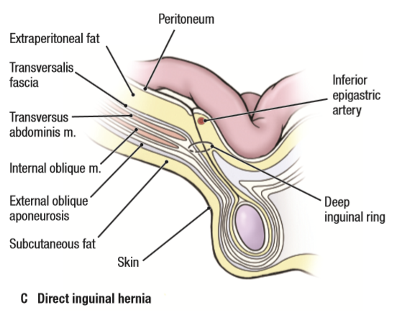
Direct hernia
Defn : when the contents of hernia enter the inguinal canal, not through deep inguinal ring but through post.wall.
Occurs – in old age after 75yrs.when abdominal muscles become weak.
It is frequently bilateral & incomplete.

Slide 32
Thank you

